Slide 1

MONAN Dynamics
Pedro S. Peixoto
Joint with
Guilherme Torres Mendonça
Danilo Couto de Souza
Felipe Augusto Ventura de Bragança Alves
Applied Mathematics
Instituto de Matemática e Estatística
Universidade de São Paulo
WMO Workshop - Nov 2025

Slide 2
Summary
Historical background
Basic concepts of MONAN/MPAS dynamics
Unstructured grids theory
MONAN computational workflow

Slide 3
Summary
Historical background
Basic concepts of MONAN/MPAS dynamics
Unstructured grids theory
MONAN computational workflow

Slide 4
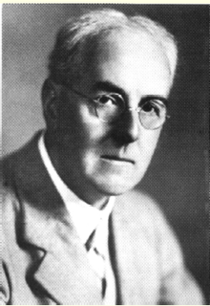
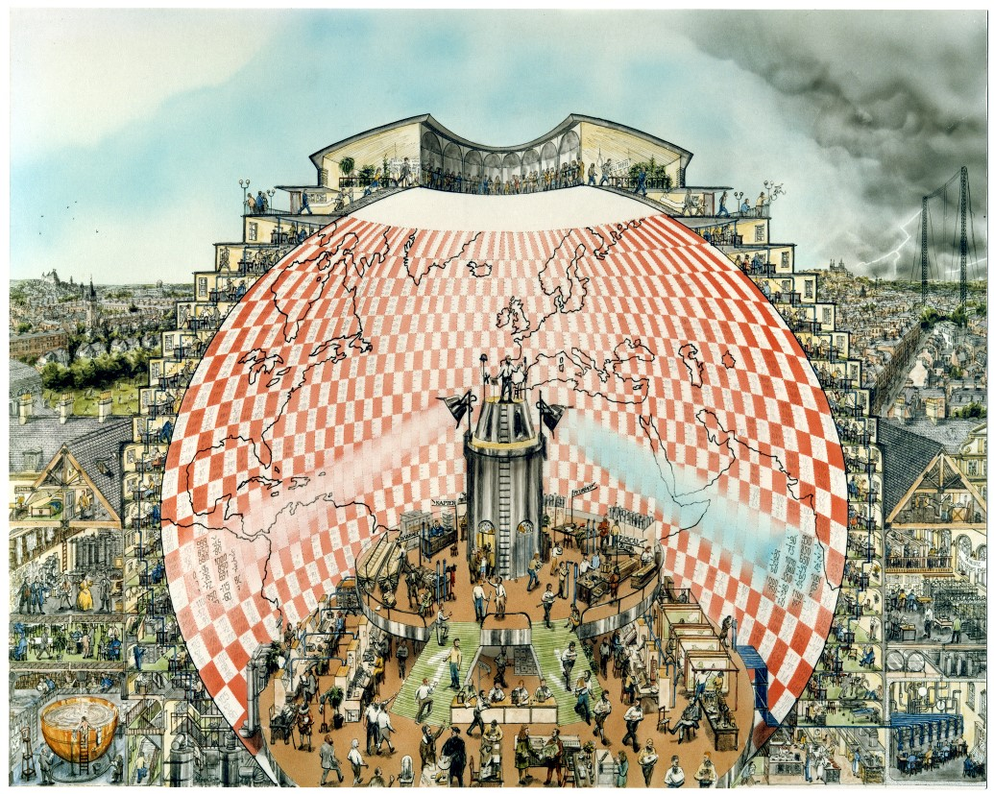
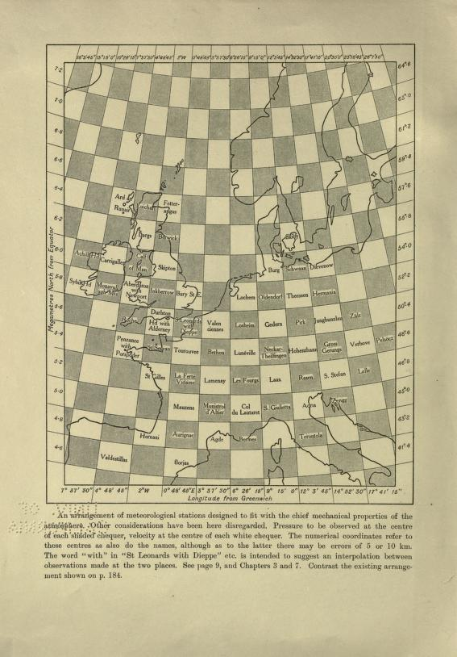
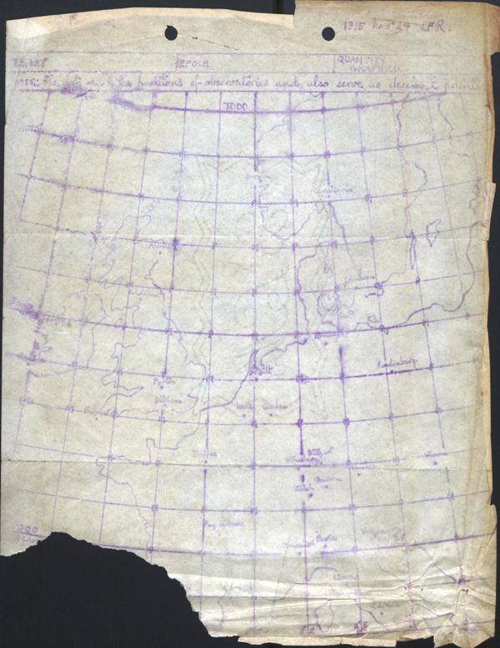
History of Weather Forecasting
Lewis Fry Richardson (UK 1881 -1953)
Richardson, L.F., 1922. Weather prediction by numerical process. Cambridge university press.
Primitive equations, spherical coordinates, finite differences, resolution ~ 200km (hand calculation during WW-I)
“Weather Forecasting Factory” by Stephen Conlin, 1986.
Hunt, J.C., 1998. Lewis Fry Richardson and his contributions to mathematics, meteorology, and models of conflict. Annual Review of Fluid Mechanics.

Slide 5
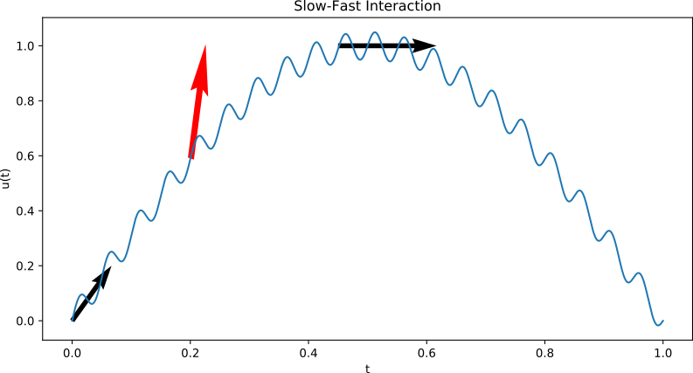
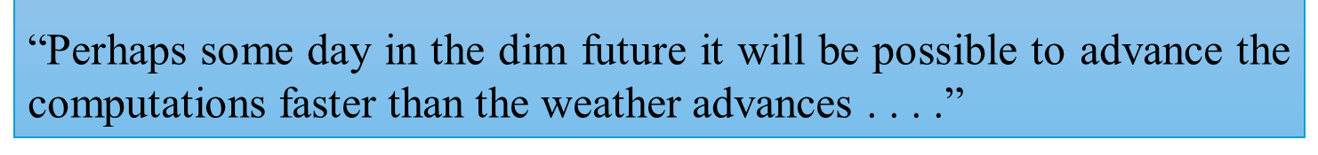
Richardson’s Results
Great ideas, but the dynamics is multiscale!
Model initialization issues (initial imbalance between pressure and wind)
Predicted a 145mb change over 6 hours at a grid point
Observations showed almost no pressure change
Lynch, P., 1999. Richardson’s marvelous forecast. In The life cycles of extratropical cyclones. American Meteorological Society, Boston, MA.

Slide 6

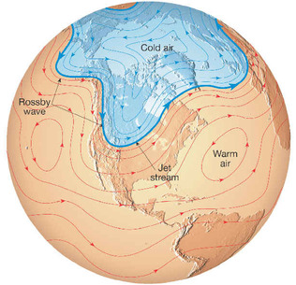
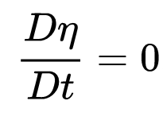

First successful numerical weather prediction
John von Neumann (1903 - 1957)
Meteorological Program, Princeton (1946):
Jule Gregory Charney, Philip Thompson, Larry Gates, Ragnar Fjørtoft, Klara Dan von Neumann.
ENIAC (Electronic Numerical Integrator and Computer) - 20,000 vacuum tubes - 100 kHz clock
Charney, J.G., Fjörtoft, R. and Neumann, J., 1950. Numerical Integration of the Barotropic Vorticity Equation. Tellus Series A, 2, pp.237-254.
Conservation of absolute vorticity (Relative + Coriolis) along with flow
Thompson, P.D., 1983. A history of numerical weather prediction in the United States. Bulletin of the American Meteorological Society, 64(7)

Slide 7

Early forecasts
1954: Rossby and team produced the first operational forecast in Sweden based on the barotropic equation.
1955-56: Charney, Thompson, Gates and team: Operational numerical weather prediction in the United States with layered barotropic models.
1959: Operational weather forecast in Japan
60’s: Primitive equations are back
(with improved initialization of the models)
Climate change modelling started!
Late 60s: Manabe, Wetherald, Smagorinsky et al. at GFDL-NOAA
1970s: First coupled models (atmosphere, ocean)
Numerically solve the equations on the whole sphere
Randall, D.A., Bitz, C.M., Danabasoglu, G., Denning, A.S., Gent, P.R., Gettelman, A., Griffies, S.M., Lynch, P., Morrison, H., Pincus, R. and Thuburn, J., 2019. 100 Years of Earth System Model Development. Meteorological Monographs, 59.
Science Museum: https://www.sciencemuseum.org.uk/objects-and-stories/weather-forecasting-and-climate-modelling-short-history

Slide 8

Operational Weather Forecast /
Climate System
Data
Initial Conditions
Dynamics (Euler Eq.)
(Advance Time)
Forecast
Coupled Models:
Ocean
Land
Ice
Maybe full models!
Parameterization
Coupling

Slide 9
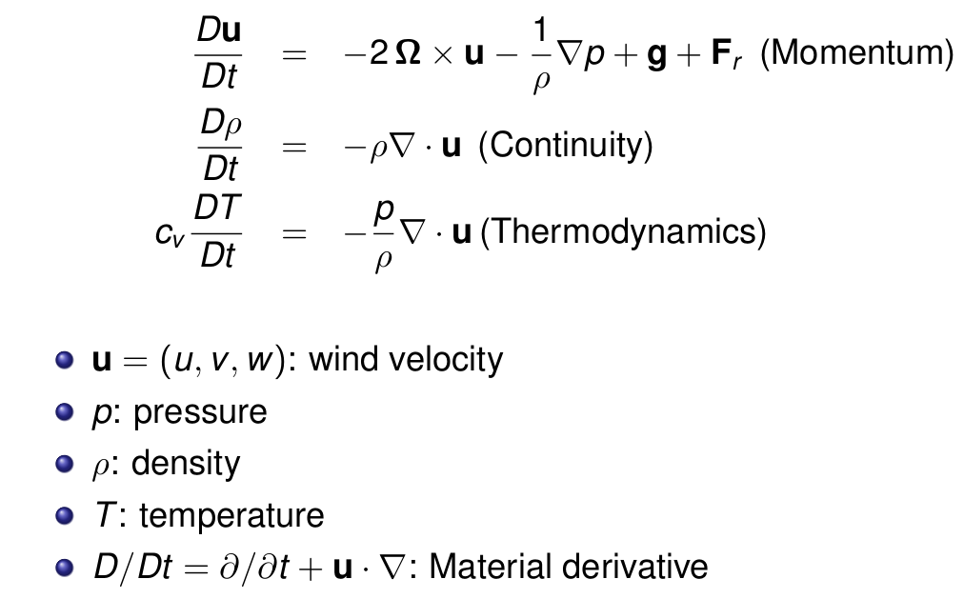
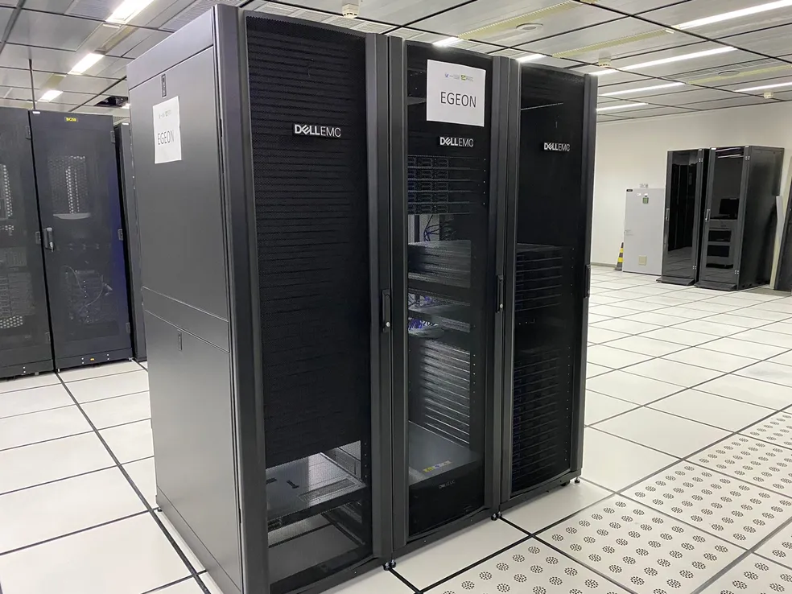
The computational challenge
Underlying dynamics equations are simplifications of
EGEON/INPE (~4k cores)
+ All parametrizations
…to be solved on the whole sphere…
https://projetos.cptec.inpe.br/attachments/download/15461/Guia%20do%20Usu%C3%A1rio%20EGEON%20INPE.pdf
… on a supercomputer.

Slide 10
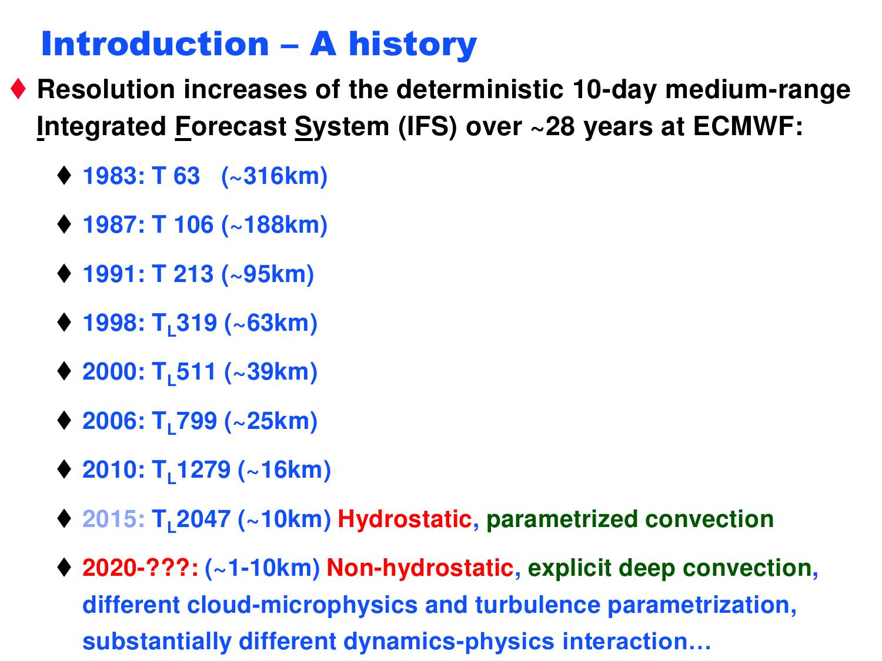

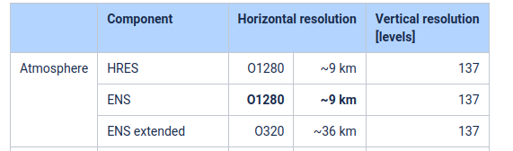
Spectral Models
Emerged around 1960-1970.
Main concept: Derivatives are calculated in spectral space
Requires: Spherical harmonics with Fast Fourier Transform
and “Fast” Legendre transforms global models
Pseudo-spectral: Global coupling of points.
Operational Examples:
IFS-ECMWF (European):
<10km
BAM-CPTEC-INPE (Brazil):
~20km
GFS-NOAA (USA) - up to 2019:
~13km
IFS Cycle 49r1 - Nov 2024
https://confluence.ecmwf.int/display/FCST/Implementation+of+IFS+Cycle+49r1

Slide 11
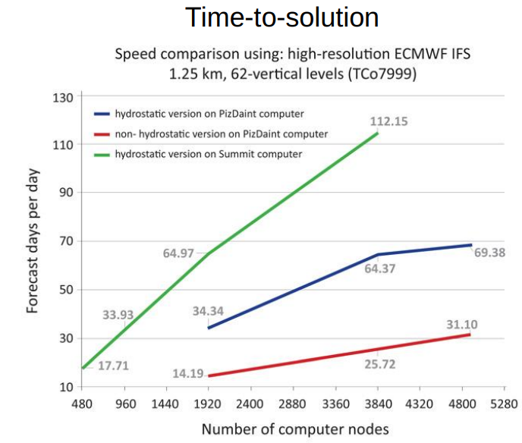
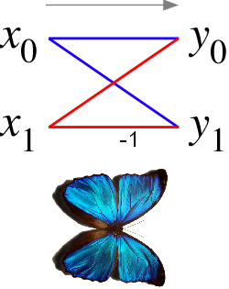
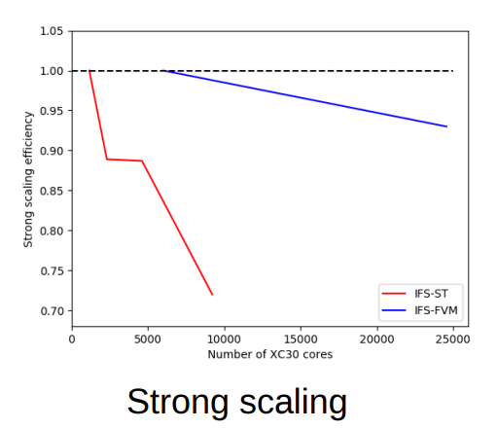
Why change? —-> Scalability
Drawbacks:
Legendre Transform is O(N²) operations
–> use “fast” Legendre transforms (Butterfly Algorithm)
Spectral transforms require global communication
–> reduces scalability (parallelism has communication bottlenecks)
IFS-ECMWF
Example:
- Wedi, N.P., Hamrud, M. and Mozdzynski, G., 2013. A fast spherical harmonics transform for global NWP and climate models. Monthly Weather Review, 141(10), pp.3450-3461.
- Bauer, P., Quintino, T., Wedi, N., Bonanni, A., Chrust, M., Deconinck, W., Diamantakis, M., Düben, P., English, S., Flemming, J. and Gillies, P., 2020. The ECMWF scalability programme: Progress and plans. European Centre for Medium Range Weather Forecasts.
- https://wgne.net/wp-content/uploads/2019/10/WED_Wedi_WGNE34_scalabilitymixed.pdf

Slide 12
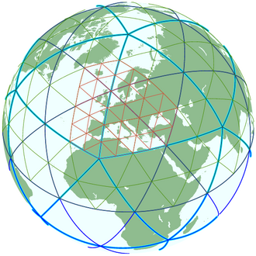
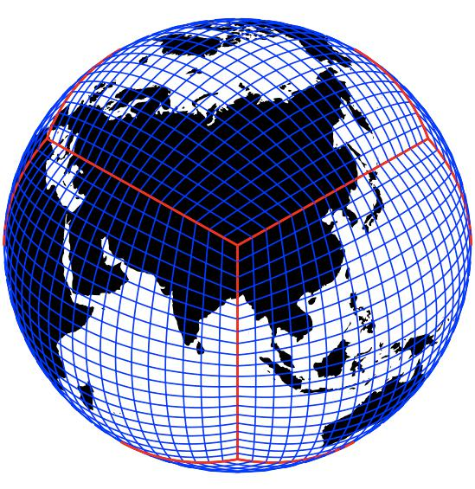
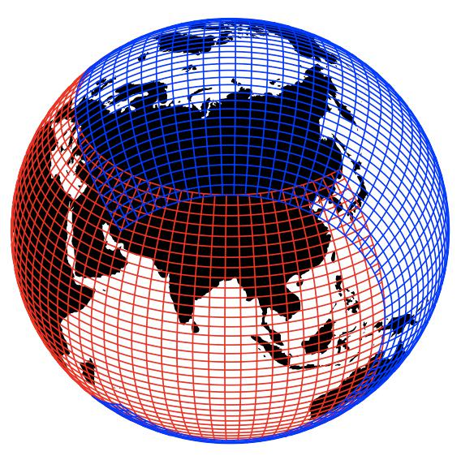
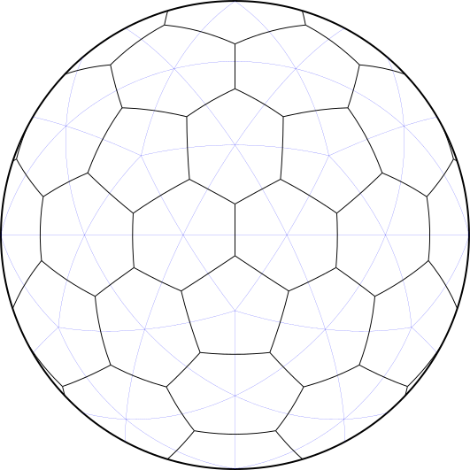
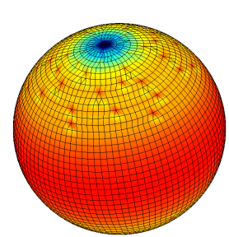
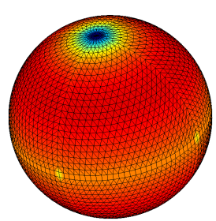
Isotropic Alternatives ~ 2000-2010
Cubed Sphere (CAM-SE/FV3/NUMA-USA)
Icosahedral/
Triangular
(ICON-Germany)
Yin-Yang
(GEM-Canada)
Voronoi
(MPAS/FIM/
OLAM-USA
NICAM-Japan)
Octahedral
(IFS-ECMWF)
Reduced Gaussian
(IFS-ECMWF)

Slide 13
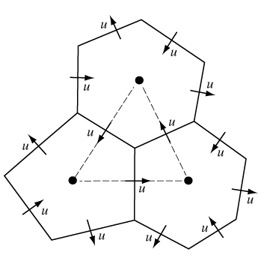
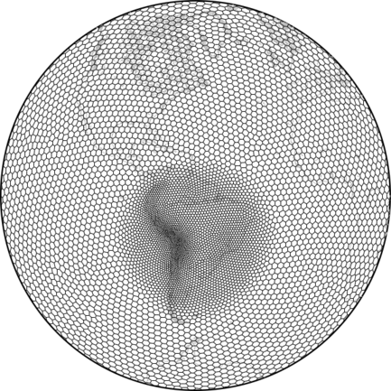

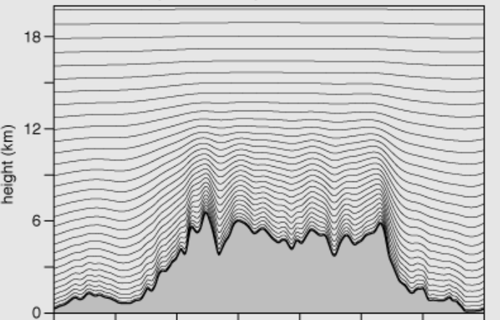
Model for Prediction Across Scales Dynamics
NCAR and Los Alamos Nat Lab
Compressible nonhydrostatic equations
C-grid staggered variables on the horizontal Voronoi mesh. Normal velocities are defined on the cell faces and all other scalar variables are defined at the cell centers. Vertical vorticity is defined at the cell vertices. (from: https://mpas-dev.github.io/)
Hybrid terrain-following height coordinate
- Skamarock, W.C., Klemp, J.B., Duda, M.G., Fowler, L.D., Park, S.H. and Ringler, T.D., 2012.
A multiscale nonhydrostatic atmospheric model using centroidal Voronoi tesselations and
C-grid staggering. Monthly Weather Review, 140(9)

Slide 14
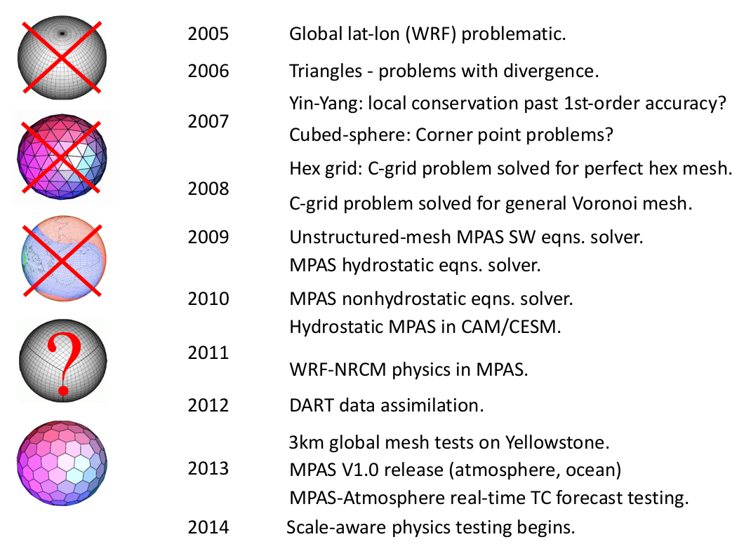
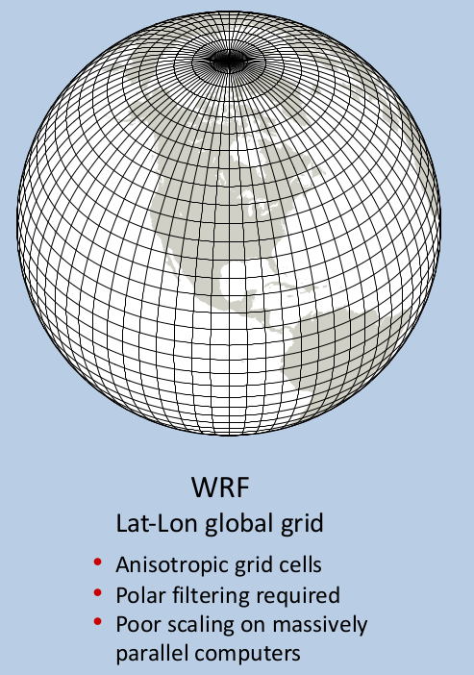
MPAS Development

Slide 15

MONAN
MONAN – Model for Ocean-laNd-Atmosphere predictioN
Modelo para Previsão dos Oceanos, Superfícies Terrestres e Atmosfera
Model for Prediction Across Scales Dynamics
9th meeting of the Scientific Committee of MONAN (03/08/2023):
MPAS as basis for MONAN
Comparison between MPAS FV3/Shield and GEF
Committee decided to have MPAS-Atmosphere as initial basis for MONAN-Atmosphere.
NCAR and Los Alamos Nat Lab
-https://monanadmin.github.io/monan_cc_docs/

Slide 16
Summary
Historical background
Basic concepts of MONAN/MPAS dynamics
Unstructured grids theory
MONAN computational workflow

Slide 17

Dynamics: Key references
Horizontal dynamics: Ringler, T., J. Thuburn, J. Klemp and W. Skamarock, 2010: A unified approach to energy conservation and potential vorticity dynamics on arbitrarily structured C-grids, Journal of Computational Physics.
Time integration: Wicker, L.J. and Skamarock, W.C., 2002. Time-splitting methods for elastic models using forward time schemes. Monthly weather review, 130(8), pp.2088-2097.
Advection: Skamarock, W.C. and Gassmann, A., 2011. Conservative transport schemes for spherical geodesic grids: High-order flux operators for ODE-based time integration. Monthly Weather Review, 139(9), pp.2962-2975.
Vertical: Klemp, J.B., Skamarock, W.C. and Dudhia, J., 2007. Conservative split-explicit time integration methods for the compressible nonhydrostatic equations. Monthly Weather Review, 135(8), pp.2897-2913.
3D Model: Skamarock, W.C., Klemp, J.B., Duda, M.G., Fowler, L.D., Park, S.H. and Ringler, T.D., 2012. A multiscale nonhydrostatic atmospheric model using centroidal Voronoi tesselations and C-grid staggering. Monthly Weather Review, 140(9), pp.3090-3105.
Following content comes mostly from MPAS tutorials given by NCAR!
Full tutorials here: https://github.com/CGFD-USP/MPAS-References

Slide 18
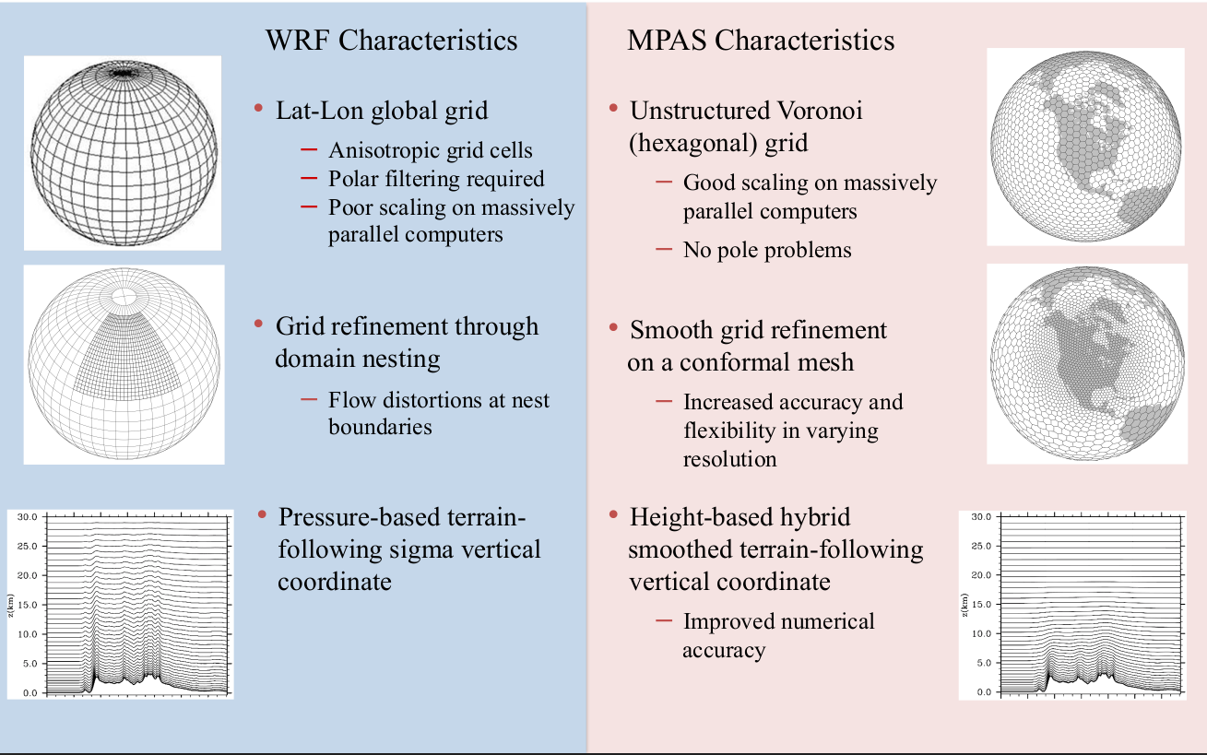
WRF vs MPAS

Slide 19
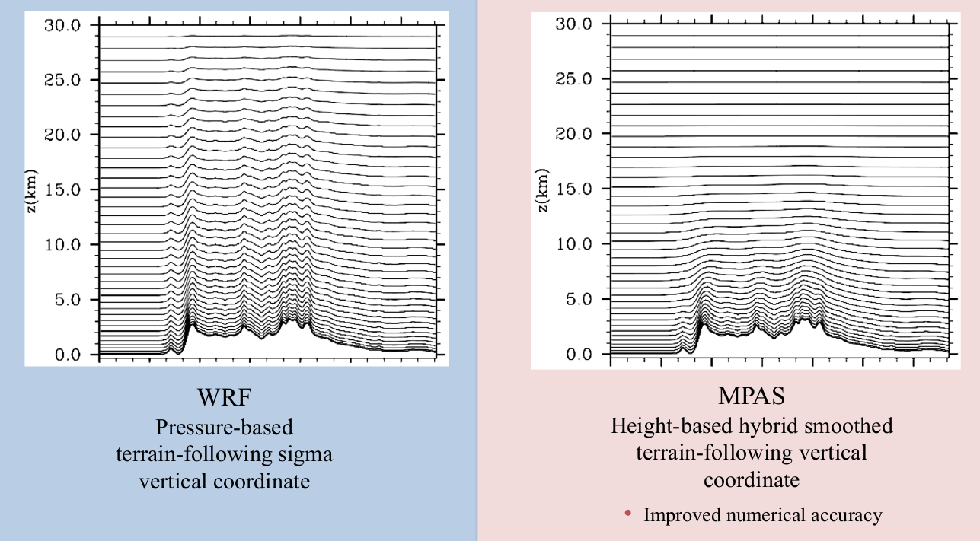
Vertical Coordinates

Slide 20


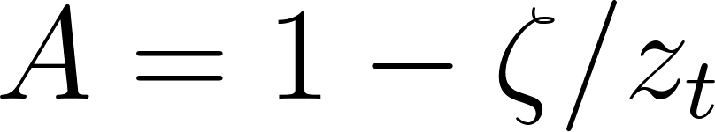
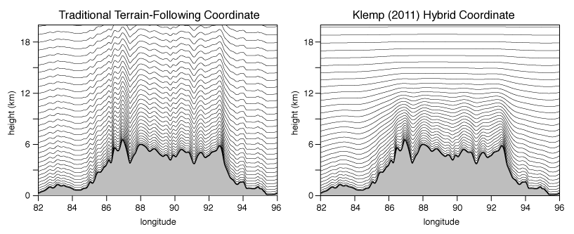
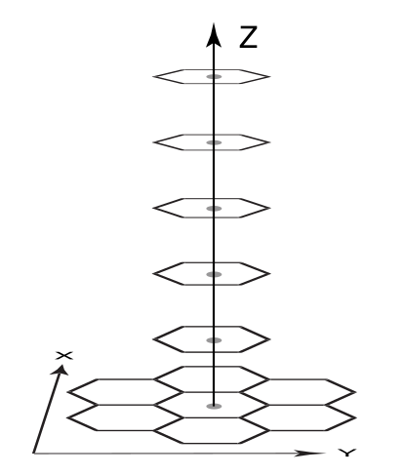
Vertical Coordinate
Height hybrid terrain-following
Pure height coordinate.
Smoothed terrain height
Pure terrain following
Factor Height/Terrain Following
Nominal heights
MPAS cross section through the Himalayas at 28 degrees N latitude for a 15 km (mean cell-center spacing) uniform mesh. The model top is at 30 km. The vertical coordinate in the MPAS-Atmosphere solver allows for both the traditional terrain following coordinate (right) and a general hybrid coordinate (left). From https://mpas-dev.github.io/ .

Slide 21
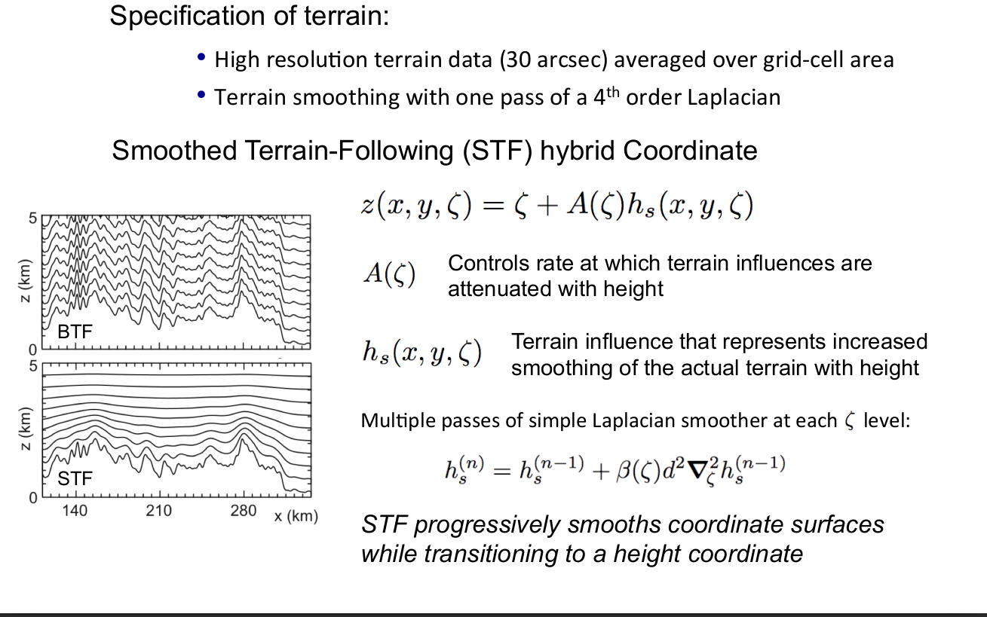

Slide 22
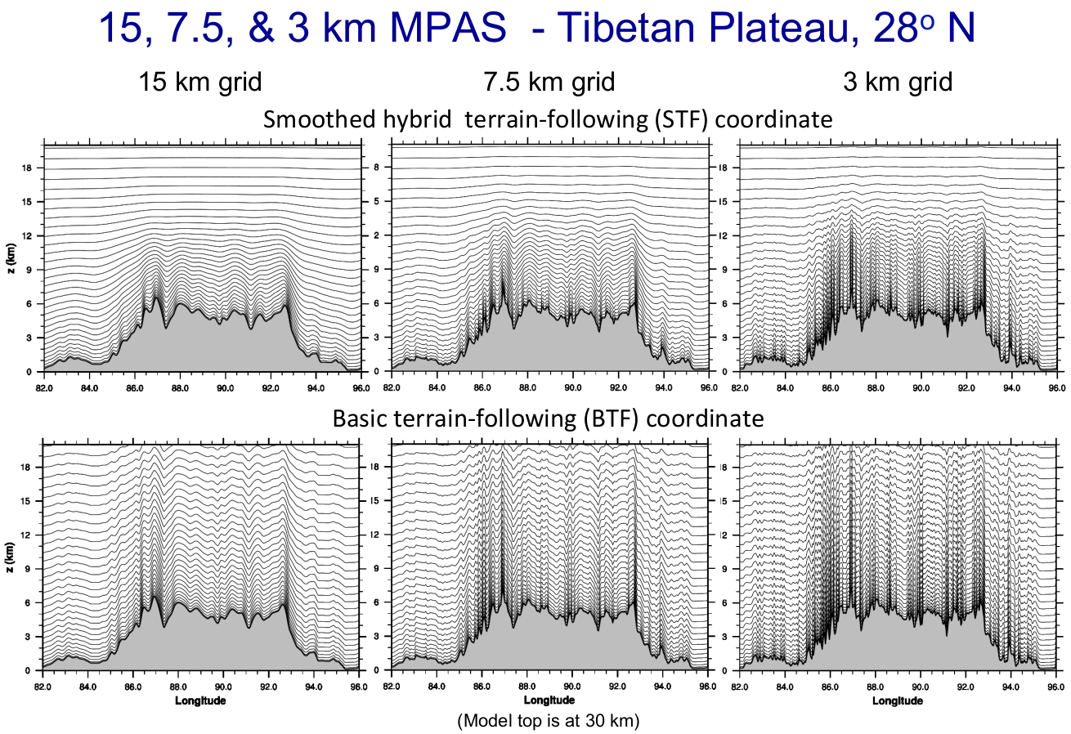

Slide 23
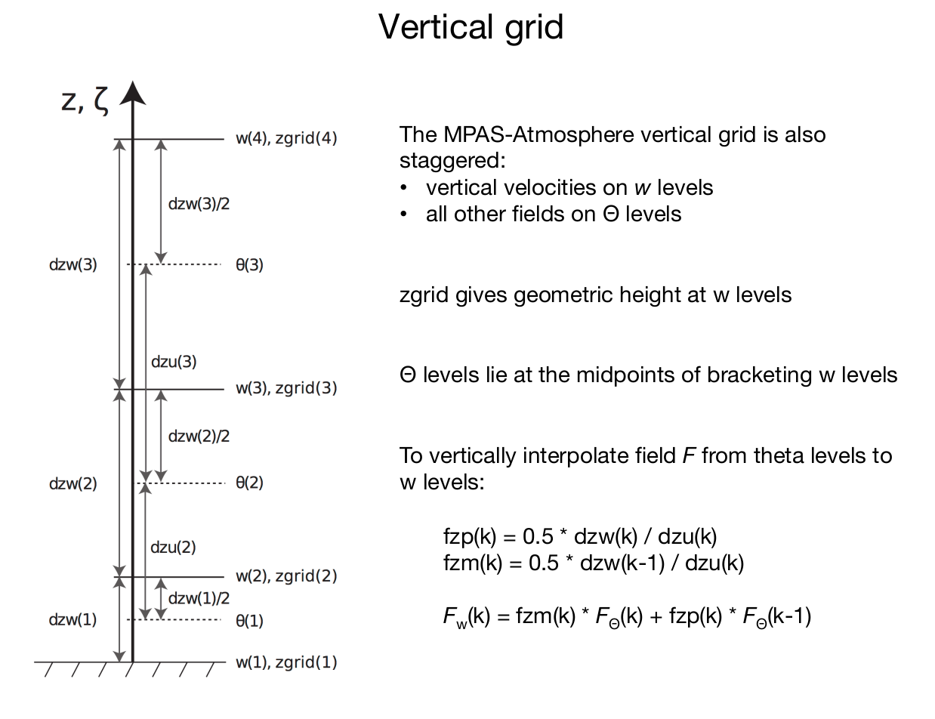
(Potential temperature)

Slide 24
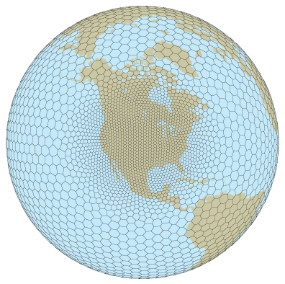
Horizontal Coordinates
Staggered Voronoi Spherical Grid
C-grid staggered variables on the horizontal Voronoi mesh. Normal velocities are defined on the cell faces and all other scalar variables are defined at the cell centers. Vertical vorticity is defined at the cell vertices.
Arbitrary cell shapes (Voronoi polygons)

Slide 25
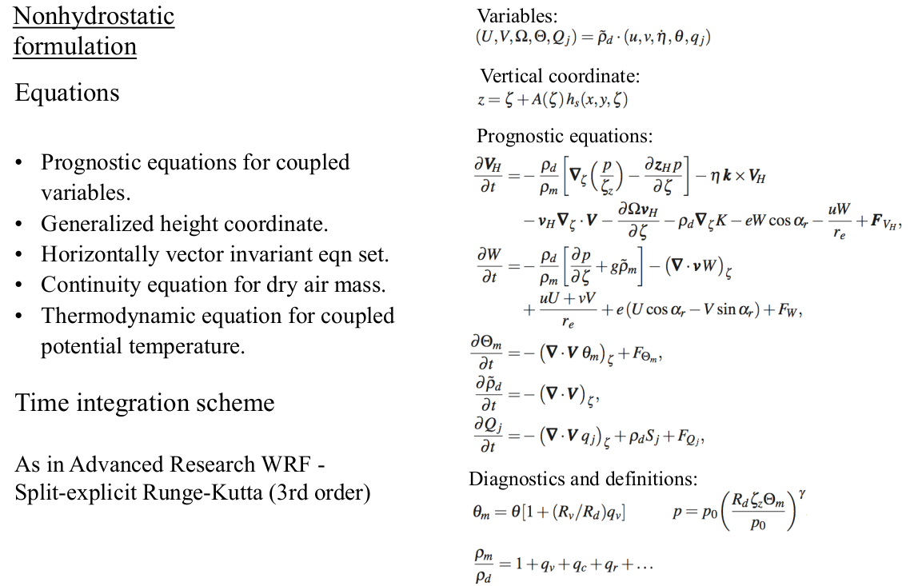

Slide 26


Prognostic Variables
Mixing ratio of water species (vapor, cloud, rain)
Vertical velocity
Horizontal Velocities
Moist potential
temperature
Vertical derivative of
height coord
Nonhydrostatic fluid-flow equations on the sphere
Dry air density

Slide 27

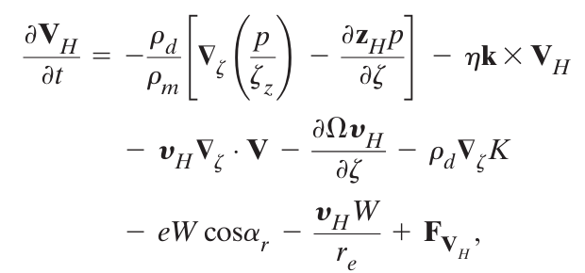
Horizontal Velocity Dynamics
Grad of pressure
Coriolis
Grad of Horizontal Kinetic Energy
3D nonlinear
divergence
Sources/sinks:
Physics, subgrid and filters
Vertical and metric terms

Slide 28

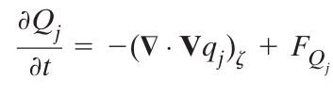

Mass Dynamics
Flux form divergence
(Ready for Finite Volumes!)

Slide 29
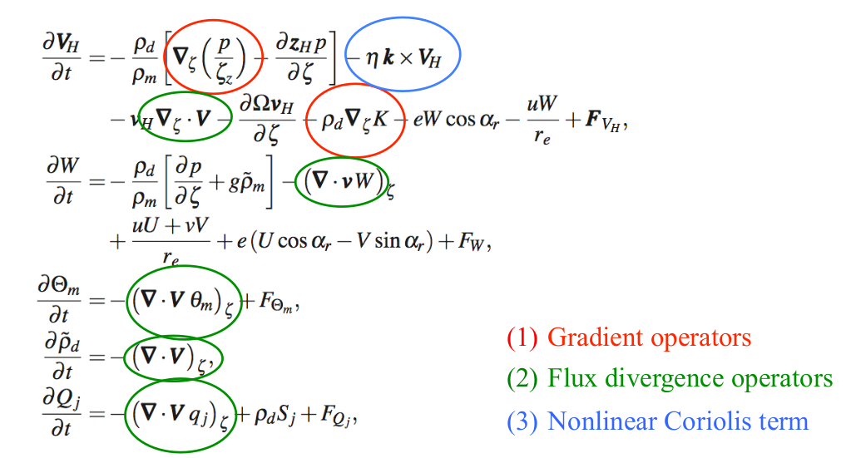
Summary

Slide 30
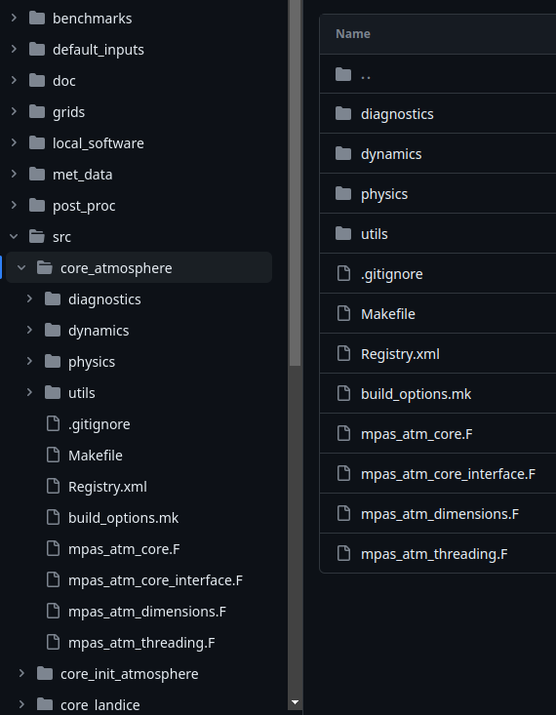
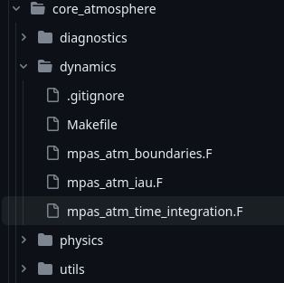
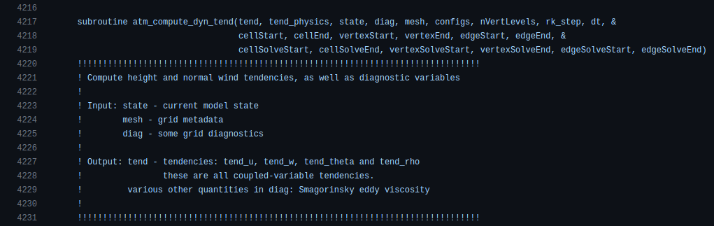
Discrete Operators / Code

Slide 31
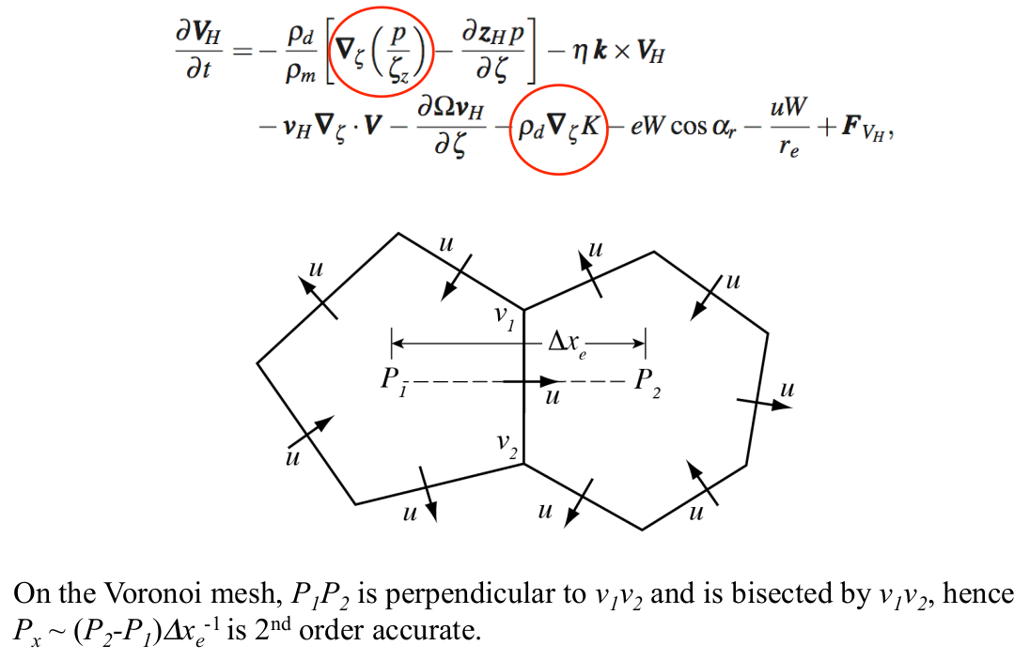
Discrete Gradient

Slide 32
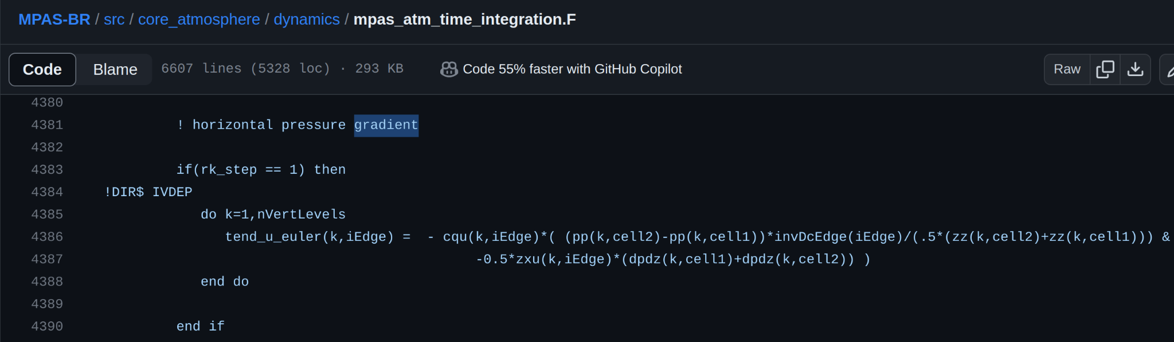
Code example

Slide 33
Summary
Historical background
Basic concepts of MONAN/MPAS dynamics
Unstructured grids theory
MONAN computational workflow

Slide 34
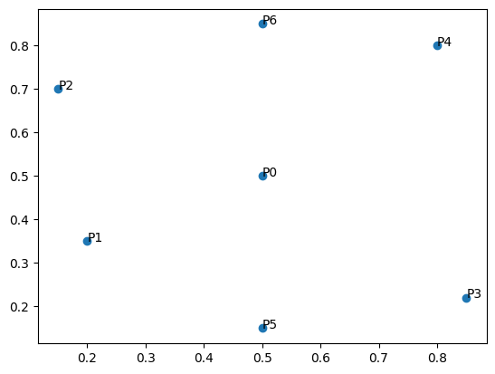
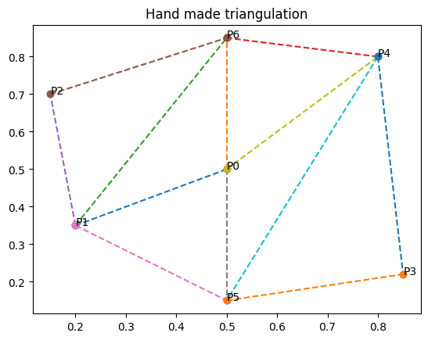
Grid basic concepts: Triangulation
Set of points: Triangulation:
Is this a good way to connect these points?

Slide 35
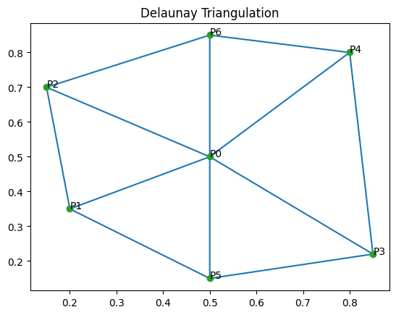
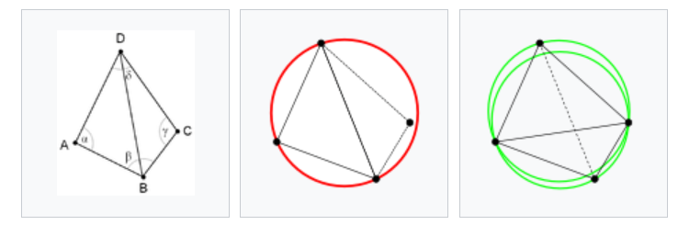
Grid basic concepts: Delaunay Triangulation
Triangulation: Delaunay Triangulation:
Better!
Bad Bad Good
Delaunay: form triangles whose circumcircles do not contain any of the points!
https://en.wikipedia.org/wiki/Delaunay_triangulation

Slide 36
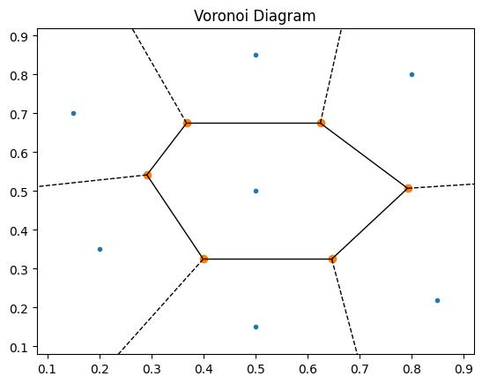
Voronoi Diagram
Set of points: Voronoi Diagram:
Voronoi cells: Each cell contains all the points in space that are nearest to that cell's single associated point

Slide 37
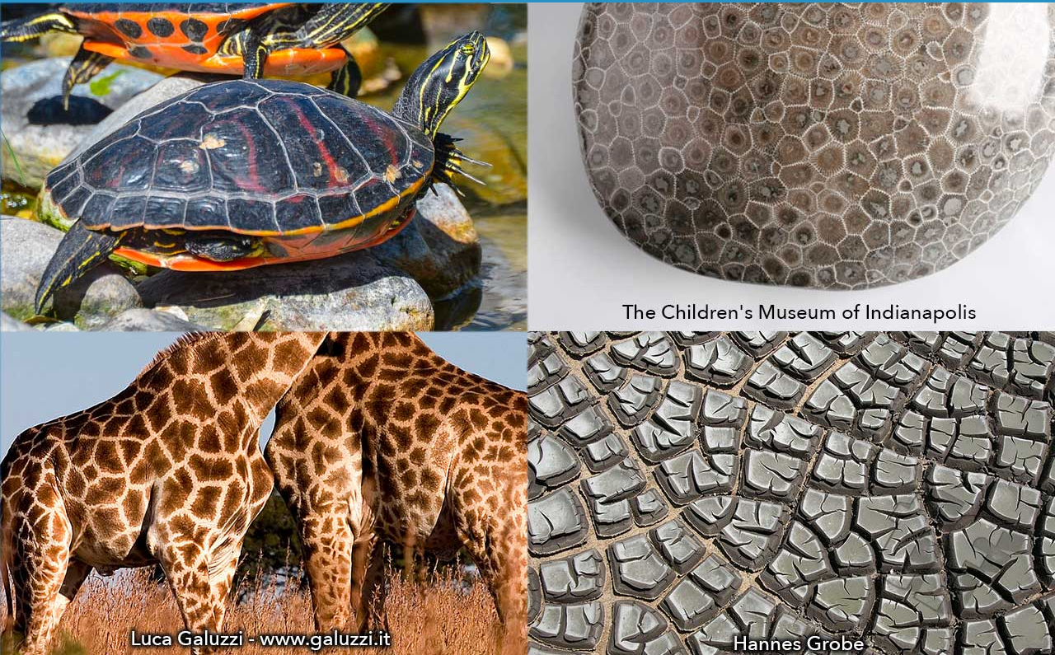


Voronoi In Nature
https://www.scientificamerican.com/blog/observations/voronoi-tessellations-and-scutoids-are-everywhere/

Slide 38

Delaunay-Voronoi Grid
Set of points: Delaunay-Voronoi Grid:
Try it out here in Colab: https://drive.google.com/file/d/1Bc3jMxor4e7NC7GKJMnpIZEKPBnAEHws/view?usp=sharing

Slide 39

On the sphere
Primal Voronoi Cells (Hexagons/Pentagons)
Dual Delaunay triangular grid

Slide 40

MPAS Grid Structures
Voronoi/Delaunay grid
Primal Grid (Voronoi):
Cells Nodes (Voronoi generators)
Cell Vertices (Triangle circumcenters)
Cell Edges (connects triangle circumcenters)
Dual Grid (Delaunay):
Triangles circumcenters
Triangle vertices (Cell nodes)
Triangle Edges (connects cell nodes)
Dual and Primal Edges:
Same indexing
Orthogonal
Reference tangent and normal vectors

Slide 41

Data structure
MPAS grid files and coding structure
Geometric Point Locations
Cell: 'latCell', 'lonCell', 'xCell', 'yCell', 'zCell', 'indexToCellID'
Edges: 'latEdge', 'lonEdge', 'xEdge', 'yEdge', 'zEdge', 'indexToEdgeID'
Vertices (Triangle circumcentres): 'latVertex', 'lonVertex', 'xVertex', 'yVertex', 'zVertex', 'indexToVertexID'
IndexToXXXX : Converts local indexing to global indexing
(to allow parallelism, the grid is split into blocks)

Slide 42

Data structure
MPAS grid files and coding structure
Connections:
Quantities: 'nEdgesOnCell'
Indexing: cellsOnCell', 'edgesOnCell', 'verticesOnCell', 'edgesOnEdge', 'cellsOnEdge', 'verticesOnEdge', 'cellsOnVertex', 'edgesOnVertex'
Example:
nEdgesOnCell(1) = 6
cellsOnCell(1) = (3, 2, 5, 9, 6, 4)
edgesOnCell(1) = (1, 2, 4, 3, 6, 7)
verticesOnCell(1) = (1, 7, 5, 3, 4, 2)
cellsOnEdge(1) = (1, 3)
verticesOnEdge(1) = (1, 2)
cellsOnVertex(1) = (1, 3, 2)
edgesOnVertex(5) = (4, 5, 3)

Slide 43

Data structure
MPAS grid files and coding structure
Properties:
Area: 'areaCell', 'areaTriangle', 'kiteAreasOnVertex'
Length: 'dcEdge', 'dvEdge'
Quality: 'cellQuality', 'gridSpacing', 'triangleQuality', 'triangleAngleQuality', 'obtuseTriangle', 'meshDensity'
Others: 'angleEdge', 'weightsOnEdge'

Slide 44




Scalar Data interpolation
From triangle vertices (cell nodes) to triangle centres:
Used in MPAS
(Exact for constant fields)
Barycentric: Exact for linear fields

Slide 45



Vector Reconstructions
Given normal edge velocities:
How to reconstruct zonal/meridional velocities at cell centre?

Slide 46





Vector Reconstruction
MPAS uses Radial Basis Functions (RBF)
Solves a linear system:
See: Peixoto, PS and Barros, SRM, 2014 : On vector field reconstructions for semi-Lagrangian transport methods on geodesic staggered grids (Journal of Computational Physics) – PDF, DOI

Slide 47





Divergence
Wiki
Finite Volume based
Key concepts:
Point value divergence is approximated by cell integral (average):
Divergence Theorem - from area integral to edge integral:
Approximate each edge integral with midpoint rule:
Interpolate depth to edges:
Normal direction correction:

Slide 48




Divergence
Cell Area:
Cell edge length:
>> If the cell is a rectangle, we recover the 2D discrete divergence!

Slide 49






Divergence in MPAS
https://github.com/pedrospeixoto/MPAS-BR/blob/master/src/core_atmosphere/dynamics/mpas_atm_time_integration.F

Slide 50



MPAS Official Grids
Pros
Well-tested and optimized grids
Cons
Slow grid generation (days/weeks) ⇒
Only few grids available
https://mpas-dev.github.io/atmosphere/atmosphere_meshes.html

Slide 51

Jigsaw Grids
Personalize your grids for MPAS
Jigsaw software: https://mpas-dev.github.io/MPAS-Tools/0.26.0/mesh_creation.html
https://github.com/dengwirda/jigsaw-python
Pros
Flexibility to generate personalized grids
Fast algorithm to generate grids (seconds/ minutes)
Cons
Generated grids may not be as well optimized as the ones provided by NCAR
Try at home: https://github.com/CGFD-USP/MPAS-References/blob/master/WMO-Workshop2025/JigsawGrids_tutorial.ipynb

Slide 52
Summary
Historical background
Basic concepts of MONAN/MPAS dynamics
Unstructured grids theory
MONAN computational workflow
Tutorials

Slide 53
MONAN computational workflow
I. Mesh
II. Preprocessing
III. Run MONAN/MPAS
a) Download official mesh
b) Generate your own mesh
a) Idealized simulation:
Generate artificial initial conditions
b) Real-case simulation: Preprocess real data for “static fields” (albedo, vegetation characteristics, etc.) and initial conditions (e.g. ERA5 or GFS)
a) Idealized simulation:
Run dynamical core only
b) Real-case simulation:
Run dynamical core + physical parametrizations

Slide 54
Tutorial 1: Mesh generation
I. Mesh
a) Download official mesh
b) Generate your own mesh
Tutorial 1 - Create your own meshes:
https://github.com/CGFD-USP/scripts_CD-CT/blob/feature/scripts-849-NF-idealized/docs/tutorial1-meshes.md

Slide 55



Tutorial 1: Mesh generation
a) Download official MPAS provided meshes (few available options):
I. Mesh
https://mpas-dev.github.io/atmosphere/atmosphere_meshes.html
b) Generate your own mesh using MONAN workflow
Personalized mesh generation tool:
- Jigsaw software (https://github.com/dengwirda/jigsaw-python/tree/master/tests) by D. Engwirda
- vtx-mpas-meshes (https://github.com/marta-gil/vtx-mpas-meshes) by M. Badarji
- MPAS-Tools (https://mpas-dev.github.io/MPAS-Tools) by
X. Asay-Davis, M. Duda et al
- MPAS-Limited-Area (https://github.com/MPAS-Dev/MPAS-Limited-Area) by
M. Duda et al
3 km
30 km
Global
or
Regional!
85 km
445 km

Slide 56
Tutorial 2: Idealized simulation
I. Mesh
II. Preprocessing
III. Run MONAN/MPAS
Meshes from tutorial 1
Artificial initial conditions
Dynamical core only
(no physics parametrizations)
Tutorial 2 - Idealized simulation: https://github.com/CGFD-USP/scripts_CD-CT/blob/feature/scripts-849-NF-idealized/docs/tutorial2-ideal-case.md
Group 1: uniform 240 km
Generated with jigsaw
Downloaded from NCAR
Group 2: refined 48 km - 240 km
Generated with jigsaw

Slide 57

Tutorial 2: Idealized simulation
IDEALIZED INITIAL CONDITIONS
II. Preprocessing
JW Baroclinic Instability
Balanced solution!
Jablonowski, C., & Williamson, D. L. (2006). A baroclinic instability test case for atmospheric model dynamical cores. Quarterly Journal of the Royal Meteorological Society, 132(621C), 2943-2975. https://www.gfdl.noaa.gov/wp-content/uploads/files/user_files/pjp/qj_jablonowski_williamson_2006.pdf

Slide 58




Tutorial 2: Idealized simulation
“init_atmosphere” code
2. Initialization & vertical grid
II. Preprocessing
MPAS user guide

Slide 59


Tutorial 2: Initial conditions
II. Preprocessing
Add perturbation!

Slide 60



Tutorial 2: Running the idealized simulation
“atmosphere” code
III. Run MONAN/MPAS
No physics!

Slide 61



Tutorial 2: Results
JW BI case with 50 km grid resolution: Pressure field at day 13
Vertical Level 0

Slide 62

Tutorial 2: Results
JW BI case with 50 km grid resolution: Zonal wind field at day 13
Vertical Level 0

Slide 63
Tutorial 2: Animations
JW BI case
50 km grid resolution (Jigsaw)
Level 0 (ground)
Evolution of fields:
Vorticity
Zonal Wind
Meridional Wind
Pressure

Slide 64
Tutorial 3: Real-case simulation
I. Mesh
II. Preprocessing
III. Run MONAN/MPAS
Personalized mesh with refinement at
La Plata region
ERA5 initial conditions
Dynamical core + physics parametrizations
Tutorial 3 - Real-case simulation: https://github.com/CGFD-USP/scripts_CD-CT/blob/feature/scripts-849-NF-idealized/docs/tutorial3-real-case.md

Slide 65

Tutorial 3: Real-case simulation
Bomb-extratropical cyclone
Presentation:
https://www.canva.com/design/DAG12r0AyUU/sZfZk8xb9T4rvgOhPoElxw/view?utm_content=DAG12r0AyUU&utm_campaign=designshare&utm_medium=link&utm_source=viewer
Dias Pinto, J. R., & Da Rocha, R. P. (2011). The energy cycle and structural evolution of cyclones over southeastern South America in three case studies. Journal of Geophysical Research: Atmospheres, 116(D14).

Slide 66



Tutorial 3: Personalized mesh generation
I. Mesh

Slide 67

Tutorial 3: Static fields
II. Preprocessing
Time-invariant “static” data

Slide 68

Tutorial 3: Static fields
II. Preprocessing

Slide 69





Tutorial 3: Real initial conditions
II. Preprocessing
External meteorological data
(supports ERA5 and GFS)
Preprocessed data in simple “intermediate” format that can be read by MONAN
Real initial conditions on MONAN mesh

Slide 70

Tutorial 3: Running the real-case simulation
“atmosphere” code
III. Run MONAN/MPAS
Physics parametrizations!

Slide 71

Tutorial 3: Results

Slide 72

That is all for now…
“All models are wrong, but some are useful”
— George Box
More details at: https://github.com/CGFD-USP/MPAS-References
And: www.ime.usp.br/~pedrosp
Thanks!

Slide 73
Extra slides

Slide 74
Initial setup / configuration
First, let's create a 200km uniform mesh using Jigsaw.
In the MPAS source code directory:
Activate the maps-tools conda environment: conda activate mpas-tools
Step into de grids/grids directory: cd grids/grids
Create the grid: python3 ../utilities/jigsaw/spherical_grid.py -g unif -r 200 -o unif200km
This will create the unif200km directory with the following data:
Inside this new directory we partition the grid using metis and the unif200km_graph.info, for example, for 4 processes: gpmetis -contig -minconn unif200km_graph.info 4
This will create the unif200km_graph.info.part.4 file.

Slide 75

Initial setup / configuration
We can check the grid resolution using one of the post-processing scripts from the MPAS-BR repository:
python ../../../post_proc/py/grid_maps/mpas_plot_grid.py -g unif200km_mpas.nc -o unif200km-grid.jpg

Slide 76
Example Simulations: JW Baroclinic Instability

Slide 77
JW BI case with 50km grid resolution: Zonal wind field at day 13
Vertical Level 0

Slide 78
JW BI case with 50km grid resolution: Pressure field at day 13
Vertical Level 0

Slide 79
Example Simulations: JW Baroclinic Instability
In the MPAS root directory create a new runs directory and a directory for this case:
mkdir -p runs/jw-bi-200km ; cd runs/jw-bi-200km
Create a link to the grid files:
ln -s ../../grids/grids/unif200km/unif200km_mpas.nc ./
ln -s ../../grids/grids/unif200km/unif200km_graph.info.part.4 ./
Create a link to the init_atmosphere executable:
ln -s ../../init_atmosphere ./
Then, create the namelist.init_atmosphere and streams.init_atmosphere files

Slide 80


Example Simulations: JW Baroclinic Instability

Slide 81

Example Simulations: JW Baroclinic Instability
Run the init_atmosphere executable:
mpirun -n 4 ./init_atmosphere_model
Check that the unif200km_jw-bi.init.nc file was created. The end of the log.init_atmosphere.0000.out should look like:

Slide 82



Slide 83

namelist.atmosphere options
The available options for the namelist.atmosphere file can be inspected in src/core_atmosphere/Registry.xml

Slide 84
Namelist and Streams (links)
Init_atmosphere
Namelist
Streams
Atmosphere
Namelist
Streams
Run the atmosphere executable:
mpirun -n 4 ./atmosphere_model

Slide 85

JW BI case with 200km grid resolution: Zonal wind field at day 13
Vertical Level 0

Slide 86
JW BI case with 50km grid resolution: Zonal wind field at day 13
Vertical Level 0

Slide 87

JW BI case with 200km grid resolution: Pressure field at day 13
Vertical Level 0

Slide 88
JW BI case with 50km grid resolution: Pressure field at day 13
Vertical Level 0

Slide 89

JW BI case with 200km grid resolution: Vorticity field at day 13
Vertical Level 0

Slide 90

JW BI case with 50km grid resolution: Vorticity field at day 13
Vertical Level 0

Slide 91

JW BI case with 200km grid resolution: Meridional wind field at day 13
Vertical Level 0

Slide 92

JW BI case with 50km grid resolution: Meridional wind field at day 13
Vertical Level 0

Slide 93

DCMIP2016
Non-hydrostatic dynamical core design and intercomparison
https://www.earthsystemgrid.org/project/DCMIP_2016.html
https://gmd.copernicus.org/articles/10/4477/2017/

Slide 94

DCMIP2016
Non-hydrostatic dynamical core design and intercomparison
https://gmd.copernicus.org/articles/10/4477/2017/

Slide 95

DCMIP2016
Non-hydrostatic dynamical core design and intercomparison

Slide 96
DCMIP2016
Non-hydrostatic dynamical core design and intercomparison
https://www2.cesm.ucar.edu/events/wg-meetings/2018/presentations/amwg/jablonowski.pdf

Slide 97

DCMIP2016
Non-hydrostatic dynamical core design and intercomparison
https://www2.cesm.ucar.edu/events/wg-meetings/2018/presentations/amwg/jablonowski.pdf

Slide 98

DCMIP2016
Non-hydrostatic dynamical core design and intercomparison
https://www2.cesm.ucar.edu/events/wg-meetings/2018/presentations/amwg/jablonowski.pdf

Slide 99

DCMIP2016
Non-hydrostatic dynamical core design and intercomparison
https://www2.cesm.ucar.edu/events/wg-meetings/2018/presentations/amwg/jablonowski.pdf

Slide 100

HIWPP - High Impact Weather Prediction Project
Non-hydrostatic dynamical core tests: Results from
idealized test cases
The “new” NCEP Global Model, replacing Spectral (2019)

Slide 101





Baroclinic wave test case at day 9

Slide 102



Slide 103
Installation
MPAS source code can be downloaded directly at:
https://github.com/pedrospeixoto/MPAS-BR/archive/refs/heads/master.zip
Alternatively, the repository can be cloned using git in a terminal (you may wish to FORK to your account):
git clone https://github.com/pedrospeixoto/MPAS-BR.git
To compile the code fortran mpi compilers are needed. Working options are described in the file "Makefile". The most straightforward option is to use gfortran and OpenMPI, which can be installed on a Debian system with the terminal command:
sudo apt install gfortran libopenmpi-dev
MPAS uses the NetCDF file format for its input and output. Software libraries to work with those files are needed. MPAS accepts a few different libraries for that purpose. We’ve found the most robust option to be using the PNetCDF library together with new built-in SMIOL code. PNetCDF can be installed on a Debian system with the terminal command:
sudo apt install pnetcdf-bin libpnetcdf-dev
SMIOL comes bundled with MPAS source code and needs not to be installed.

Slide 104

Compilation
The MPAS Atmosphere model is divided into two components (also called cores): the ‘init_atmosphere’ core, used just for initialization of a problem, and the ‘atmosphere’ core, which actually runs the model.
To compile the ‘init_atmosphere’ core, in a terminal inside the source code directory, issue the following command:
make gfortran CORE=init_atmosphere PNETCDF=/usr
The PNETCDF environment variable should point to the directory where PNetCDF was installed, which, on Debian systems, is “/usr” by default. If PNetCDF was installed by other means, the env var should be changed accordingly. If compilation works, the following banner should be visible:

Slide 105

Compilation
Now, to compile the ‘atmosphere’ core, in a terminal inside the source code directory, issue the following command:
make gfortran CORE=atmosphere AUTOCLEAN=true PNETCDF=/usr
If compilation was successful, the same banner as before should be displayed. After compiling both cores, the contents of the directory should be:

Slide 106
Grid Recall
Load environment
$conda activate maps-tools
Create an example grid with Jigsaw
(mpas-tools) /…/MPAS-BR/grids/utilities/jigsaw$ python3 spherical_grid.py -g unif -o unif240km -r 240 -l 240
Check the grid created (resolutions) - Plot.
(mpas-tools) /…/MPAS-BR/post_proc/py/grid_maps$ python3 mpas_plot_grid.py -g ../../../grids/utilities/jigsaw/unif240km/unif240km_mpas.nc -o ../../../grids/utilities/jigsaw/unif240km/unif240km_mpas.jpg

Slide 107

Grid partitions
Grid partitions for parallel processing are done using Metis
sudo apt-get install metis
Create partitions. Ex:
gpmetis -minconn -contig -niter=200 unif240km_graph.info 4
N: number of partitions

Slide 108
Summary
Grid
Static
fields
Install/Make
init_atmosphere
atmosphere
Clone MPAS repository
Install gfortran, libopenmpi, libpnetcdf
Make
Configure an initial condition (idealized or real data)
Initialize the atmosphere model
Set grid and static fields
Run the atmospheric model based on the ini_atmosphere output
Post process

Slide 109

Static fields (examples)

Slide 110
Pre-processing

Slide 111

Config init_atmosphere
You can hand tune the namelists/streams and streams of MPAS ....
or
… we can use Python based scripts to create necessary files to initialize MPAS-A.

Slide 112


Idealized test case
Namelist
src/core_init_atmosphere/mpas_init_atm_cases.F

Slide 113

Idealized test case
Streams
(related files)
Input grid file
Output initialization file
For MPAS run

Slide 114
Run init_amosphere
Run the init_atmosphere executable:
mpirun -n 4 ./init_atmosphere_model
Must match the number of partitions set with metis!

Slide 115

Netcdf output (mpas input file)
Use either ncdump -h or ncmpidump -h to quickly inspect the file created:

Slide 116


Log ini_atmosphere

Slide 117


Vertical Coordinates
src/core_init_atmosphere/mpas_init_atm_cases.F

Slide 118

Plot init fields
MPAS-BR/benchmarks/monan-class-example/jw_baroclinic_wave$ python ../../../post_proc/py/scalar_lat_lon_2d_plot/mpas_plot_scalar.py -v theta x1.40962.init.nc
Uses “basemap”
Python library

Slide 119

Plot init fields
MPAS-BR/benchmarks/monan-class-example/jw_baroclinic_wave$ python3 ../../../post_proc/py/plot_scalar_on_native_grid/mpas_plot.py -f x1.40962.init.nc -o x1.40962.init.theta.jpg -v theta -l 0 -t 0
Uses “cartopy”
Python library

Slide 120

Using Jigsaw grids
With the grid created, we need to create a partition for parallel runs.
We have a file xx.graph.info from JIGSAW
Install METIS software for grid partitioning (http://glaros.dtc.umn.edu/gkhome/views/metis)
sudo apt-get install metis
Run metis partitioning:
gpmetis -minconn -contig -niter=200 xx.graph.info N
N = number of partitions (nodes/cores to be used)
Adjust namelist.init_atmosphere and streams.init_atmosphere to point to jigsaw grid.
Run init_atmosphere_model

Slide 121



Slide 122
Convert MPAS data to lat-lon
It is possible to interpolate the MPAS output data to latitude-longitude data, so you can work on your preferred visualization tool….
…. we will not discuss this topic in this class.

Slide 123

Flux Divergence and Transport

Slide 124

Flux Divergence and Transport

Slide 125

Flux Divergence and Transport

Slide 126

Flux Divergence and Transport

Slide 127

Flux Divergence and Transport

Slide 128


Código (init_atmosphere)
Polynomial fit
Pre-calculations for high-order flux

Slide 129

Código (atmosphere)
Flux calculation

Slide 130

Nonlinear Coriolis Term

Slide 131

Nonlinear Coriolis Term

Slide 132

Nonlinear Coriolis Term

Slide 133

Nonlinear Coriolis Term

Slide 134

Nonlinear Coriolis Term

Slide 135

Nonlinear Coriolis Term

Slide 136

Nonlinear Coriolis Term

Slide 137

Nonlinear Coriolis Term

Slide 138

Exemplo código (atmosphere)

