Slide 1
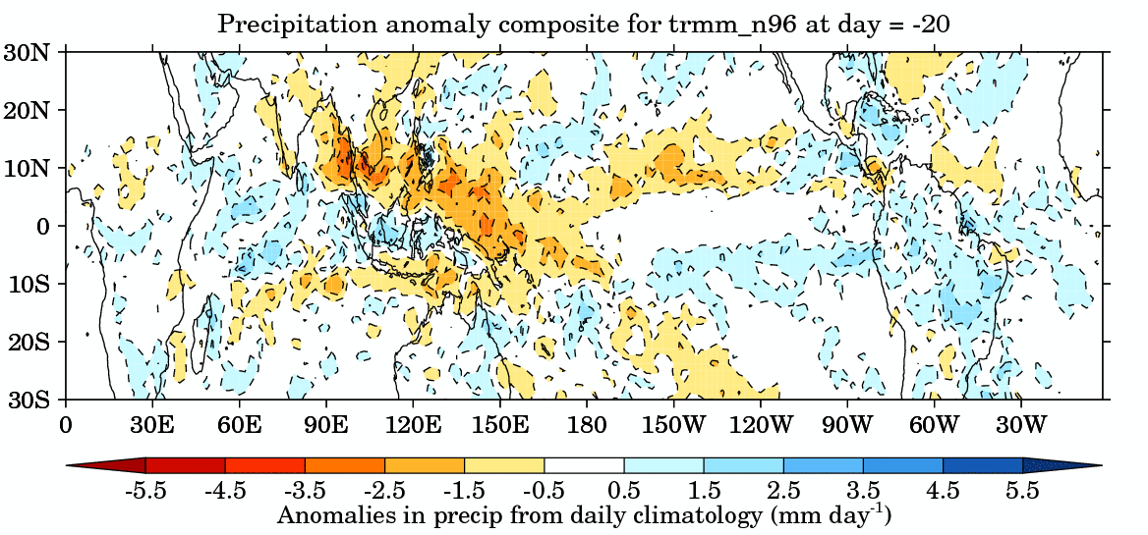

A OSCILAção de Madden-JULIAN (OMJ)
Laís G. Fernandes, Ph.D.
24 de novembro de 2025.

Slide 2
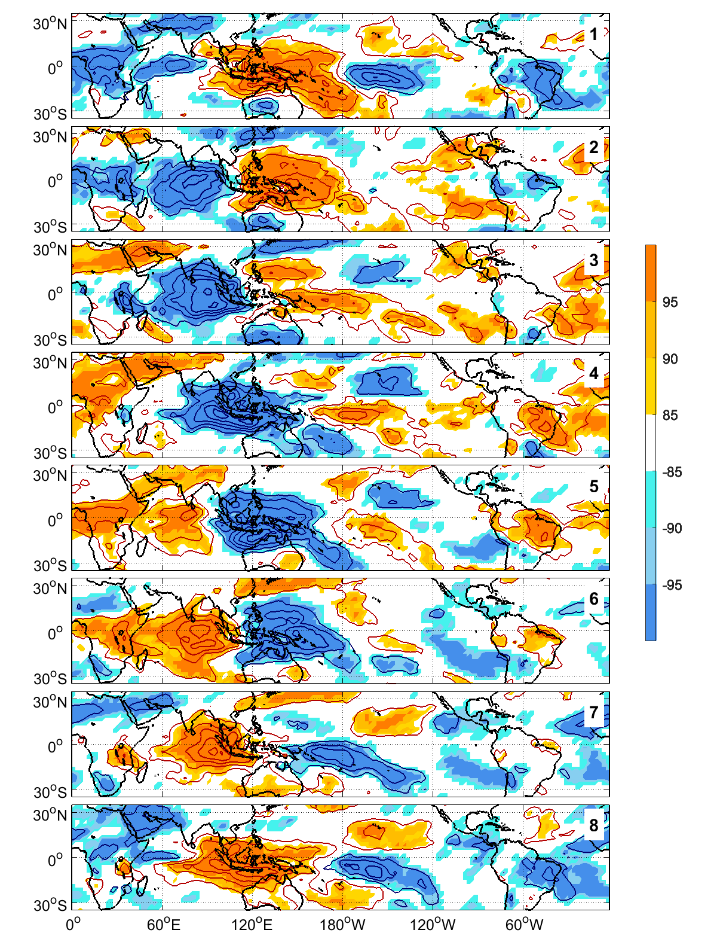
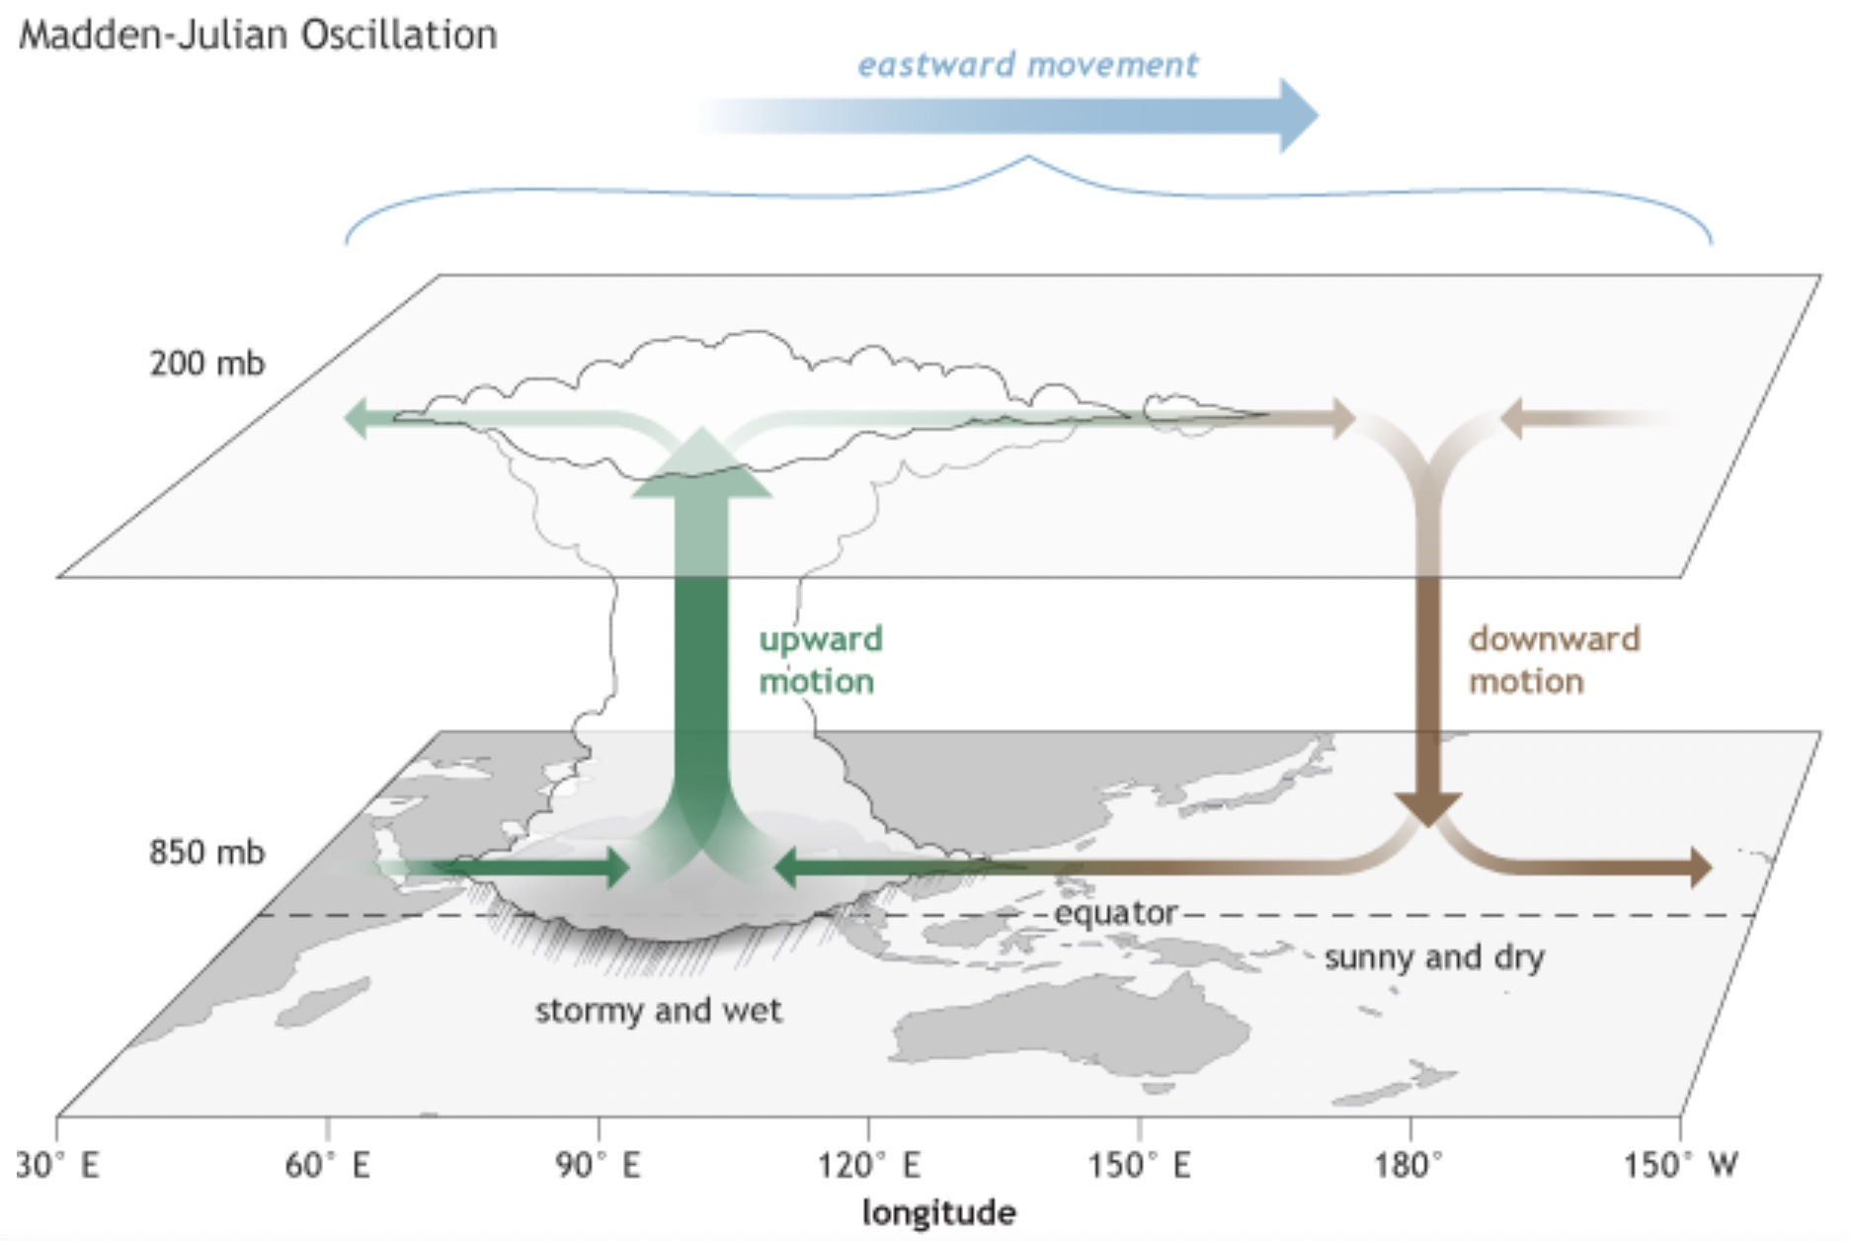
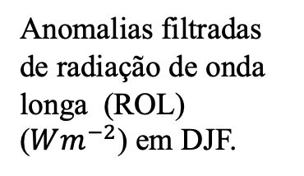
A Oscilação de
Madden-Julian (OMJ)
Anomalias filtradas de radiação de onda longa (ROL) ($Wm^{−2}$) em DJF.
Grimm (2019)
Notes:
MJO: characterized just by an atmospheric part and comprises two main regions with cloudiness and prec and no cloudiness and no prec (they follow each other)
The region of green arrows in fig 1 is the big cloudiness in blue in fig 2
8 active phases showing the eastward propagation of the main convection around the globe; each phase shows the position of the convection;

Slide 3
A Oscilação de
Madden-Julian (OMJ)
Modo de variabilidade climática natural que ocorre em escala de tempo intrassazonal identificado pela primeira vez por Roland Madden and Paul Julian nos anos 70 em observações de vento e pressão;
Cada fase da OMJ dura cerca de 6-8 dias, e leva em torno de 30-60 dias para a oscilação completar a volta completa em torno do globo terrestre;
A OMJ apresenta forte sazonalidade marcada por uma migração latitudinal ao longo do equador: em DJF está mais forte no Hemisfério Sul e em JJA é dominante ao norte do equador;
Considerada uma “janela de oportunidade” para a previsão em escala subssazonal (2-5 semanas).

Slide 4
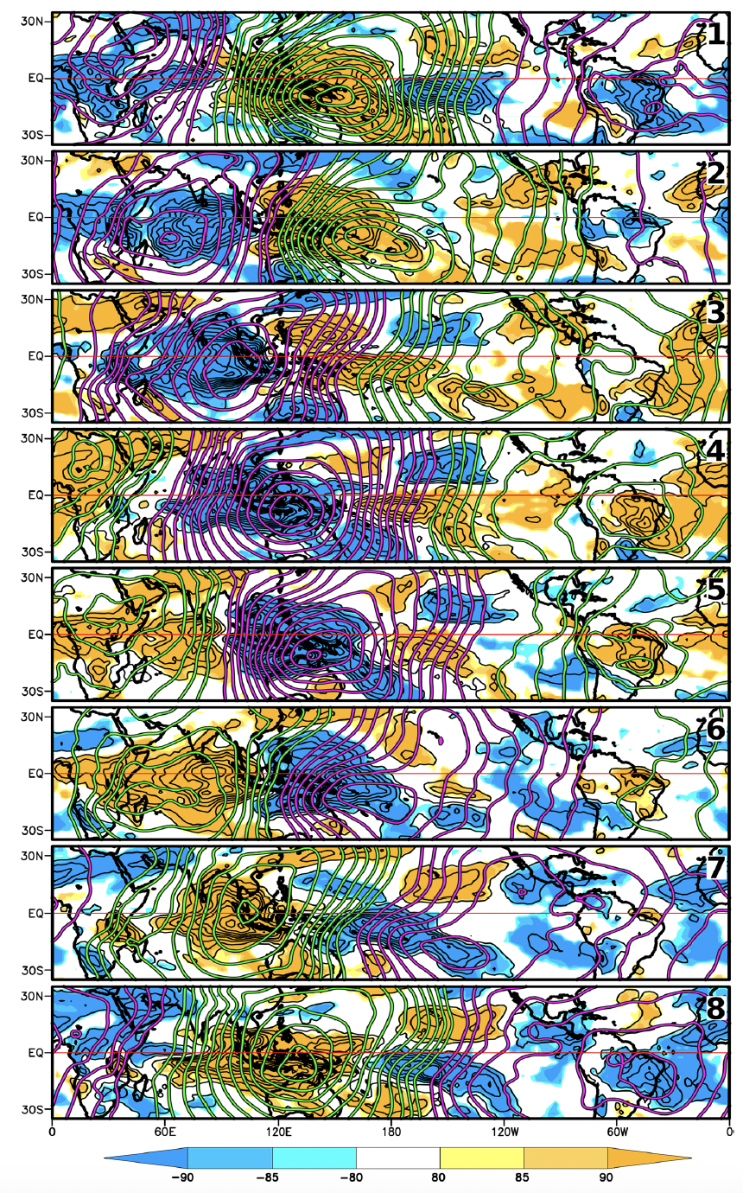
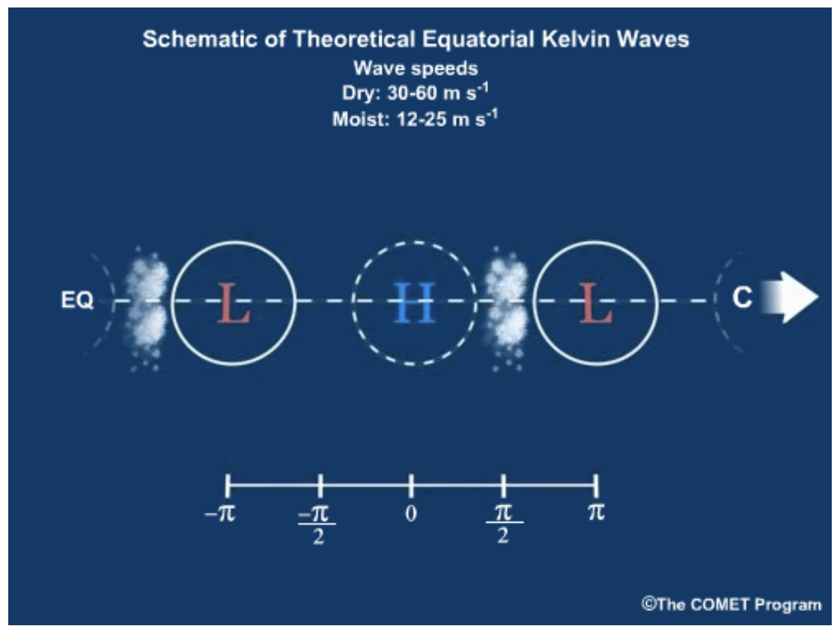
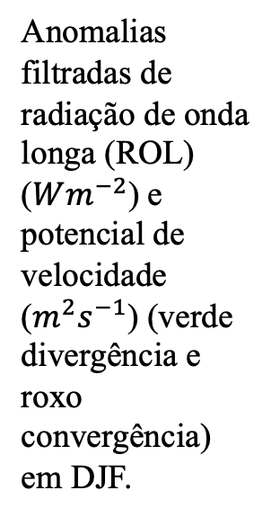
Anomalias filtradas de radiação de onda longa (ROL) ($Wm^{−2}$) e potencial de velocidade ($m^{2}s^{−1}$) (verde divergência e roxo convergência) em DJF.
Grimm (2019)

Slide 5
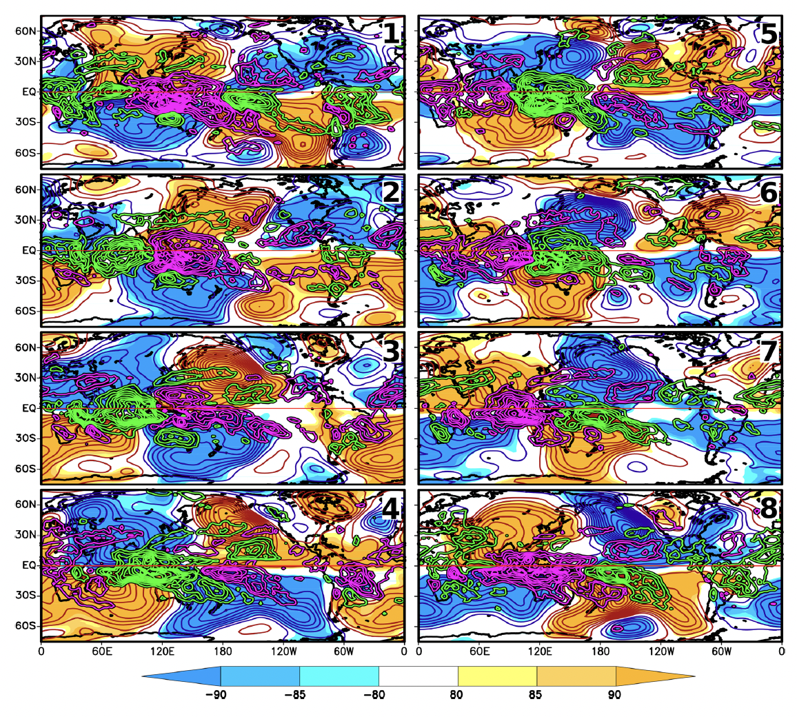
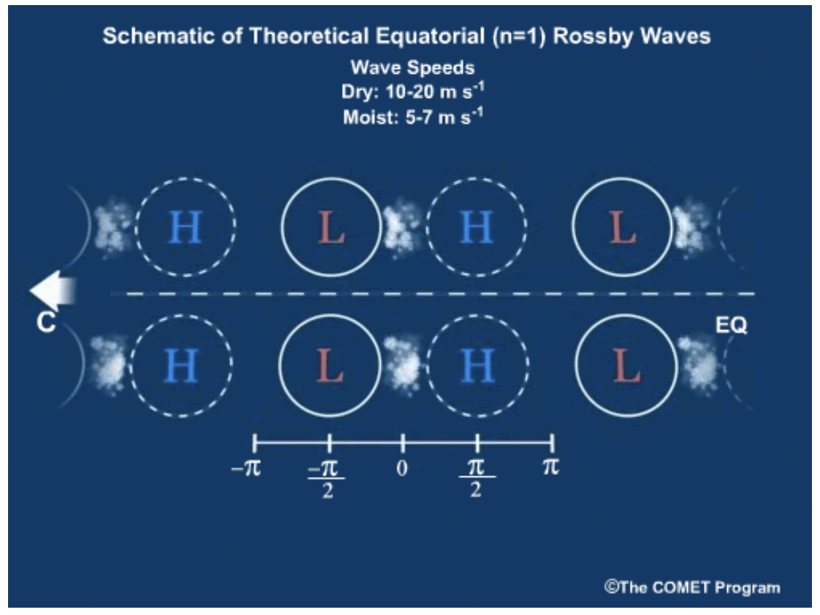
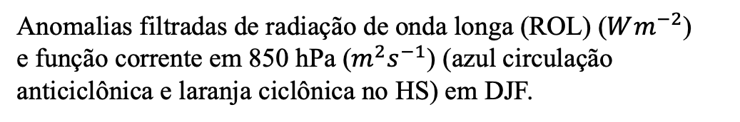
Anomalias filtradas de radiação de onda longa (ROL) ($Wm^{−2}$)
e função corrente em 850 hPa ($m^{2}s^{−1}$) (azul circulação anticiclônica e laranja ciclônica no HS) em DJF.
Grimm (2019)

Slide 6
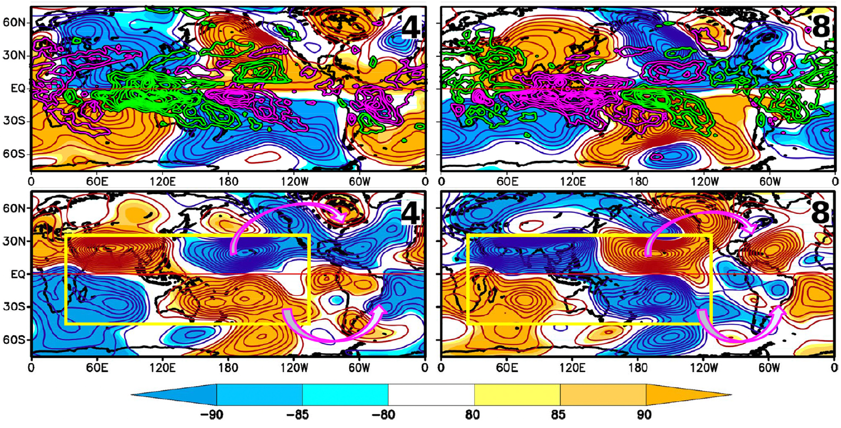
Estrutura da OMJ e suas teleconexões
Fernandes et al. (2025)
Notes:
Eastward MJO propagation in a counterclockwise movement
Colors for the days in a month (MJO circumnavigated the globe twice and a half during this period)
Around 6-8 days in each phase when it is strong and active

Slide 7
Impactos da OMJ
Início da estação de monção na Índia e na Austrália, precipitação nos EUA e no Canadá, precipitação de monção na América do Sul, bloqueios de inverno no Hemisfério Norte, rios atmosféricos sobre o Oceano Pacífico Norte, ciclones tropicais, bem como impactos em outras oscilações naturais como a Oscilação do Atlântico Norte (NAO) e o fenômeno El Niño-Oscilação Sul (ENOS).
Yoneyama and Zhang (2020)

Slide 8
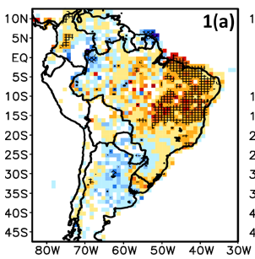
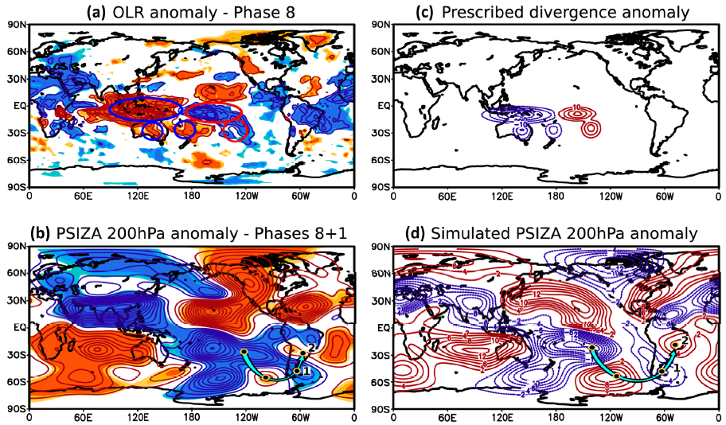
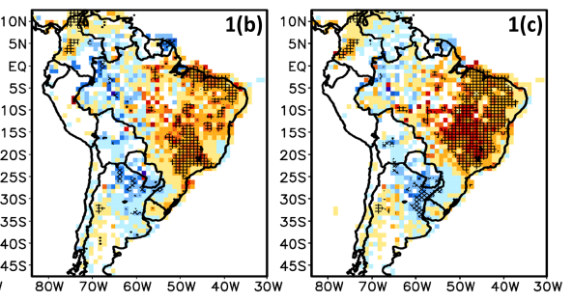

MJO impacts on SA rainfall
Precipitation anomalies $(mm day^{−1})$.
Streamfunction anomalies (200 hPa) $\left(m^{2}s^{−1}\right)$ Phases 8+1.
(Grimm, 2019)
Quadrupole (Rossby and Kelvin equatorial waves)
CESA
Extratropical Rossby waves
SACZ
SACZ
Notes:
Most significant MJO impacts in phases 8+1;
Tropical TC, quadripole, prec over tropical SA;
Extratropical TC (blue arrow), excited from the convection of the small red circle (fig), over subtropical South Pacific starts prec over the SACZ (which reaches subtropical SA) and increase prec in tropical SA;

Slide 9
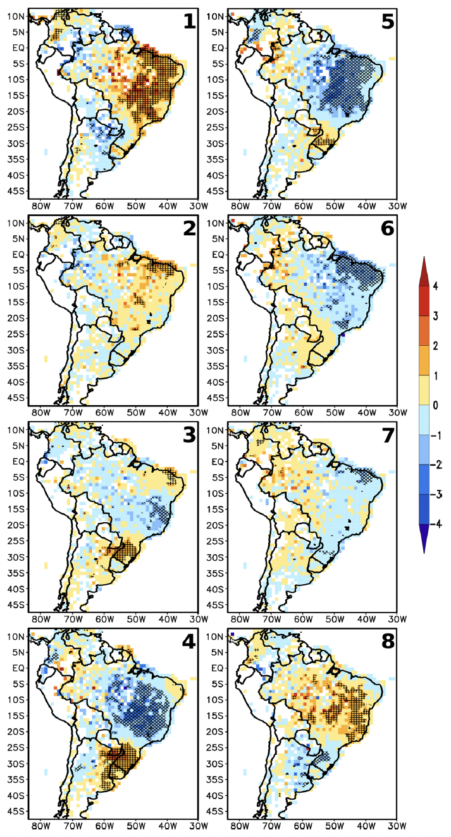
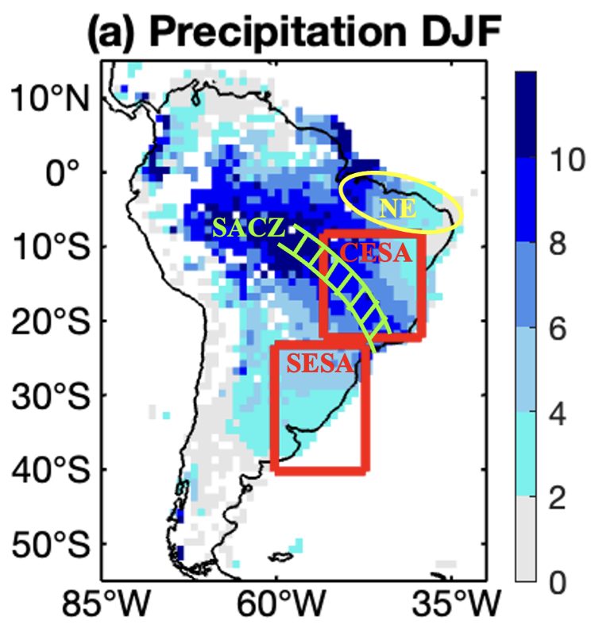
Impactos da OMJ na América do Sul
Grimm (2019)
Anomalias filtradas de precipitação (mm/dia) em DJF.
Notes:
Eastward MJO propagation in a counterclockwise movement
Colors for the days in a month (MJO circumnavigated the globe twice and a half during this period)
Around 6-8 days in each phase when it is strong and active

Slide 10
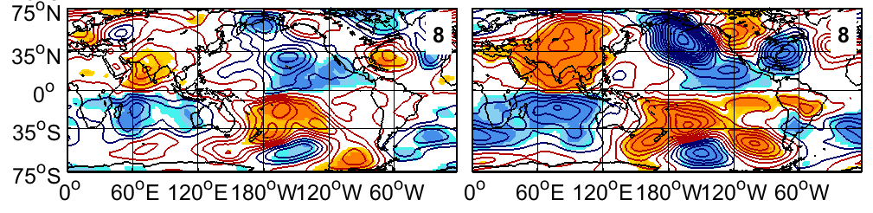
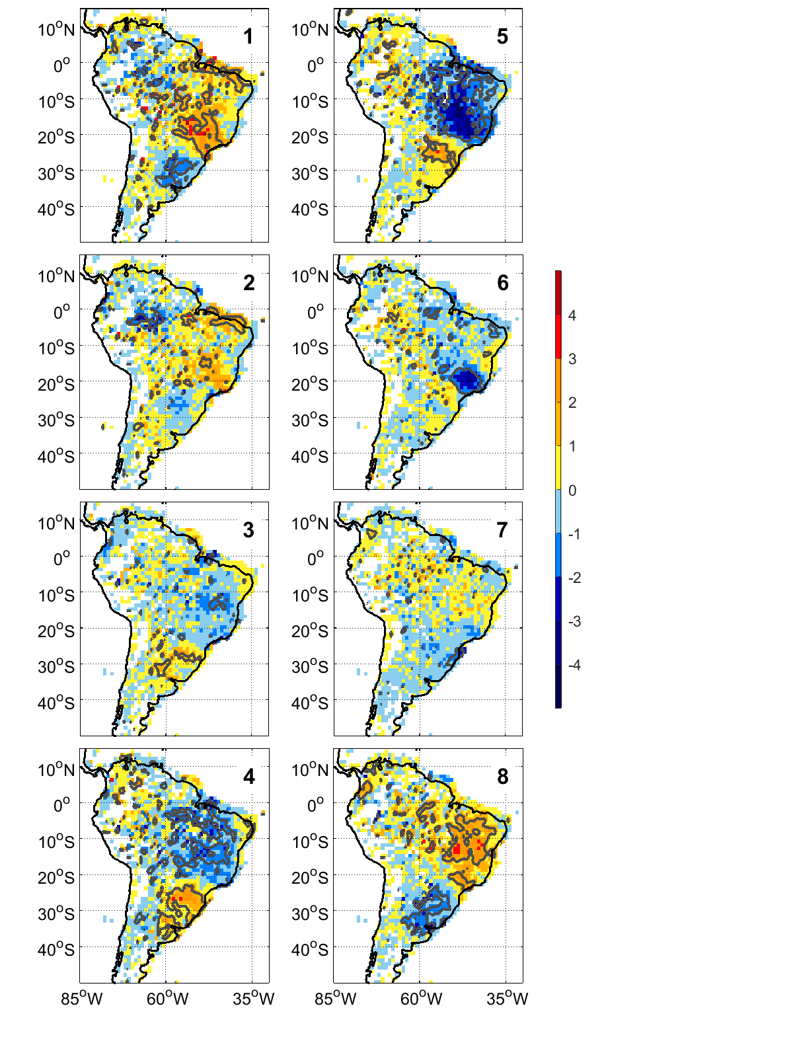
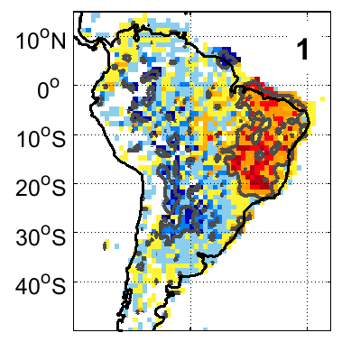
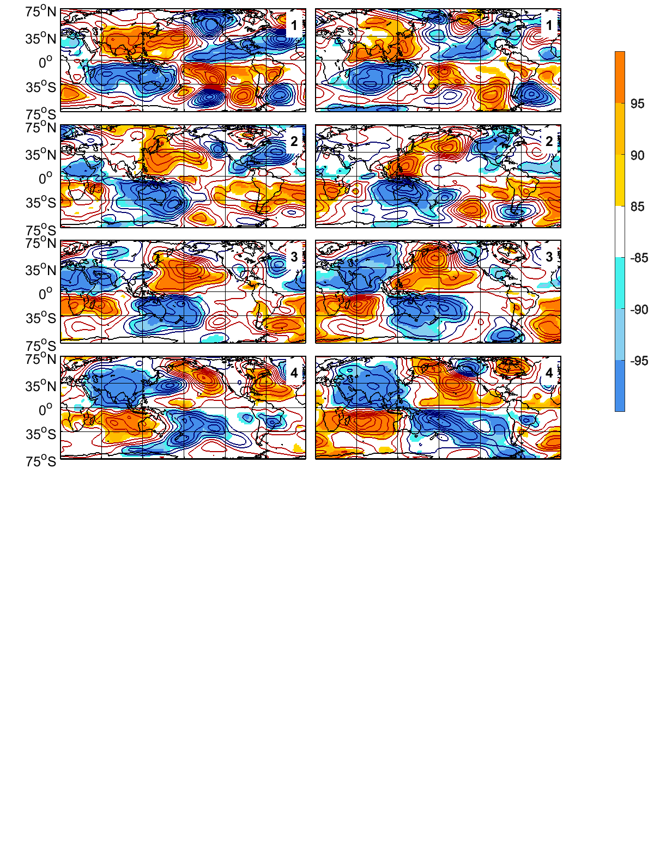
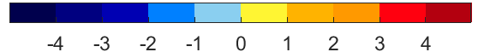
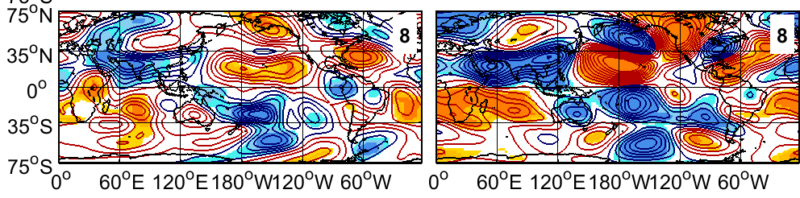
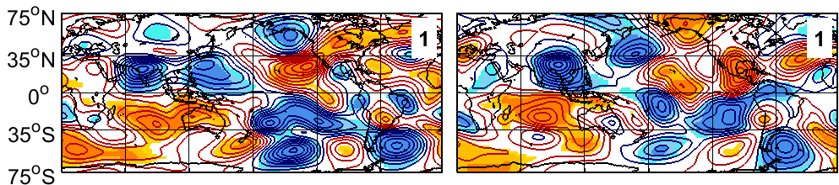
Modulação do ENOS nos impactos da OMJ
EN State (Tropical TC)
LN State (Tropical TC)
LN State
EN State
Peak
Peak
Peak
Peak
EN State (Extratropical TC)
LN State (Extratropical TC)
The strongest MJO impact over SA is advanced by one phase in LN with respect to EN, since both, the tropics-tropics and the tropics-extratropics teleconnections that connect the MJO to SA are established one phase before in LN;
Peak
Peak
Fernandes and Grimm (2023)
Notes:
Impacts over the SACZ (subtropical SA) appear only when the ENSO is active, suggesting that the ENSO has a similar effect on the MJO extratropical TC to SA;
Both EN and LN background state favor convection over the subtropical South Pacific, while NT years do not favor;

Slide 11
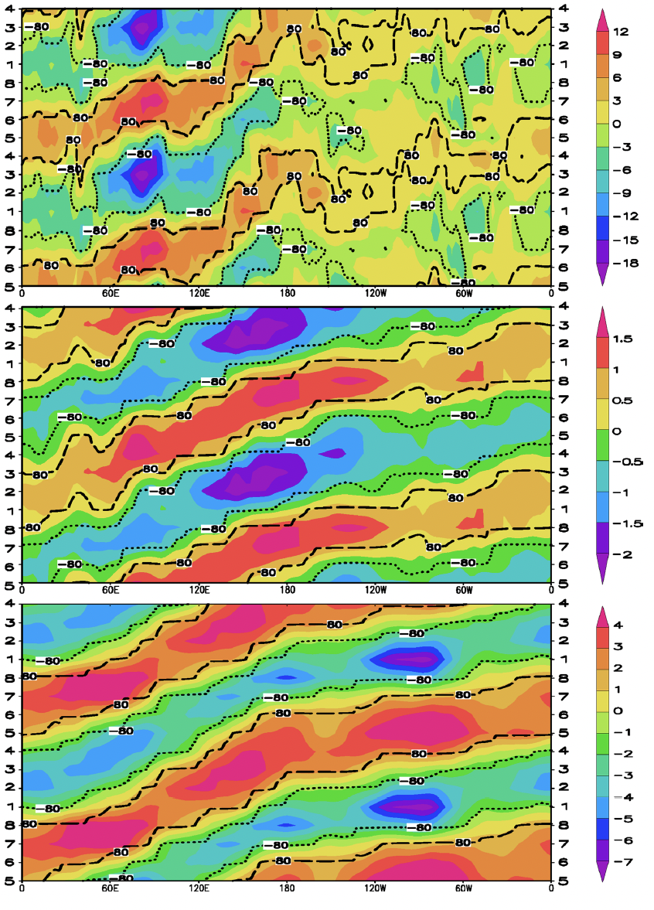
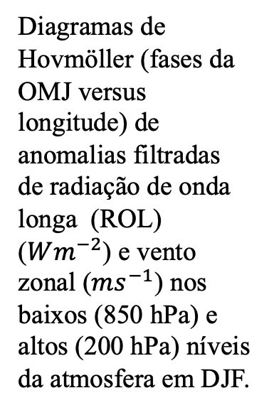
Diagramas de Hovmöller
Diagramas de Hovmöller (fases da OMJ versus longitude) de anomalias filtradas de radiação de onda longa (ROL) ($Wm^{−2}$) e vento zonal ($ms^{−1}$) nos baixos (850 hPa) e altos (200 hPa) níveis da atmosfera em DJF.
Grimm (2019)
Notes:
Falar que a inclinação das anomalias no diagrama mostra a propagação da OMJ.

Slide 12
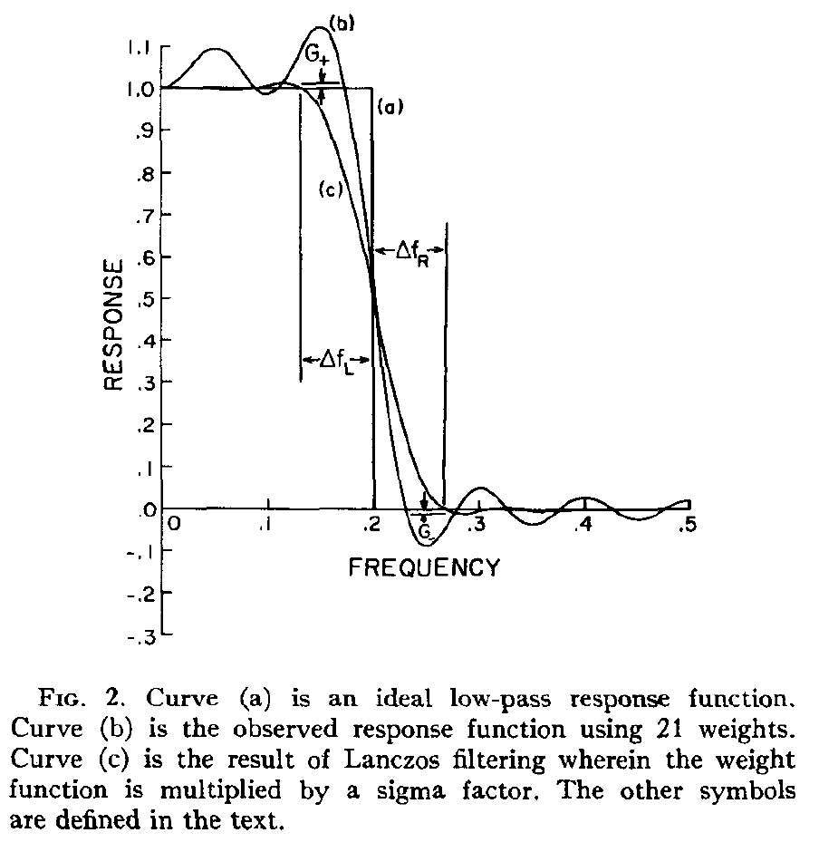
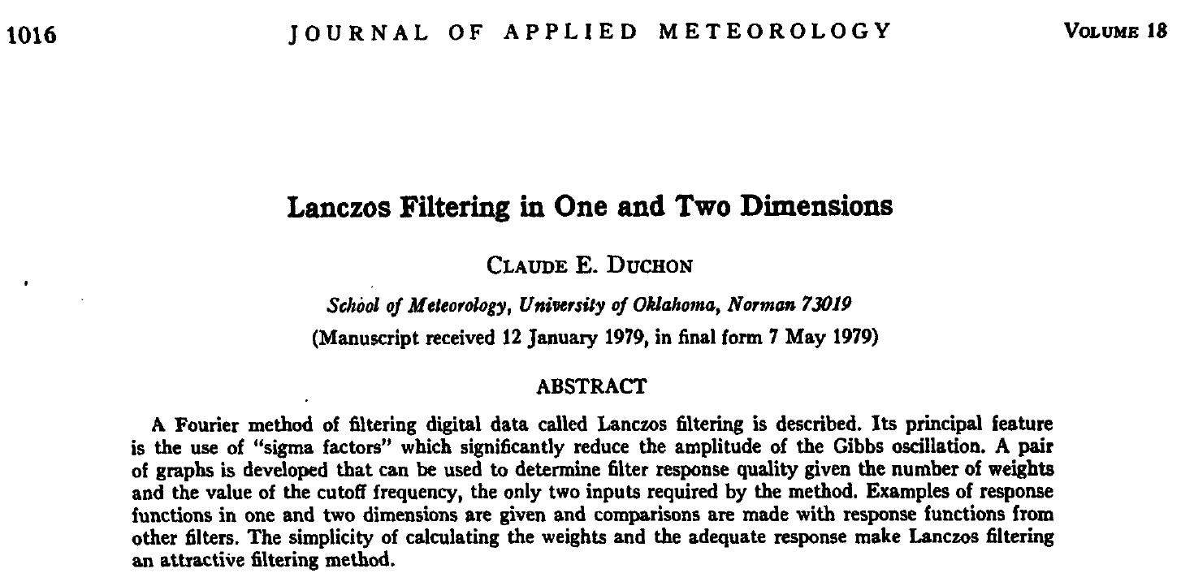
Como detectar o sinal da OMJ nas composições?
Filtrar as anomalias de convecção, circulação, e precipitação na banda de 20-90 dias (ou 20-80, 20-100 dias) utilizando o filtro de Lanczos (Duchon, 1979);
Notes:
Falar que a inclinação das anomalias no diagrama mostra a propagação da OMJ.

Slide 13
Teorias sobre
a OMJ
A fonte de energia para a OMJ ocorrer bem como a sua propagação para leste podem ser explicadas sob o ponto de vista de pelo menos 3 diferentes teorias que envolvem interações entre ondas equatoriais, convecção, umidade, e a dinâmica dentro da camada limite da atmosfera;
Embora grande progresso tem sido feito para compreender a dinâmica da OMJ e seus impactos globais na últimas décadas, muitos elementos da OMJ permanecem não totalmente compreendidos e são o foco de pesquisas na atualidade, como por exemplo, a convecção e propagação da OMJ através do Pacífico central-leste, Américas e África, bem como o seu início no Oceano Índico equatorial oeste;

Slide 14
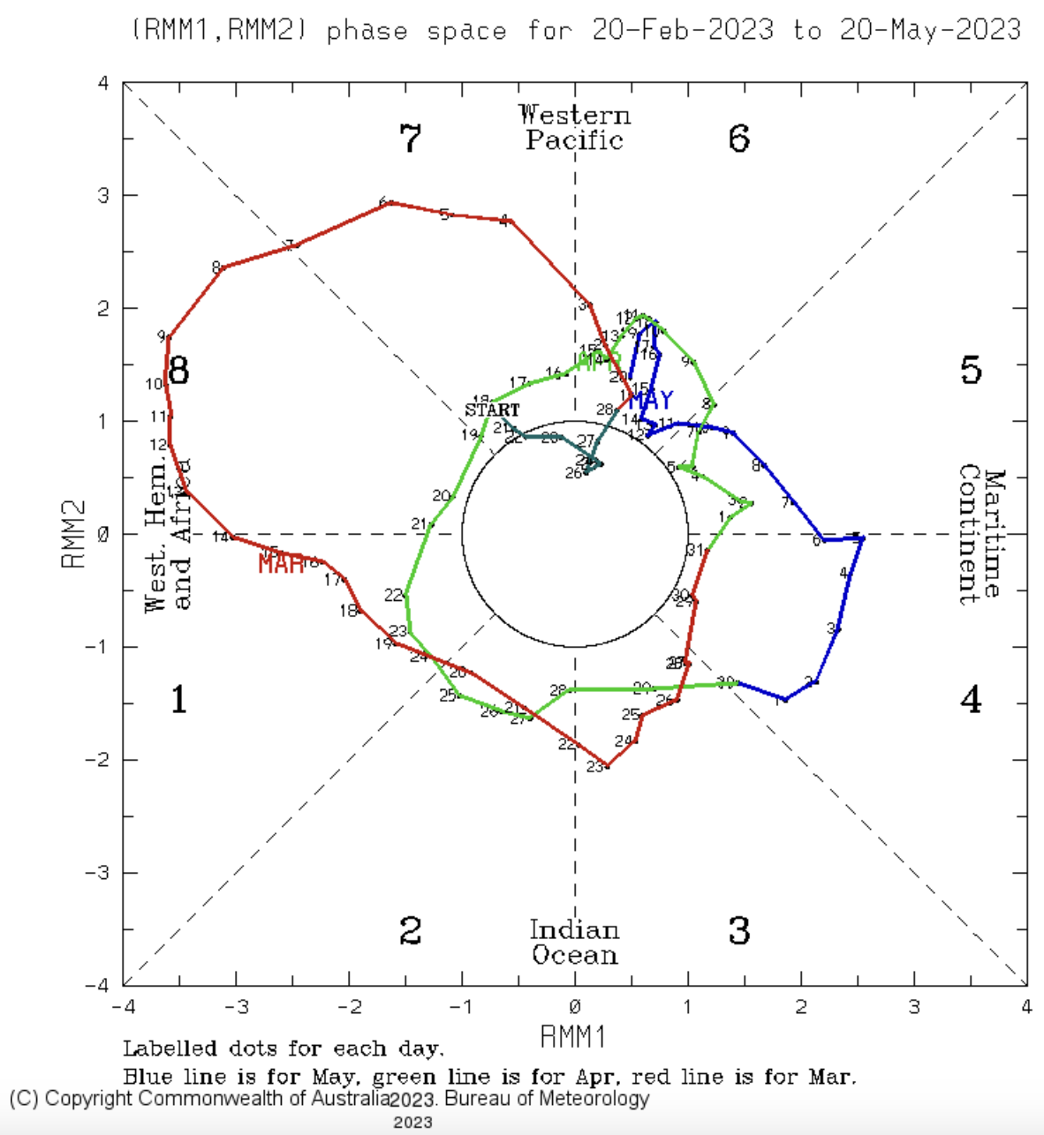
Monitorando a OMJ
http://www.bom.gov.au/climate/mjo/
Notes:
Eastward MJO propagation in a counterclockwise movement
Colors for the days in a month (MJO circumnavigated the globe twice and a half during this period)
Around 6-8 days in each phase when it is strong and active

Slide 15
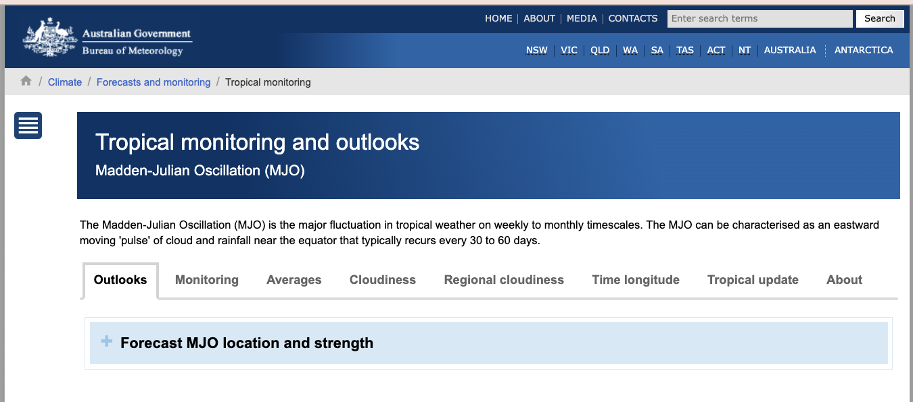
http://www.bom.gov.au/climate/mjo/

Slide 16
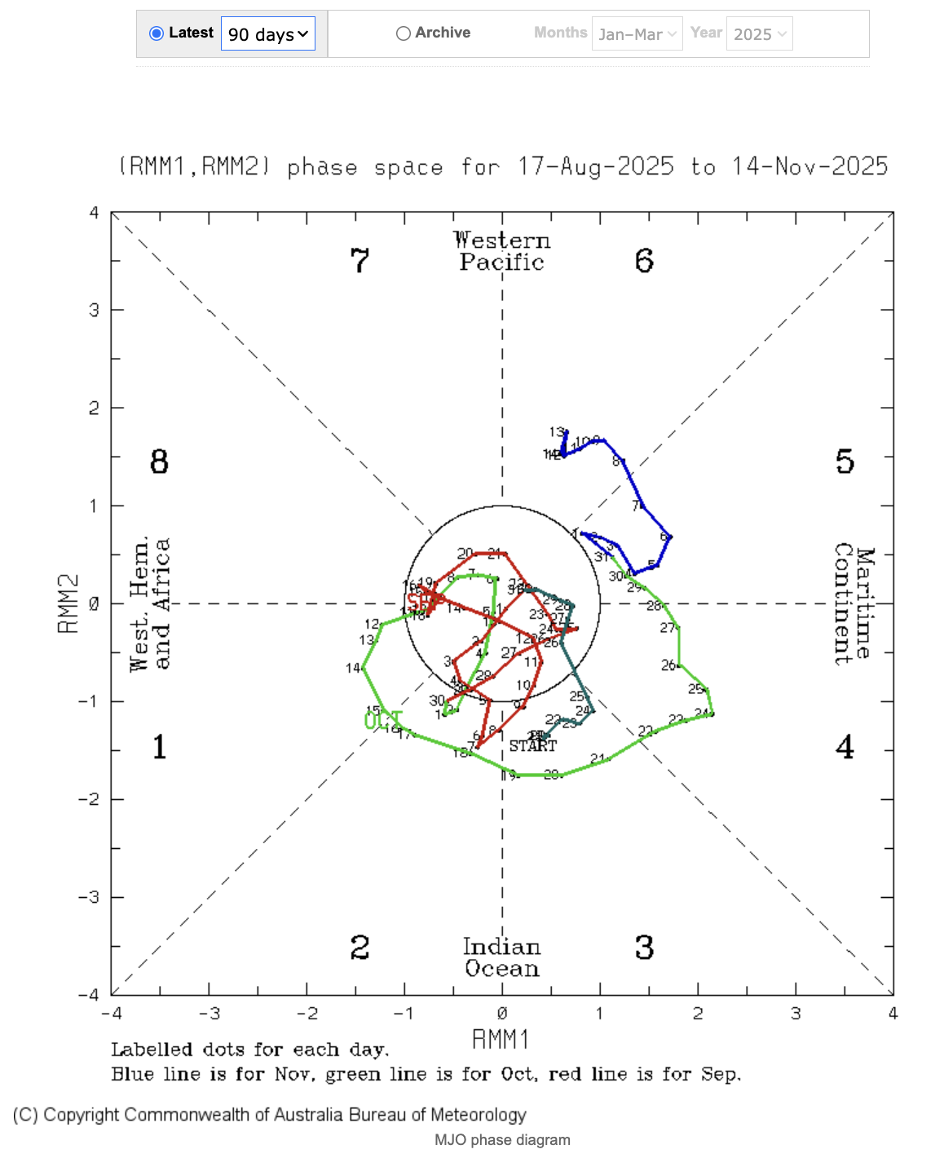
Monitorando a OMJ
http://www.bom.gov.au/climate/mjo/
Notes:
Eastward MJO propagation in a counterclockwise movement
Colors for the days in a month (MJO circumnavigated the globe twice and a half during this period)
Around 6-8 days in each phase when it is strong and active

Slide 17
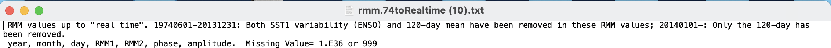
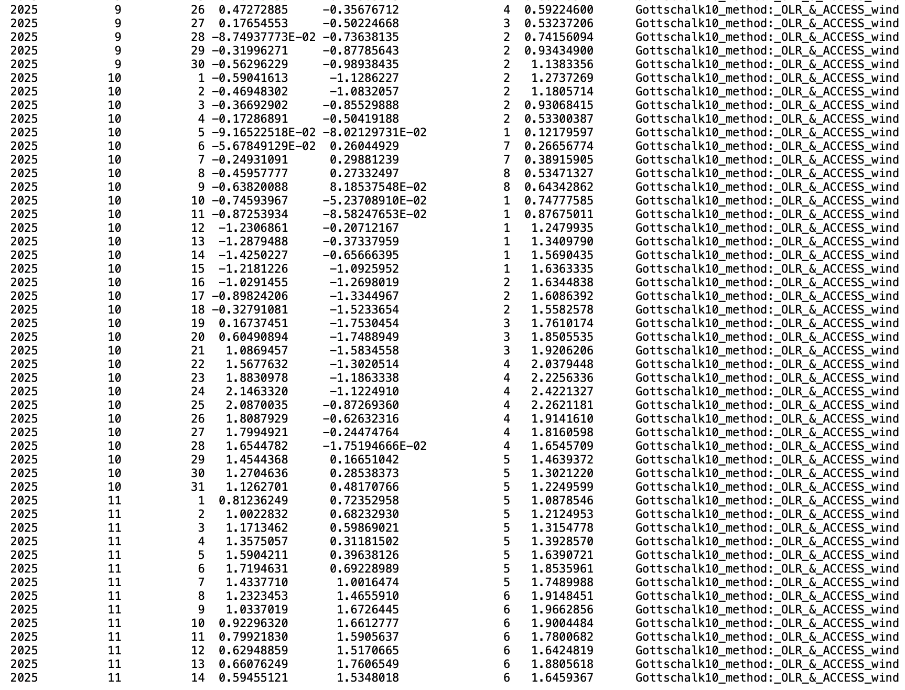
Realtime Multivariate MJO (RMM) Index
http://www.bom.gov.au/climate/mjo/
Wheeler and Hendon (2004)
Notes:
Eastward MJO propagation in a counterclockwise movement
Colors for the days in a month (MJO circumnavigated the globe twice and a half during this period)
Around 6-8 days in each phase when it is strong and active

Slide 18
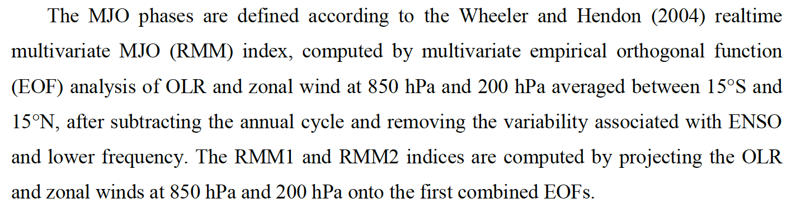
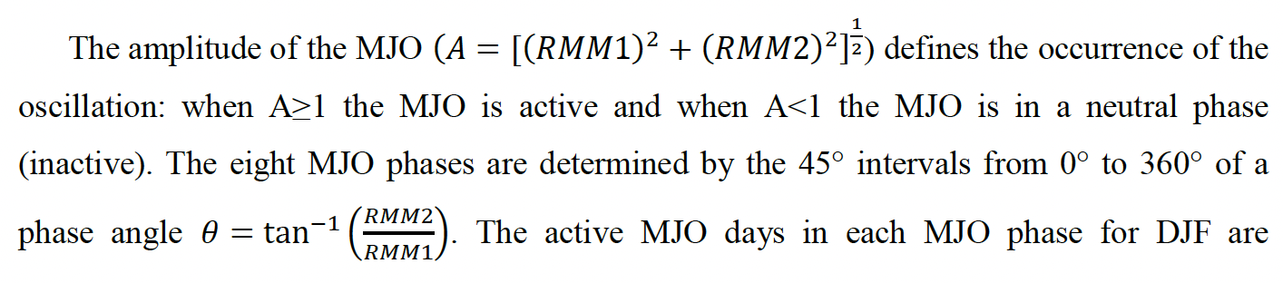
Como são calculados os RMMs, a amplitude e a fase da OMJ?
“RMM1 and RMM2 are mathematical methods that combine cloud amount and winds at upper and lower levels of the atmosphere to provide a measure of the strength and location of the MJO.”
Fernandes and Grimm (2023)
Notes:
In climate studies, EOF analysis is often used to study possible spatial modes (ie, patterns) of variability and how they change with time (e.g., the North Atlantic Oscilliation). In statistics, EOF analysis is known as Principal Component Analysis (PCA).

Slide 19
http://www.bom.gov.au/climate/mjo/

Slide 20
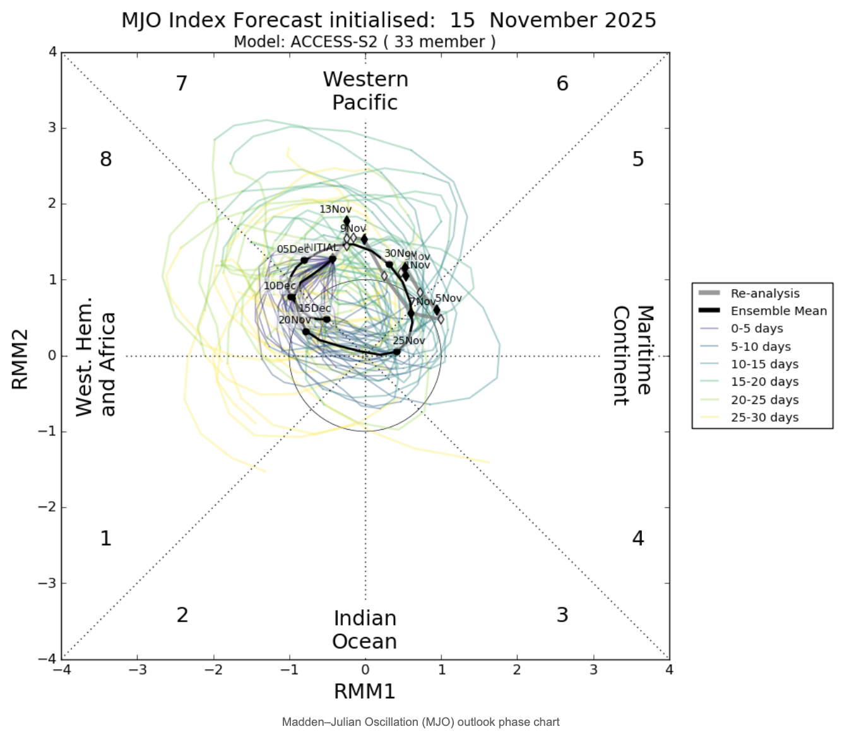
Monitorando a OMJ
http://www.bom.gov.au/climate/mjo/

Slide 21
http://www.bom.gov.au/climate/mjo/

Slide 22
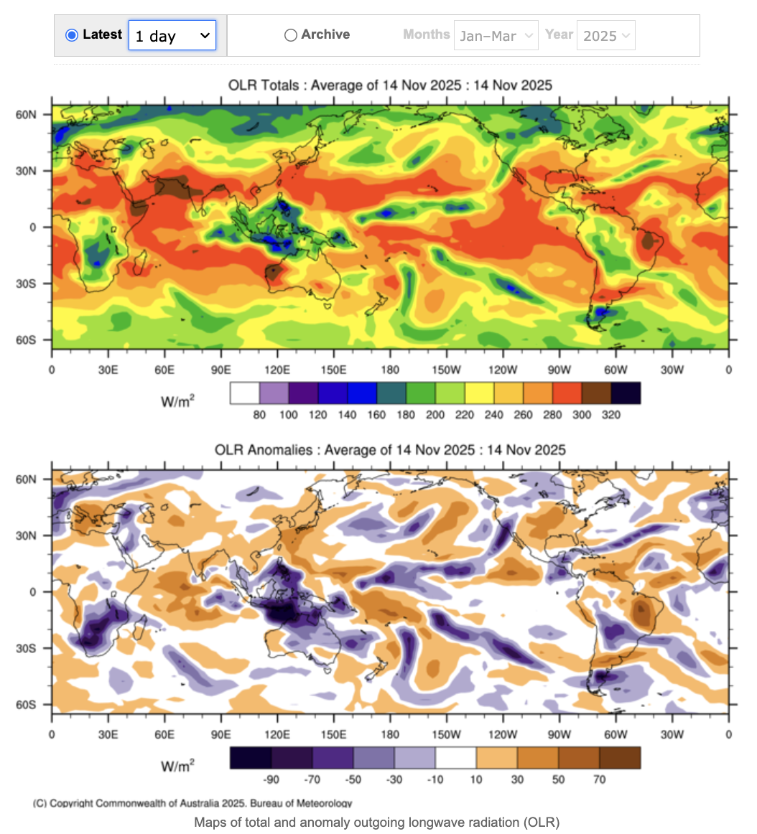
Monitorando a OMJ
http://www.bom.gov.au/climate/mjo/

Slide 23
http://www.bom.gov.au/climate/mjo/

Slide 24
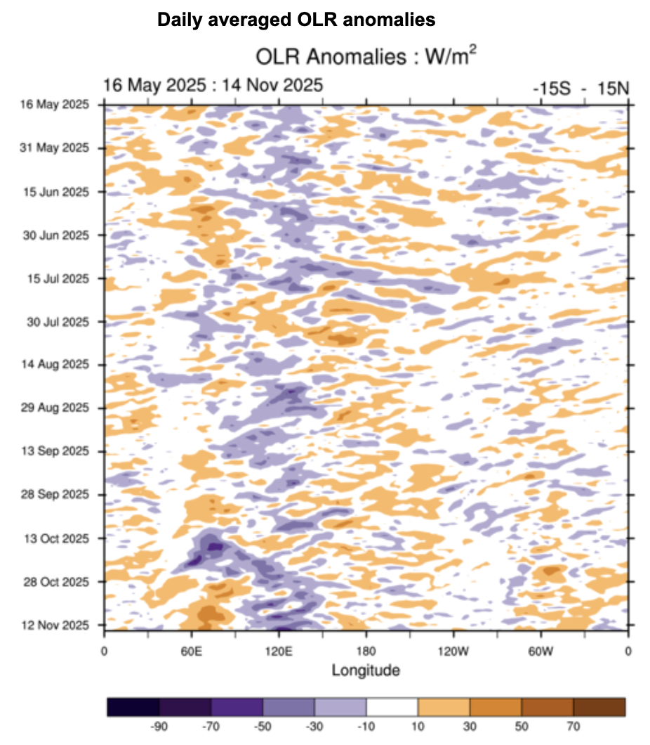
Monitorando a OMJ
http://www.bom.gov.au/climate/mjo/

Slide 25
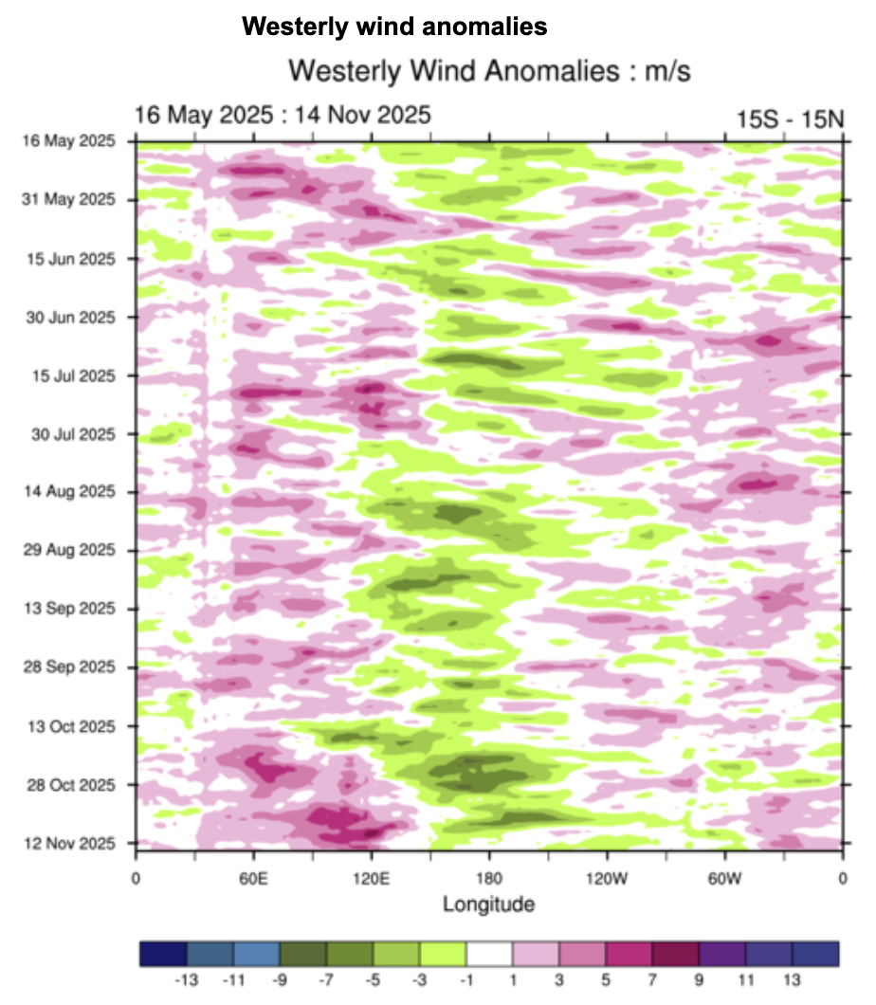
Monitorando a OMJ
http://www.bom.gov.au/climate/mjo/

Slide 26
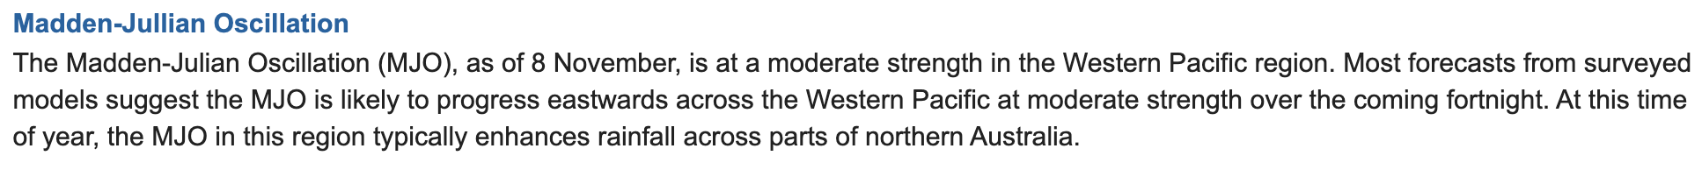
http://www.bom.gov.au/climate/mjo/

Slide 27
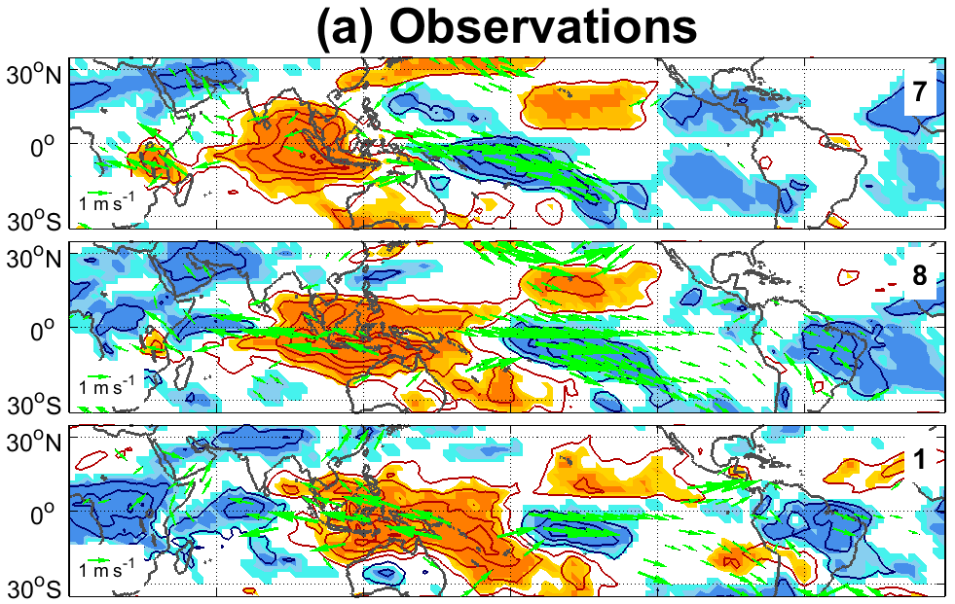
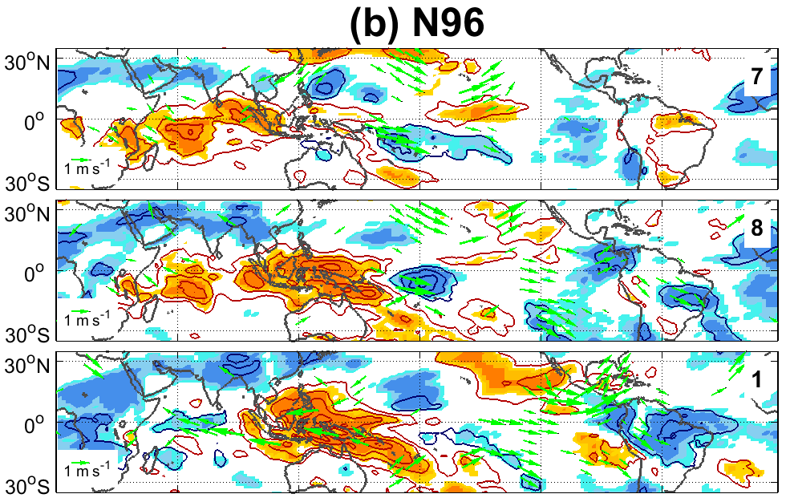
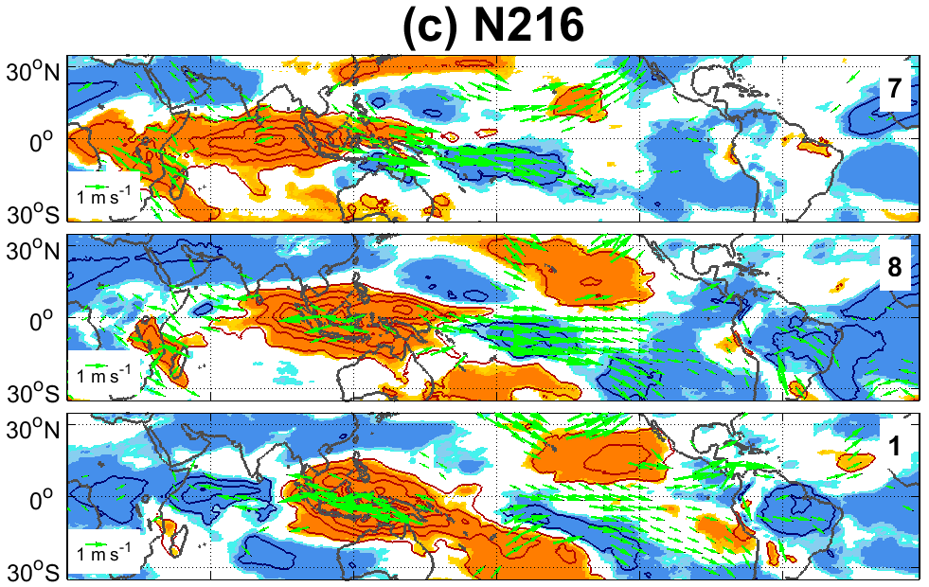
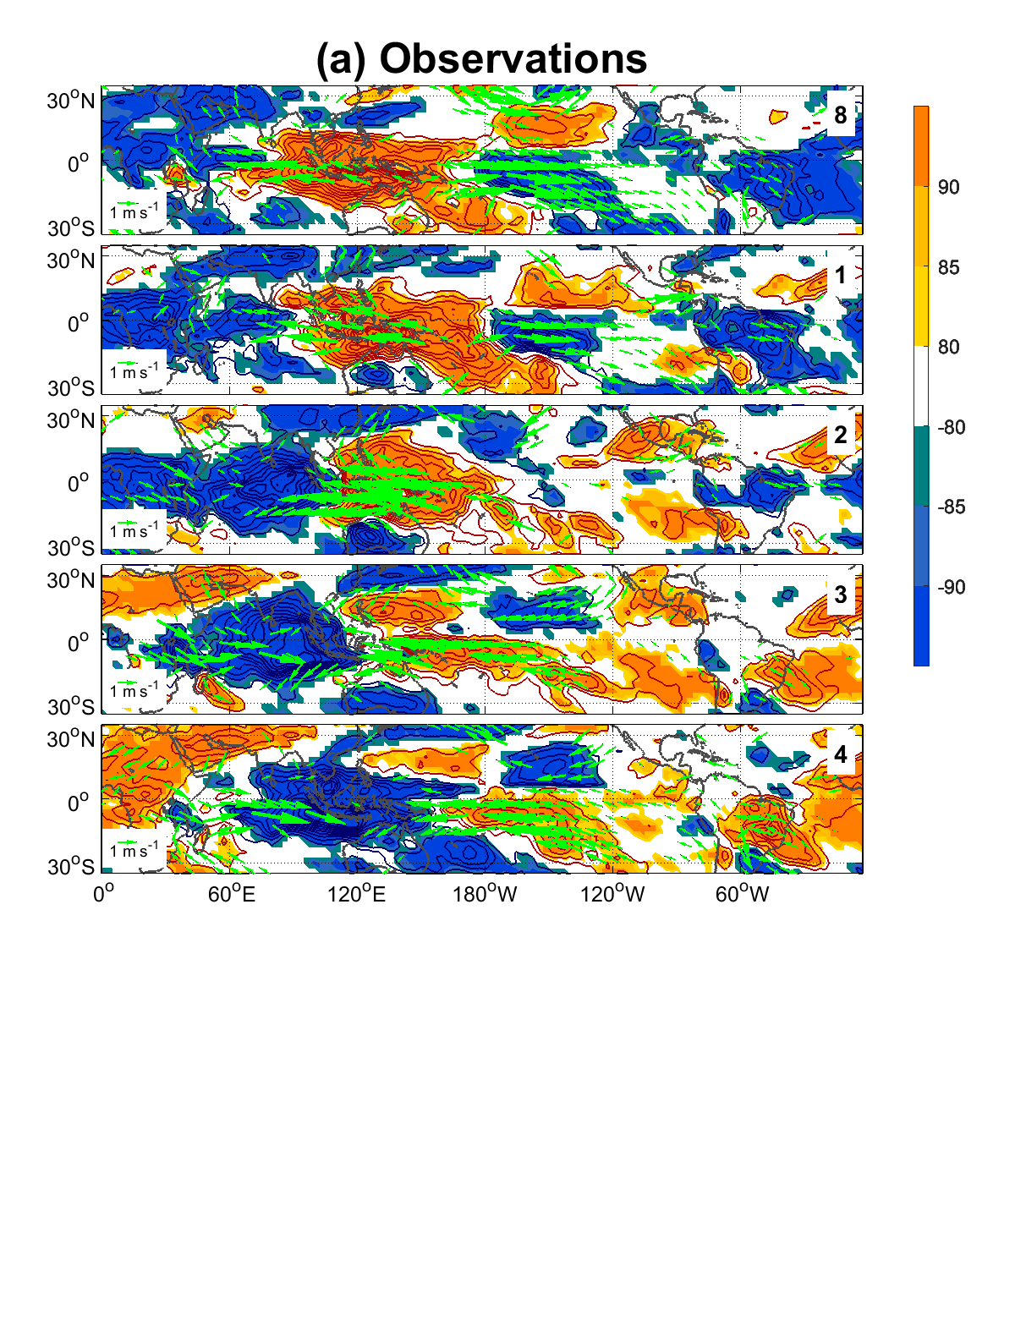
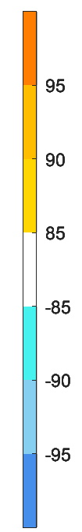
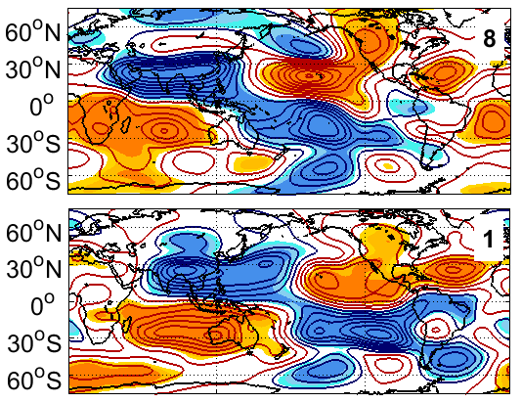
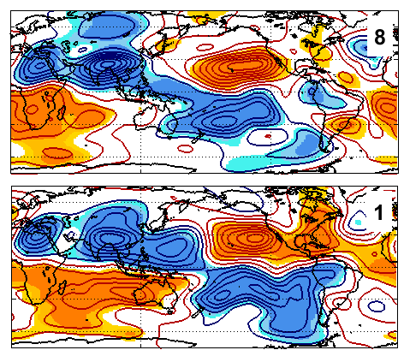
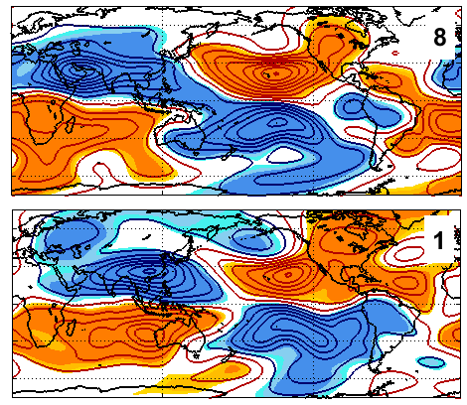
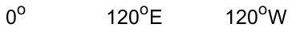
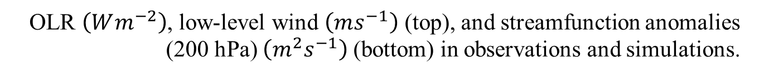
Observations
N96
N216
OLR $\left(Wm^{−2}\right)$, low-level wind $\left(ms^{−1}\right)$ (top), and streamfunction anomalies (200 hPa) $\left(m^{2}s^{−1}\right)$ (bottom) in observations and simulations.
MJO phases 7, 8, 1
Fernandes et al. (submetido)
Notes:
Observations: strong convection and convergence over the subtropical South Pacific from phase 7 through phase 1 and the teleconnection appears in phase 8 and peaks in phase 1;
Model simulates well the enhancement of convection and low-level convergence over the source region in phases 7+8 as obs;
However, these conditions weakens earlier in the model → they are stronger in obs than in the model in phase 1;
One of the reasons is because the eastward MJO propagation is advanced in the model compared to observations;
Extratropical TC is established one phase before in the model with respect to observed;

Slide 28
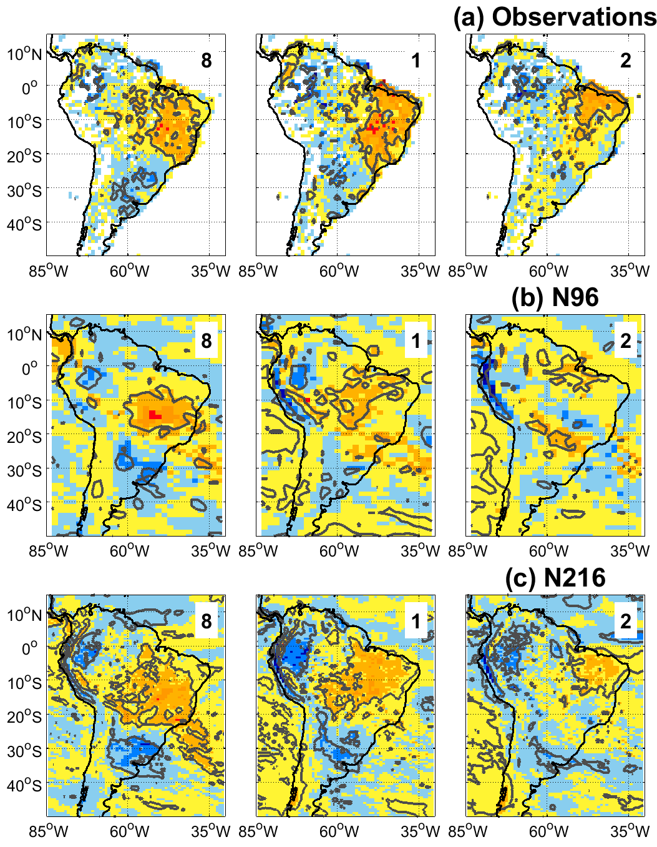





Observations
MJO phases 8 and 1
Streamfunction (850 hPa) (left) $\left(m^{2}s^{−1}\right)$ and precipitation (right) anomalies $(mm day^{−1})$ in observations and simulations.
N96
N216
Fernandes et al. (submetido)
Notes:
Tropical TC is also established one phase before in the model with respect to observed;
Hence, the model simulates the strongest SA precipitation dipole earlier than observed;
Observed precipitation in phases 1 and 2 is simulated in phases 8 and 1 in the model;

Slide 29
References
Duchon CE (1979) Lanczos Filtering in One and Two Dimensions. J Appl Meteorol 18:1016–1022.
Fernandes LG, Grimm AM (2023) ENSO modulation of global MJO and its impacts on South America. J Clim, 33(22), 7715–7738.
Fernandes LG et al. (2025) Ocean-atmosphere interactions: Madden-Julian Oscillation and El Niño-Southern Oscillation. In B. Guan (Ed.), Atmospheric oscillations: Sources of subseasonal-to-seasonal variability and predictability. Elsevier.
Grimm AM (2019) Madden-Julian Oscillation impacts on South American summer monsoon season: precipitation anomalies, extreme events, teleconnections, and role in the MJO cycle. Clim Dyn, 53, 907–932.
Wheeler MC, Hendon HH (2004) An All-Season Real-Time Multivariate MJO Index: Development of an Index for Monitoring and Prediction. Mon Weather Rev 132:1917–1932.
Yoneyama K, Zhang C (2020) Years of the Maritime Continent. Geophys Res Lett, 47, e2020GL087182.

Slide 30


Rio Grande do Sul rainfall case
(15/04/24 a 22/05/24)

Slide 31
Rio Grande do Sul rainfall case
(15/04/24 a 22/05/24)

Slide 32



How does the
El Niño affect the weather over subtropical/ extratropical
South America?
A
C
A
C
A
Notes:
There is so much energy within this convective system that it releases energy at the top of the cloud by triggering an atmospheric (slides)….
How does this wave modify atmospheric circulation? They impose an alternate atmospheric pattern (for example, here the wind spins…) that affect circulation at low-levels changing precipitation over the continent.
These waves and their impacts on climate at the ground level are called teleconnections, and they appear when natural climate oscillations are active and intensified.

Slide 33


Rio Grande do Sul rainfall case
(15/04/24 a 22/05/24)

Slide 34
Impactos da OMJ na América do Sul
Grimm (2019)
Anomalias filtradas de precipitação (mm/dia) em DJF.
Notes:
Eastward MJO propagation in a counterclockwise movement
Colors for the days in a month (MJO circumnavigated the globe twice and a half during this period)
Around 6-8 days in each phase when it is strong and active

Slide 35
Heat wave case
(15/04/24 a 22/05/24)

Slide 36
Heat wave case
(15/04/24 a 22/05/24)

Slide 37
How does the
El Niño affect the weather over subtropical/ extratropical
South America?
A
C
A
C
A
Notes:
There is so much energy within this convective system that it releases energy at the top of the cloud by triggering an atmospheric (slides)….
How does this wave modify atmospheric circulation? They impose an alternate atmospheric pattern (for example, here the wind spins…) that affect circulation at low-levels changing precipitation over the continent.
These waves and their impacts on climate at the ground level are called teleconnections, and they appear when natural climate oscillations are active and intensified.

Slide 38
Heat wave case
(15/04/24 a 22/05/24)

Slide 39
Impactos da OMJ na América do Sul
Grimm (2019)
Anomalias filtradas de precipitação (mm/dia) em DJF.
Notes:
Eastward MJO propagation in a counterclockwise movement
Colors for the days in a month (MJO circumnavigated the globe twice and a half during this period)
Around 6-8 days in each phase when it is strong and active

Slide 40


Cyclone Yaku
(07/03/23 a 13/03/23)

Slide 41
A Oscilação de
Madden-Julian (OMJ)
Anomalias filtradas de radiação de onda longa (ROL) ($Wm^{−2}$) em DJF.
Grimm (2019)
Notes:
MJO: characterized just by an atmospheric part and comprises two main regions with cloudiness and prec and no cloudiness and no prec (they follow each other)
The region of green arrows in fig 1 is the big cloudiness in blue in fig 2
8 active phases showing the eastward propagation of the main convection around the globe; each phase shows the position of the convection;

Slide 42

Cyclone Yaku
(07/03/23 a 13/03/23)

Slide 43
Arrows and dashed lines show that strong westerlies (WWB) over the western-central equatorial Pacific trigger downwelling oceanic Kelvin waves that cause positive SST anomalies over the eastern equatorial Pacific around three months later.
McPhaden (2009)
Notes:
Time-longitude sections of anomalies in surface zonal wind, 20 degrees Celsius isotherm depth, and SST from September 1996 to August 1998.
Strong positive winds (left) represent WWBs, and positive 20 degrees Celsius isotherm depths (middle) indicate a deeper thermocline.

Slide 44



Cyclone Yaku
(07/03/23 a 13/03/23)
Peng et al. (2024)

Slide 45
Cyclone Yaku
(07/03/23 a 13/03/23)
﻿In early March, a record-strong MJO drives westerly wind anomalies over the EEP, and a rare low-pressure system Yaku develops off Peru with anomalous northerly alongshore winds. ﻿Results show that these anomalous winds are crucial in driving the 2023 coastal El Niño by suppressing coastal upwelling and deepening the thermocline depth via downwelling Kelvin waves.

Slide 46
Cyclone Yaku
(07/03/23 a 13/03/23)
﻿The study further identifies a positive feedback between coastal warming and internal atmospheric variability such as Yaku-like cyclones off Peru. The analysis suggests that Yaku is part of the strong phase 8 MJO, induced by the orographic effect of the high Andes and ﻿amplified by convective heating over warm coastal waters.
Given the rarity of extreme coastal El Niño, the 2023 case provides a valuable opportunity to test ocean-atmospheric processes involved.

Slide 47

Furacão Júlia
(07/10/22 a 11/10/22)

Slide 48
Furacão Júlia
(07/10/22 a 11/10/22)
ENSO (El Niño-Southern Oscillation) significantly impacts Caribbean tropical cyclone (TC) activity, with El Niño typically leading to lower activity and La Niña leading to higher activity. This is primarily due to ENSO’s influence on environmental conditions in the Atlantic basin, such as vertical wind shear and atmospheric stability. During an El Niño, increased vertical wind shear suppresses storm formation, while during a La Niña, reduced shear and atmospheric stability allow for more activity.
(Doane-Solomon et al., 2023
and ref. therein)

Slide 49
How ENSO leads to a cascade of global impacts
ENSO arises from changes across the tropical Pacific Ocean. So why does ENSO affect the climate over sizable portions of the globe, including some regions far removed from the tropical Pacific Ocean? Does the strength of ENSO matter for global impacts?

Slide 50
How ENSO leads to a cascade of global impacts
ENSO arises from changes across the tropical Pacific Ocean. So why does ENSO affect the climate over sizable portions of the globe, including some regions far removed from the tropical Pacific Ocean? Does the strength of ENSO matter for global impacts?

Slide 51

How ENSO leads to a cascade of global impacts
El Niño causes excess heating in the tropical Pacific upper atmosphere → the air flow toward the poles becomes more vigorous → strength of the Hadley cell → elongated jet stream → supply of storms;
https://www.climate.gov/news-features/blogs/enso
/how-enso-leads-cascade-global-impacts

Slide 52


Furacão Júlia
(07/10/22 a 11/10/22)

Slide 53


Furacão Júlia
(07/10/22 a 11/10/22)
MJO 1-2-3
MJO 4-5-6

