Slide 1

Physics
and Physics Configurations in MPAS

Slide 2
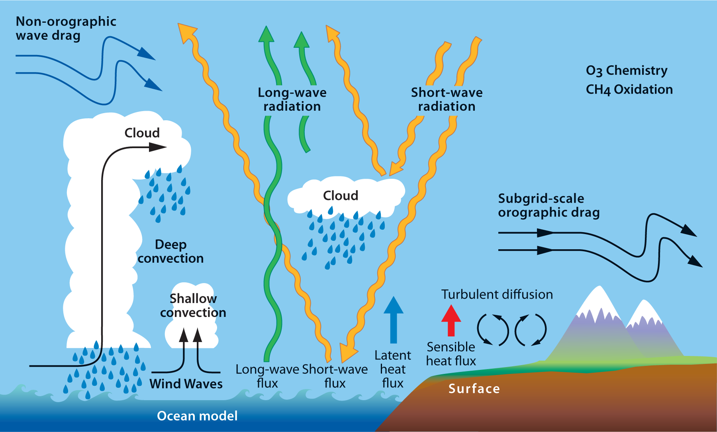
Atmospheric Physical Processes
Atmospheric physics model processes not explicitly contained in the Navier Stokes equations (e.g. radiation), or provide boundary conditions to the atmospheric model (e.g. ocean and land models).
MPAS-Atmosphere contains physics options to cover most of these processes, and includes a land model.
(From ECMWF)

Slide 3
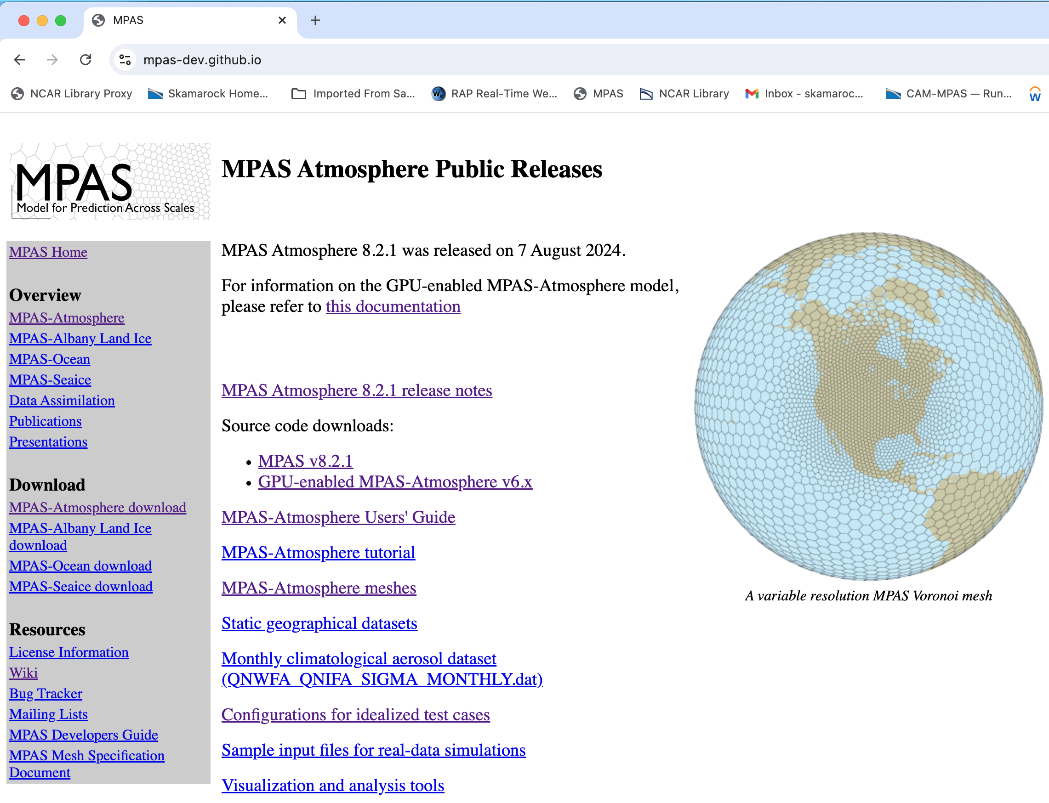
MPAS-Atmosphere
Resources
MPAS-Atmosphere Users’ Guide: On the MPAS-Atmosphere download page

Slide 4
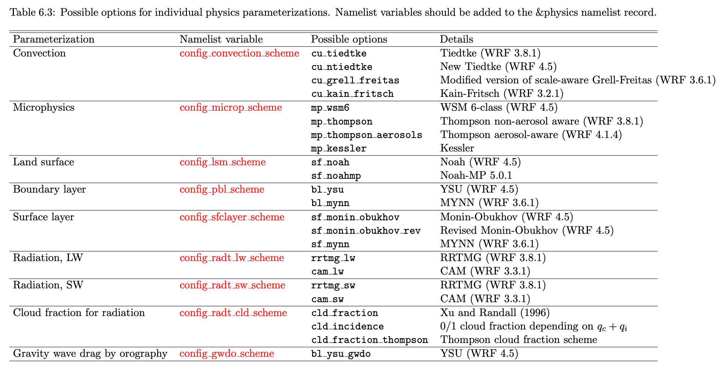
Physics Schemes in MPAS v8.2
From the MPAS-Atmosphere Users’ Guide

Slide 5
Specifying Physics in MPAS
Example shown the ‘mesoscale_reference’ suite:
&physics
config_physics_suite = 'mesoscale_reference'
config_convection_scheme = 'cu_ntiedtke'
config_microp_scheme = 'mp_wsm6'
config_pbl_scheme = 'bl_ysu'
config_sfclayer_scheme = 'sf_monin_obukhov'
config_lsm_scheme = 'sf_noah'
config_radt_lw_scheme = 'rrtmg_lw'
config_radt_sw_scheme = 'rrtmg_sw'
config_radt_cld_scheme = ‘cld_fraction’
config_gwdo_scheme = 'bl_ysu_gwdo’
/
See Chapter 6 and B11 in the User’s Guide

Slide 6
Specifying Physics in MPAS
Physics is configured by using namelist record &physics. It can be defined as a suite, or individual options, or combination of both.
&physics
config_physics_suite = 'mesoscale_reference'
config_convection_scheme = 'cu_ntiedtke'
config_microp_scheme = 'mp_wsm6'
config_pbl_scheme = 'bl_ysu'
config_sfclayer_scheme = 'sf_monin_obukhov'
config_lsm_scheme = 'sf_noah'
config_radt_lw_scheme = 'rrtmg_lw'
config_radt_sw_scheme = 'rrtmg_sw'
config_radt_cld_scheme = ‘cld_fraction’
config_gwdo_scheme = 'bl_ysu_gwdo’
/
See Chapter 6 and B11 in the User’s Guide

Slide 7
Specifying Physics in MPAS
Physics Suites | Options
‘mesoscale_reference’ | RRTMG, Xu-Randall cloud fraction, Noah, YSU, MM5 sfclay, new Tiedtke, WSM6, GWDO
‘convection_permitting’ | RRTMG, Xu-Randall cloud fraction, Noah, MYNN, MYNN sfcaly, Grell-Freitas, Thompson, GWDO

Slide 8
Specifying Physics in MPAS
Physics Suites | Options
‘mesoscale_reference’ | RRTMG, Xu-Randall cloud fraction, Noah, YSU, MM5 sfclay, new Tiedtke, WSM6, GWDO
‘convection_permitting’ | RRTMG, Xu-Randall cloud fraction, Noah, MYNN, MYNN sfcaly, Grell-Freitas, Thompson, GWDO
You can replace one or more options in a suite:
&physics
config_physics_suite = ‘convection_permitting'
config_convection_scheme = 'cu_ntiedtke'
/

Slide 9
Specifying Physics in MPAS
Along with these physics options, also consider the following – all have corresponding options in WRF:
&physics
config_radtlw_interval = '00:15:00'
config_radtsw_interval = '00:15:00'
config_o3climatology = true
config_sfc_albedo = true
config_sfc_snowalbedo = true
config_sst_update = false
config_sstdiurn_update = false
config_deepsoiltemp_update = false
/
radiation related
longer simulations
See Chapter 6 and B11 in the User’s Guide

Slide 10
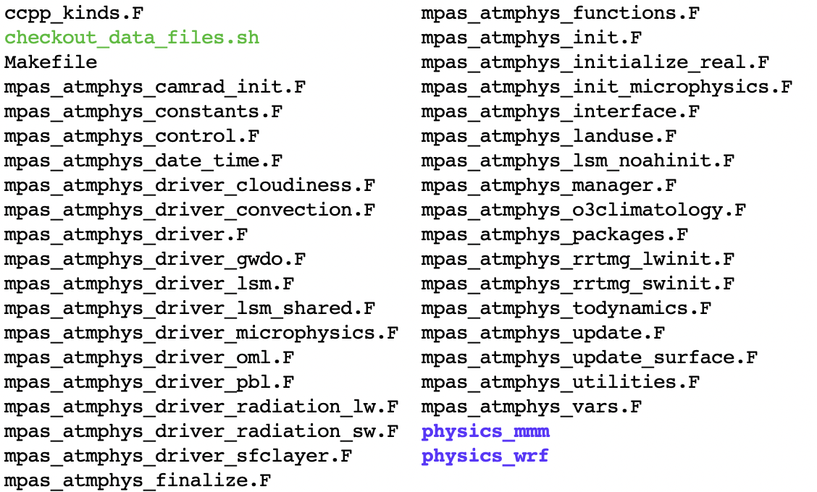
MPAS-Model/src/core_atmosphere/physics/
access to data files
initialization of separate physics process
Physics code in MPAS
/
physics modules
/
drivers for separate physics process
10

Slide 11
MPAS Model Simulation Sequence
Initialize model state, physics
Do timesteps
Physics drivers
All physics see the same model state
Each physics component contributes to state-variable tendencies
Physics are only evaluated once per timestep
Call physics
Do dynamics_split_steps
Do rk3_step = 1, 3
compute large-time-step tendency
Do acoustic_steps
update u rho, theta and w
End acoustic_steps
End rk3_step
End dynamics_split_steps
Do scalar_rk3_step = 1, 3
scalar RK3 transport
End scalar_rk3_step
Call microphysics
Clouds, longwave and shortwave radiation
Surface layer
Land surface
Planetary boundary layer
GWDO driver
Convection
Result – state variable tendencies
Microphysics directly updates the model state (theta, q).
The heating (θ) tendency from the microphysics is also used in the dynamics.
End timesteps

Slide 12
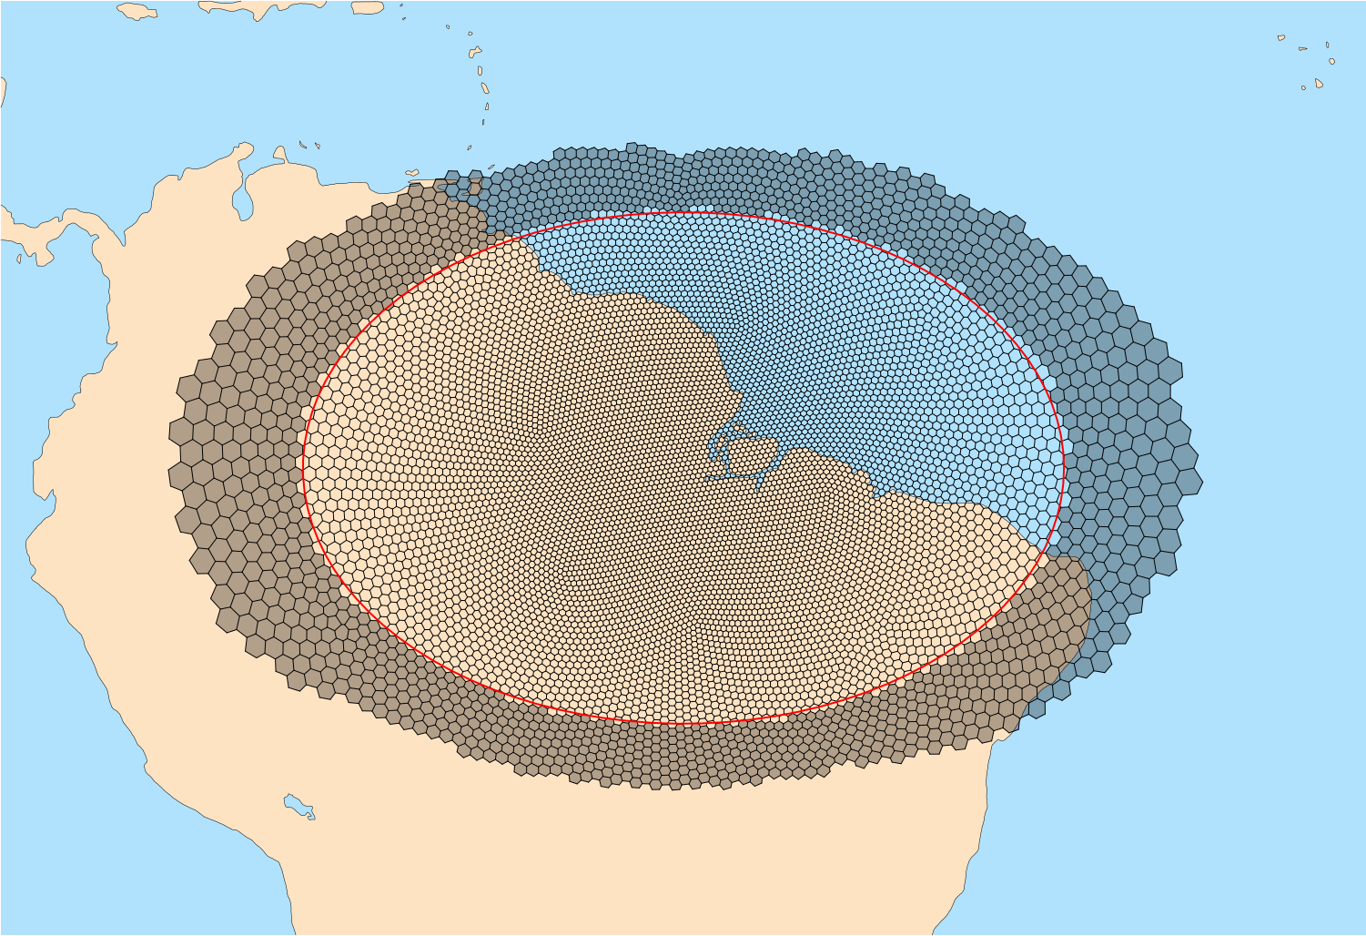
Scale-Aware Convection Schemes
For variable resolution applications with mesh sizes ranging from mesoscale to cloud-permitting scale, we need to consider physics that is ‘scale-aware’.
global
regional

Slide 13

Cumulus Convection Processes
A convective or cumulus scheme parameterizes convective transport of heat and moisture and its effect on grid scale.
Includes both deep and shallow convection.
A scheme needs to determine where and when convection occurs and how strong it is.
Cloud species can be detrained to grid scale.
All CPS schemes in MPAS are mass-flux type. Some schemes consider momentum transport. Some are scale-aware.
Link to cloud parameterization
Compensating subsidence
Entrainment/Detrainment
Type of convection shallow/deep
Cloud base mass flux - Closure
Downdrafts
precipitation
(From ECMWF)

Slide 14
Scale-Aware Convection Schemes
Energy-containing deep convective updraft scale
Energy
“ l ”
Convective energy spectrum
in cloud scales
Scale of
motions
30 km
3 km
300 m
Δ >> l
Δ << l
Convective Grey Zone
CPS
Resolved
A schematic showing the energy spectrum in a horizontal plane as a function of model grid distance.

Slide 15
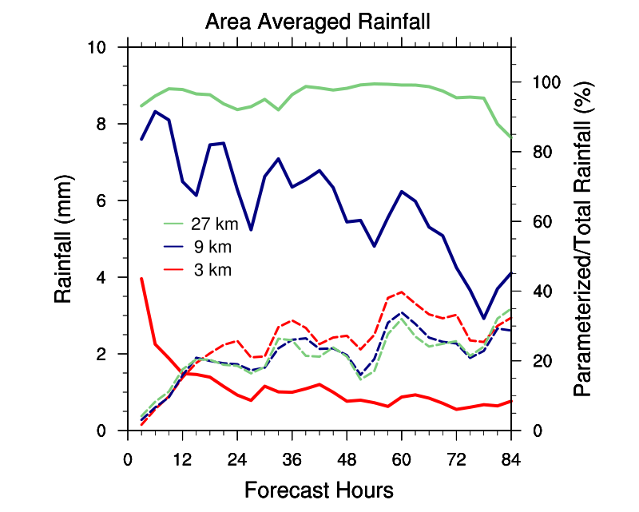
Scale-Aware Convection Schemes
Hurricane Harvey simulations at 27, 9 and 3 km with WRF
The convective portion of the rainfall decreases as the grid size decreases from 27 km (green) to 3 km (red)
Solid lines: ratios
Dashed: 3 hrly rainfall

Slide 16
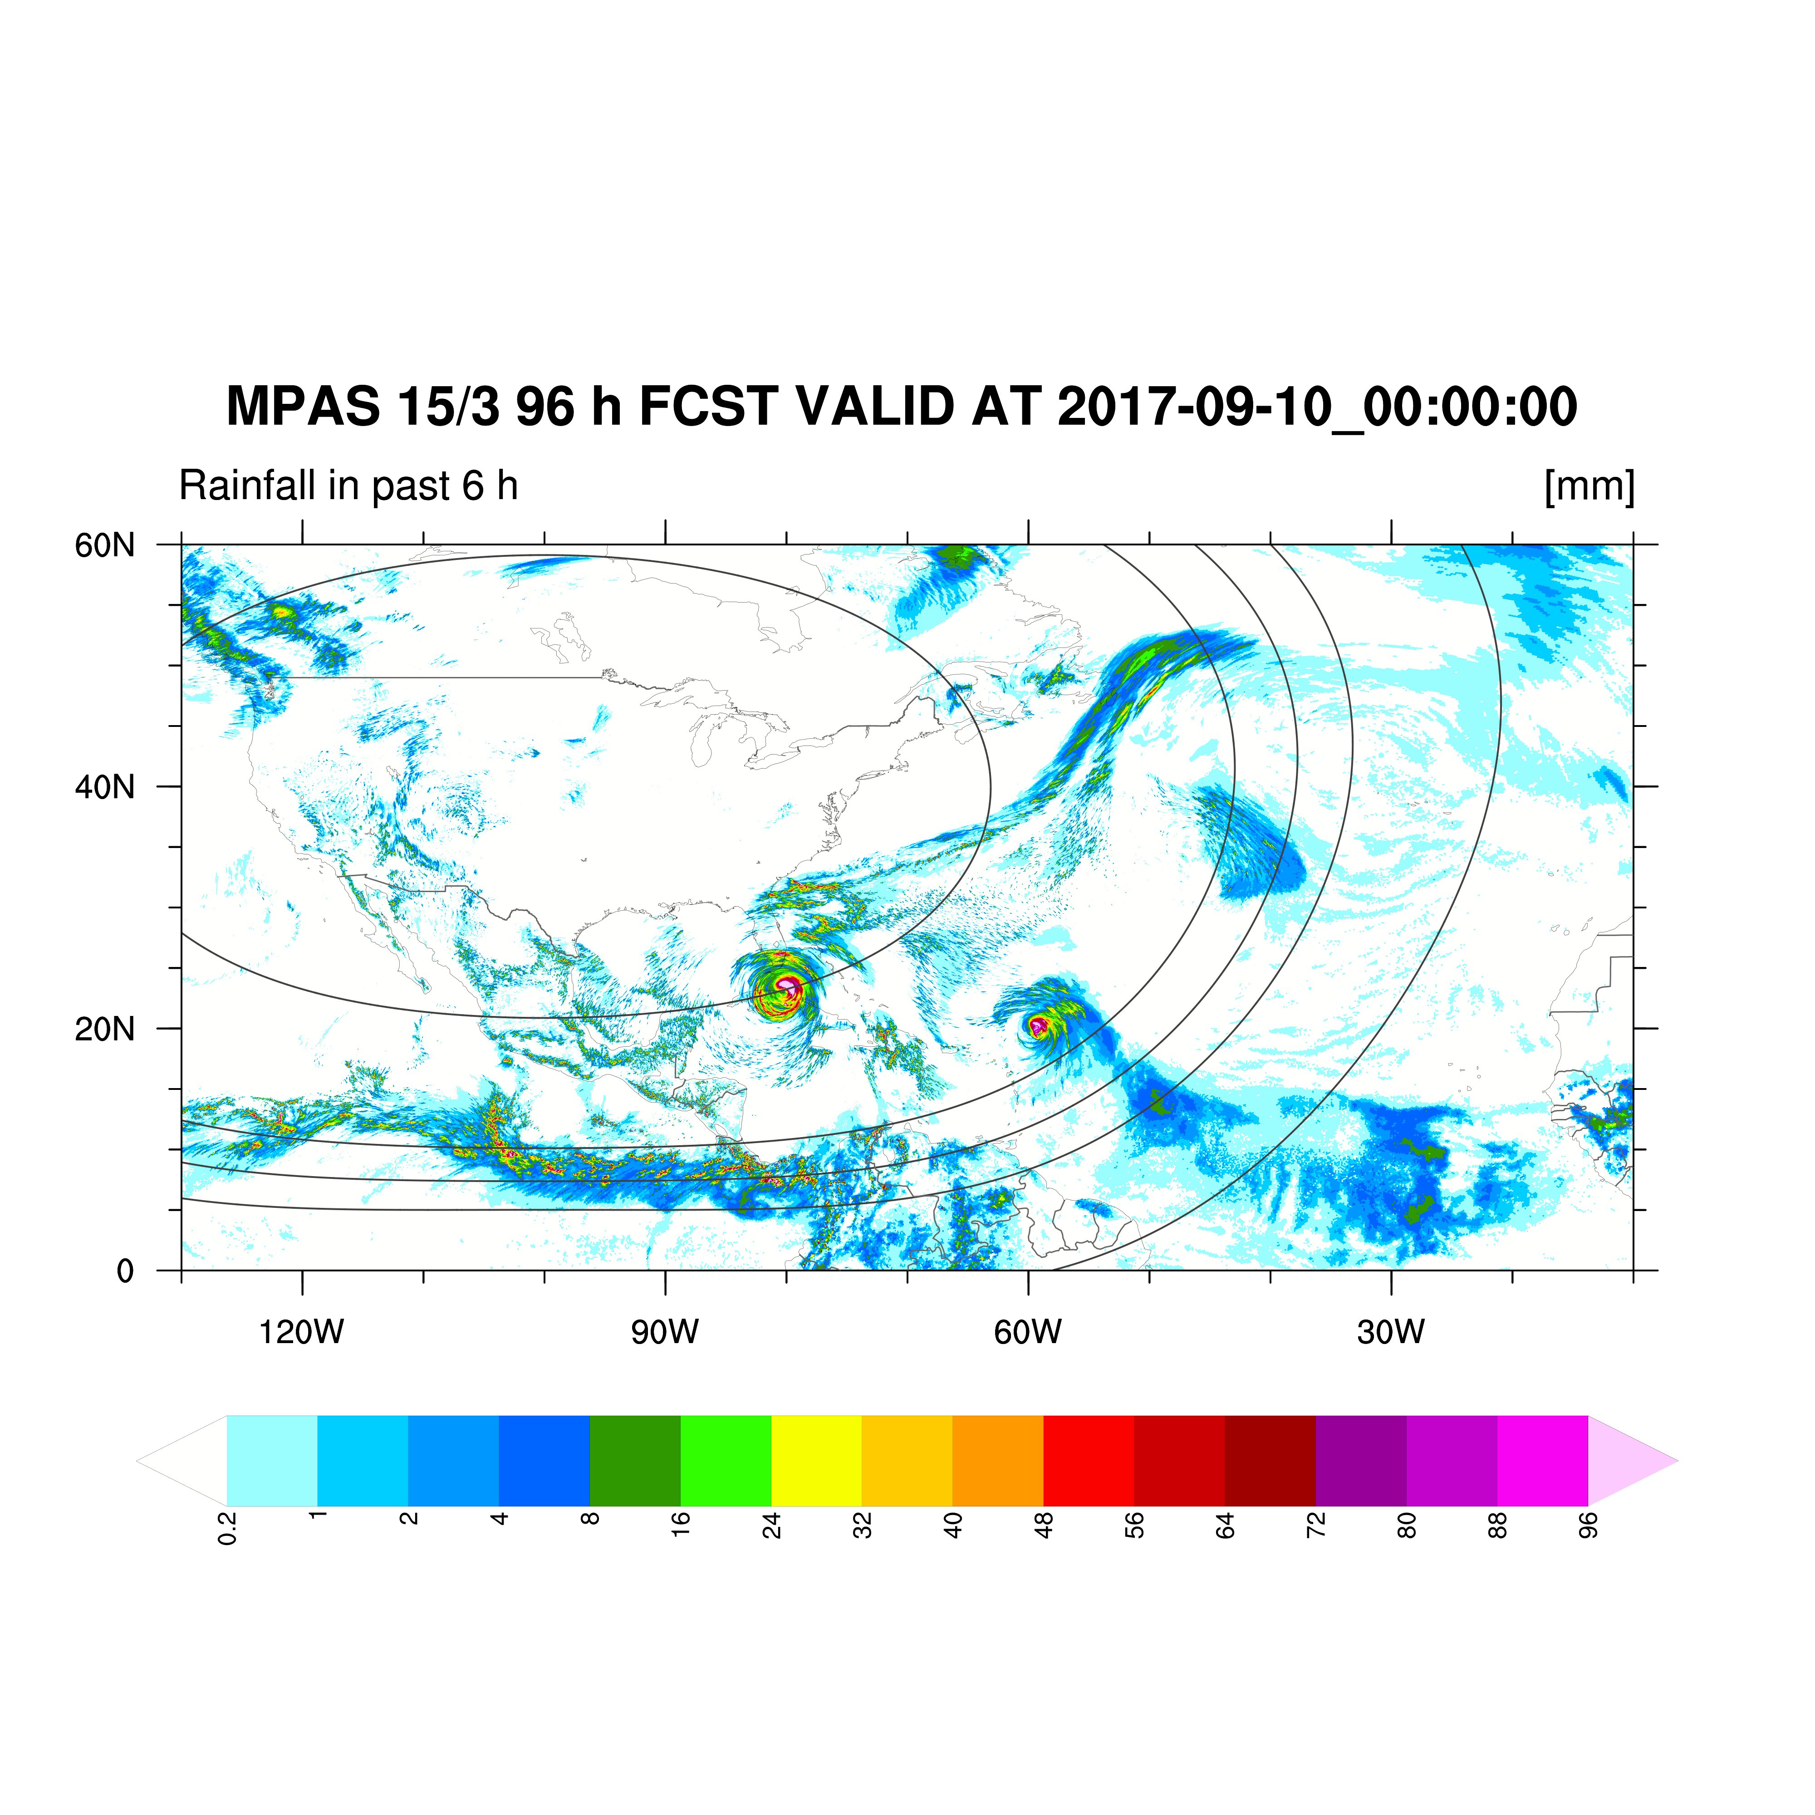
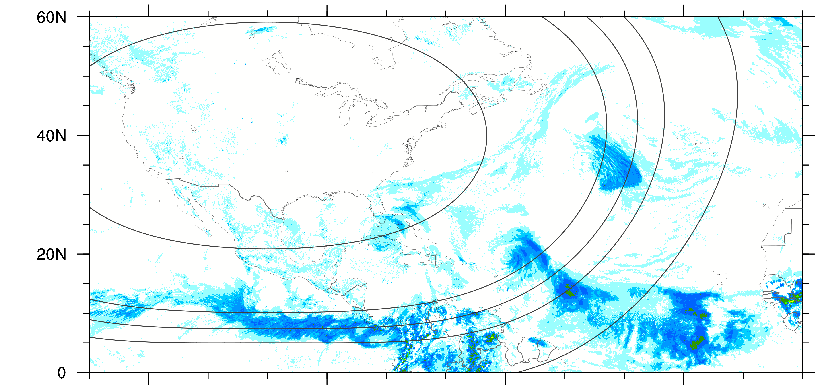
Simulation of Hurricane Irma with a 15-3 km Mesh
Total Rainfall
6
9
12
15 km
3 km
Convective Rainfall

Slide 17
Summary
MPAS has a fairly complete collection atmospheric and land surface physics, including two “suites”.
It is not difficult to add a new physics – follow the examples of existing physics.
New physics coming into the repository is expected to be CCPP-compliant (CCPP: Common Community Physics Package).
Modeling physics is still very challenging, and improving model physics can improve model simulations.
For references to various physics schemes and detailed physics talks:
1. https://www2.mmm.ucar.edu/wrf/users/physics/phys_references.html
2. https://www2.mmm.ucar.edu/wrf/users/tutorial/tutorial.html
The authoritative list of physics is in the MPAS-A Users’ Guide.

