Slide 1



Based on unstructured centroidal Voronoi (hexagonal) meshes using C-grid staggering and selective grid refinement.
Collaboratively developed, primarily by NCAR and LANL/DOE
MPAS infrastructure - NCAR, LANL, others.
MPAS - Atmosphere (NCAR)
MPAS - Ocean (LANL)
MPAS – Land and Sea Ice, etc. (LANL and others)

Slide 2
Welcome to the MPAS Tutorial
Monday, 12 August
08:30-09:00 Registration
09:00-09:30 Overview of the MONAN program (A)
09:30-10:00 Opening Remarks by the host Institution (A)
10:00-10:20 MPAS Overview (A)
10:20-10:30 Break
10:30-10:50 Downloading and compiling MPAS-Atmosphere (A)
10:50-11:35 Dynamics and dynamics configuration (A)
11:35-12:05 Physics and physics configuration (A)
12:05-13:30 Lunch
13:30-14:25 Running MPAS, part 1: Initialization and running a basic global simulation (A)
14:25-14:55 Running MPAS, part 2: Variable-resolution, I/O streams, restarts, and other options (A)
14:55-15:05 Introduction to the practical exercises (A)
15:05-16:00 Practical session (TR)
16:00-16:10 Break
16:10-17:00 Practical session (TR)

Slide 3
Welcome to the MPAS Tutorial
Tuesday, 13 August
09:00-09:30 An overview of the structure of MPAS meshes (A)
09:30-10:00 Running MPAS, part 3: Preparing limited-area meshes and LBCs (A)
10:00-10:30 Post-processing and visualizing MPAS-Atmosphere output (A)
10:30-10:40 Break
10:40-11:20 Spatial discretization, filters and transport (A)
11:20-11:40 Unique aspects of MPAS code: Registry, pools, and logging (A)
11:40-12:00 Adding passive tracers to MPAS-Atmosphere simulations (A)
12:00-13:30 Lunch
13:30-14:00 Computing new diagnostic fields in MPAS-Atmosphere simulations (A)
14:00-15:30 Practical session (TR)
15:30-15:40 Break
15:40-17:00 Practical session (TR)

Slide 4
Welcome to the MPAS Tutorial
Wednesday, 14 August
09:00-09:30 MPAS mesh generation (A)
09:30-09:55 New MPAS capabilities under development, and concluding remarks (A)
09:55-10:45 Practical session (TR)
10:45-10:55 Break
10:55-12:00 Practical session (TR)
12:00-13:30 Lunch
13:45-14:10 MONAN 1.0.0 overview and future plans (A)
14:10-14:30 Overview of MONAN implementation (A)
14:30-16:00 MONAN Regional Model Training (TR)
16:00-16:15 Break
16:15-17:00 MONAN Regional Model Training (TR)
17:00-17:10 Registering MONAN workshop group photograph

Slide 5
What is MPAS?
Freely available modeling system
MPAS Version 8.2.1 (7 August 2024)
MPAS infrastructure - NCAR, LANL, others.
Infrastructure for the Voronoi mesh and solvers (data structures; mesh generation, manipulation; operators on the mesh).
MPAS - Atmosphere (NCAR)
Nonhydrostatic atmospheric solver; pre- and post-processors
MPAS - Ocean (LANL)
Hydrostatic ocean solver, pre- and post-processors
MPAS – Albany Land Ice, and Sea ice models (LANL and others)
Land ice and sea-ice models, pre- and post-processors
These are all stand-alone models – there is no coupler in MPAS

Slide 6
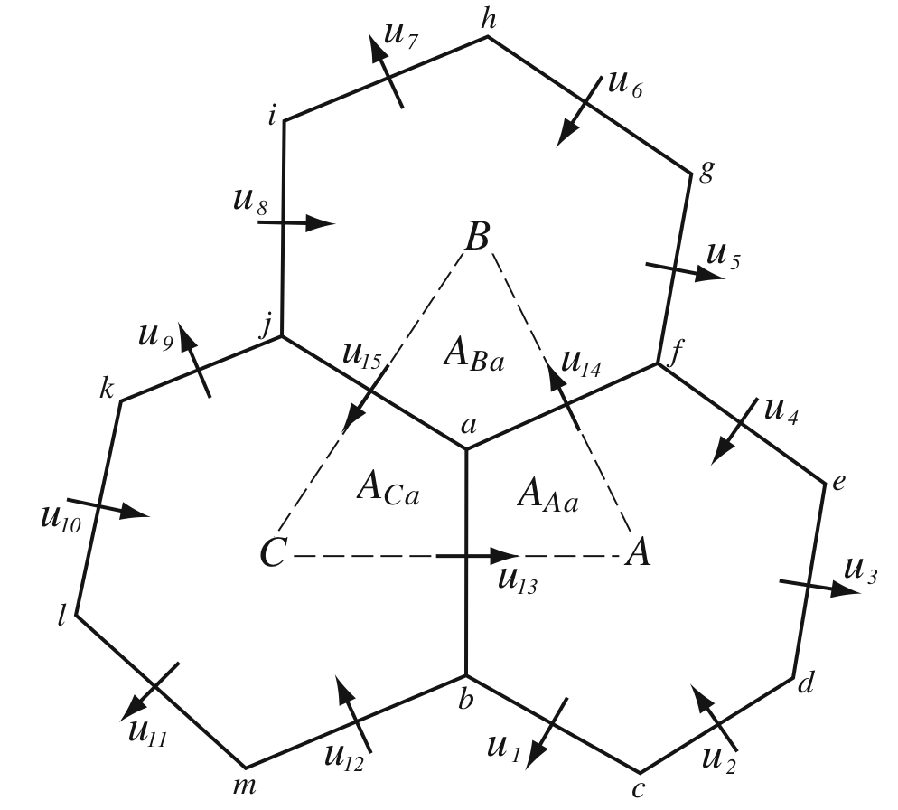
What is MPAS?
Centroidal Voronoi Meshes
Unstructured spherical centroidal Voronoi meshes
Mostly hexagons, some pentagons and 7-sided cells
Cell centers are at cell center-of-mass (centroidal).
Cell edges bisect lines connecting cell centers; perpendicular.
Uniform resolution – traditional icosahedral mesh.
C-grid
Solve for normal velocities on cell edges.
Gradient operators in the horizontal momentum equations are 2nd-order accurate.
Velocity divergence is 2nd-order accurate for edge-centered velocities.
Reconstruction of full velocity requires care.

Slide 7
What is MPAS?
Centroidal Voronoi Meshes
The mesh is structured in the vertical
The 2D (horizontal) mesh is unstructured
there is no global coordinate

Slide 8
MPAS Nonhydrostatic Atmospheric Solver
Fully Compressible Nonhydrostatic Equations
Prognostic equations for coupled variables.
Generalized height coordinate.
Horizontally vector invariant eqn set.
Continuity equation for dry air mass.
Thermodynamic equation for coupled potential temperature.
Time integration as in Advanced Research WRF
Split-explicit Runge-Kutta, with extensions
Full complement of atmospheric-model physics
MPAS-Atmosphere can be configured for both global and regional applications.

Slide 9
Why MPAS?
Significant differences between WRF and MPAS
MPAS
  Unstructured Voronoi
  (hexagonal) grid
    Good scaling on massively parallel computers
    No pole problems
WRF
  Lat-Lon global grid
    Anisotropic grid cells
    Polar filtering required
    Poor scaling on massively parallel computers

Slide 10
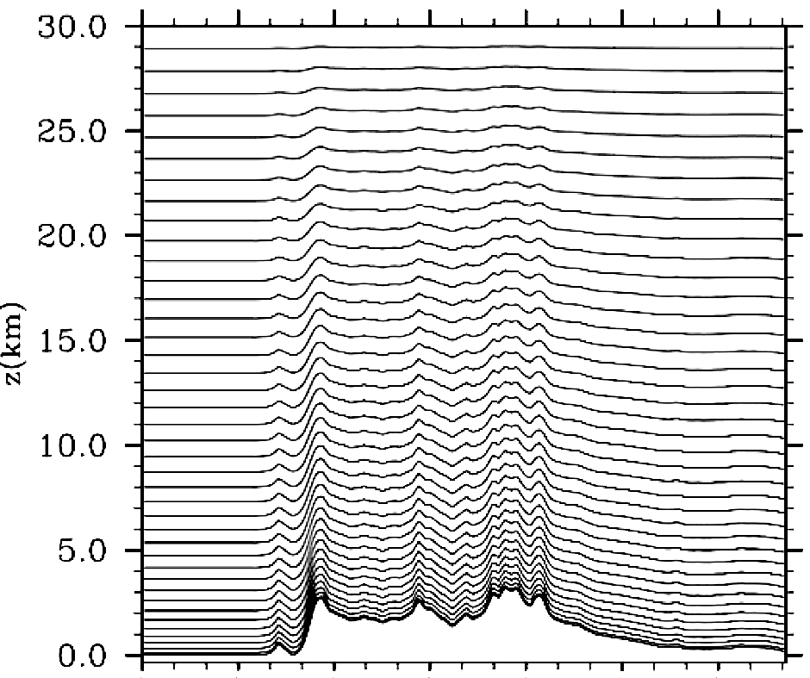
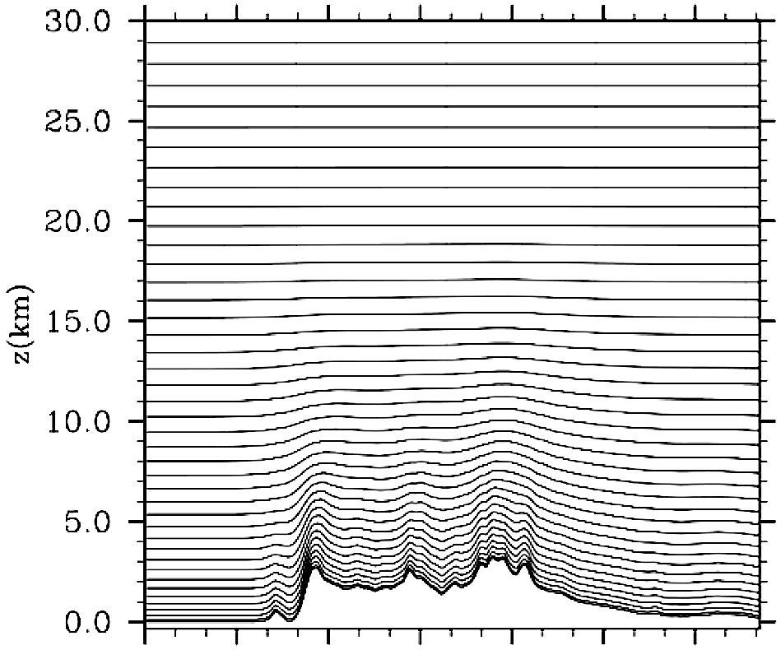
Why MPAS?
Significant differences between WRF and MPAS
WRF
Pressure-based
terrain-following sigma
vertical coordinate
MPAS
Height-based hybrid smoothed terrain-following vertical coordinate

Slide 11
Regional MPAS
Why is there a regional version of MPAS given we have WRF?
Provide a consistent (equations, mesh) regional solver to complement global MPAS.
Allow for more efficient (less costly) testing of MPAS at high resolutions.
Leverage MPAS development for next-generation architectures to regional applications.
Enable regional atmospheric applications within MPAS-enabled coupled modeling systems (e.g. CESM).
Employ variable resolution in regional applications to reduce LBC errors.
We are no longer developing WRF at NCAR, and we would like users to transition to MPAS if their applications allow.

Slide 12
Why MPAS?
Significant differences between WRF and MPAS
MPAS
  Smooth grid refinement
  on a conformal mesh
    Increased accuracy and flexibility for variable resolution applications
    No abrupt mesh transitions.
WRF
  Grid refinement through domain nesting
    Flow distortions at nest boundaries

Slide 13
WRF
MPAS
Urban
meteorology
Regional NWP
Global NWP
Tropical cyclone/
hurricane prediction
LES modeling
Integrated global
/regional NWP
Convection permitting
hazardous weather forecasting
Nested regional
climate modeling
Regional atmospheric chemistry
research
Global atmospheric
chemistry research
Ensemble (EnKf), variational and Hybrid DA
Obs/grid nudging
applications
Global/regional
climate modeling
Idealized simulations
across scales
Fire model
coupling
Regional air-quality
forecasting
Seasonal
prediction

Slide 14
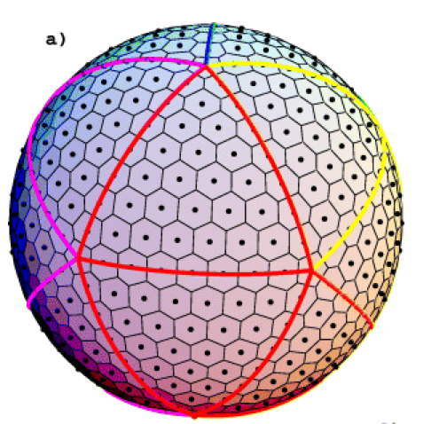
Global Quasi-Uniform Mesh (SCVT)
Many models use an icsoahedral mesh
(NICAM, BUGS, FIM, NIM, OLAM, etc.)

Slide 15
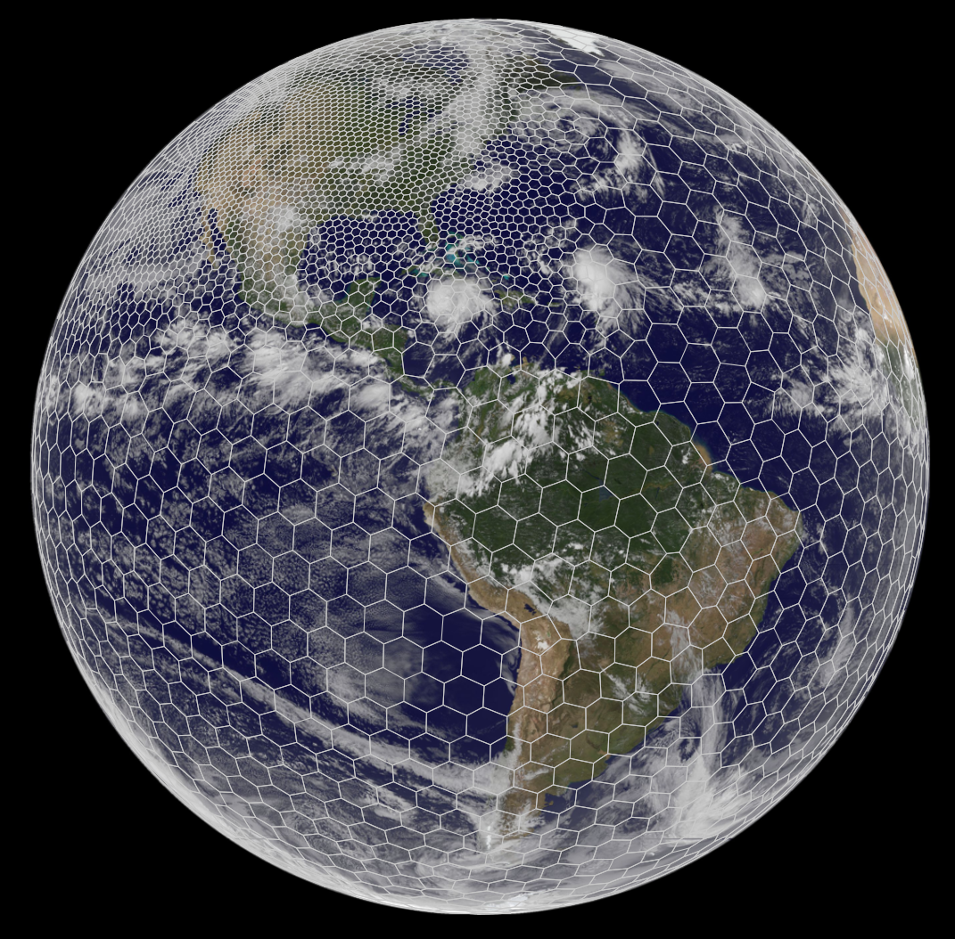
Mesh generation
Lloyd’s method
(iterative)
using a user-supplied density function
North
American refinement

Slide 16
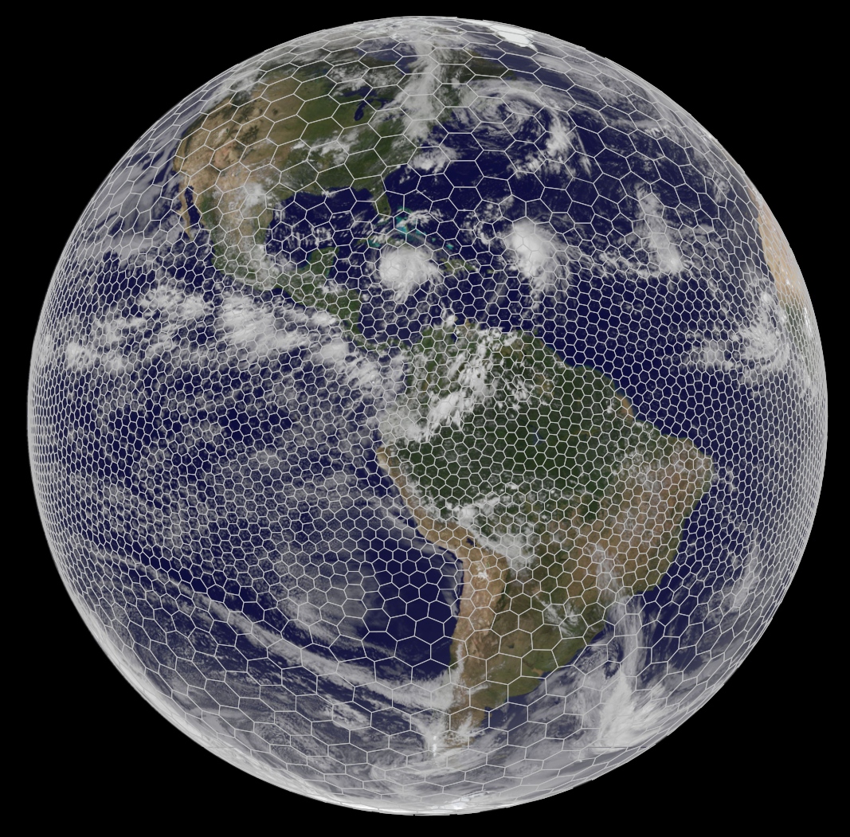
Mesh generation
Lloyd’s method
(iterative)
using a user-supplied density function
Equatorial
refinement

Slide 17
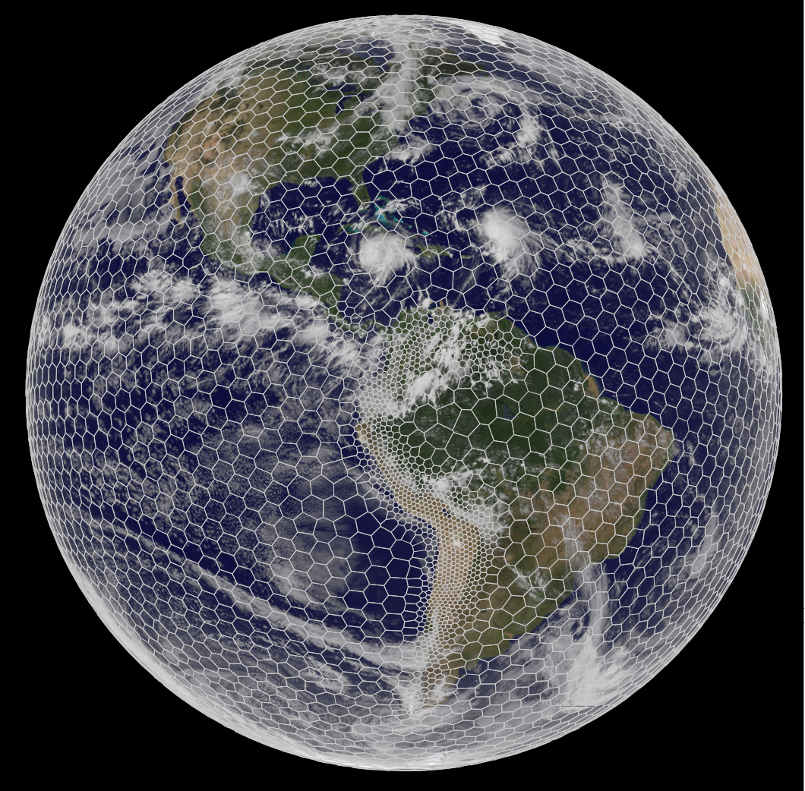
Mesh generation
Lloyd’s method
(iterative)
using a user-supplied density function
Andes
refinement

Slide 18
Other mesh spaces
Doubly-periodic Cartesian mesh

Slide 19
Other mesh spaces
2D (y,z) mesh in MPAS
The solution is periodic in y and does not vary in y

Slide 20
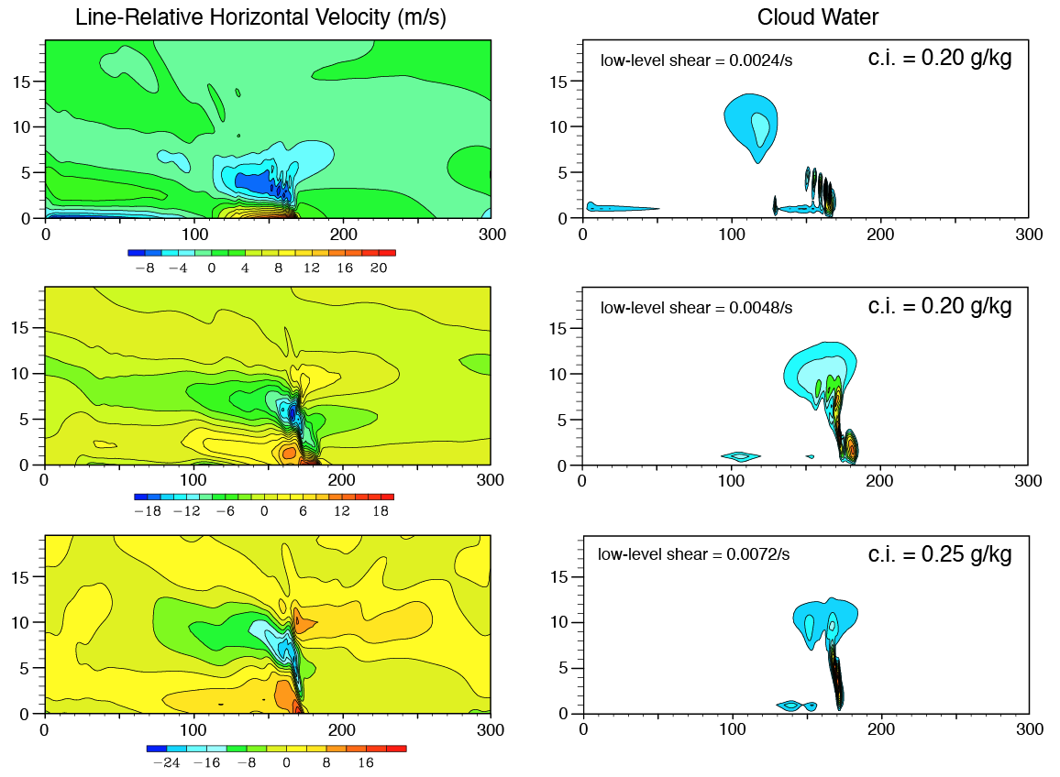
Squall-Line Tests
2D (x,z)
Low-level shear (0-2.5 km),
Weisman-Klemp sounding
Warm-bubble perturbation,
results at 3 hours

Slide 21
Next Up…
Monday, 12 August
08:30-09:00 Registration
09:00-09:30 Overview of the MONAN program (A)
09:30-10:00 Opening Remarks by the host Institution (A)
10:00-10:20 MPAS Overview (A)
10:20-10:30 Break
10:30-10:50 Downloading and compiling MPAS-Atmosphere (A)
10:50-11:35 Dynamics and dynamics configuration (A)
11:35-12:05 Physics and physics configuration (A)
12:05-13:30 Lunch
13:30-14:25 Running MPAS, part 1: Initialization and running a basic global simulation (A)
14:25-14:55 Running MPAS, part 2: Variable-resolution, I/O streams, restarts, and other options (A)
14:55-15:05 Introduction to the practical exercises (A)
15:05-16:00 Practical session (TR)
16:00-16:10 Break
16:10-17:00 Practical session (TR)

