Slide 1
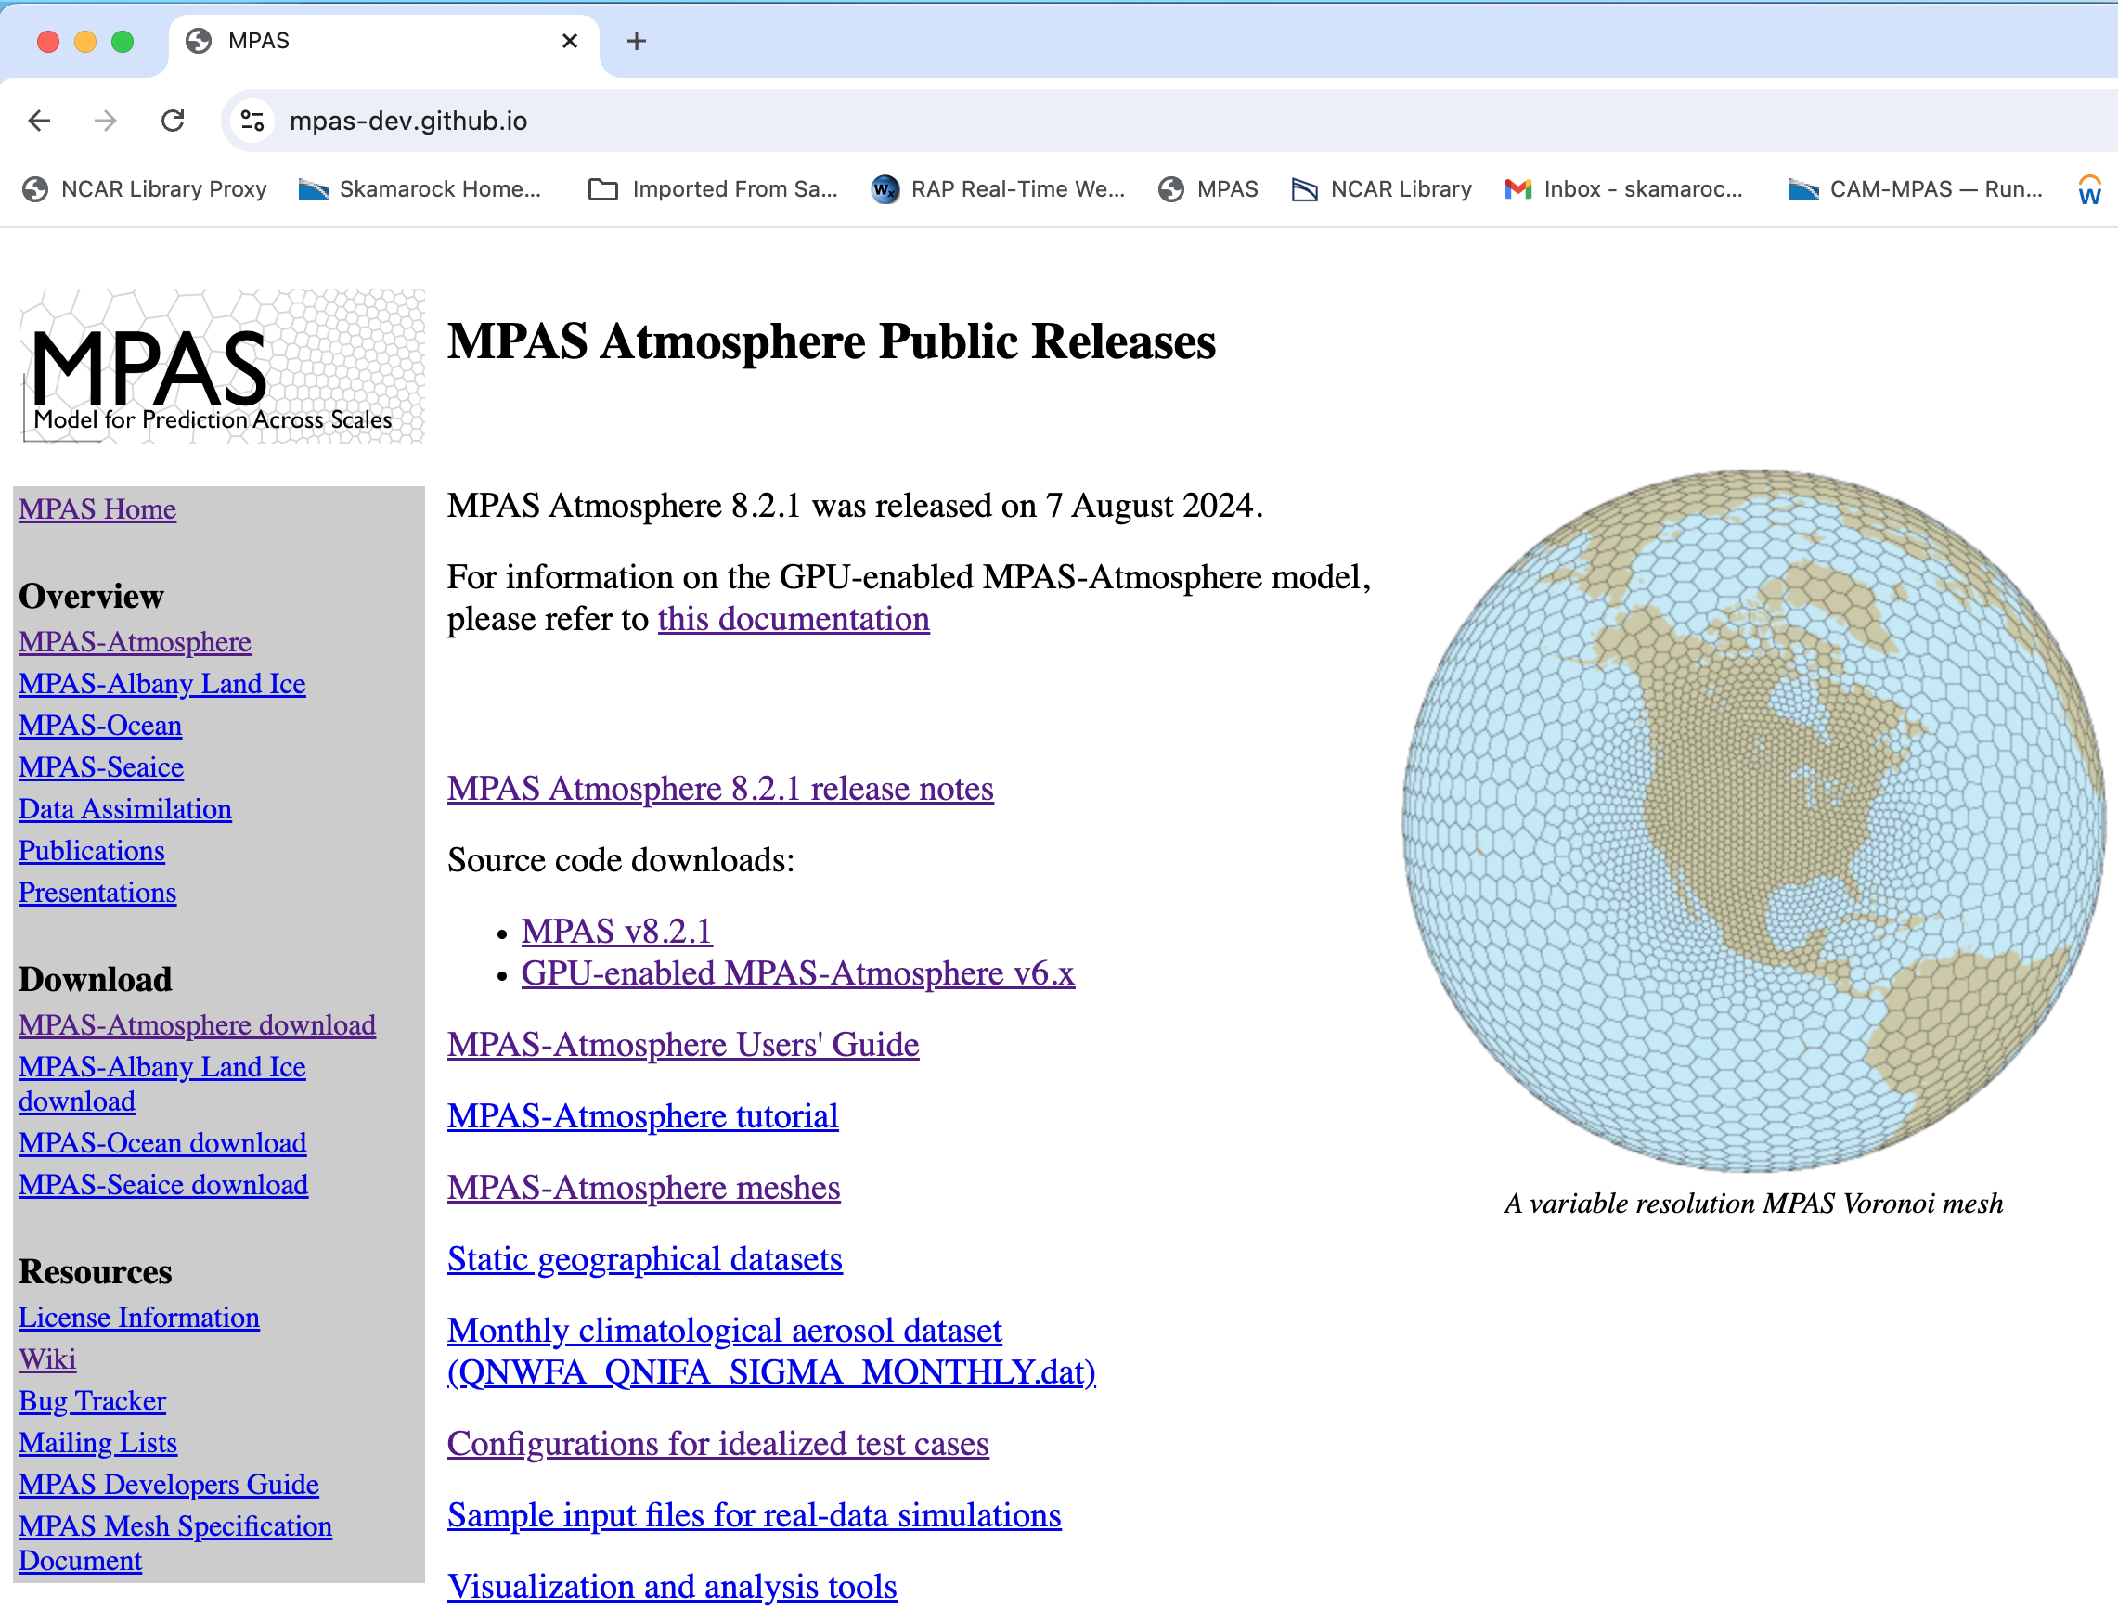
MPAS-Atmosphere
Resources
MPAS-Atmosphere Users’ Guide: On the MPAS-Atmosphere download page

Slide 2
MPAS-Atmosphere
Resources
MPAS-Atmosphere tutorial: On the MPAS-Atmosphere download page

Slide 3
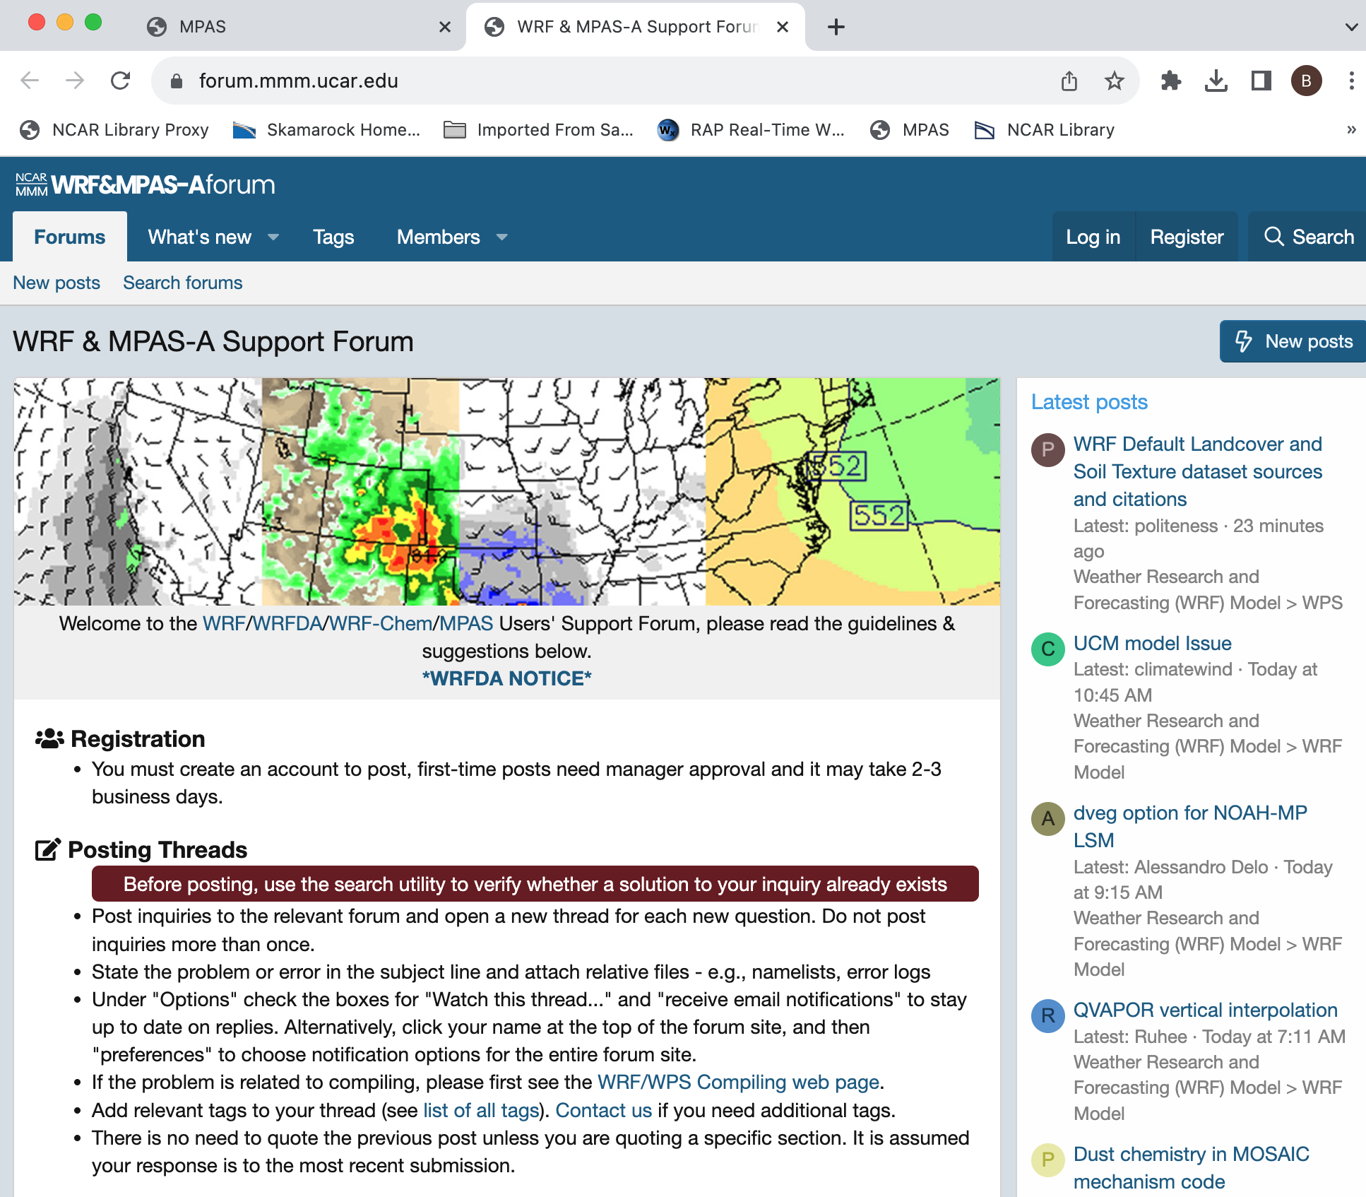
MPAS-Atmosphere
Resources
WRF&MPAS-A Support Forum
You need to create an account to post to it.
Searchable

Slide 4
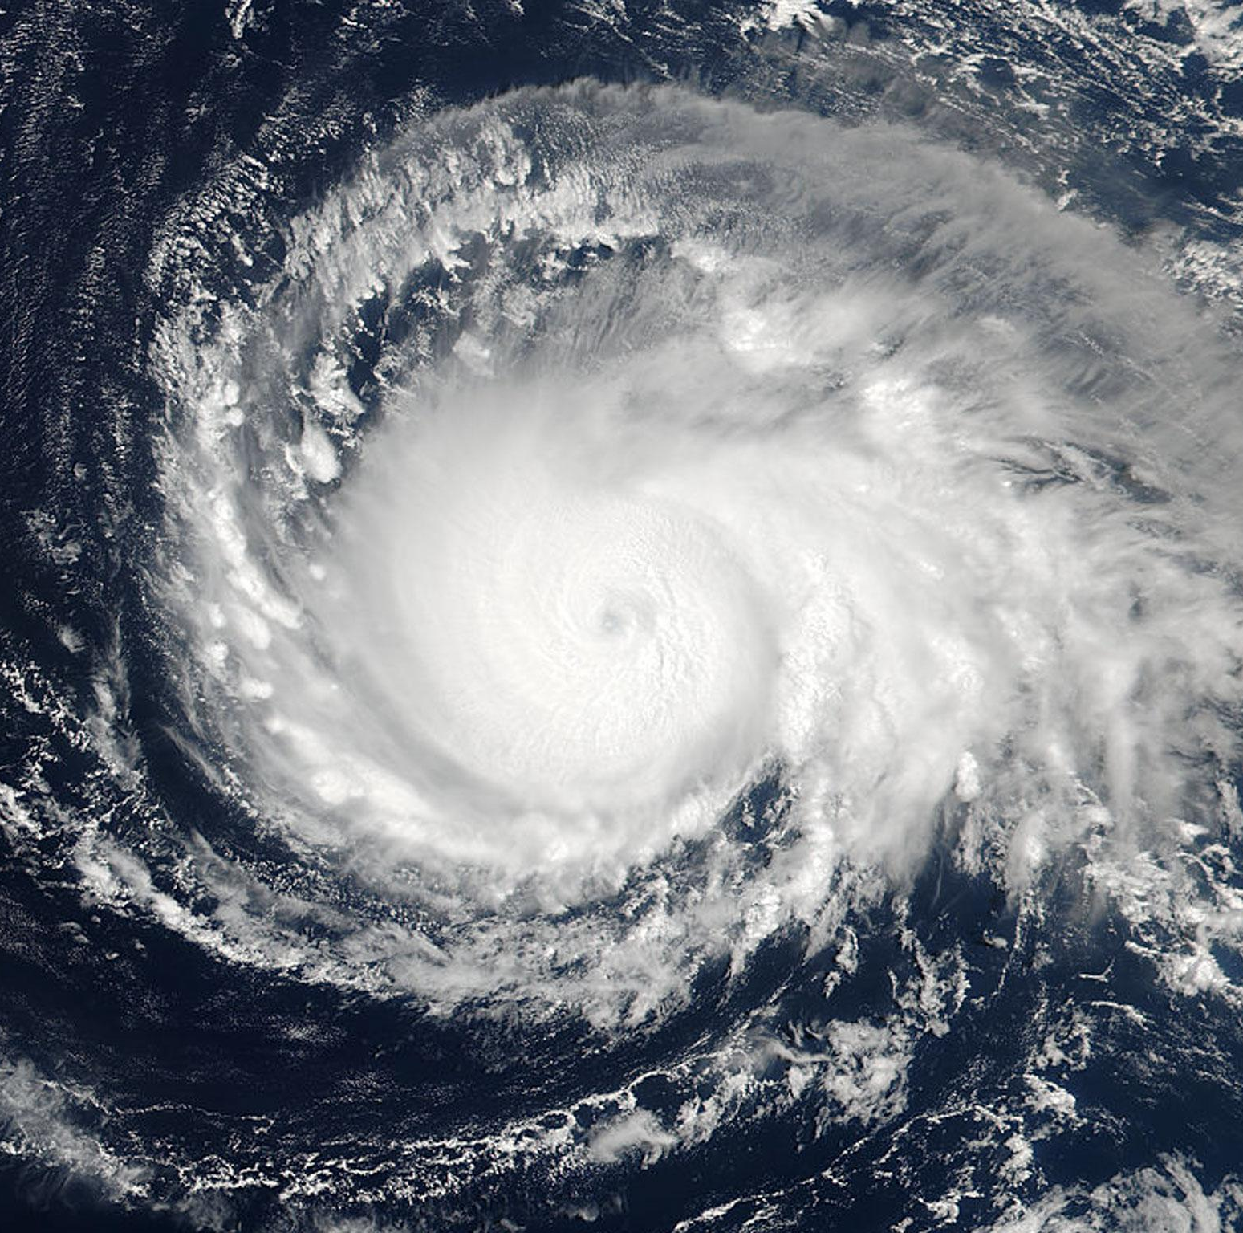
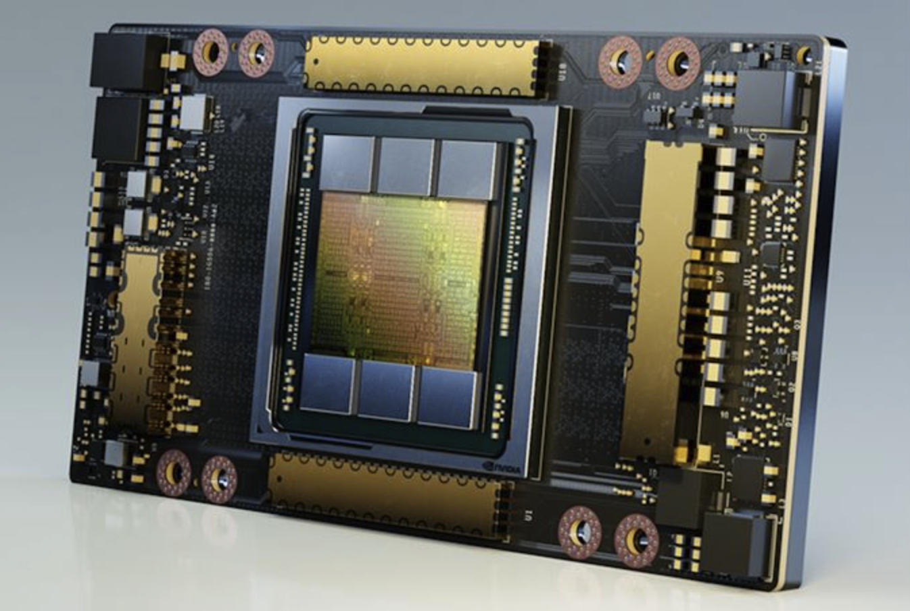
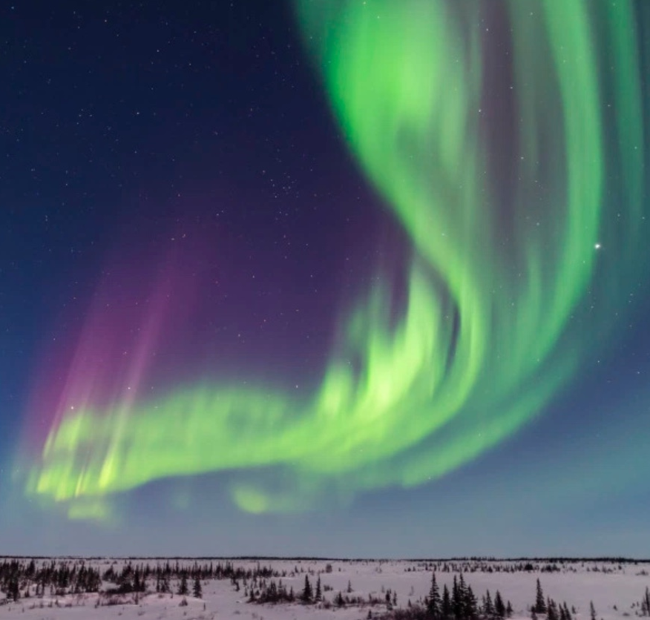
The Model for Prediction Across Scales
Atmosphere
MPAS-Atmosphere and the future
MPAS-A in an Earth System Model
MPAS-A and GPUs
NVIDIA Ampere A100 GPU
SIMA
EarthWorks

Slide 5
System for Integrated Modeling of the Atmosphere (SIMA)
Weather
(1) MPAS-Atmosphere in an Earth System Model (ESM), using CESM components. Other ESM components: ocean, land,
land and sea ice, chemistry
Existing
Applications
Geospace
Climate
Chemistry
(2) WRF/MPAS physics in an ESM using the Common Community Physics Package (CCPP) interface.
Common Community Physics Package
Host Model
Physics scheme 1
Metadata
(developer responsibility)
Status:
MPAS-A in CESM is being tested.
Only CESM/CAM physics will be available in a first release.
CCPP implementation in MPAS and CESM is not yet complete.
Initial release (experimental) TBD.
Host Model
Interface
Physics scheme 2
Metadata
(developer responsibility)
Host Model Metadata
Automatically generated code
Physics scheme 3
Metadata
(developer responsibility)
Physics scheme 1
Physics scheme 2
Physics scheme 3

Slide 6
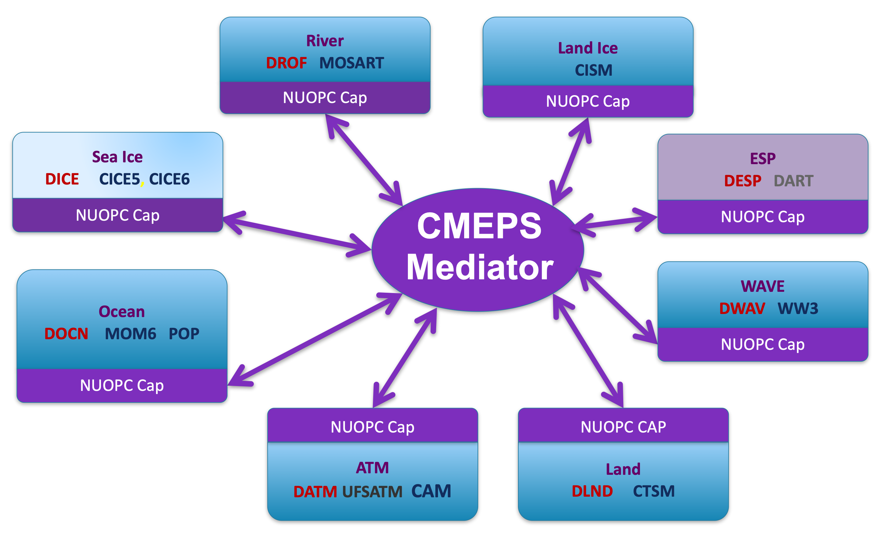
EarthWorks
EarthWorks is a five-year university-based project (CSU), supported by NSF/CISE, to develop a global convection-permitting coupled model based on the CESM with GPU capability for all components.
Earthworks consists of:
The MPAS non-hydrostatic dynamical core, with a resolved stratosphere and CAM-ish physics
The MPAS ocean model, developed at Los Alamos
The MPAS sea ice model, based on CICE
The Community Land Model (CLM)
The Community Mediator for Earth Prediction Systems (CMEPS)

Slide 7
EarthWorks
EarthWorks is available now in a first “functional” release: git clone https://github.com/EarthWorksOrg/EarthWorks.git
Earthworks consists of:
The MPAS non-hydrostatic dynamical core, with a resolved stratosphere and CAM-ish physics
The MPAS ocean model, developed at Los Alamos
The MPAS sea ice model, based on CICE
The Community Land Model (CLM)
The Community Mediator for Earth Prediction Systems (CMEPS)

Slide 8
MPAS and GPUs
We released the GPU-enabled MPAS-Atmosphere in October 2020 as a branch from MPAS Version 6.1. We have a Version 7 update but it has not been released.
NVIDIA Ampere A100 GPU
What is in current (2020) release:
GPU-enabled MPAS dynamical core using OpenACC directives.
Some GPU-enabled physics (e.g. YSU, WSM6, M-O, scale-aware nTiedtke)
Asynchronous execution capability on heterogenous architectures - currently radiation (lagged) and NOAH land model on CPUs, all else on GPUs
Configurations tested and validated on IBM POWER9 architectures and on AMD architectures employing NVIDIA V100 and A100 GPUs.

Slide 9
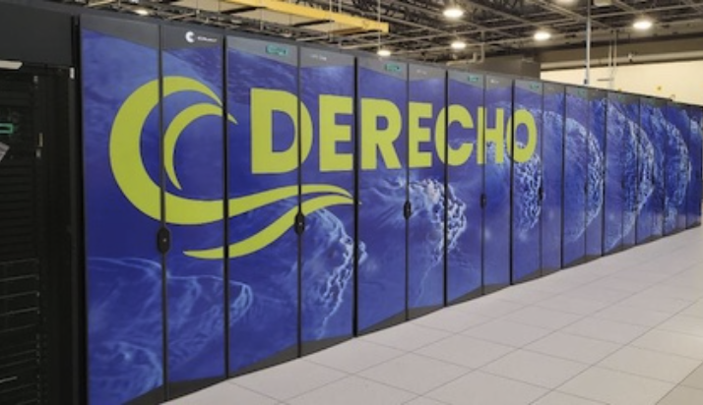
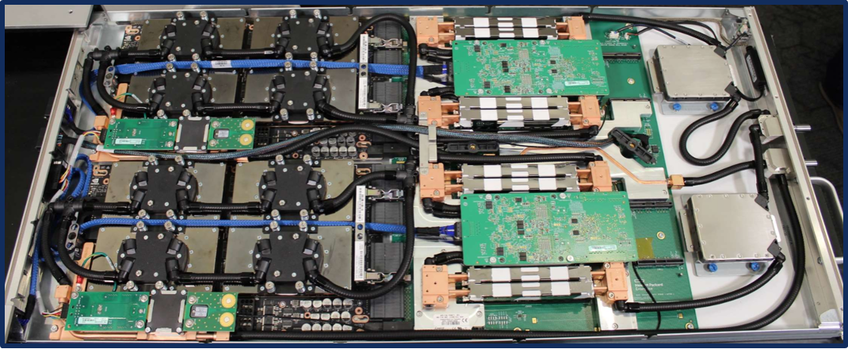
MPAS-Atmosphere Upcoming Releases
MPAS-Atmosphere GPU Implementation
GPU implementation for MPAS-Atmosphere
https://mpas-dev.github.io/atmosphere/OpenACC/index.html
Based on our experience with this release, we are re-implementing this capability
Initial (partial) GPU capability has been released and in MPAS v8.2.0
Subsequent MPAS-A releases will incrementally extend GPU capabilities in the dynamical core and physics.
Demonstrates commitment to MPAS-A as a community model designed for next-generation computing systems
Builds on lessons learned from past partnerships with IBM, The Weather Company, the University of Wyoming, and NVIDIA.
Above: A Derecho GPU blade with two GPU nodes, each with 1 AMD EPYC Zen3 “Milan” 64-core processor and 4 NVIDIA A100 Ampere GPUs.

Slide 10
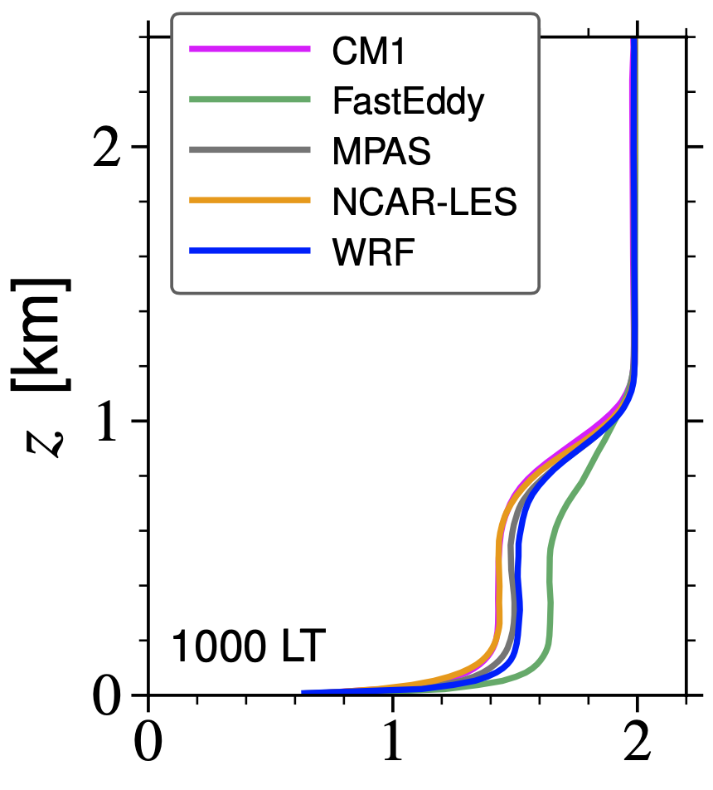
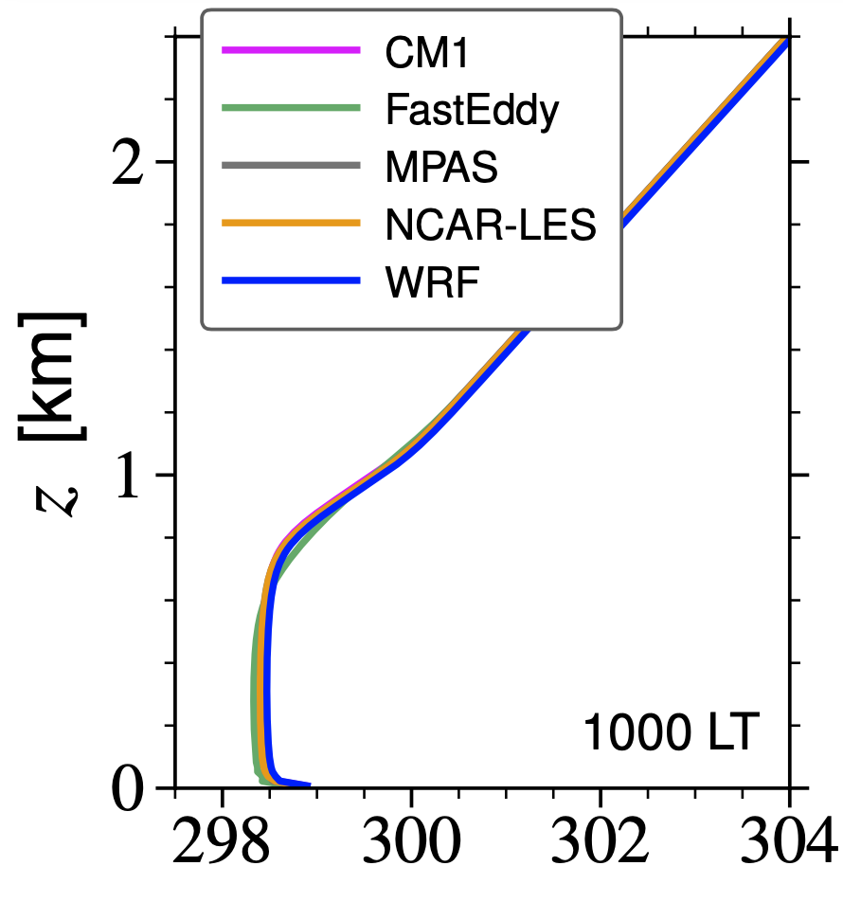
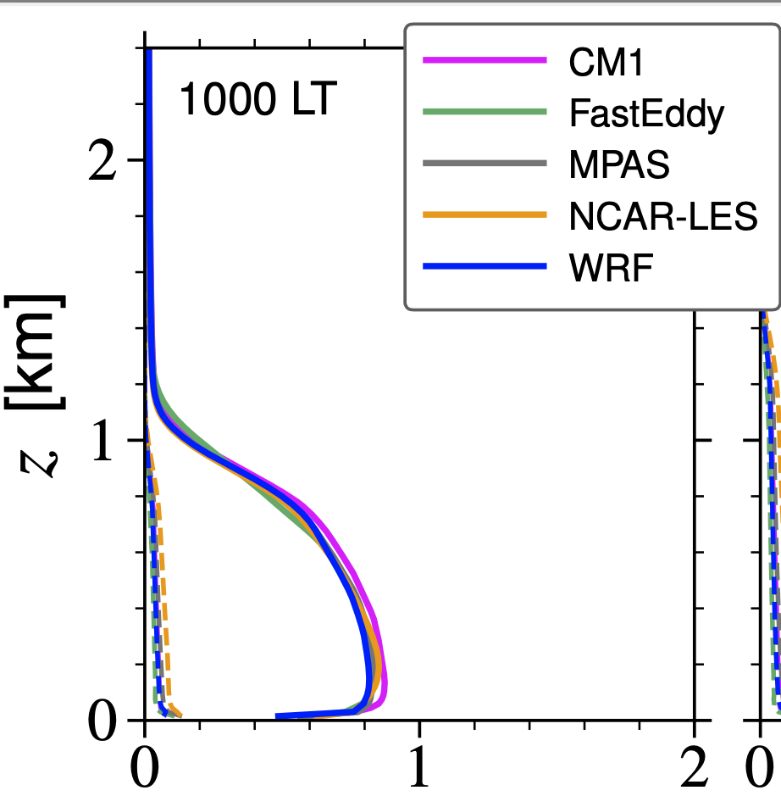
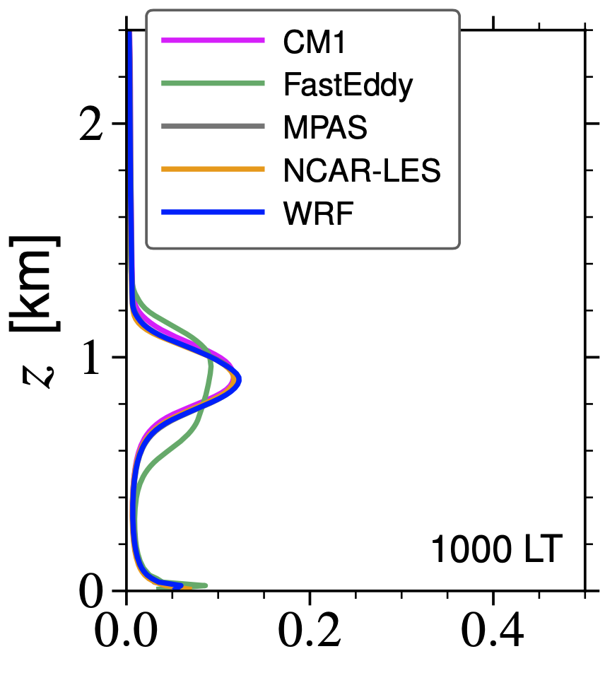
LES capabilities in MPAS
We implemented 2 LES SGS turbulence models in MPAS: 3D Smagorinsky scheme (diagnostic) and a 1.5 order TKE scheme (prognostic).
MPAS LES results look at lot like WRF and CM1 results.
Extensions for terrain need implementing.
Release timetable TBD.
θ
U
TKE
w’θ’
SAS LES test case, NCAR PBL reinvestment project

Slide 11
Also under development…
Scalar transport in physics parameterizations (convection, boundary layer) in preparation for chemistry.
Prognostic ozone
GOCART implementation
Unified (MPAS, WRF, CM1) physics
Mesh generation, global and regional
MPAS-Atmosphere Technical Note
There are ongoing discussions about a full chemistry implementation

Slide 12
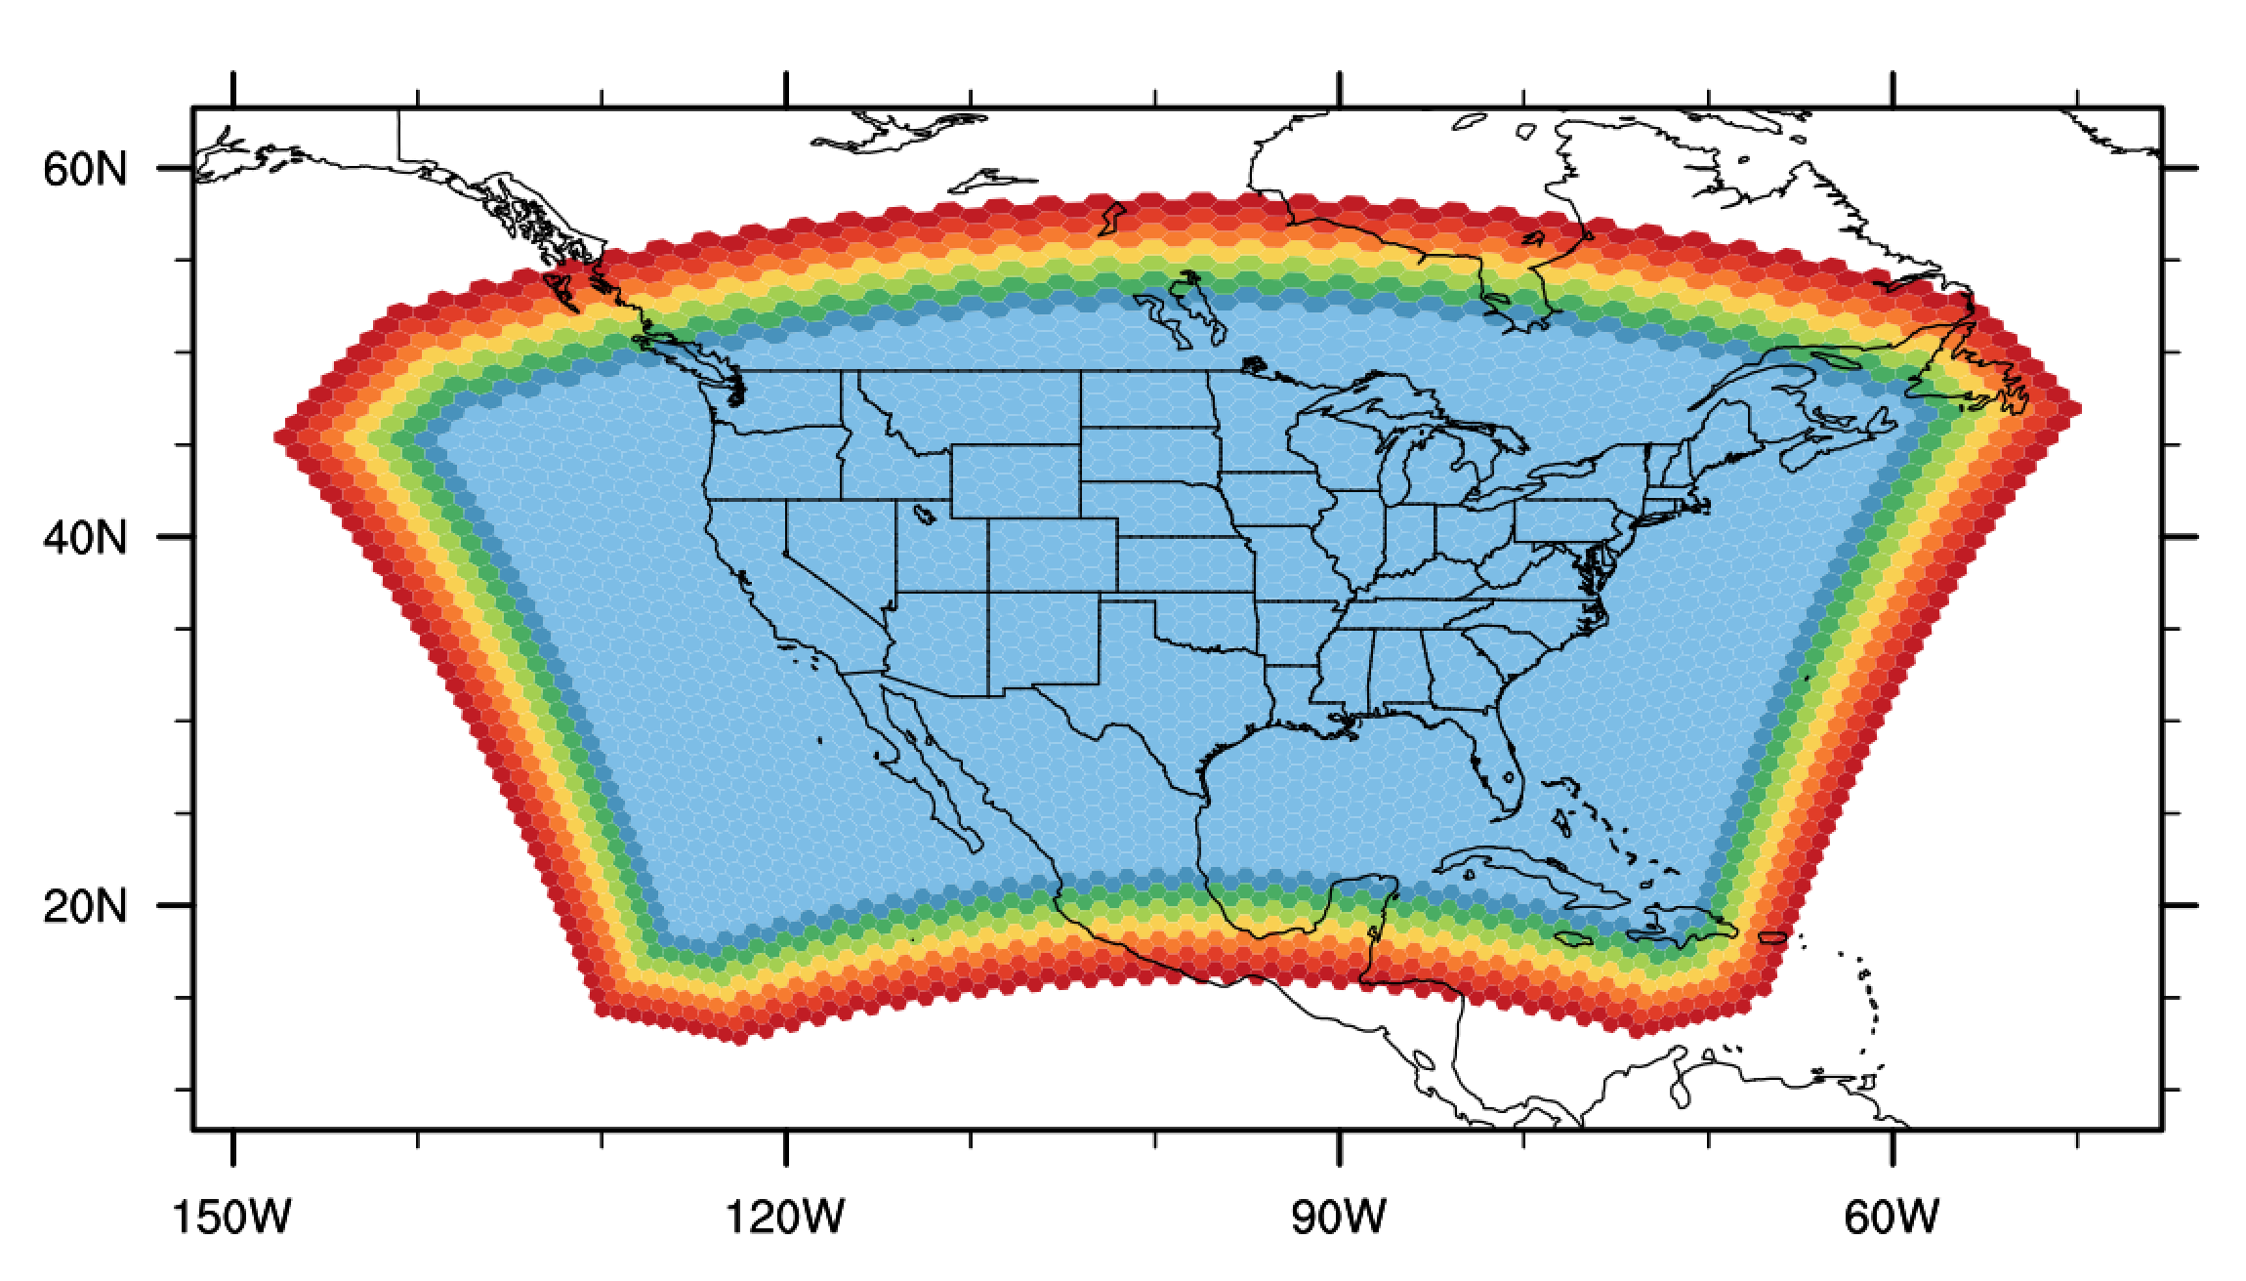
Also under development…
Mesh of perfect hexagons projected to the sphere. Lambert conformal projection
7
6
5
cell mask value
4
3
2
1
0

Slide 13
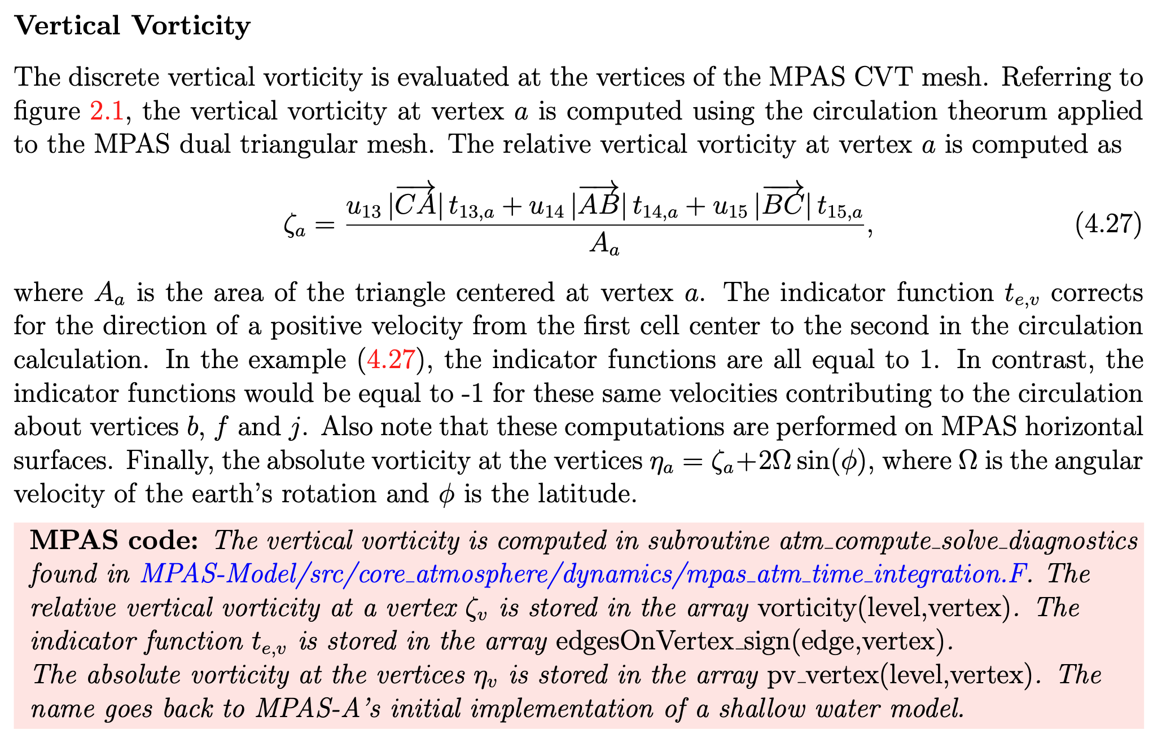
An example from the draft technical note

Slide 14
Coming Events
WRF-MPAS workshop
June 2025 (in person), specific week TBD (likely 2-6 June 2025).
We’ve begun work on an MPAS NCAR Technical Note. Draft – early 2025?
We have two tutorials each year, NH spring (virtual) and NH fall (in person):
September 30 – October 4, Howard University Washington DC.
April or May 2025.
Feature and bug releases occur whenever components are ready.

