Slide 1

Dynamical Core
Time integration
  Algorithms
  Timesteps
  Namelist parameters
  References
  Spatial Discretization for the dynamics

Slide 2



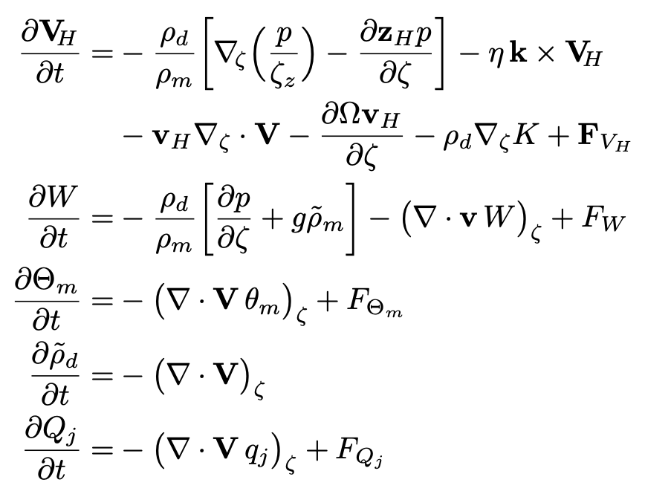

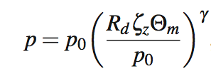

MPAS Nonhydrostatic Atmospheric Solver
Variables:
Equations
Vertical coordinate:
Prognostic equations for coupled variables.
Generalized height coordinate.
Horizontally vector- invariant equation set.
Continuity equation for dry air mass.
Thermodynamic equation for coupled potential temperature.
Prognostic
equations:
Diagnostics
and definitions:

Slide 3
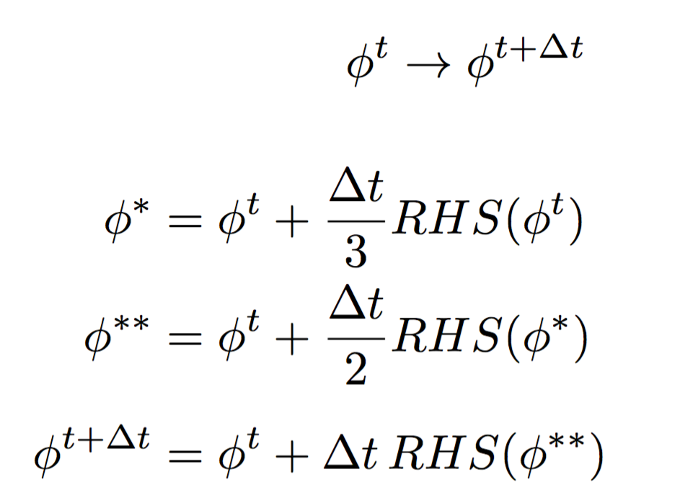
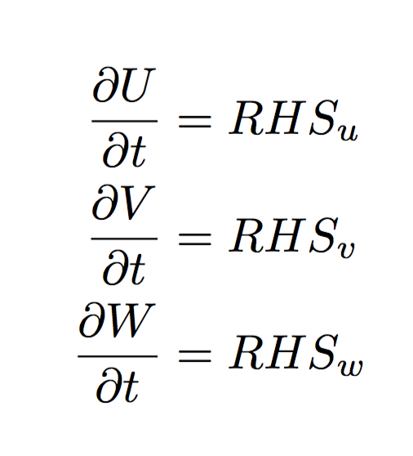
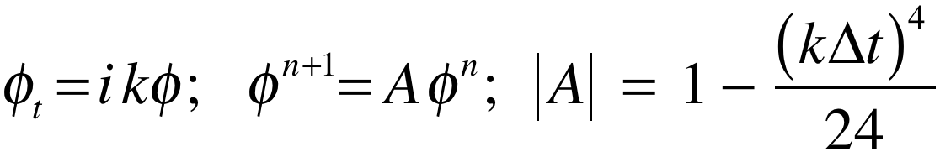
Time Integration
3rd Order Runge-Kutta time integration
Advance one time step
+ H.O.T

Slide 4
Time Integration
2nd-order RK variant – default in MPAS
Advance one time step
2
3
+ H.O.T
12

Slide 5
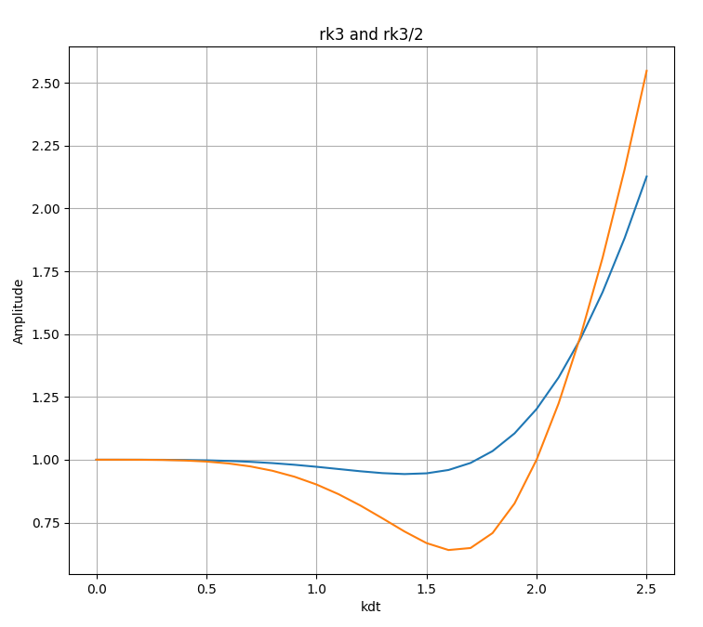
Time Integration
RK32 unstable for kΔt > 2
Exact: |A| = 1
RK3 and RK32
RK3 unstable for kΔt > 1.73
In applications we see little difference in MPAS solutions using RK3 compared to those using RK32

Slide 6
Time Integration: Acoustic Modes
U_{t} = L_{fast}(U) + L_{slow}(U)
3rd order Runge-Kutta, 3 steps
acoustic steps in RK substeps
Split-explicit time integration
fast: acoustic waves and gravity waves.
slow: everything else.
L_{s}(U^{t})
U*
t
t+dt/3
t+dt
L_{s}(U*)
U**
RK3 is 3rd order accurate for linear eqns, 2nd order accurate for nonlinear eqns.
Stable for centered and upwind advection schemes.
Stable for Courant number Udt/dx < 1.73
Three L_{slow}(U) evaluations per timestep.
t
t+dt/2
t+dt
L_{s}(U**)
U^{t+dt}
t
t+dt

Slide 7
Time Integration
Default time integration
Call physics
Do dynamics_split_steps
Do rk3_step = 1, 3
compute large-time-step tendency
Do acoustic_steps
update u
update rho, theta and w
End acoustic_steps
End rk3_step
End dynamics_split_steps
Do scalar_rk3_step = 1, 3
scalar RK3 transport
End scalar_rk3_step
Dynamics are integrated first
(config_split_dynamics_transport = .true.),
typically with multiple Runge-Kutta timesteps (dynamics_split_steps > 1)
Scalar transport is integrated separately, after the dynamics

Slide 8
Time Integration
3rd order Runge-Kutta, 3 steps
Default time integration
Call physics
Do dynamics_split_steps
Do rk3_step = 1, 3
compute large-time-step tendency
Do acoustic_steps
update u
update rho, theta and w
End acoustic_steps
End rk3_step
End dynamics_split_steps
Do scalar_rk3_step = 1, 3
scalar RK3 transport
End scalar_rk3_step
L_{s}(U^{t})
U*
t
t+dt/3
t+dt
L_{s}(U*)
U**
t
t+dt/2
t+dt
L_{s}(U**)
U^{t+dt}
t
t+dt

Slide 9
Time Integration
3rd order Runge-Kutta, 3 steps
acoustic steps in RK substeps
Default time integration
Call physics
Do dynamics_split_steps
Do rk3_step = 1, 3
compute large-time-step tendency
Do acoustic_steps
update u
update rho, theta and w
End acoustic_steps
End rk3_step
End dynamics_split_steps
Do scalar_rk3_step = 1, 3
scalar RK3 transport
End scalar_rk3_step
L_{s}(U^{t})
U*
t
t+dt/3
t+dt
L_{s}(U*)
U**
t
t+dt/2
t+dt
L_{s}(U**)
U^{t+dt}
t
t+dt

Slide 10
Time Integration
3rd order Runge-Kutta, 3 steps
acoustic steps in RK substeps
Default time integration
Call physics
Do dynamics_split_steps
Do rk3_step = 1, 3
compute large-time-step tendency
Do acoustic_steps
update u
update rho, theta and w
End acoustic_steps
End rk3_step
End dynamics_split_steps
Do scalar_rk3_step = 1, 3
scalar RK3 transport
End scalar_rk3_step
Forward-Backward acoustic mode time integration:
Explicit integration of the horizontal momentum. There is stability constraint on the acoustic timestep.
Implicit (in time) integration of the vertically-propagating acoustic modes and gravity waves. There is no stability constraint on the timestep. It uses the result from (1).

Slide 11
Time Integration
Default time integration
3rd order Runge-Kutta, 3 steps
Call physics
Do dynamics_split_steps
Do rk3_step = 1, 3
compute large-time-step tendency
Do acoustic_steps
update u
update rho, theta and w
End acoustic_steps
End rk3_step
End dynamics_split_steps
Do scalar_rk3_step = 1, 3
scalar RK3 transport
End scalar_rk3_step
L (Q^{t})
Q*
t
t+dt/3
t+dt
L (Q*)
Q**
t
t+dt/2
t+dt
L (Q**)
Q^{t+dt}
t
t+dt

Slide 12
Time Integration
Default time integration
Call physics
Do dynamics_split_steps
Do rk3_step = 1, 3
compute large-time-step tendency
Do acoustic_steps
update u
update rho, theta and w
End acoustic_steps
End rk3_step
End dynamics_split_steps
Do scalar_rk3_step = 1, 3
scalar RK3 transport
End scalar_rk3_step
Allows for smaller dynamics timesteps relative to scalar transport timestep and the main physics timestep.
We can use any transport scheme here
(we are not limited to RK3)
Scalar transport and physics are the expensive pieces in most applications.

Slide 13
Time Integration
Default time integration
&nhyd_model
config_dt = 90
config_start_time = ”2010-10-23_00:00:00"
config_run_duration = ”5_00:00:00”
config_split_dynamics_transport = true
config_dynamics_split_steps = 3
config_number_of_sub_steps = 2
Call physics
Do dynamics_split_steps
Do rk3_step = 1, 3
compute large-time-step tendency
Do acoustic_steps
update u
update rho, theta and w
End acoustic_steps
End rk3_step
End dynamics_split_steps
Do scalar_rk3_step = 1, 3
scalar RK3 transport
End scalar_rk3_step
Default time integration
In the file “namelist.atmosphere”

Slide 14
Time Integration
Default time integration
&nhyd_model
config_dt = 90
config_start_time = ”2010-10-23_00:00:00"
config_run_duration = ”5_00:00:00”
config_split_dynamics_transport = true
config_dynamics_split_steps = 3
config_number_of_sub_steps = 2
Call physics
Do dynamics_split_steps
Do rk3_step = 1, 3
compute large-time-step tendency
Do acoustic_steps
update u
update rho, theta and w
End acoustic_steps
End rk3_step
End dynamics_split_steps
Do scalar_rk3_step = 1, 3
scalar RK3 transport
End scalar_rk3_step
Default time integration
config_dt
config_dynamics_split_steps
Δt (dynamics) =
Δt (dynamics)
config_number_of_sub_steps
Δt (acoustic) =
Δt (scalar transport) = config_dt

Slide 15
Time Integration
Default configuration summary
config_dynamics_split_steps = 3, config_number_of_sub_steps = 2,
config_time_integration_order = 2
Dynamics timestep
U(t)
U(t+dt_{dyn})
U(t+ 2dt_{dyn})
U(t+3dt_{dyn})
t
t+dt_{dyn}
t+2dt_{dyn}
t+3dt_{dyn}
U(t+ dt_{dyn})
U(t+2dt_{dyn})
t+dt_{dyn}
t+2dt_{dyn}
Scalar transport timestep
Q^{t}
Q^{t+dt}
t
t+dt/2
t+dt

Slide 16
Time Integration
Option: The WRF approach
config_split_dynamics_transport = true/false
config_dynamics_split_steps = 3
config_number_of_sub_steps = 6
(acoustic_steps)
Time integration option in MPAS
Δt (dynamics) = Δt (scalar transport)
Call physics
Do rk3_step = 1, 3
compute large-time-step tendency
Do acoustic_steps
update u
update rho, theta and w
End acoustic_steps
scalar RK3 transport
End rk3_step
= config_dt
Δt (dynamics)
config_number_of_sub_steps
Δt (acoustic) =

Slide 17
Time Integration
Testing the Timestep Configuration
If MPAS integrations become unstable
(producing NaNs) after just a few timesteps, the issue may be the acoustic modes.
Reduce the main timestep (config_dt) and see if the simulations are stable.
If stable with a reduced timestep, try the original timestep with a reduced acoustic timestep: config_number_of_sub_steps > 2 (even integer)
The acoustic and dry dynamics timestep can also be reduced by increasing config_dynamics_split_steps > 3 (can be odd or even)
If none of these work, then the problem is likely not the dynamics. Check the initial conditions.
&nhyd_model
config_dt = 90
Timestep in seconds
Similar to WRF, the model timestep (in seconds) initially should be set to be 6 times the finest nominal mesh spacing in km. For example – 15 km fine-mesh spacing would use a 90 second timestep.
We have found that a larger timestep is often stable.

Slide 18
Time Integration
References
Runge-Kutta scheme:
Wicker, L. J., and W. C. Skamarock, 2002: Time Splitting Methods for Elastic Models
Using Forward Time Schemes. Mon. Wea. Rev., 130, 2088-2097.
https://doi.org/10.1175/1520-0493(2002)130<2088:TSMFEM>2.0.CO;2
Detailed presentation on the acoustic time splitting:
Klemp. J. B., W. C. Skamarock, and J. Dudhia, 2007: Conservative Split-Explicit Time Integration Methods for the Compressible Nonhydrostatic Equations. Mon. Wea. Rev., 135, 2897-2913, doi:10.1175/MWR3440.1
(specifically section 2 and Appendix section (a) which deal with height-coordinate models, i.e. MPAS)

Slide 19
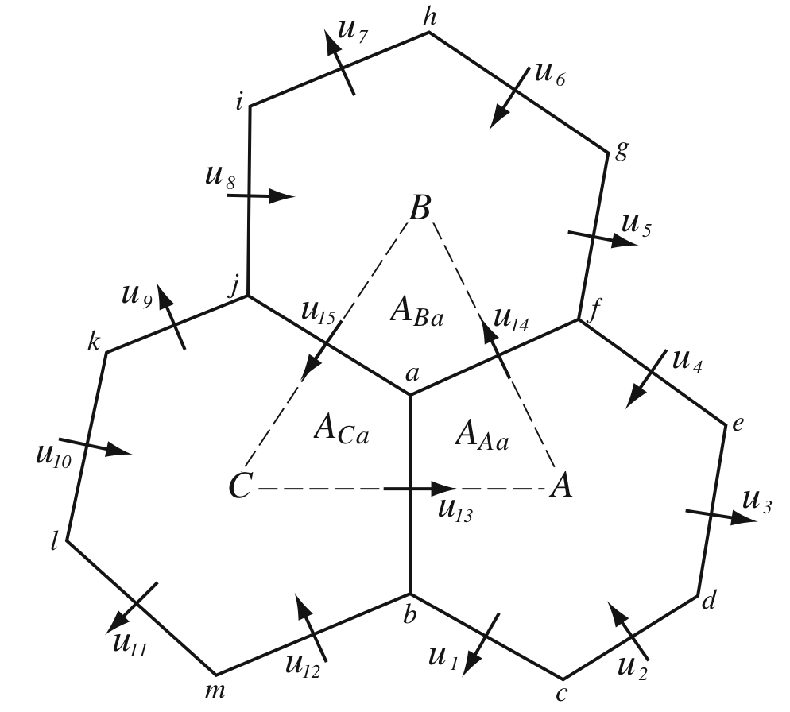
MPAS Horizontal Mesh
Unstructured spherical centroidal Voronoi meshes
Mostly hexagons, some pentagons (5-sided cells) and
heptagons (7-sided cells).
Cell centers are at cell center-of-mass (centroidal).
Cell edges bisect lines connecting cell centers; perpendicular.
C-grid staggering of velocities (velocities are perpendicular to cell faces).
Uniform resolution – traditional icosahedral mesh.

Slide 20
MPAS Nonhydrostatic Atmospheric Solver
Variables:
Equations
Vertical coordinate:
Prognostic equations for coupled variables.
Generalized height coordinate.
Horizontally vector- invariant equation set.
Continuity equation for dry air mass.
Thermodynamic equation for coupled potential temperature.
Prognostic
equations:
Gradient operators
Nonlinear Coriolis term
Diagnostics
and definitions:

Slide 21
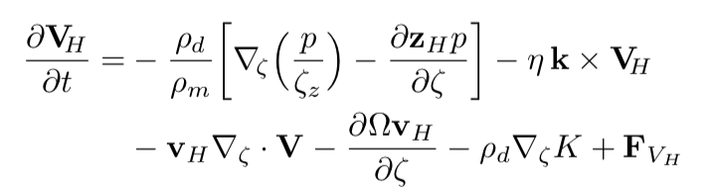
Operators on the Voronoi Mesh
Pressure and KE gradients
On the Voronoi mesh, P₁P₂ is perpendicular to v₁v₂ and is bisected by v₁v₂, hence
P_{x} ~ (P₂-P₁)Δx_{e}⁻¹ is 2nd order accurate.

Slide 22
Operators on the Voronoi Mesh
Pressure and KE gradients
Cell center kinetic energy: KE_{i}
Vertex kinetic energy: KE_{v}

Slide 23
Operators on the Voronoi Mesh
Pressure and KE gradients
Cell center kinetic energy: KE_{i}
Vertex kinetic energy: KE_{v}

Slide 24
Operators on the Voronoi Mesh
Pressure and KE gradients
Cell center kinetic energy: KE_{i}
Vertex kinetic energy: KE_{v}

Slide 25
Operators on the Voronoi Mesh
Pressure and KE gradients
Cell center kinetic energy: KE_{i}
Vertex kinetic energy: KE_{v}

Slide 26
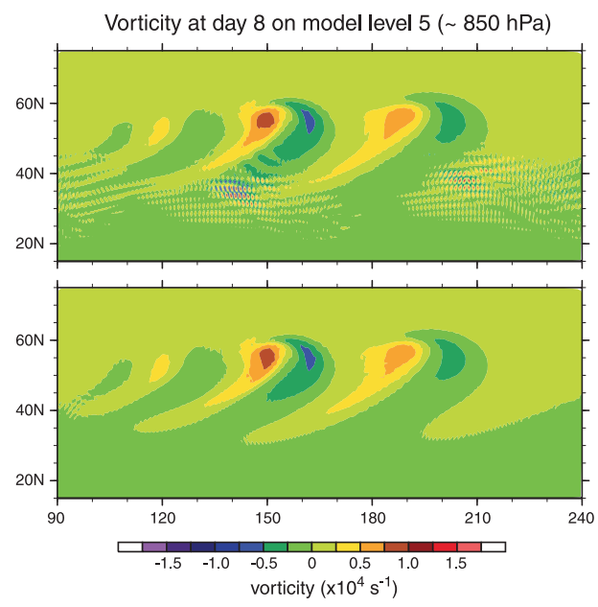
Operators on the Voronoi Mesh
cell-center KE evaluation
β = 0
MPAS uses β = 3/8
β = 3/8

Slide 27
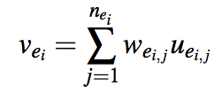
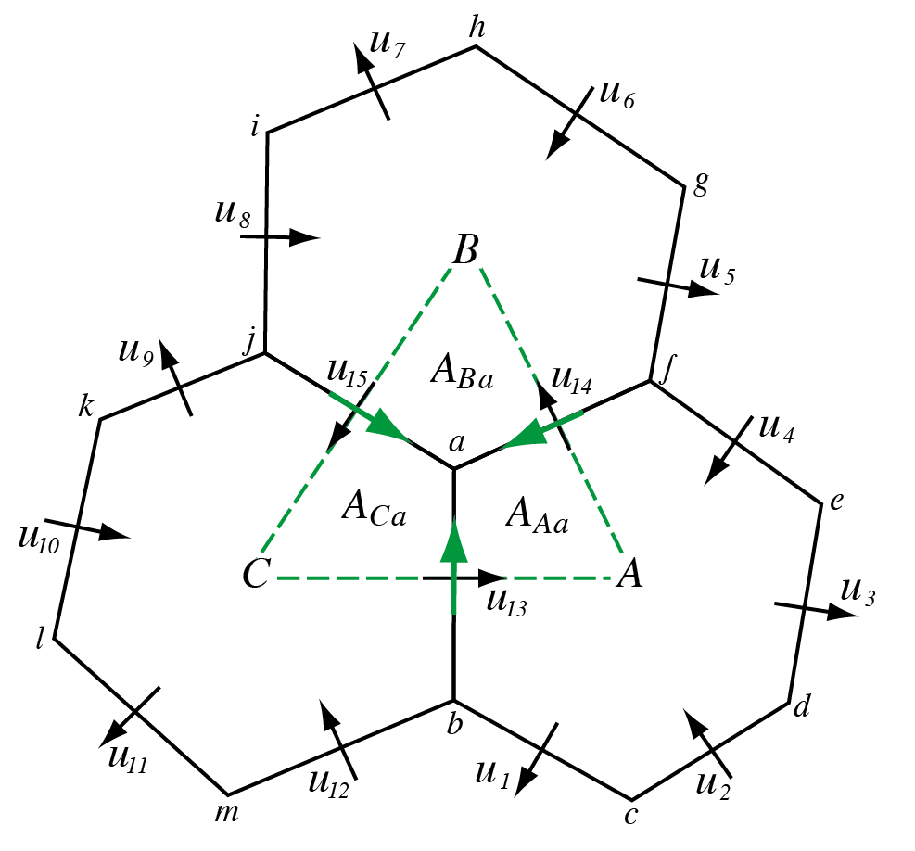
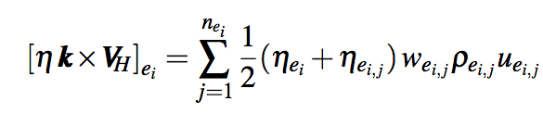
Operators on the Voronoi Mesh
‘Nonlinear’ Coriolis force
Tangential
velocity
reconstruction:
Nonlinear term:
The general tangential velocity reconstruction produces a consistent divergence on the primal and dual grids, and allows for PV, enstrophy and energy* conservation in the nonlinear SW solver.

Slide 28
Operators on the Voronoi Mesh
‘Nonlinear’ Coriolis force
Example: absolute vorticity at e₁₃
Example: absolute vorticity at vertex a

Slide 29
Configuring the dynamics
Upwind estimate of vorticity at the cell faces using a timestep of config_apvm_upwinding Δt
(namelist.atmosphere)
&nhyd_model
config_apvm_upwinding = 0.5
APVM: Anticipated Potential Vorticity Method
(Sadourny 1985)
Upwinding the vorticity here will result in dissipation of the vorticity.
a
b
Vorticity at cell faces (at u points)
config_apvm_upwinding = 0, η₁₃ = (η_{a} + η_{b} )
Vorticity at edge 13:
config_apvm_upwinding = 0.5, η₁₃ = (η_{a} + η_{b} ) – 0.5 Δt (u_{e}η_{x} – v_{e} η_{y})

Slide 30
Spatial Discretization in MPAS
references
Dynamics
Skamarock, W. C., J. B. Klemp, M. G. Duda, L. Fowler, S.-H. Park, and T. D. Ringler, 2012: A Multi-scale Nonhydrostatic Atmospheric Model Using Centroidal Voronoi Tesselations and C-Grid Staggering. Mon. Wea. Rev., 140, 30903105. doi:10.1175/MWR-D-11-00215.1
Ringler, T. D., J. Thuburn, J.B. Klemp, W. C. Skamarock, 2010: A unified approach to energy conservation and potential vorticity dynamics for arbitrarily-structured C-grids. J. Comp. Phys., 229, 3065-3090. doi:10.1016/j.jcp.2009.12.007

Slide 31
The Most Important Takeaway from this Lecture
Testing the Timestep Configuration
If MPAS integrations become unstable
(producing NaNs) after just a few timesteps, the issue may be the acoustic modes.
Reduce the main timestep (config_dt) and see if the simulations are stable.
If stable with a reduced timestep, try the original timestep with a reduced acoustic timestep: config_number_of_sub_steps > 2 (even integer)
The acoustic and dry dynamics timestep can also be reduced by increasing config_dynamics_split_steps > 3 (can be odd or even)
If none of these work, then the problem is likely not the dynamics. Check the initial conditions.
&nhyd_model
config_dt = 90
Timestep in seconds
Similar to WRF, the model timestep (in seconds) initially should be set to be 6 times the finest nominal mesh spacing in km. For example – 15 km fine-mesh spacing would use a 90 second timestep.
We have found that a larger timestep is often stable.

