Slide 1
Unique Aspects of MPAS Code: Registry, Pools, and Logging
Michael G. Duda
NCAR/MMM

Slide 2
Introduction
When taking a first look inside the MPAS-Atmosphere model, there are several features that can be confusing without proper background:
The MPAS “Registry”
Pools
Logging mechanism
This talk is very software-oriented, but the ideas will be important for upcoming talks about adding new diagnostics and passive tracers in MPAS!

Slide 3
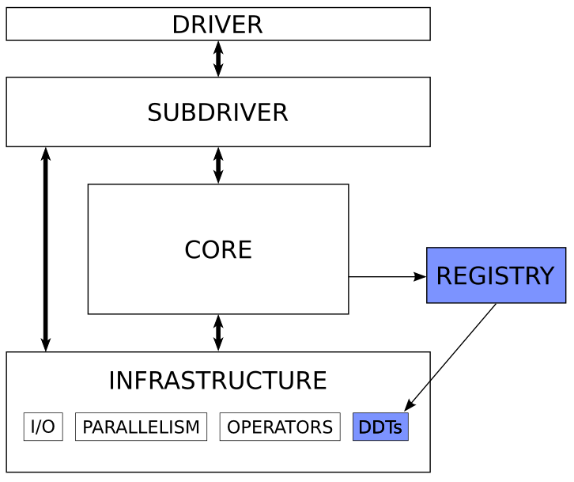
The MPAS Registry File
A central component of all MPAS “cores” is the Registry file.
An idea borrowed from the Weather Research and Forecasting (WRF) model
Motivation:
We wanted to avoid manually writing copy-and-paste code every time we added a new variable or namelist option in MPAS
Allocation/deallocation
Addition of fields to data structures
I/O
The Registry mechanism parses the Registry.xml file and writes this code for us!

Slide 4
The MPAS Registry File
One could argue that through appropriately designed data structures and functions, we shouldn’t have needed to write copy-and-paste code in the first place (and that’s true!), but…
By having all namelist options and fields defined in a single XML file, we can automatically generate ~120 pages of documentation!

Slide 5
The MPAS Registry File
There are five primary constructs that can are defined in the Registry.xml file for an MPAS “core”
1) Namelist options
&damping
config_zd = 22000.0
/
This namelist option is defined by this entry in the Registry.xml file
<nml_record name="damping" in_defaults="true">
<nml_option name="config_zd" type="real"
default_value="22000.0"
units="m"
description="Height MSL to begin w-damping profile"
possible_values="Positive real values"/>
</nml_record>

Slide 6
The MPAS Registry File
There are five primary constructs that can are defined in the Registry.xml file for an MPAS “core”
2) Dimensions
<dims>
<dim name="nCells"
description="The number of Voronoi cells in the primal mesh"/>
<dim name="nVertLevels"
description="The number of atmospheric layers"/>
</dims>

Slide 7
The MPAS Registry File
There are five primary constructs that can be defined in the Registry.xml file for an MPAS “core”
3) Variable structures (...which we should rename as "pools"...)
<var_struct name="mesh" time_levs="1">
...
</var_struct>

Slide 8
The MPAS Registry File
There are five primary constructs that can be defined in the Registry.xml file for an MPAS “core”
4) Variables
<var_struct name="mesh" time_levs="1">
<!-- horizontal grid information -->
<var name="latCell" type="real" dimensions="nCells"
units="rad"
description="Latitude of cells"/>
<var name="lonCell" type="real" dimensions="nCells"
units="rad"
description="Longitude of cells"/>
</var_struct>

Slide 9
The MPAS Registry File
There are five primary constructs that can are defined in the Registry.xml file for an MPAS “core”
5) Default I/O streams
<streams>
<stream name="input"
type="input"
filename_template="x1.40962.init.nc"
input_interval="initial_only"
immutable="true">
<var name="latCell"/>
<var name="lonCell"/>
...
</stream>
</streams>
NB: as described in an earlier talk, additional streams can always be defined at run-time in the “streams” file

Slide 10
The MPAS Registry File
How and when does the Registry impact MPAS?
During compilation, there is a build step that parses the Registry.xml file and generates Fortran code that is included by an MPAS “core”
Changing the Registry.xml file requires recompilation of MPAS!
MPAS-Model/
src/
core_atmosphere/
diagnostics/
dynamics/
inc/
physics/
Registry.xml
utils/
Automatically generated Fortran code goes in the inc/ directory
About 18,600 lines of code for MPAS-Atmosphere v7.0

Slide 11
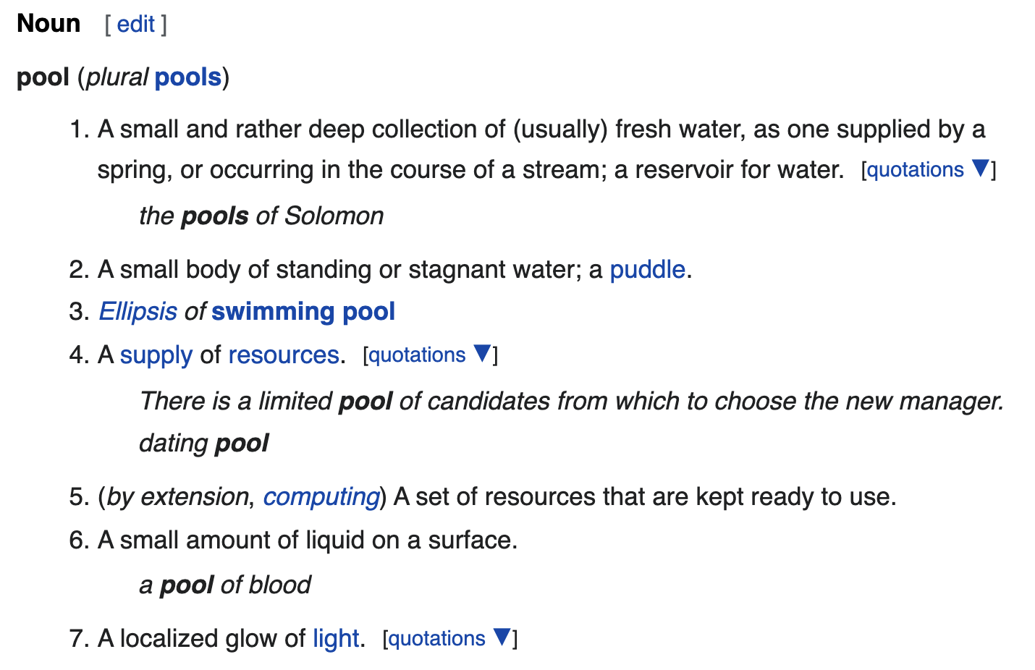
MPAS Pools
Closely related to the Registry in MPAS are “pools”
These are best explained with a little historical perspective…
Left: Some possible definitions of what a pool is...
Taken from wiktionary.org

Slide 12
MPAS Pools: some history
When we started to develop MPAS, we wanted a way to write more abstract and more maintainable code.
Consider a function, below, for computing dynamics tendencies:
subroutine compute_dyn_tend(theta_m, rho_zz, u, w, zgrid, &
areaCell, dcEdge, tend_u, tend_rho, &
tend_w)
real, dimension(:,:), intent(in) :: theta_m
real, dimension(:,:), intent(in) :: rho_zz
real, dimension(:,:), intent(in) :: u
real, dimension(:,:), intent(in) :: w
real, dimension(:,:), intent(in) :: zgrid
real, dimension(:,:), intent(in) :: areaCell
real, dimension(:,:), intent(in) :: dcEdge
real, dimension(:,:), intent(out) :: tend_u
... And so on ...

Slide 13
MPAS Pools: some history
With some code comments, it’s not hard to figure out what this routine does
But if any new inputs or outputs are needed, those need to be individually declared and added to the argument list
We wanted to be able to write code like this:
subroutine compute_dyn_tend(stateFields, meshInfo, tendencyFields)
type(state_t), intent(in) :: stateFields
type(mesh_t), intent(in) :: meshInfo
type(tend_t), intent(out) :: tendencyFields
Where, e.g., state_t could be defined as:
type state_t
real, dimension(nVertLevels, nCells) :: theta_m
real, dimension(nVertLevels, nCells) :: rho_zz
real, dimension(nVertLevels, nEdges) :: u
! ... And so on ...
end type state_t

Slide 14
MPAS Pools: some history
The problem comes when we have two different MPAS cores (e.g., MPAS-Atmosphere and MPAS-Ocean) that need to define the state_t type differently
MPAS-Atmosphere needs this:
type state_t
real, dimension(nVertLevels, nCells) :: theta_m
real, dimension(nVertLevels, nCells) :: rho_zz
real, dimension(nVertLevels, nEdges) :: u
! ... And so on ...
end type state_t
While MPAS-Ocean needs this:
type state_t
real, dimension(nVertLevels, nCells) :: salinity
real, dimension(nCells) :: SSH
real, dimension(nVertLevels, nCells) :: layerThickness
! ... And so on ...
end type state_t

Slide 15
MPAS Pools: some history
Our solution to this problem in MPAS was to develop a generic, dynamic data type called a “pool”, which:
Can be instantiated multiple times
Can have different fields added to each instance
Now, we can do something like this:
type(mpas_pool_type), pointer :: AtmStatePool
type(mpas_field_2d_real_type), pointer :: theta_m_ptr
allocate(AtmStatePool)
call mpas_pool_add_field(AtmStatePool, ‘theta_m’, theta_m_ptr)
Note: the exact type names above don’t match the actual MPAS code… I just used names that are closer to what we probably should have chosen in the first place…

Slide 16
MPAS Pools
Whereas before we could access members of types like this:
type(state_t) :: State
write(0,*) maxval(State % theta_m)
We now have to access members of pools like this:
type(mpas_pool_type) :: State
real, dimension(:,:), pointer :: theta_m_ptr
call mpas_pool_get_array(State, ‘theta_m’, theta_m_ptr)
write(0,*) maxval(theta_m_ptr)
Pools are a little more cumbersome to use, but they allow us to write rich infrastructure to perform operations on entire groups of fields!

Slide 17
MPAS Pools
Using mpas_pool_get_* routines, we can access the dimensions, fields, and namelist options that we define in a Registry.xml file:
Variable structures (aka, pools)
call mpas_pool_get_subpool(structs, ‘state’, AtmState)
Namelist options:
call mpas_pool_get_config(Configs, ‘config_dt’, dt)
Dimensions:
call mpas_pool_get_dimension(AtmState, ‘nCells’, nCells)
Fields:
call mpas_pool_get_field(AtmState, ‘theta_m’, theta_m_fld)
Array pointer for a field:
call mpas_pool_get_array(AtmState, ‘theta_m’, theta_m)

Slide 18
The MPAS Logging Mechanism
Naturally, we’d like to write out messages as the model runs
An informal survey revealed that many of us use print statements as our primary means of debugging!
What happens if we do something like the following in parallel code (both MPI and OpenMP)?
subroutine RHS(arg1, arg2, arg3)
integer, intent(in) :: arg1, arg2
integer, intent(out) :: arg3
write(0,*) arg1, arg2, arg3

Slide 19
The MPAS Logging Mechanism
In MPAS v5.x and earlier, our solution was to cleverly redirect stdout and stderr to log files named log.XXXX.out and log.XXXX.err
However, this is less than ideal when several different MPAS components (e.g., ocean, land ice, sea ice) are running together in the same coupled Earth-system model!
MPAS v6.0 introduced a completely new mechanism for logging messages during model execution

Slide 20
The MPAS Logging Mechanism
The standard way for logging a message in MPAS uses the mpas_log module’s mpas_log_write(…) routine
Each MPAS core writes log messages to a file named log.<CORE>.0000.out
mpas_log_write(…) handles tagging of messages with threadID for messages logged from threaded code regions
subroutine RHS(arg1, arg2, arg3)
use mpas_log, only : mpas_log_write
integer, intent(in) :: arg1, arg2
integer, intent(out) :: arg3
call mpas_log_write(‘Hello from the RHS routine’)

Slide 21
The MPAS Logging Mechanism: printing variables
Variables can be included in messages with placeholders $i, $r, or $l for integers, reals, or logicals
The variables to substitute for these placeholders are specified with optional arguments intArgs, realArgs, and logicArgs
subroutine RHS(arg1, arg2, arg3)
use mpas_log, only : mpas_log_write
integer, intent(in) :: arg1, arg2
integer, intent(out) :: arg3
call mpas_log_write(‘Inputs are $i and $i’, &
intArgs=[arg1, arg2])

Slide 22
The MPAS Logging Mechanism: message types
There are four types of messages that can be written:
Regular messages
Warnings
Error messages
Critical error messages – writing one of these will halt the model!
The type of a log message is specified with the optional argument messageType, which can be:
MPAS_LOG_OUT – the default, which doesn’t need to be specified
MPAS_LOG_WARN
MPAS_LOG_ERR
MPAS_LOG_CRIT

Slide 23
The MPAS Logging Mechanism: message types
An example of messageType:
subroutine RHS(arg1, arg2, arg3)
use mpas_log, only : mpas_log_write, MPAS_LOG_ERR
integer, intent(in) :: arg1, arg2
integer, intent(out) :: arg3
if (arg1 < 0 .or. arg2 < 0) then
call mpas_log_write(‘Both input args must be >0’,&
messageType=MPAS_LOG_ERR)
end if

Slide 24
The MPAS Logging Mechanism: message types
The counts of each message type are summarized at the end of model execution (whether that’s a successful run or a failed run)
-----------------------------------------
Total log messages printed:
Output messages = 213
Warning messages = 3
Error messages = 4
Critical error messages = 1
-----------------------------------------
Logging of errors and critical errors will trigger the creation of a log.<core>.<processorID>.err file with the message, e.g.,
-rw-r--r-- 1 duda mmm 10260 Jul 28 12:32 log.atmosphere.0000.out
-rw-r--r-- 1 duda mmm 628 Jul 28 12:32 log.atmosphere.0001.err
-rw-r--r-- 1 duda mmm 628 Jul 28 12:32 log.atmosphere.0003.err
Above: MPI tasks 1 and 3 both encountered errors, which can be found in the log.atmosphere.0001.err and log.atmosphere.0003.err files.

Slide 25
Summary
The MPAS code is fairly plain Fortran 2008, and the key unique features are:
The Registry, where all fields, dimensions, and run-time options are defined
Dynamic data structures called “pools”
A logging mechanism to deal with the complexities of writing messages from parallel executables that may contain more than one MPAS core
Having an understanding of these is essential to successfully making changes or additions to the MPAS code!

