Slide 1
Post-processing and visualizing MPAS-Atmosphere output
Michael G. Duda
NCAR/MMM

Slide 2
Post-processing overview
Now that you’ve run MPAS-Atmosphere, how can you take a graphical look at the output?
diag.2010-10-23_00.00.00.nc
diag.2010-10-23_03.00.00.nc
diag.2010-10-23_06.00.00.nc
diag.2010-10-23_09.00.00.nc
diag.2010-10-23_12.00.00.nc
diag.2010-10-23_15.00.00.nc
diag.2010-10-23_18.00.00.nc
diag.2010-10-23_21.00.00.nc
diag.2010-10-24_00.00.00.nc
history.2010-10-23_00.00.00.nc
history.2010-10-23_06.00.00.nc
history.2010-10-23_12.00.00.nc
history.2010-10-23_18.00.00.nc
history.2010-10-24_00.00.00.nc
restart.2010-10-24_00.00.00.nc
Above: Typical output files from an MPAS-Atmosphere simulation
Interpolate to a regular lat-lon grid
Visualize output directly with NCL or Python

Slide 3
What’s in these output files, anyway?
By default, the “diag” files contain:
RH, T, height, winds @ 200, 250, 500, 700, 850, 925 hPa
CAPE, CIN, LCL, LFC, updraft helicity
U10, V10, T2, Q2
Simulated radar reflectivity
PMSL
Surface, 1km AGL, 6km AGL winds
(various other 2-d fields)
In the "Computing new diagnostics" lecture, we'll say more about the framework for adding new diagnostics to MPAS-A.

Slide 4
What’s in these output files, anyway?
By default, the "history" files contain:
q_{v} , q_{c} , q_{r} , …
theta
zonal, meridional wind
vertical velocity
full pressure
dry density
accumulated rain (cumulus and microphysics)
soil moisture, soil temperature
(various other fields)
Full mesh information (horizontal and vertical)
In the "Running MPAS, part 2" talk, we discussed how to modify the set of fields written to model output files using streams

Slide 5
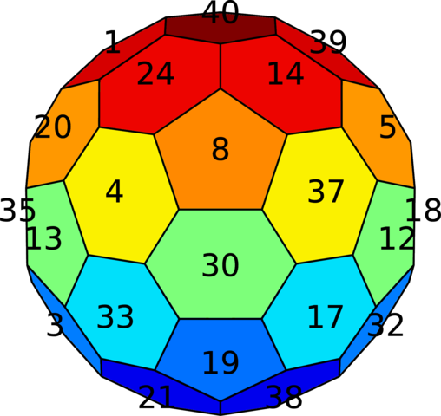
Interpolating output to a regular lat-lon grid
MPAS stores 2-d horizontal fields in 1-d arrays; 3-d fields are 2-d arrays with the vertical (structured) dimension innermost, e.g., qv(nVertLevels,nCells).
Left: Can you spot Hurricane Matthew in the MPAS ‘qv’ field seen in ncview?
Using ‘ncview’ directly on MPAS netCDF files doesn’t work well...

Slide 6
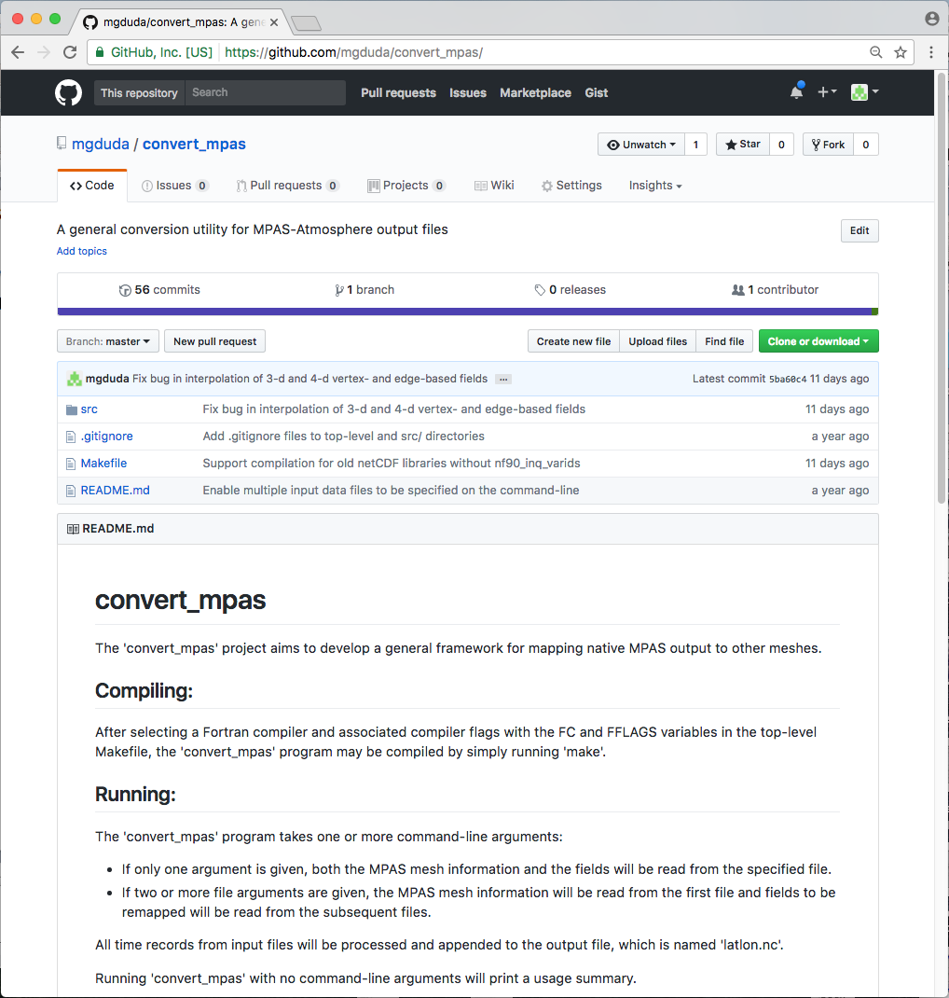
Interpolating output to a regular lat-lon grid
The ‘convert_mpas’ tool can quickly interpolate MPAS files to a specified lat-lon grid
Source code can be obtained from https://github.com/mgduda/convert_mpas/
The README.md file summarizes the key details of compiling and running

Slide 7
The convert_mpas utility
Basic usage of ‘convert_mpas’:
If just one argument is given, it specifies an MPAS file that has mesh information as well as fields to be interpolated
E.g.: convert_mpas x1.40962.init.nc
If more than one argument is given:
First argument is used only to obtain mesh information
All remaining arguments contain fields to be interpolated
E.g.: convert_mpas x1.40962.grid.nc diag*nc
E.g.: convert_mpas history.2017-06-16_00.nc history*nc
Output file is always called latlon.nc
Probably best to remove this file before re-running ‘convert_mpas’
Default output grid is 0.5-degree lat-lon grid

Slide 8
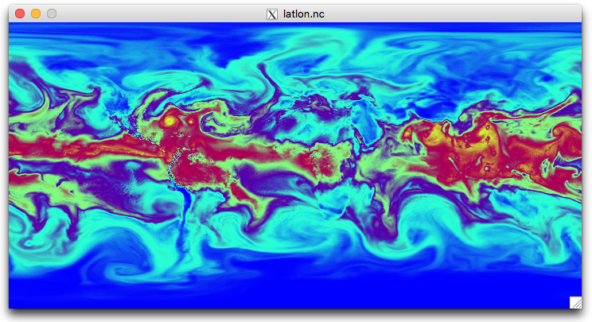
The convert_mpas utility
Now we can see Hurricane Matthew in our MPAS output
How can we interpolate to just the region of interest and at higher resolution?

Slide 9
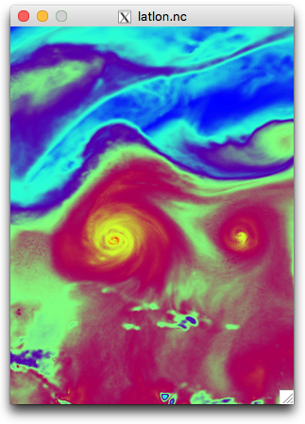
The convert_mpas utility
A text file named target_domain in your working directory may be used to specify parameters of the lat-lon grid:
startlat=10.0
endlat=50.0
startlon=-90.0
endlon=-60
nlat=400
nlon=300
A text file named include_fields in your working directory may also be used to list the fields that should be interpolated

Slide 10
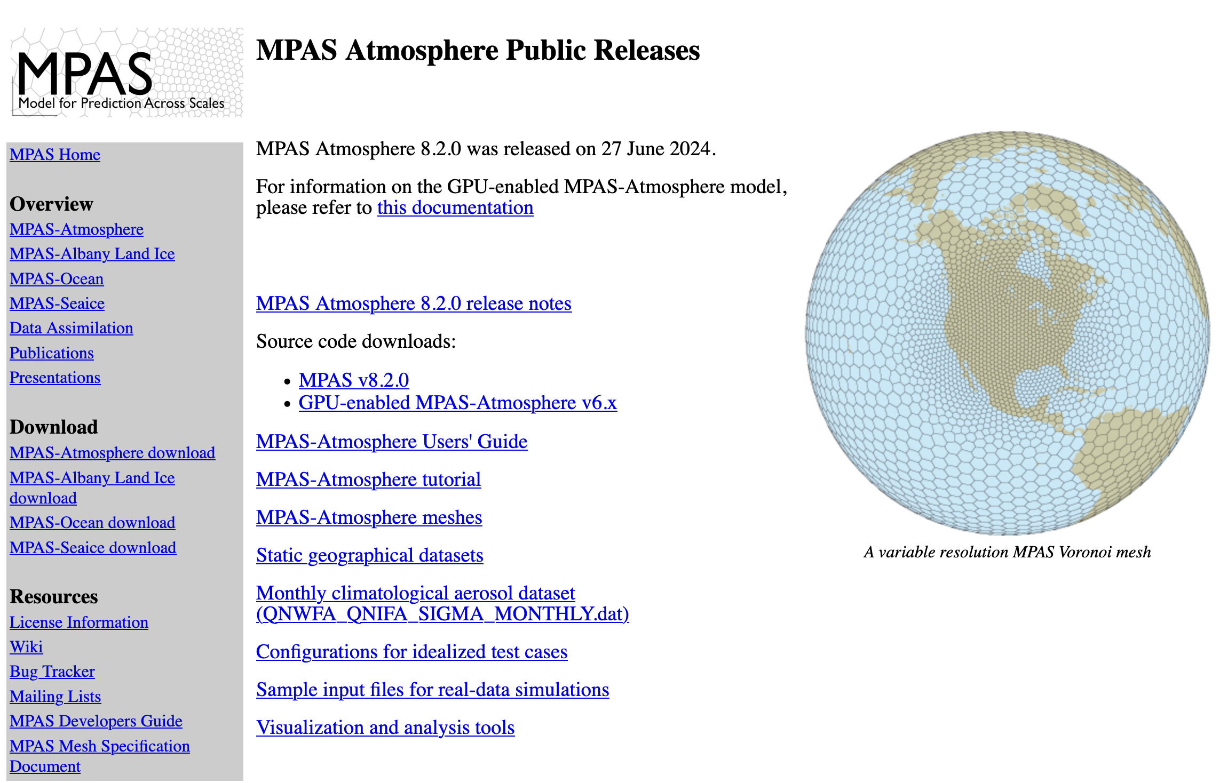
Plotting output directly with NCL or Python
To plot fields directly from the native MPAS mesh, try NCL or Python
The MPAS-Atmosphere download page contains a collection of example NCL scripts
Python examples are coming soon!

Slide 11
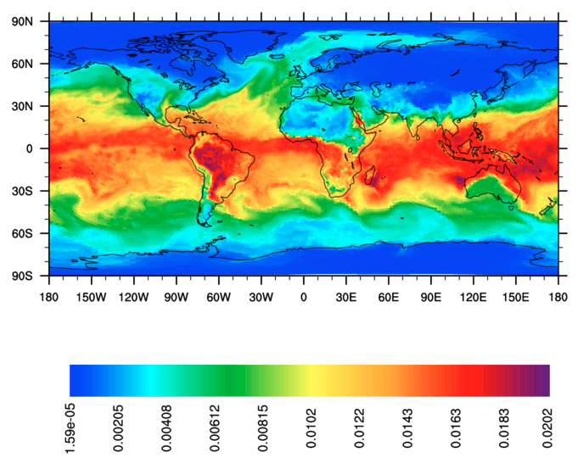
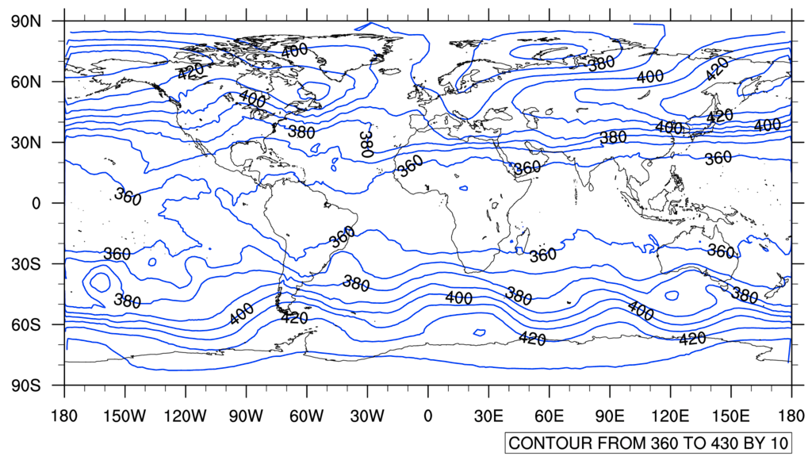
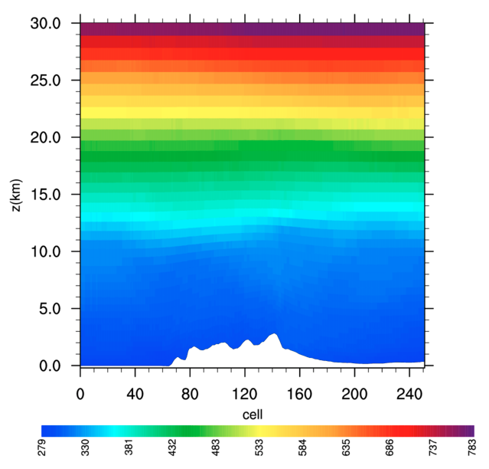
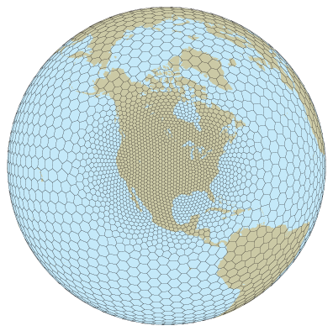
Example NCL scripts from the MPAS-Atmosphere downloads page
Contours – simple or color-filled
Individual grid cells as a color-filled polygons
Vertical cross-sections with specified endpoints
Voronoi mesh against a map background

Slide 12
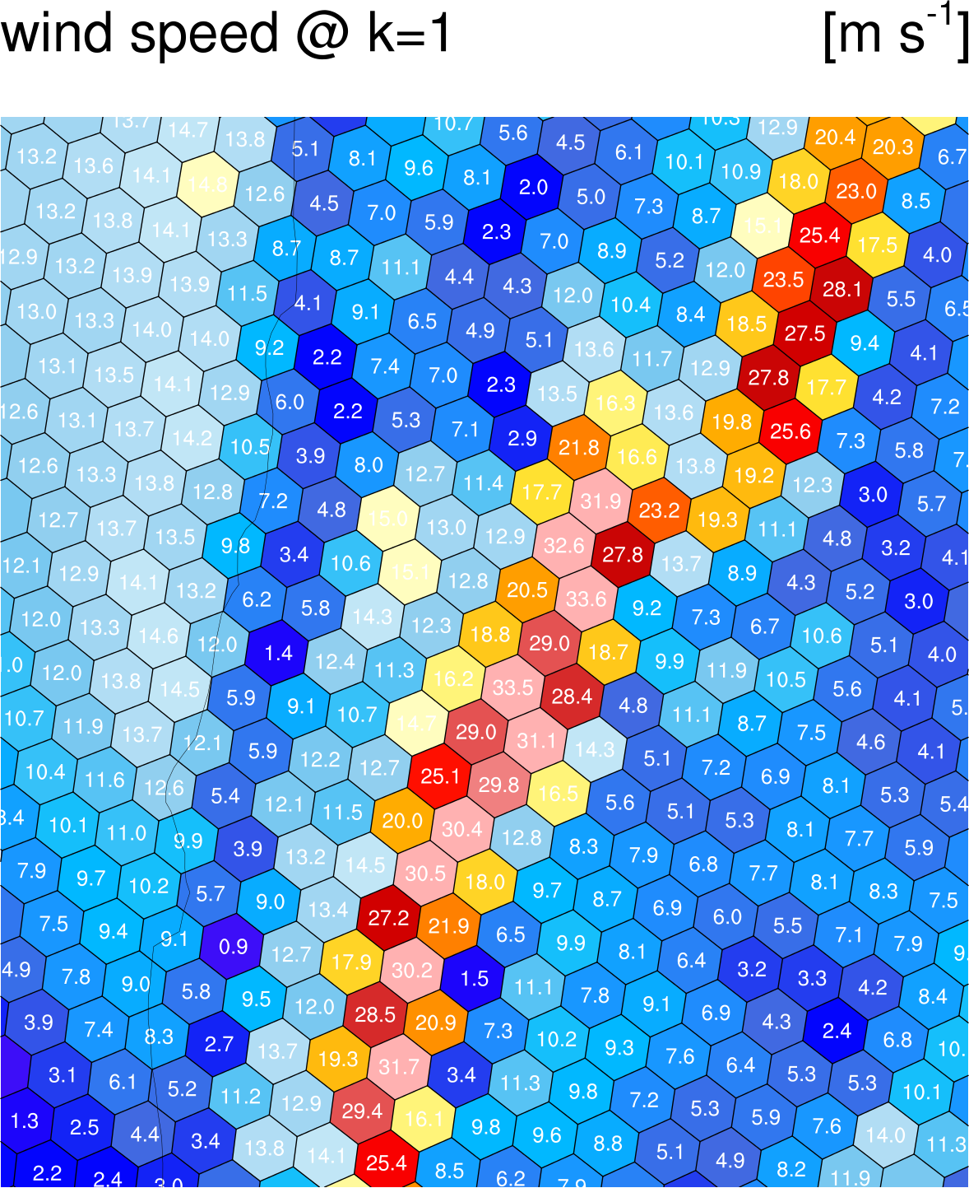
Plotting values on cells is also possible
Given latVertex, lonVertex, verticesOnCell, and nEdgesOnCell, we can plot each MPAS Voronoi cell as a color-filled polygon
Overlaying numeric values can be quite helpful in debugging

Slide 13
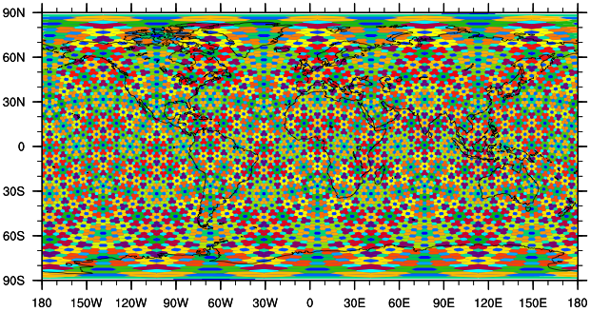
Making use of the MPAS mesh representation to more efficiently work with MPAS output
In many limited-area models, finding the nearest grid cell to a given (lat,lon) location is a constant-time operation:
Using the map projection equations for the model grid projection, compute the real-valued (x,y) coordinates of the (lat,lon) location
Round the real-valued coordinates to the nearest integer
However, in MPAS, there is no projection, and the horizontal cells may be indexed in any order.
We could just compute the distance from (lat,lon) to every cell center in the mesh and choose the nearest cell, or we could do something more efficient...
Right: Cells in the x1.10242 mesh colored according to their global index

Slide 14
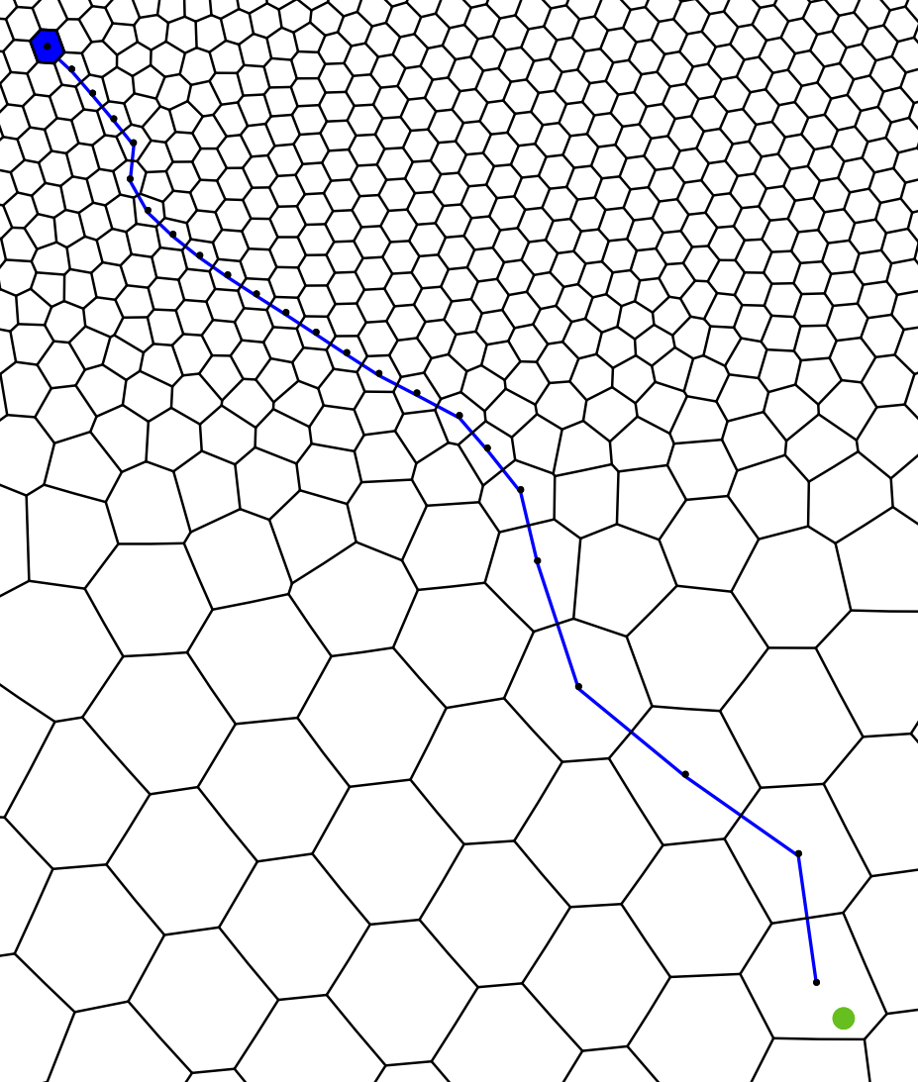
Making use of the MPAS mesh representation to more efficiently work with MPAS output
One solution would be to use search trees – perhaps a kd-tree – to store the cells in a mesh
O(n log n) setup cost; each search takes O(log n) time, for a mesh with n cells
Alternatively, we can make use of the grid connectivity arrays nEdgesOnCell and cellsOnCell to navigate a path of monotonically decreasing distance to the (lat,lon) location
No setup cost, O(n^{½}) cost per search (depending on mesh geometry...)
For repeated searches of “nearby” locations, almost constant cost!
C_{nearest} = any starting cell
C_{test} = NULL
do while (C_{nearest} ≠ C_{test})
C_{test} = C_{nearest}
d = distance from C_{test} to (lat,lon)
for i = 1 to nEdgesOnCell(C_{test})
k = cellsOnCell(i, C_{test})
d’ = distance from k to (lat,lon)
if ( d' < d )
d = d'; C_{nearest} = k
Left: Path taken from starting cell (blue) to target location (green circle).

Slide 15
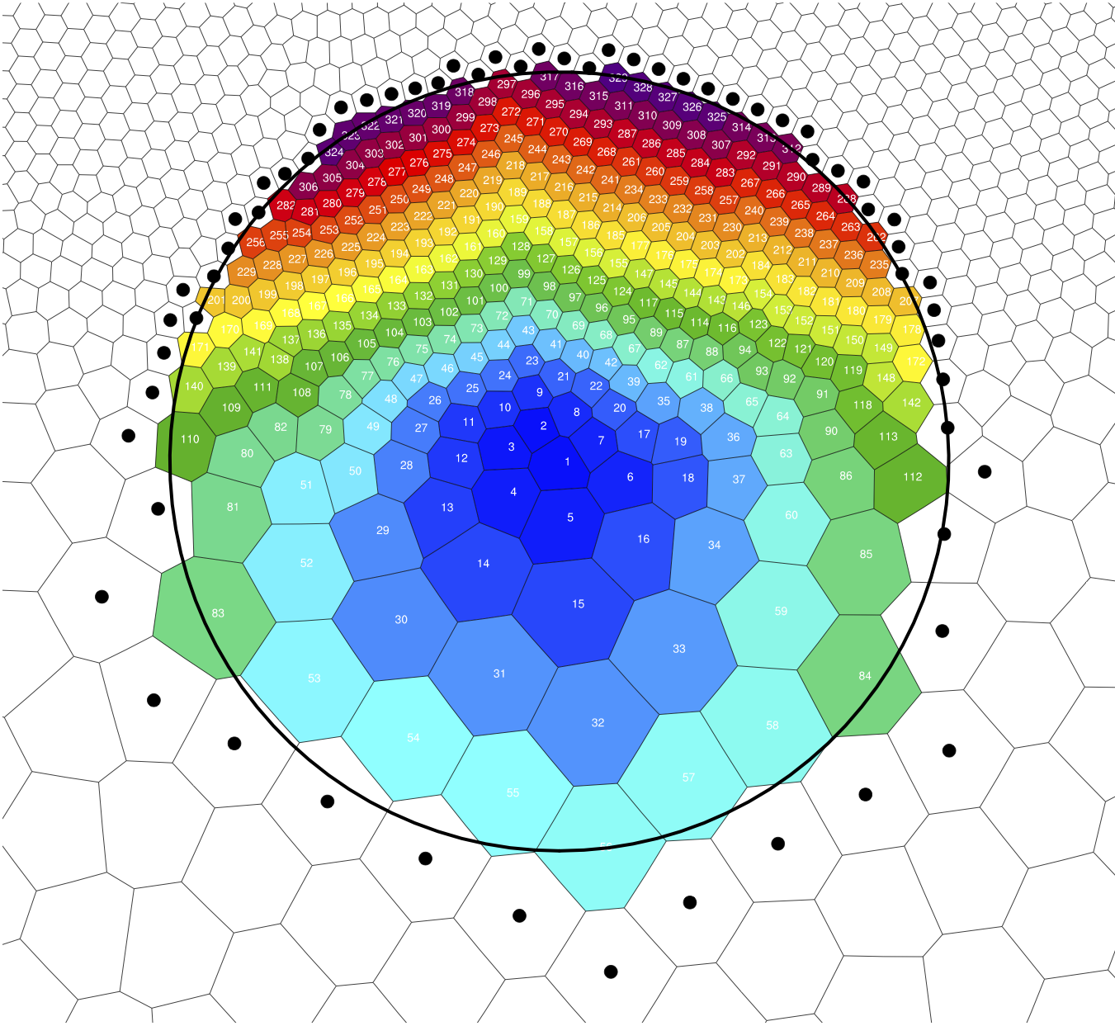
Making use of the MPAS mesh representation to more efficiently work with MPAS output
Problem: Scan all cells within a specified radius of a given (lat,lon) location
Option 1: We could check all cells in the mesh (very inefficient!)
Option 2: We could make use of the connectivity arrays (efficient!)
C = origin of the search
mark C as visited
insert C into the queue
do while (queue not empty)
C = next cell from the queue
C is within search radius, so process C
for i = 1 to nEdgesOnCell(C)
k = cellsOnCell(i,C)
if ( k not already considered )
mark k as considered
if (k within search radius)
insert k into the queue
Above: Cells shaded according to the order in which they were visited by a 750-km radius search; dots indicate cells that were considered but found to be at a radius >750 km.

Slide 16
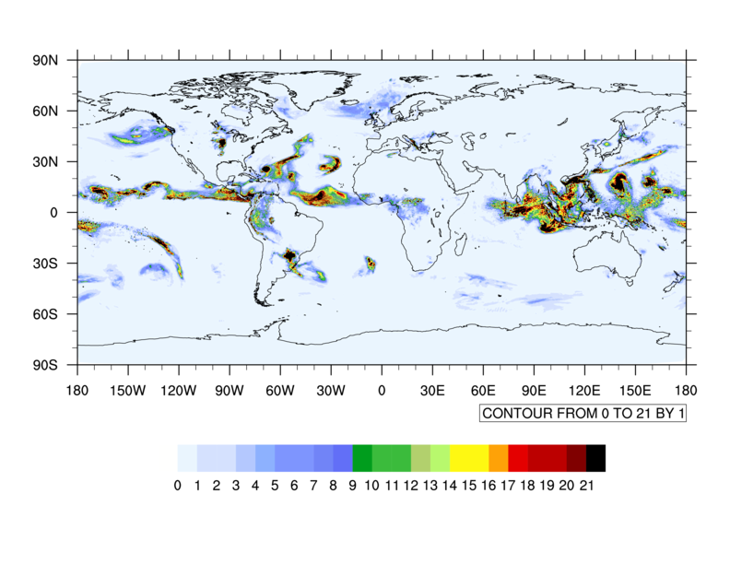
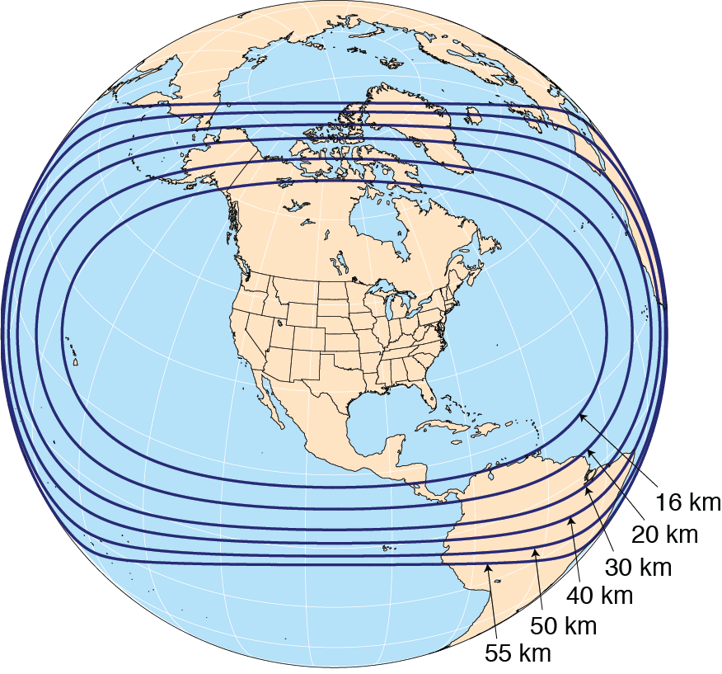
Important considerations for post-processing on variable-resolution meshes
Consider the computation of the daily mean precipitation rate on a variable-resolution MPAS mesh:
Above: An MPAS 60-15 km variable-resolution
mesh with refinement over North America
Above: The accumulated total precipitation between 2016-10-14 00 UTC and 2016-10-15 00 UTC on from MPAS with the ‘mesoscale_reference’ physics suite.
How much can the way in which we compute the daily precipitation rate affect our results?

Slide 17
An obvious conclusion, but one that’s important...
Taking a simple average of the precipitation rate in all cells gives 3.43 mm/day
In an MPAS simulation with a variable-resolution mesh with a refinement factor of N (e.g., N=4 for a 60-15 km mesh), the cell area ratio between the largest and smallest cells in the mesh is N²!
f1 = addfile("diag.2016-10-14_00.00.00.nc","r")
f2 = addfile("diag.2016-10-15_00.00.00.nc","r")
fld = (f2->rainc(0,:) + f2->rainnc(0,:)) –
(f1->rainc(0,:) + f1->rainnc(0,:))
fg = addfile("init.nc","r")
print(sum(fld * fg->areaCell(:)) / sum(fg->areaCell(:)))
Weighting the precipitation rate by cell area gives 2.93 mm/day

