Slide 1
Running MPAS Part 3: Preparing limited-area meshes and lateral boundary conditions
Michael G. Duda
NCAR/MMM

Slide 2
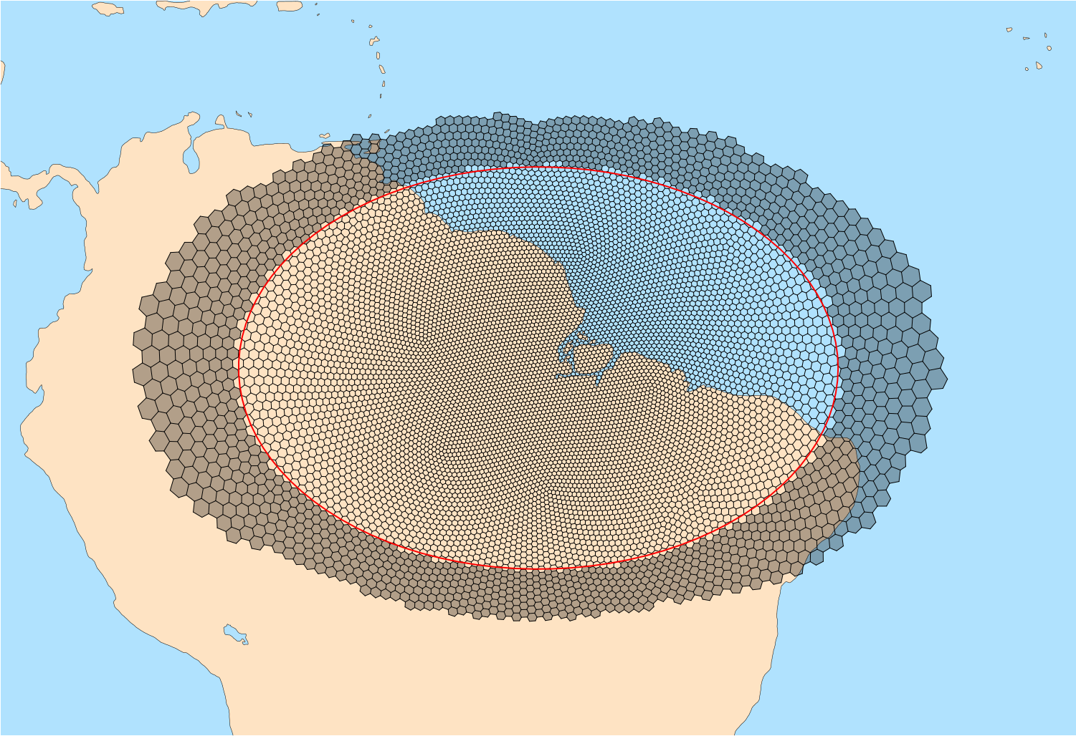
Overview
Running limited-area simulations with MPAS-Atmosphere involves only small variations on the process of running global simulations:
A limited area domain must be defined, and a mesh must be created for that domain
In addition to ICs, lateral boundary conditions (LBCs) must be generated with the init_atmosphere core
LBCs must be enabled when running the atmosphere core
Above: A variable-resolution, limited-area MPAS mesh. Relaxation zone and specified zone cells are shaded gray.
See Sections 4.3 and 8.2 in the User’s Guide

Slide 3
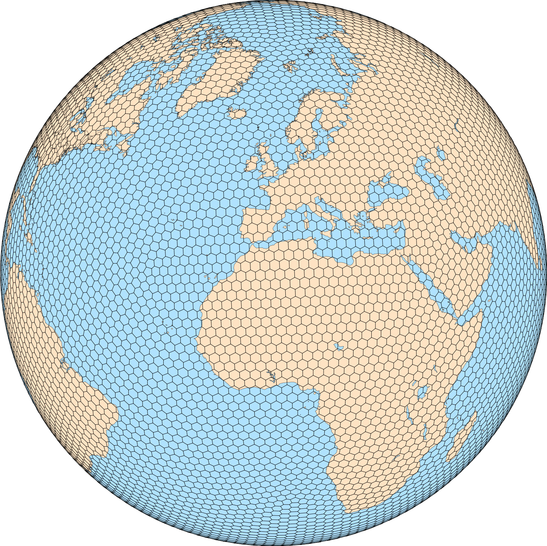
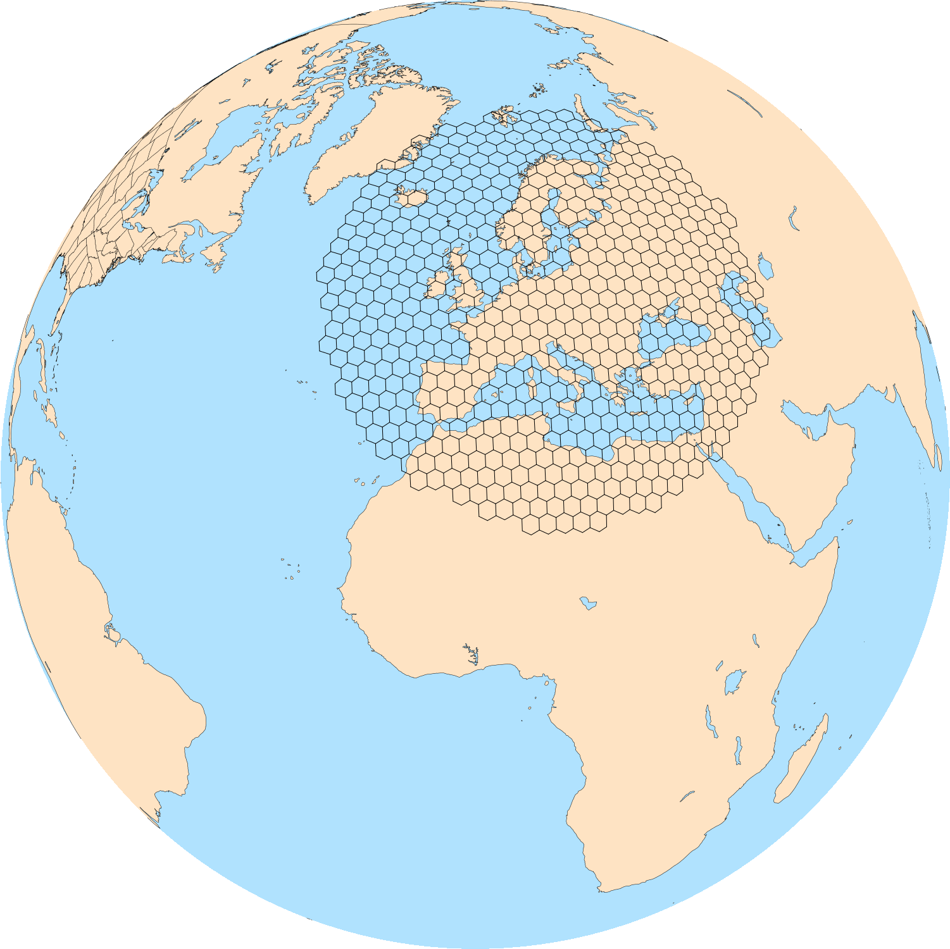
Creating limited-area meshes
As mentioned elsewhere, generating new CVT meshes can be quite time consuming
At present, limited-area meshes are created by subsetting existing meshes with the MPAS-Limited-Area tool
Each cell in the limited-area mesh is exactly coincident with a cell in the ”parent” mesh
The key point is that subsetting mesh is computational trivial, while generating a new mesh is not!

Slide 4
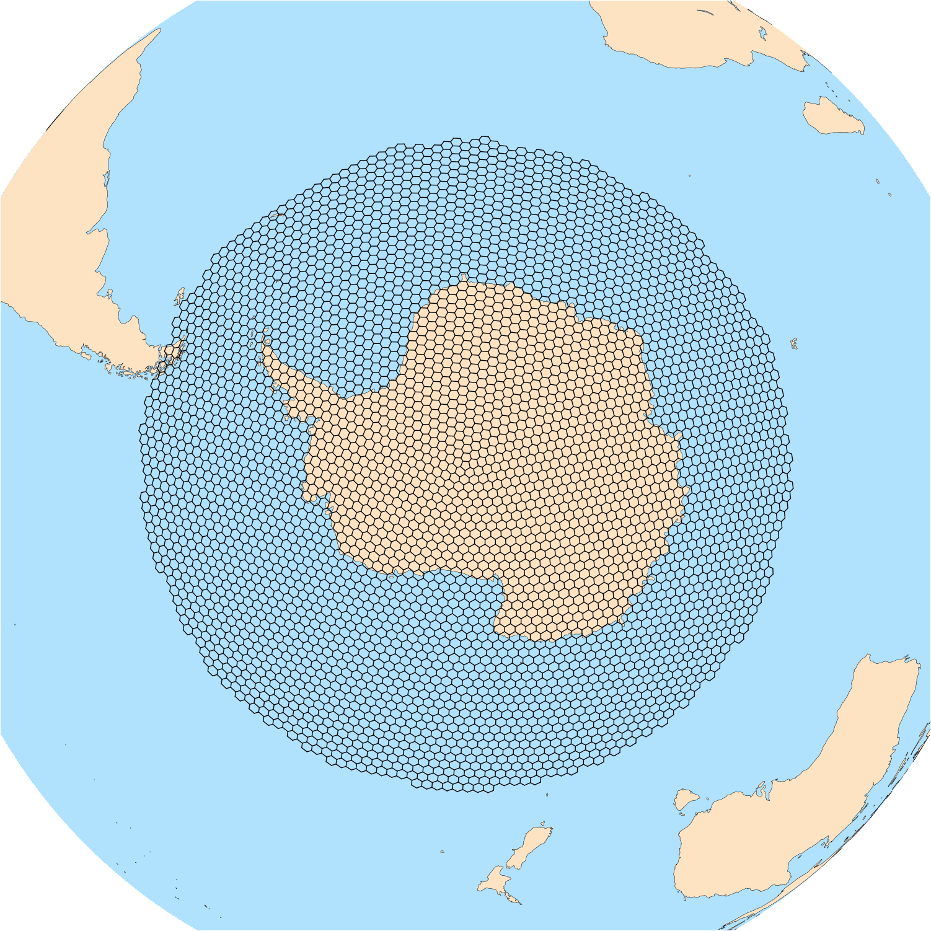
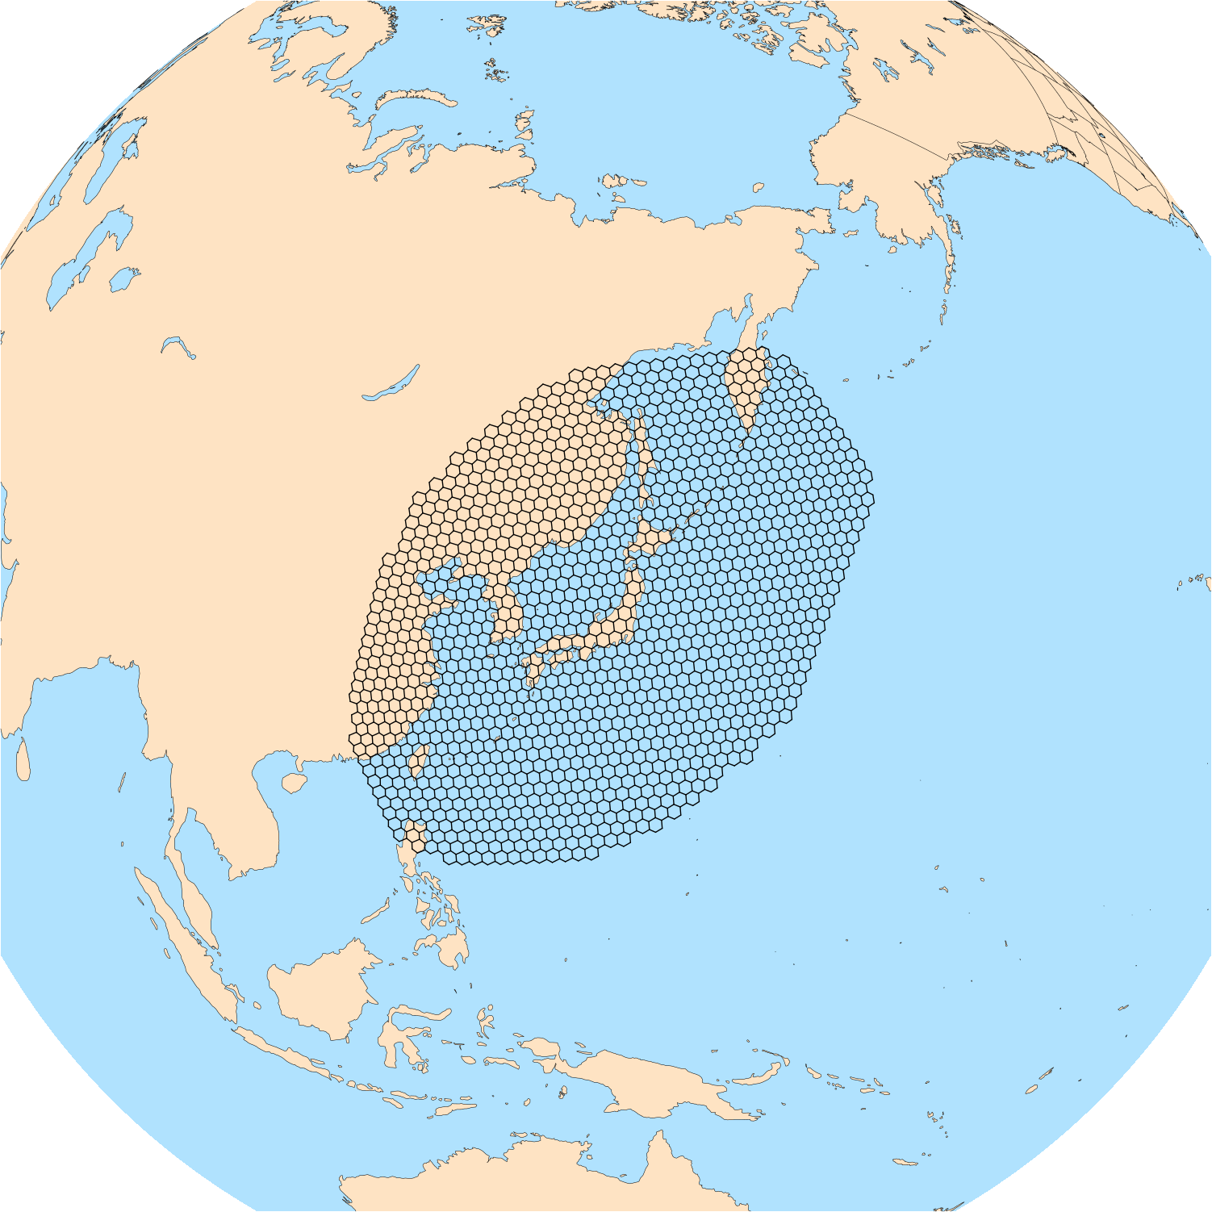
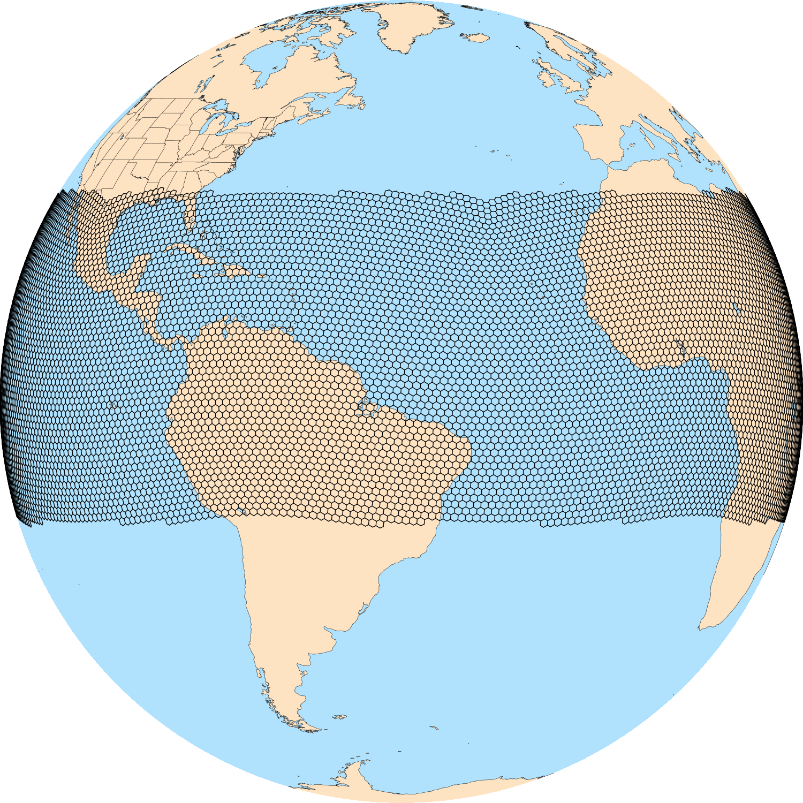
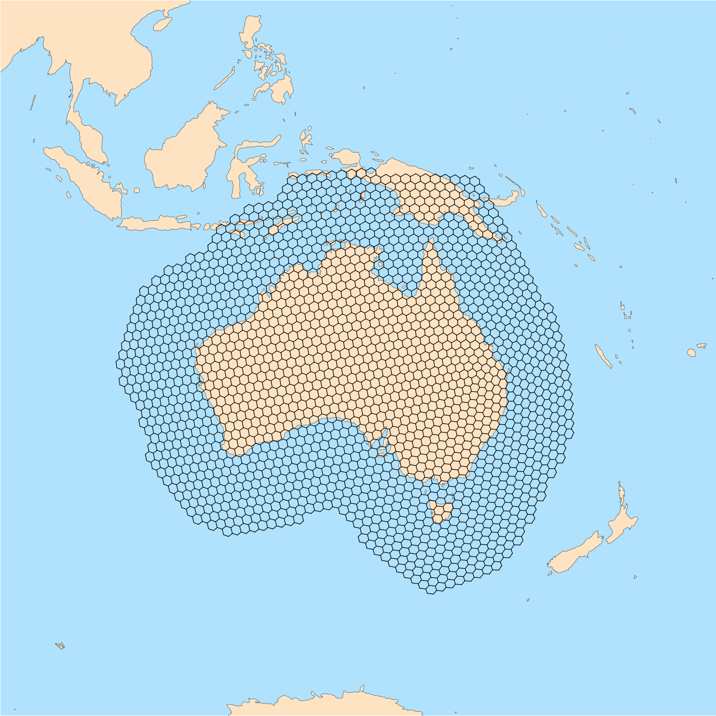
Creating limited-area meshes
MPAS-Limited-Area is a simple (~1300 lines) Python tool
The Python NumPy, and NetCDF4 modules are required
A “parent” mesh and a region definition file are the only inputs
Various region types are supported for defining regions: circles, ellipses, channels, and general polygons
With some Python knowledge, adding new region types should be easy
https://github.com/MPAS-Dev/MPAS-Limited-Area

Slide 5
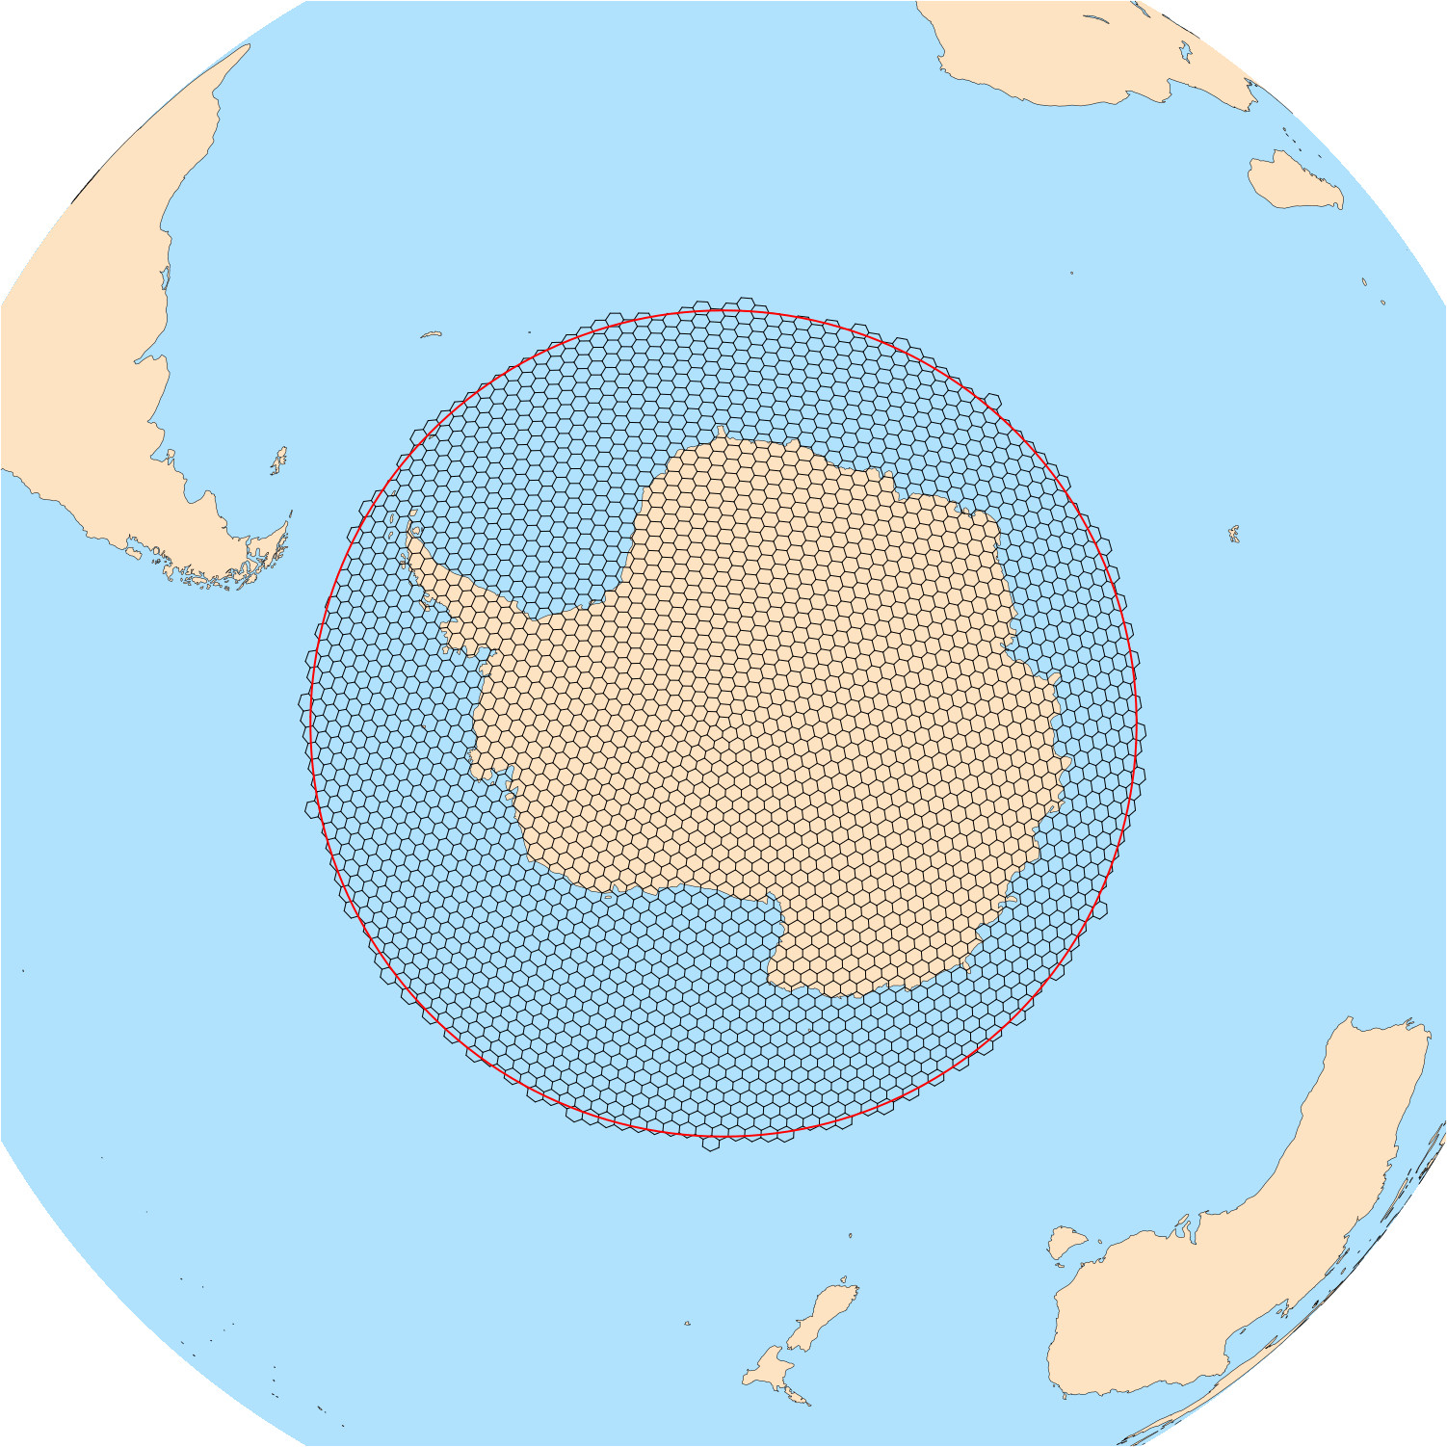
Creating limited-area meshes: circular region
For circular regions, the region definition looks like the following
Name: Antarctic
Type: circle
Point: -90.0, 0.0
radius: 3300
”Point” gives the latitude and longitude at the center of the circle, and “radius” gives the radius in km

Slide 6
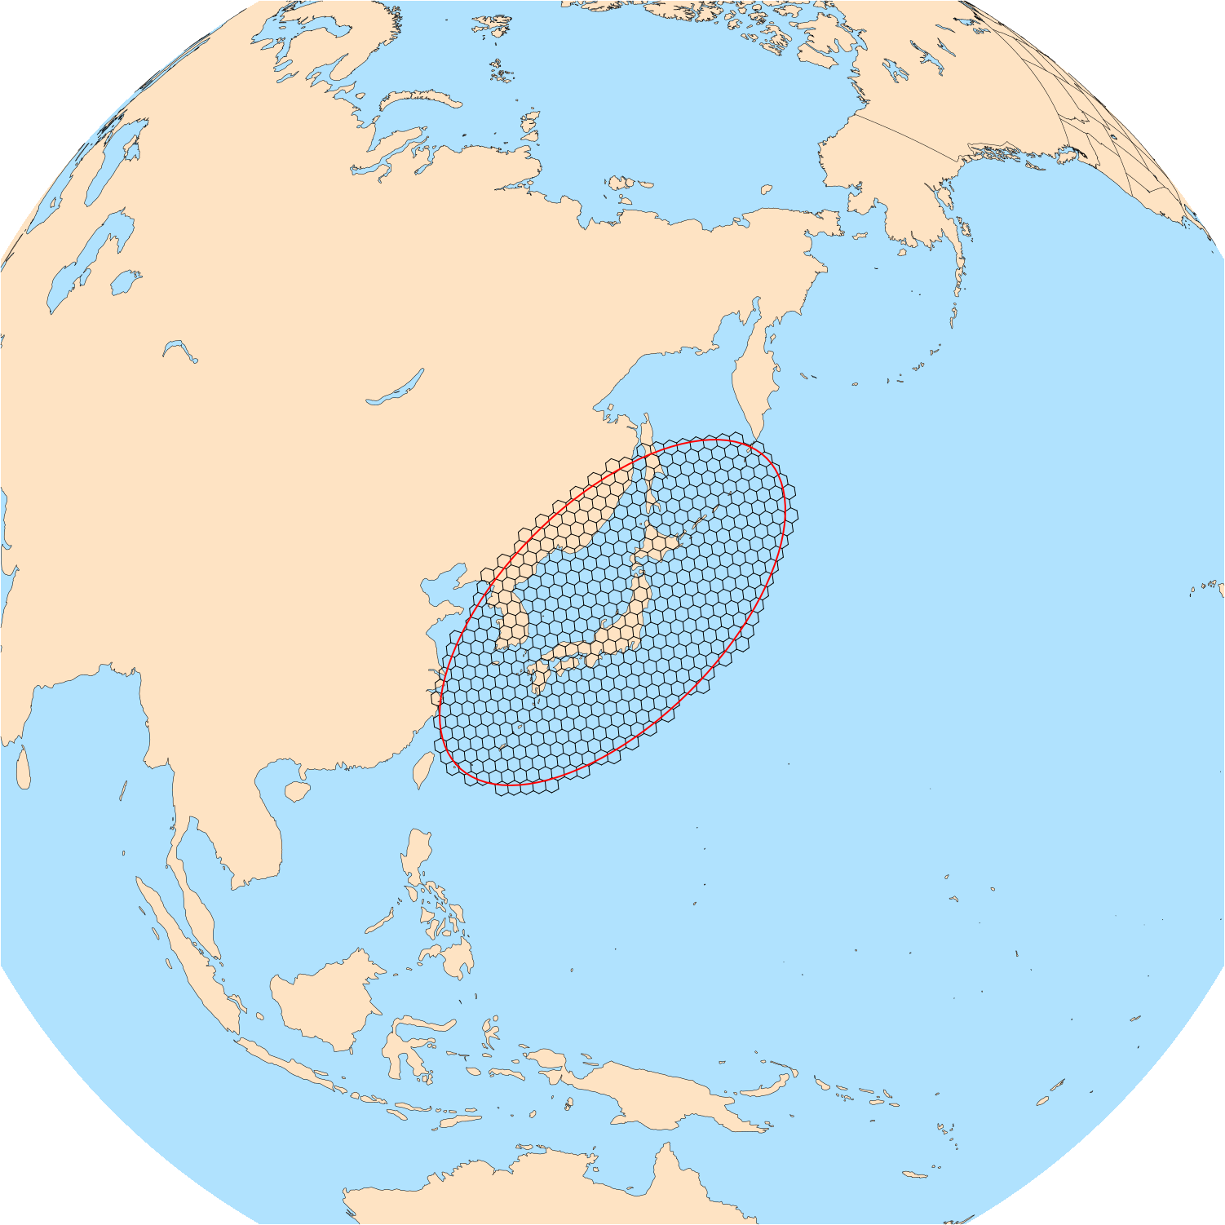
Creating limited-area meshes: elliptical region
For elliptical regions, the region definition looks like the following
Name: Japan
Type: ellipse
Point: 38.0, 138.0
Semi-major-axis: 2000000
Semi-minor-axis: 1000000
Orientation-angle: 45
”Point” gives the latitude and longitude at the center of the ellipse, ”Semi-major-axis” and “Semi-minor-axis” are in meters, and “Orientation-angle” gives the rotation of the axes of the ellipse

Slide 7
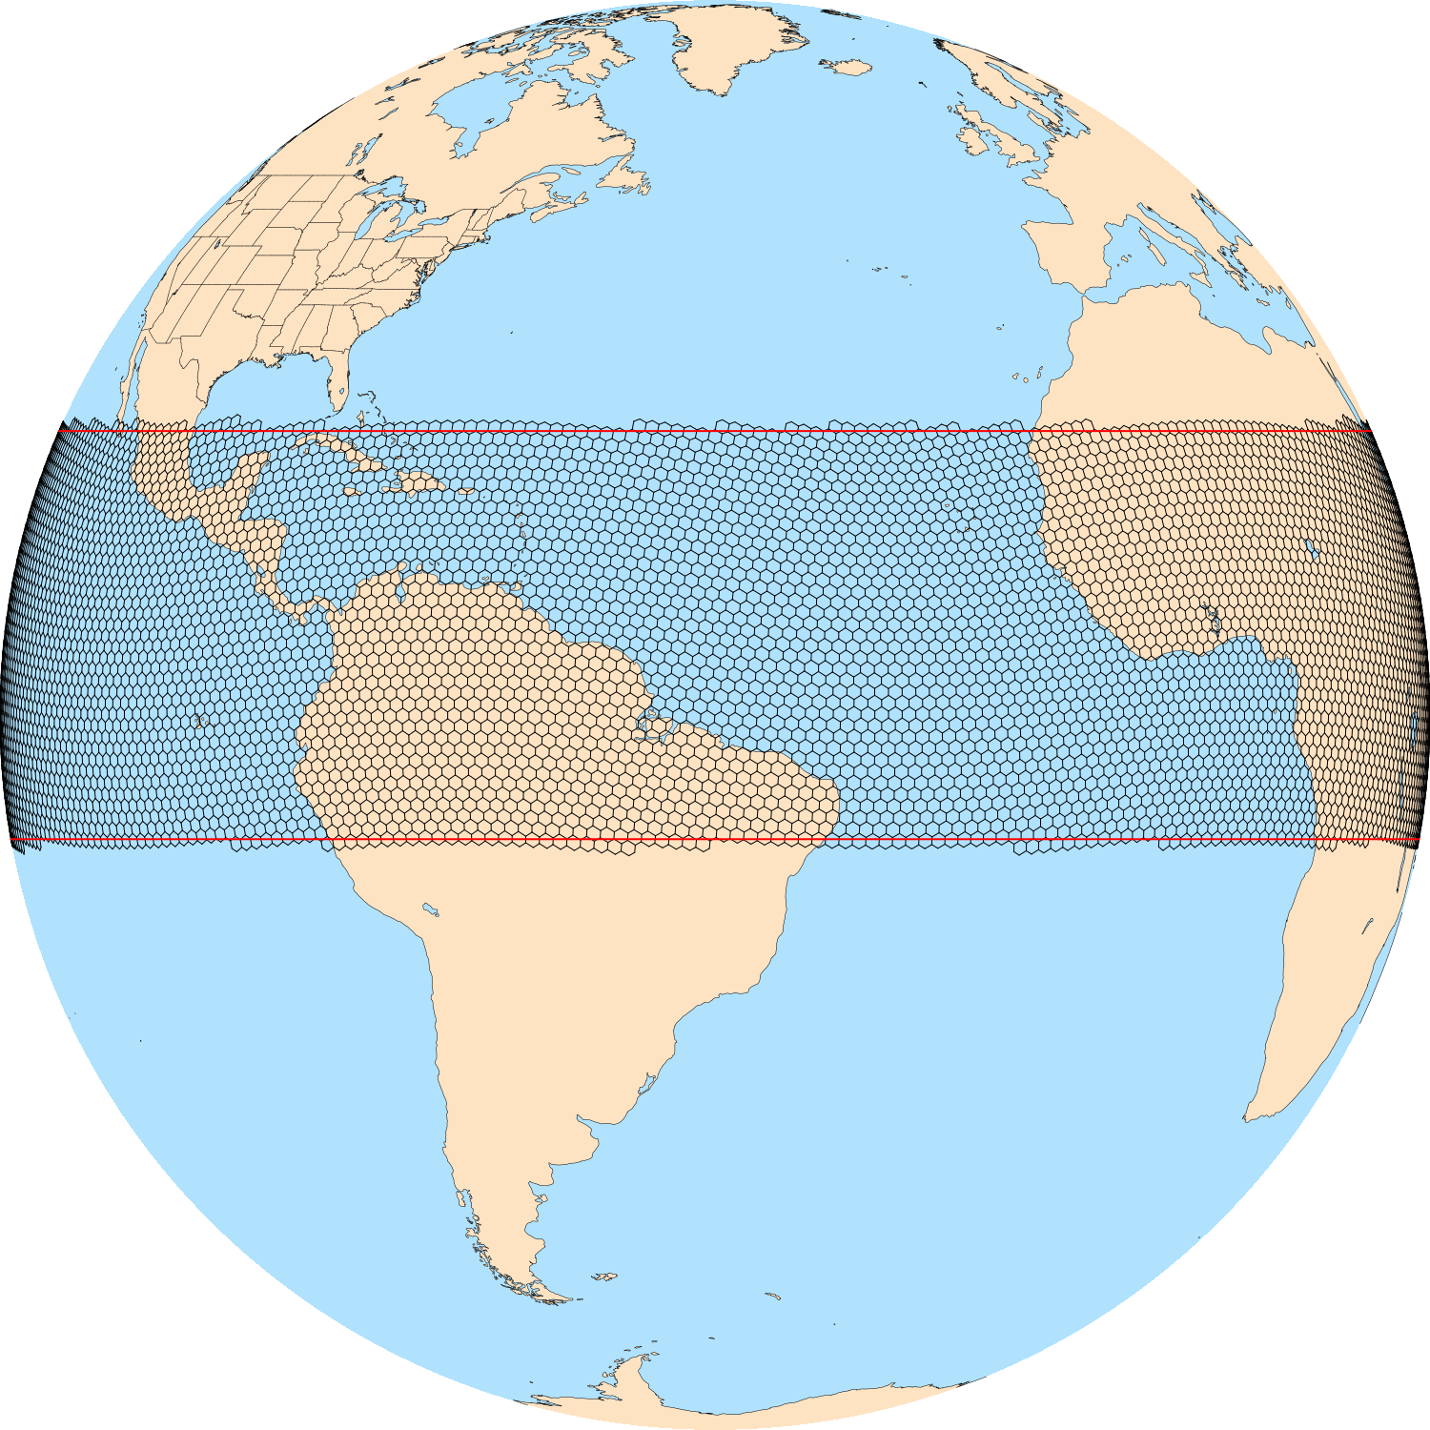
Creating limited-area meshes: channel region
For channel regions, the region definition looks like the following
Name: Tropics
Type: channel
ulat: 23.4
llat: -10.0
”ulat” gives the upper latitude of the channel, and “llat” gives the lower latitude of the channel

Slide 8
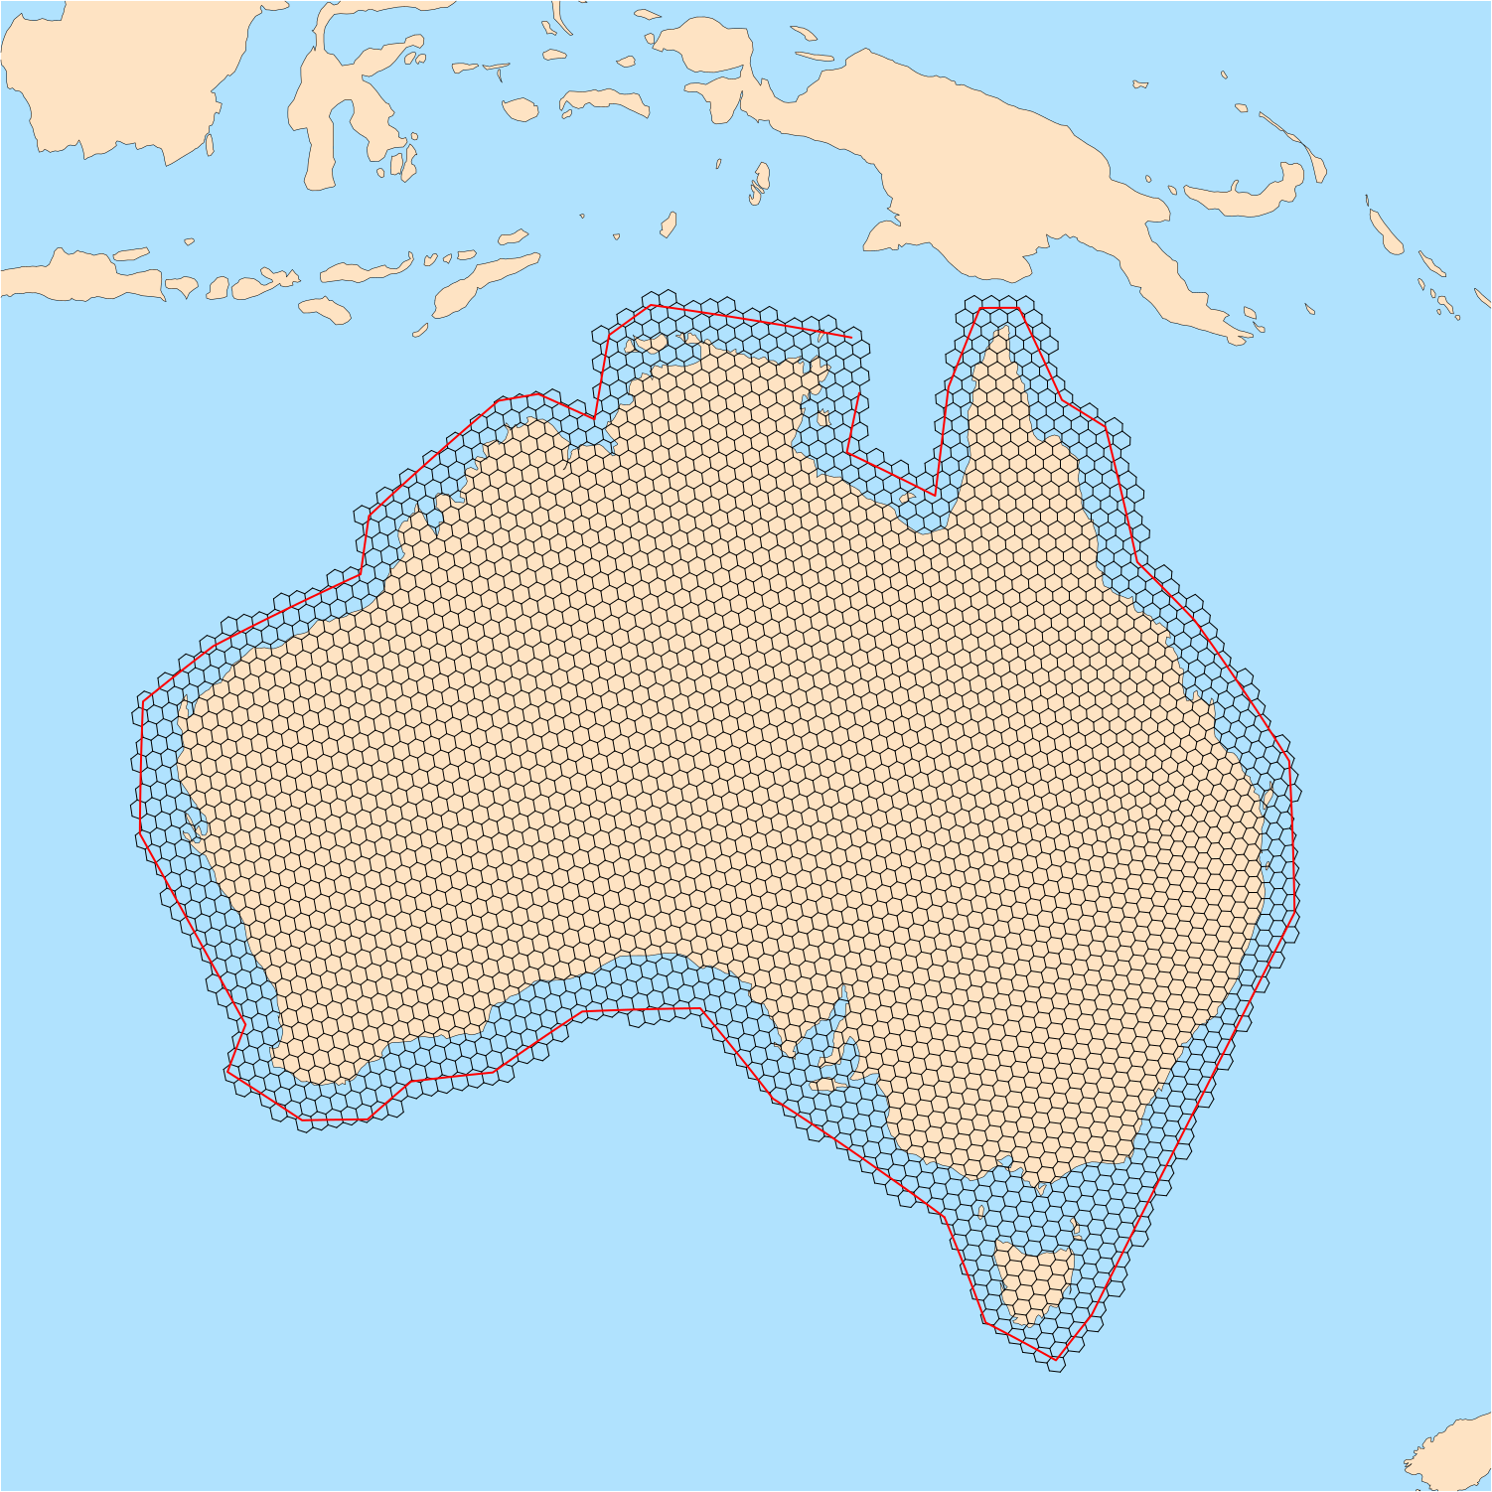
Creating limited-area meshes: polygon region
For polygon regions, the region definition looks like the following
Name: Australia
Type: Custom
Point: -24.0, 134.0
-11.36, 137.50
-10.27, 130.85
-11.24, 129.46
...
-15.17, 137.40
-13.20, 137.78
”Point” gives the latitude and longitude of a point that is interior to the polygon, and it is followed by a list of latitude, longitude boundary points

Slide 9
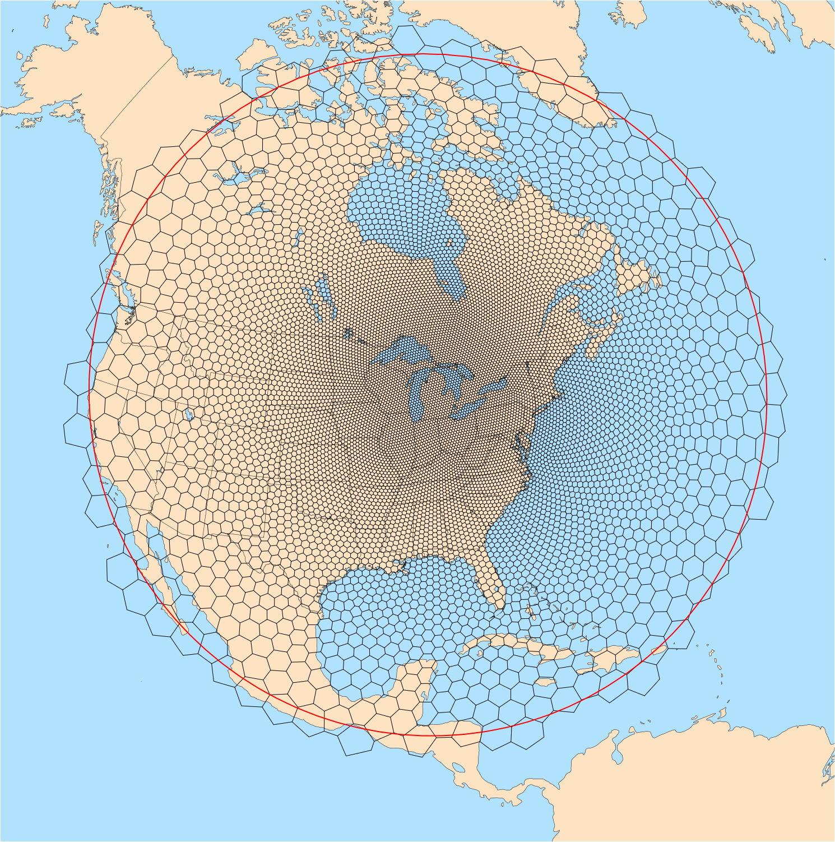
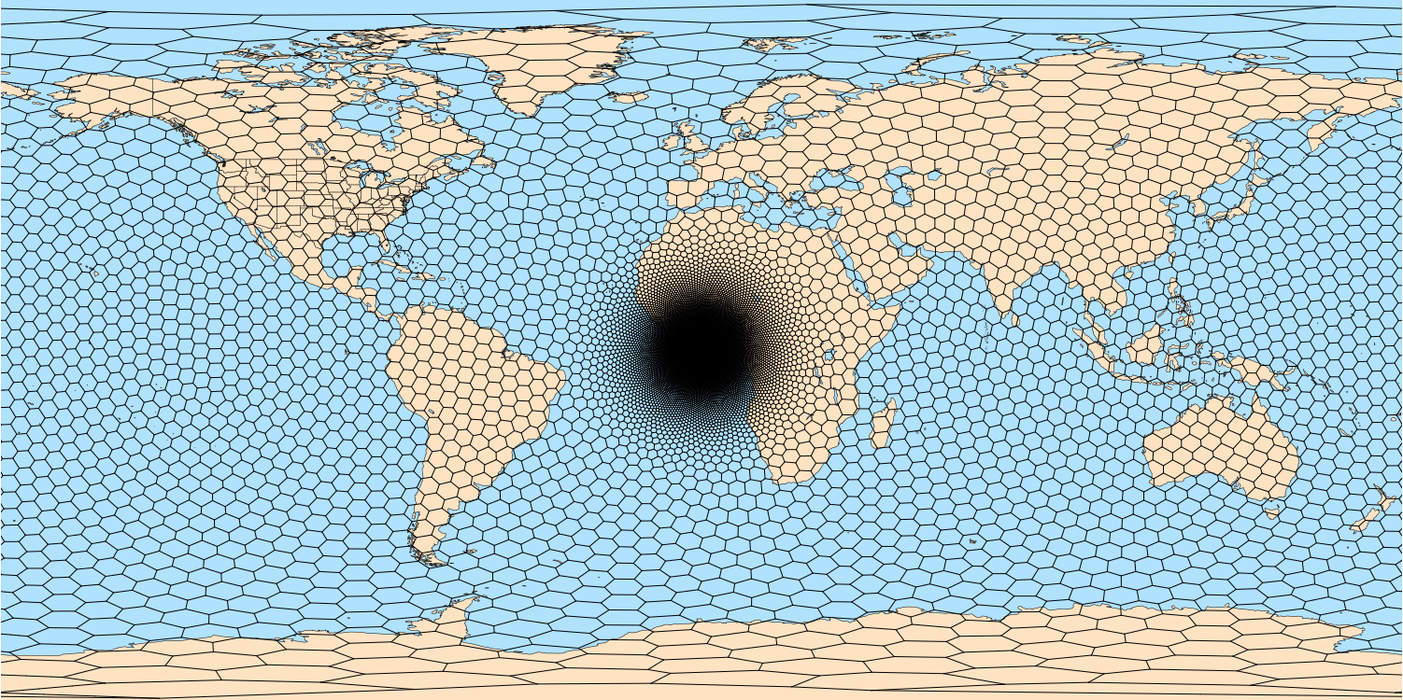
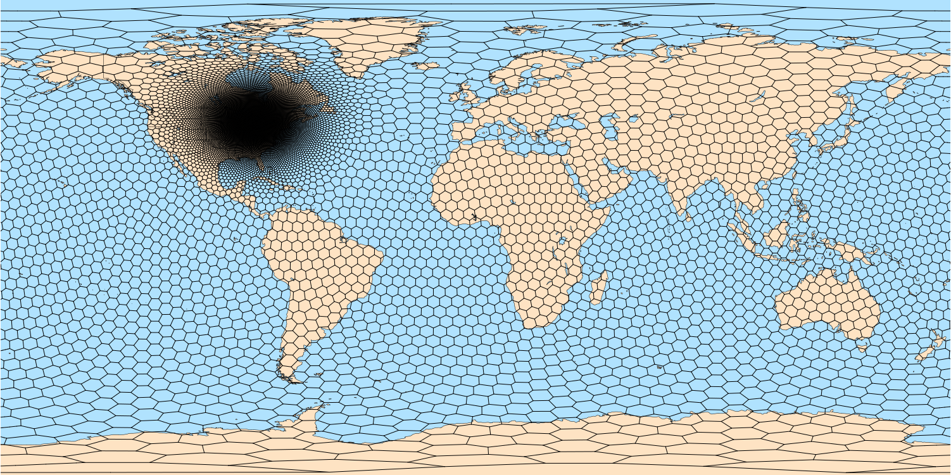
Creating limited-area meshes: refinement
Creating limited-area meshes from variable-resolution “parent” meshes works equally well…
Rotate the refinement to a region of interest using the grid_rotate tool described earlier
2) Extract a limited-area mesh using MPAS-Limited-Area

Slide 10
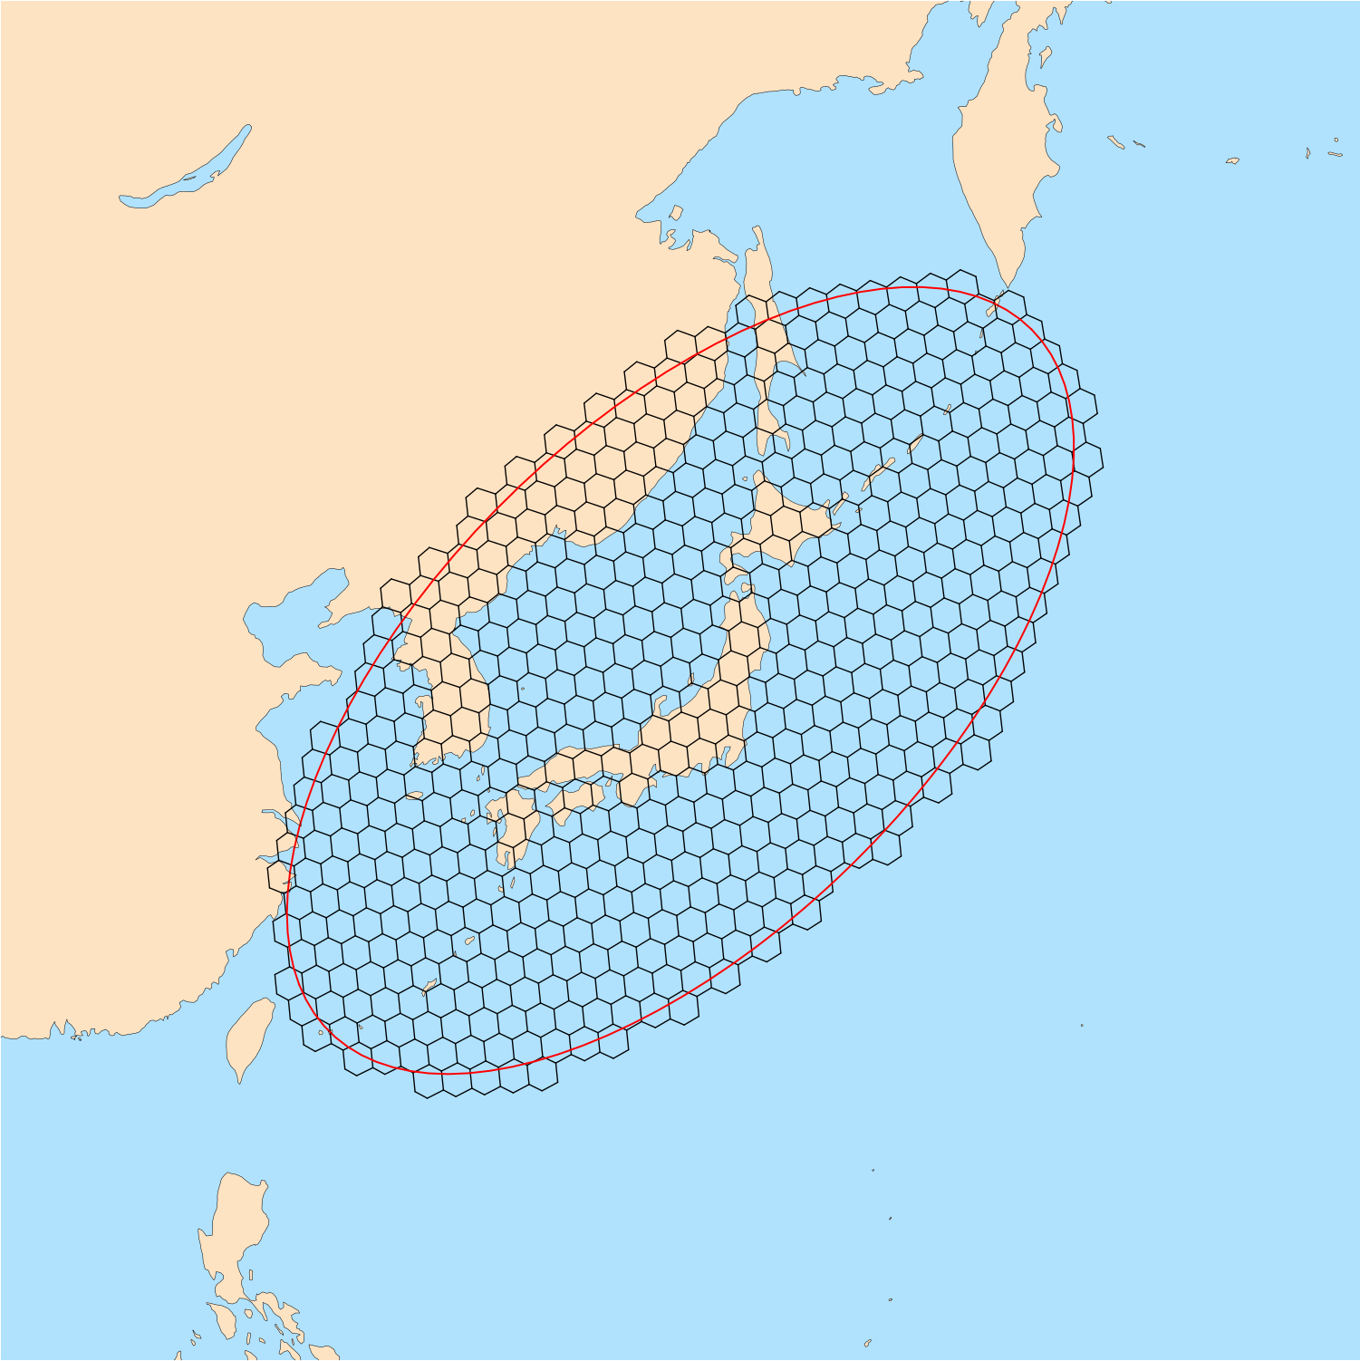
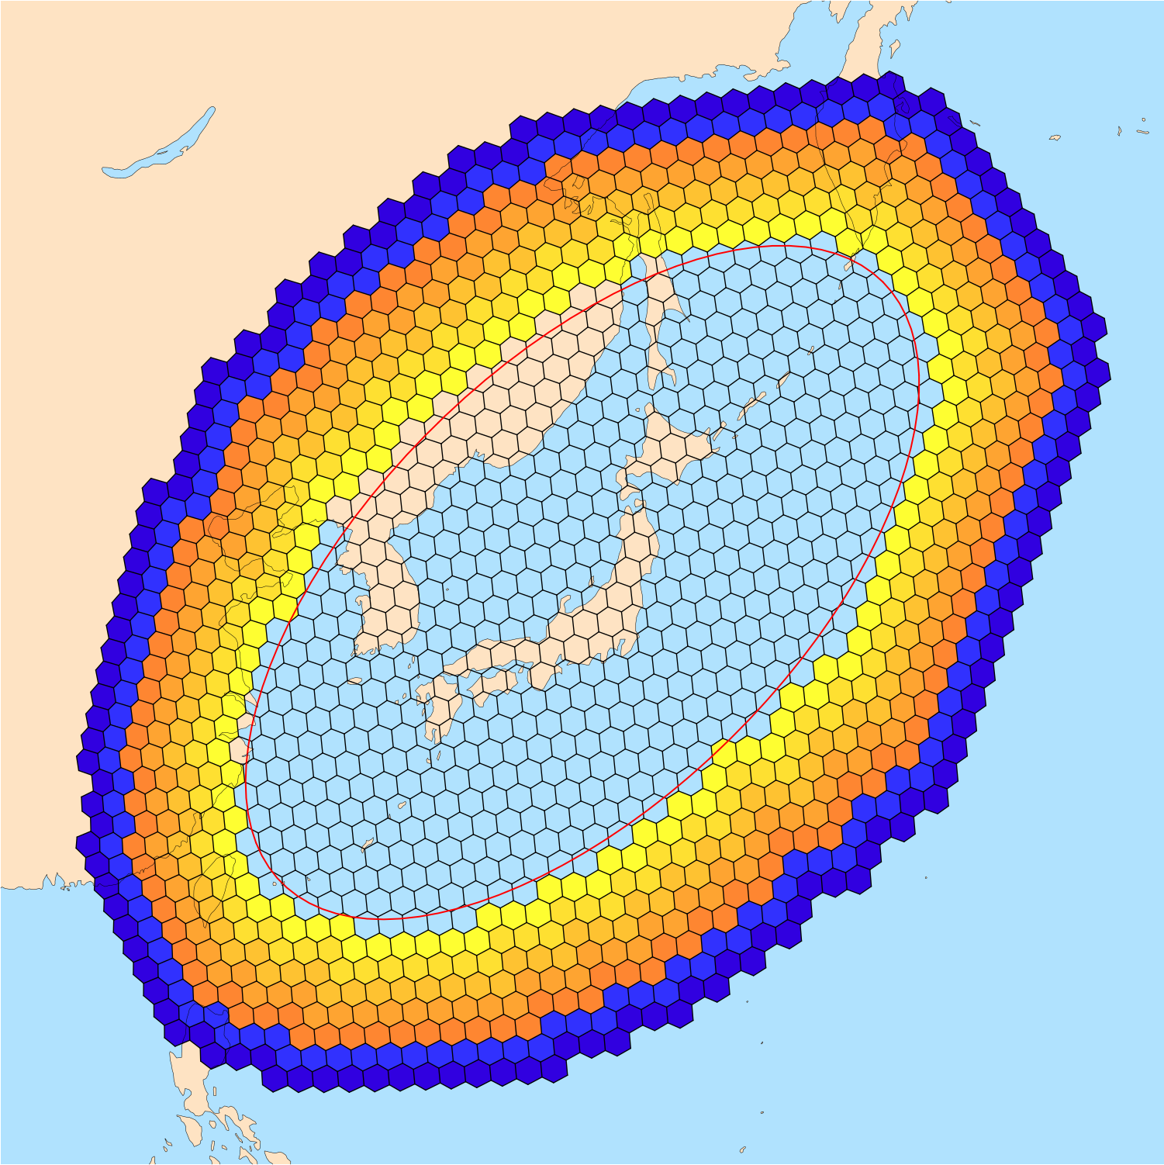
Creating limited-area meshes: boundary cells
After cells inside the region have been identified, layers of relaxation and specified cells are added
Above: An elliptical region (red) with cells identified as being in the region
Above: Layers of relaxation zone cells (yellow-orange) and layers of specified zone cells (blue-purple) are added

Slide 11
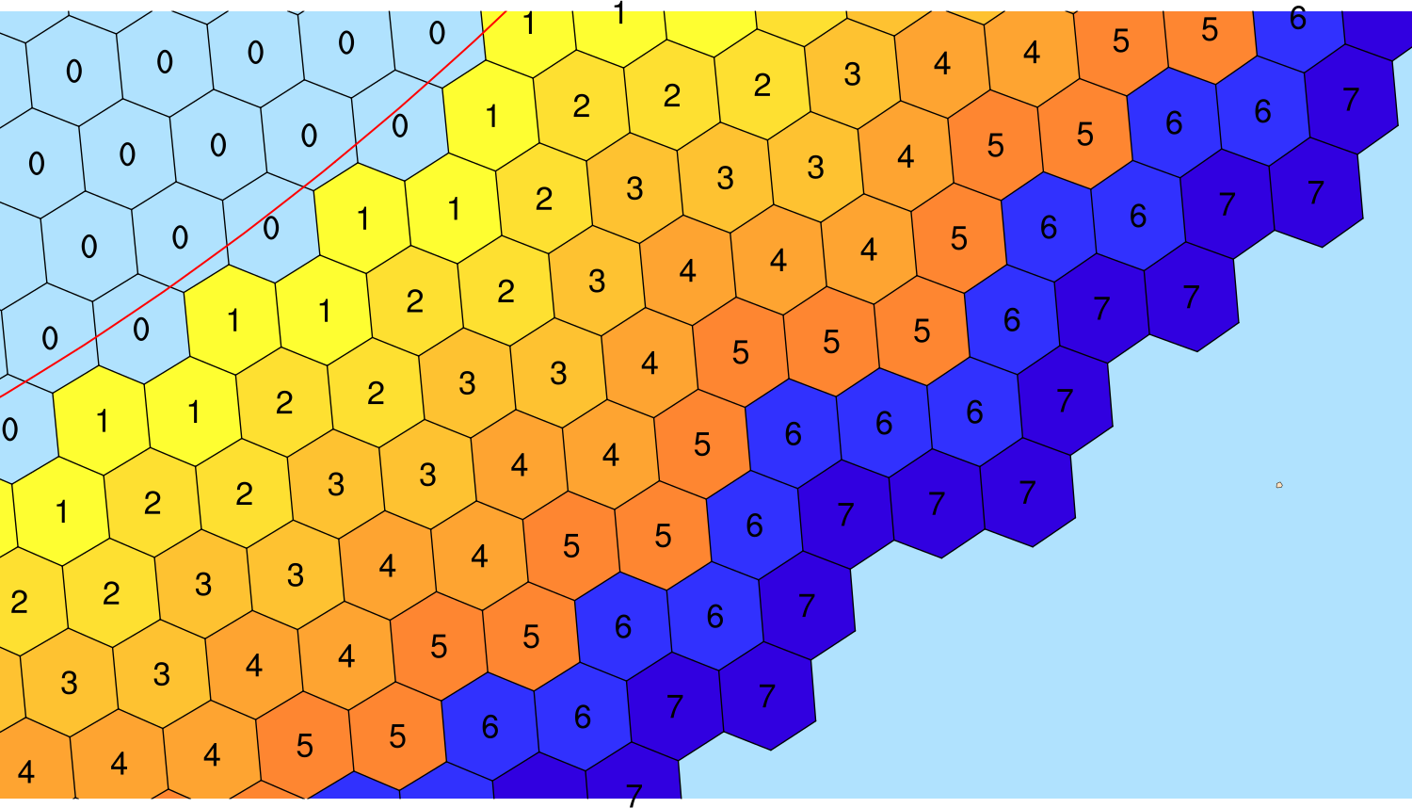
Creating limited-area meshes: boundary cells
In MPAS v8.2, we have
Five layers of relaxation-zone cells
Two layers of specified-zone cells
An integer field, bdyMaskCell, identifies boundary cell types in the regional mesh file
Left: Values of the bdyMaskCell field at the lateral boundary

Slide 12
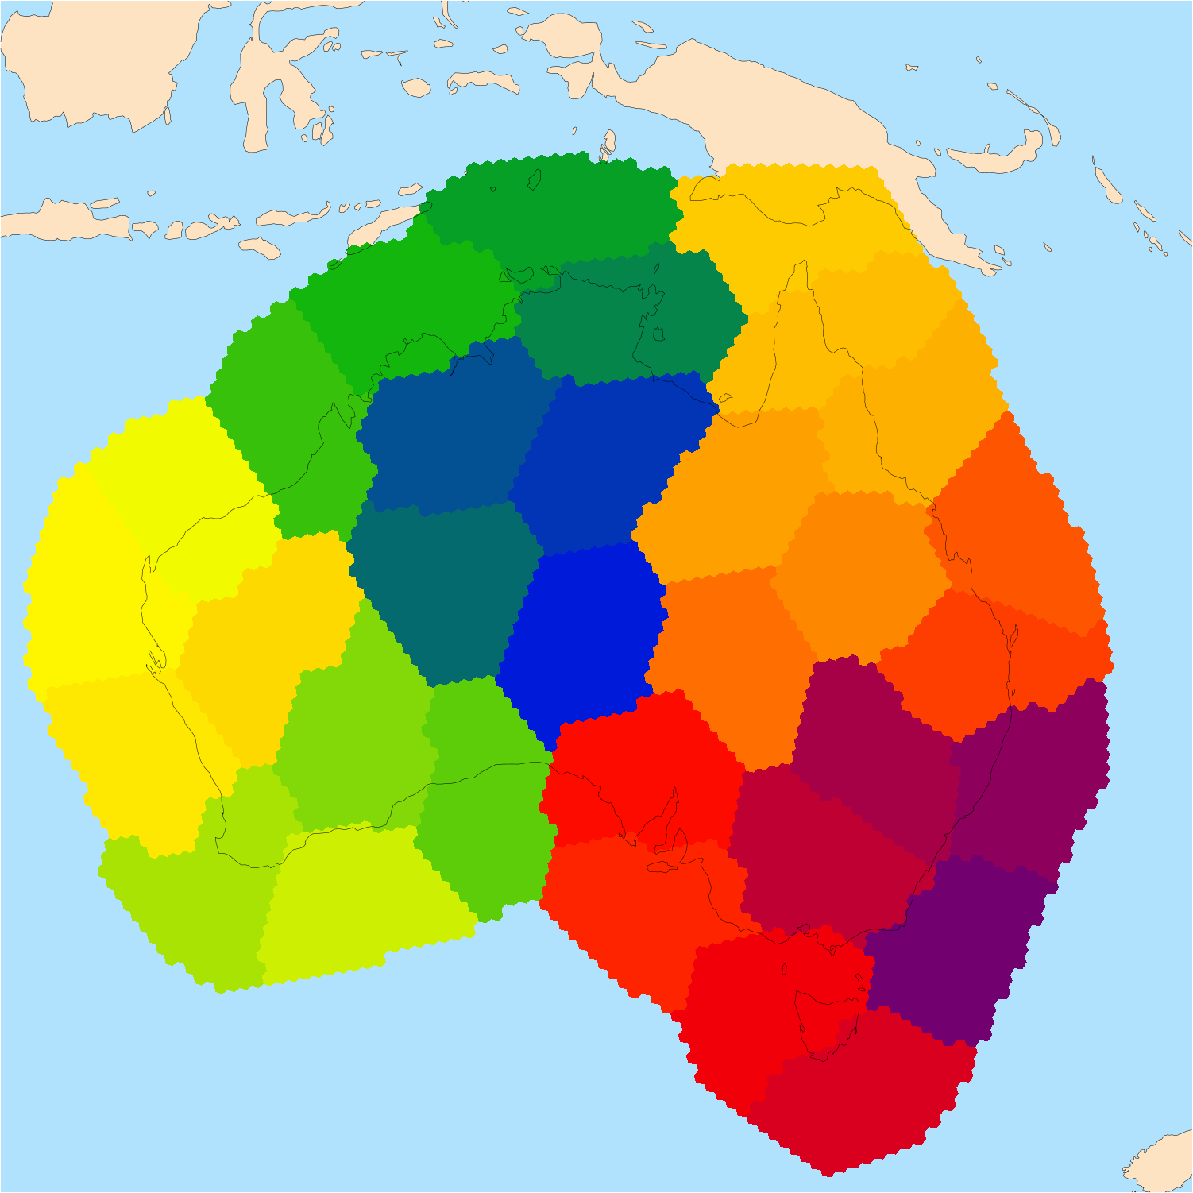
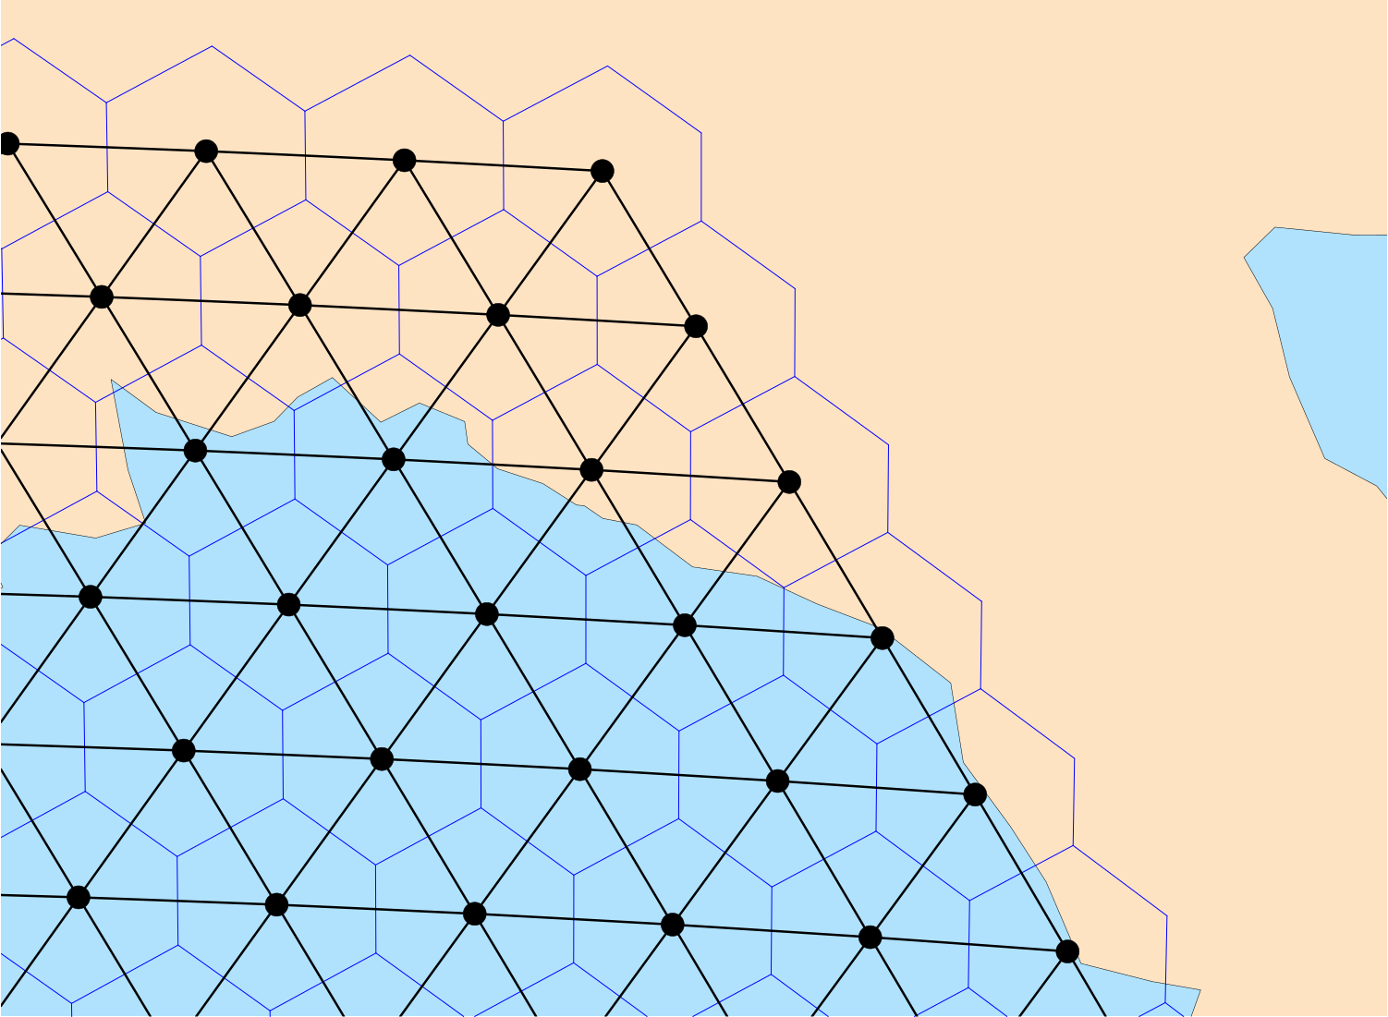
Creating limited-area meshes: partitioning
For newly created limited-area meshes, one must partition the mesh for parallel execution
MPAS-Limited-Area writes not only the netCDF mesh file, but also a graph.info file
Above: An illustration of the mesh connectivity information contained in a graph.info file
Above: Cells in a regional mesh colored according to their partition
See Section 4.1 in the User’s Guide

Slide 13
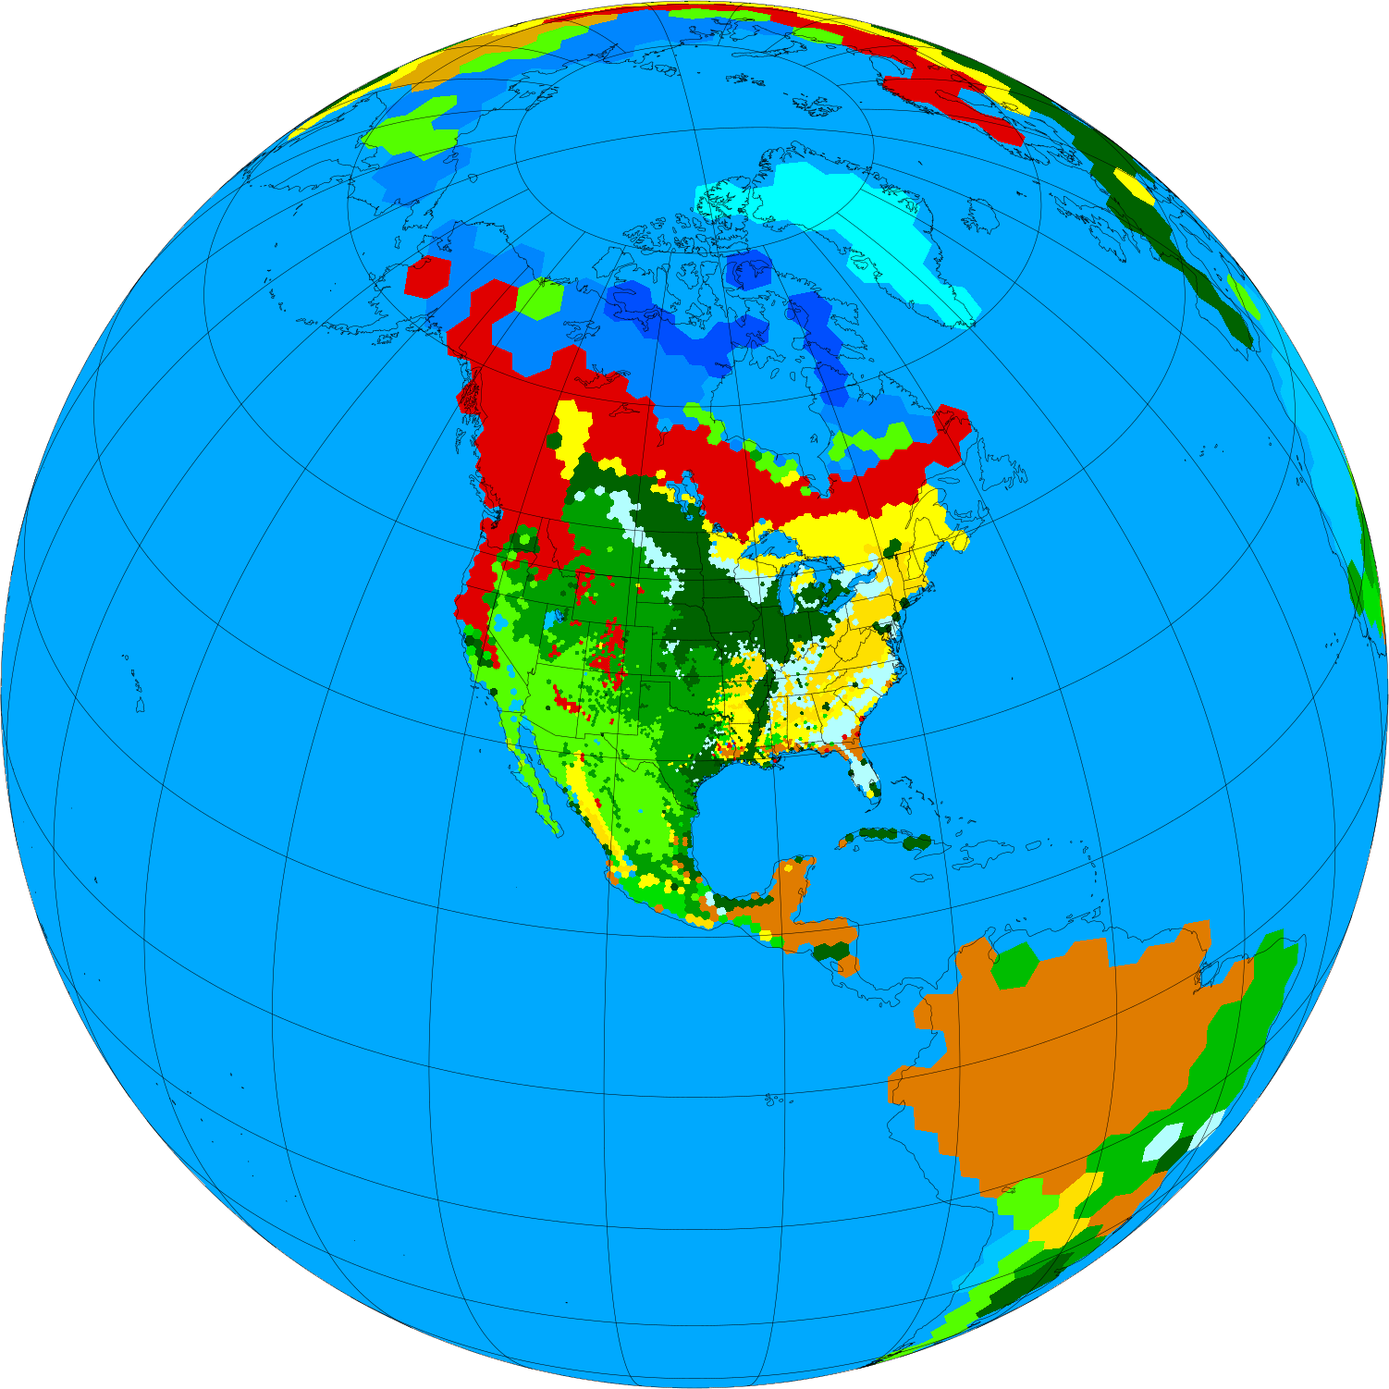
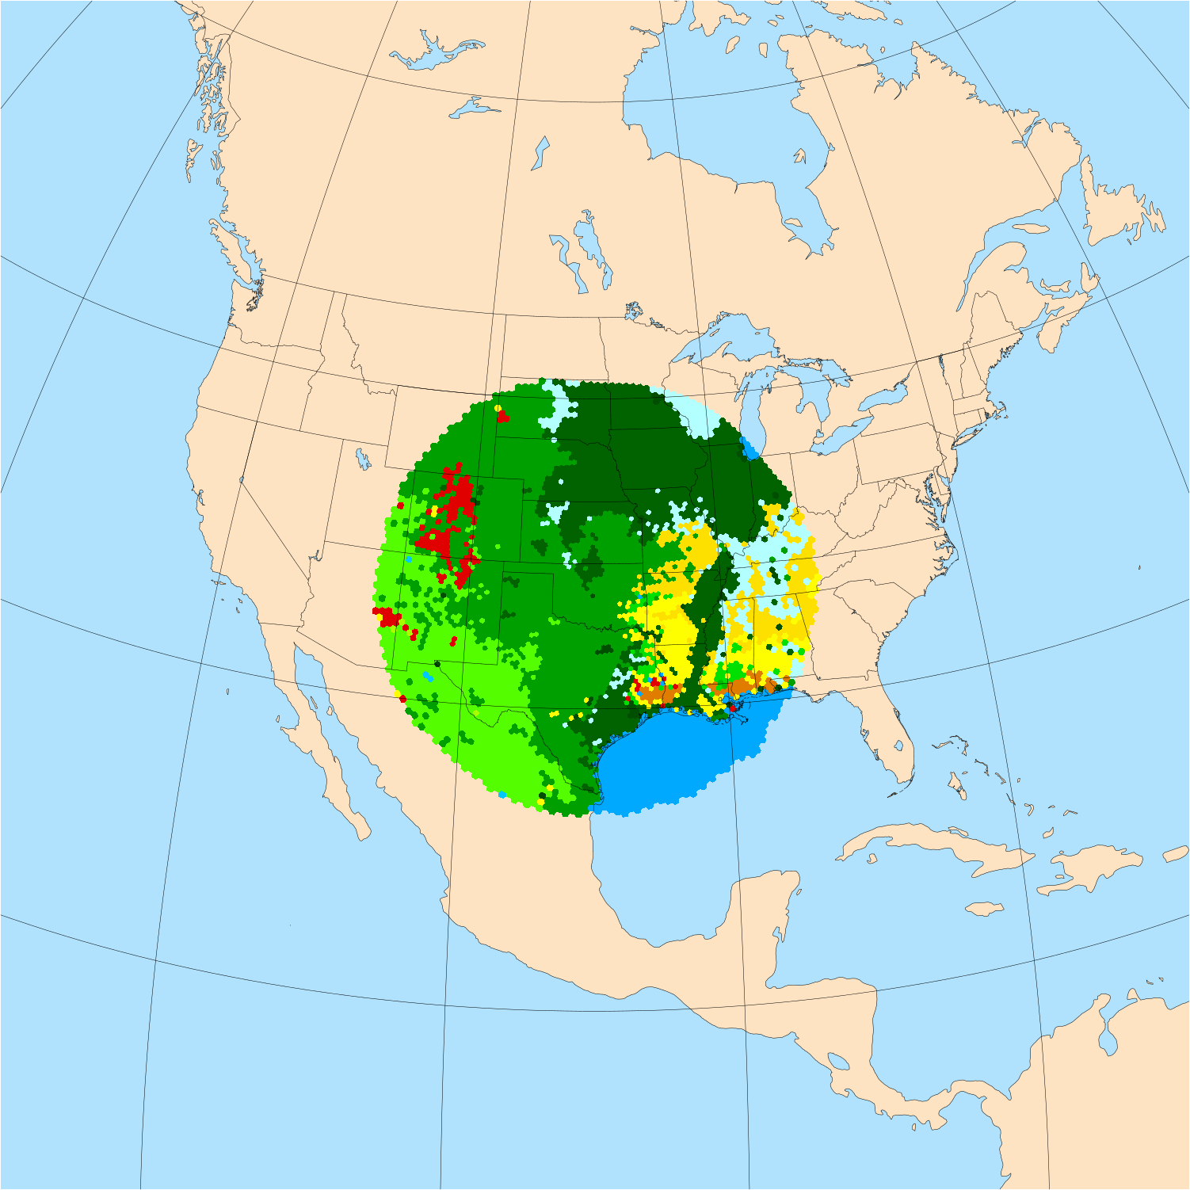
Creating limited-area meshes: static fields
If no rotation needs to be applied, the MPAS-Limited-Area tool can also subset “static” files
This can save time, e.g., if a global, uniform static file already exists!
Above: A global, variable-resolution static file that took ~34 minutes to produce
Above: A limited-area subset of the static file that took <5 seconds to subset

Slide 14
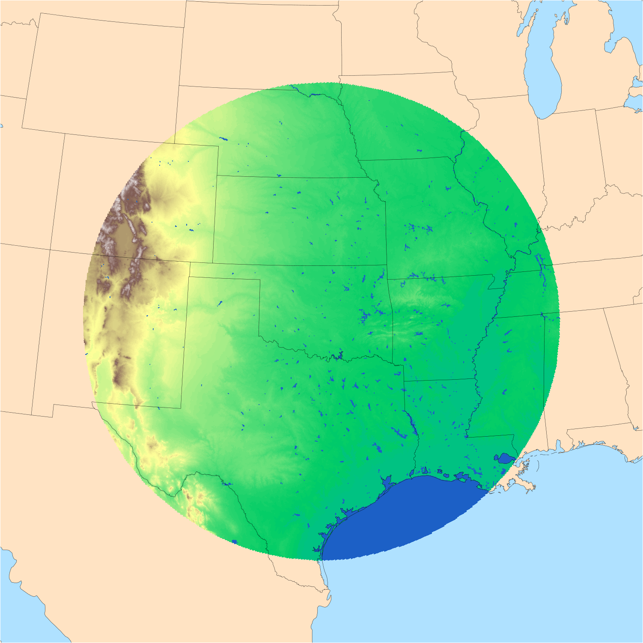
Regional ICs
Generating limited-area initial conditions works exactly as for global initial conditions, with one exception:
The terrain height in boundary cells is generally averaged with the terrain height from the first-guess dataset
&vertical_grid
config_ztop = 30000.0
config_nsmterrain = 1
config_smooth_surfaces = true
config_dzmin = 0.3
config_nsm = 30
config_tc_vertical_grid = true
config_blend_bdy_terrain = true
/
Above: When config_vertical_grid=true, config_blend_bdy_terrain should be ‘true’ as well
Above: The terrain field in a ~3-km regional mesh

Slide 15
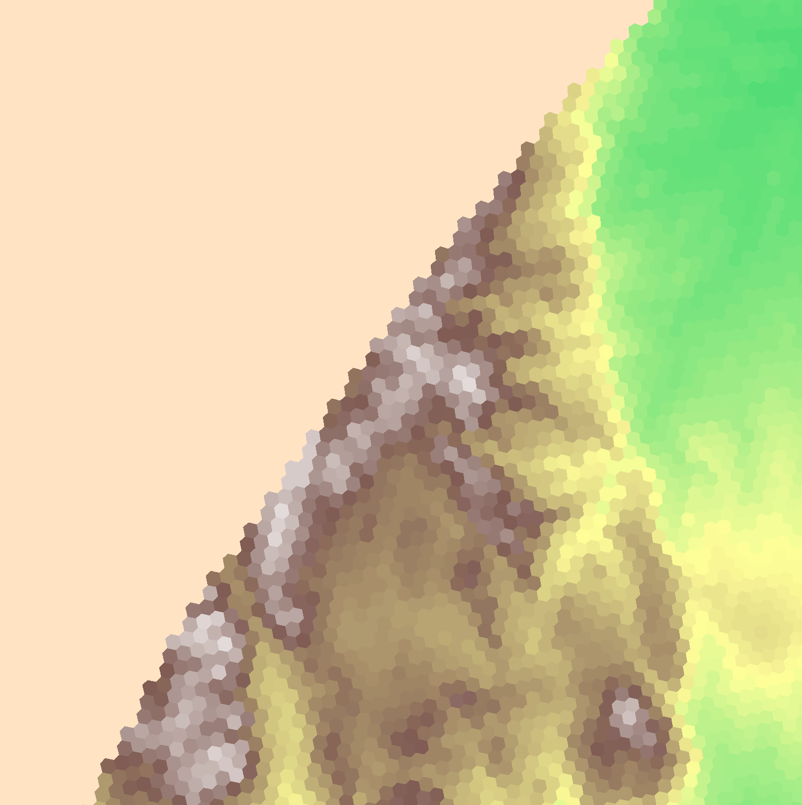
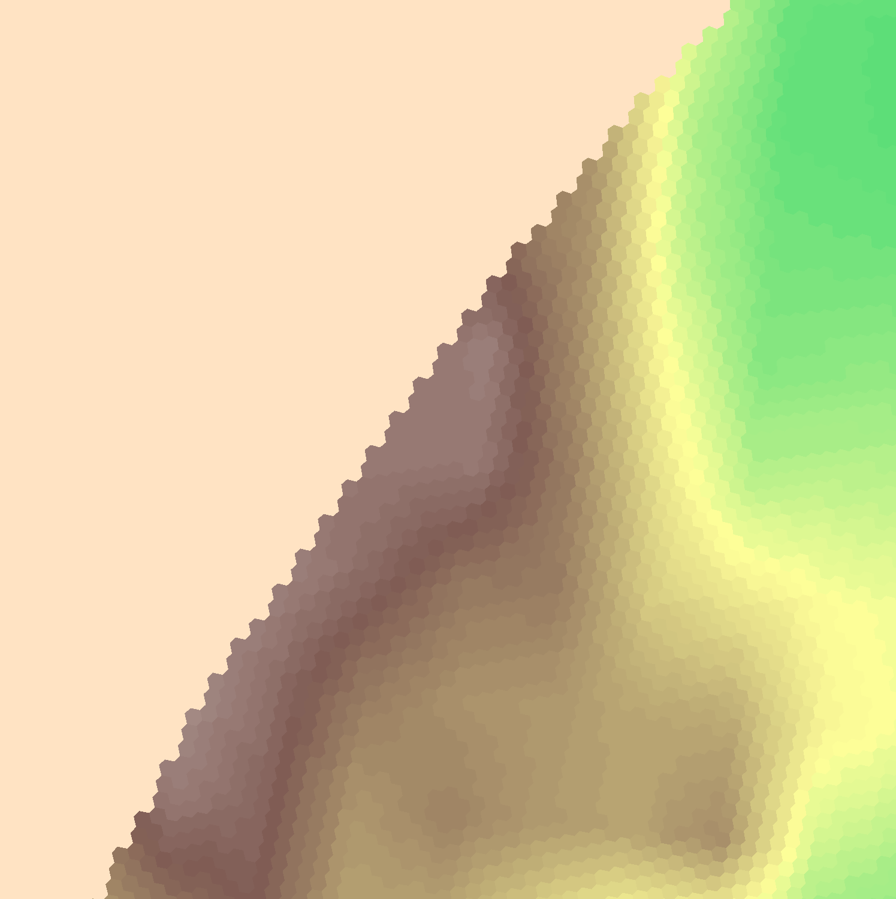
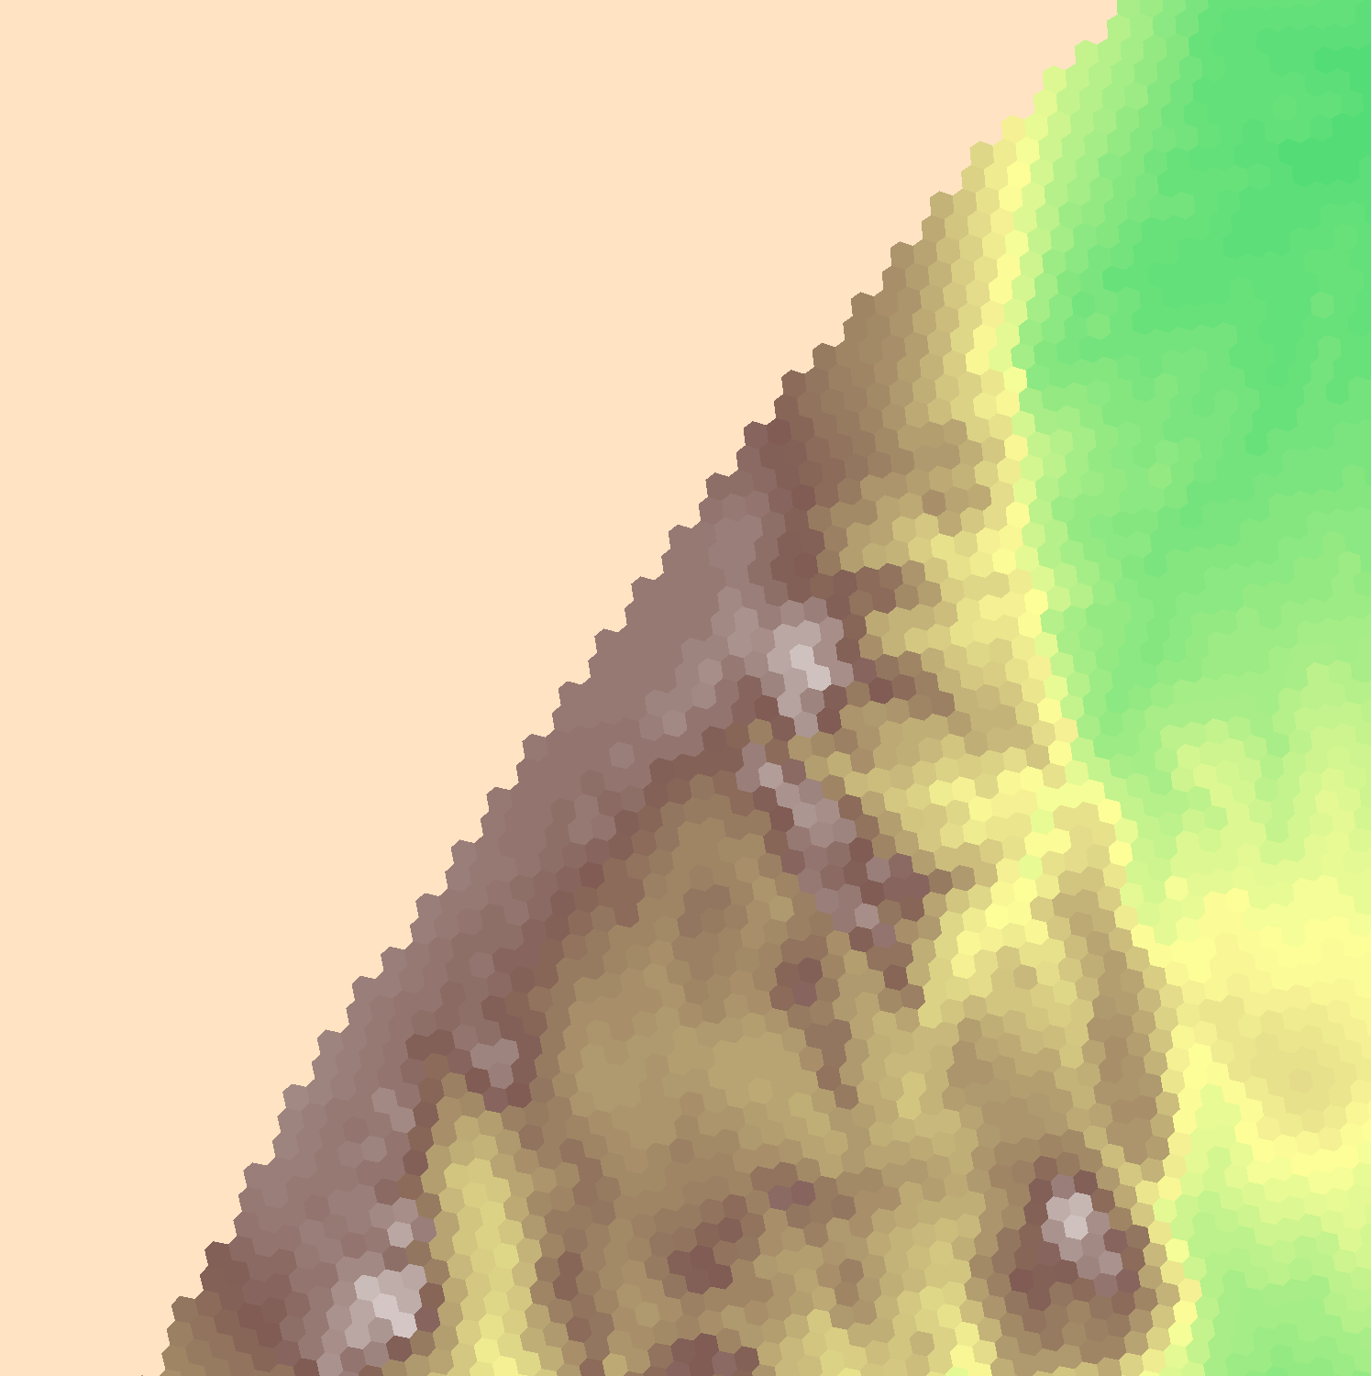
Regional ICs: blending boundary terrain
The config_blend_bdy_terrain option only affects terrain in the boundary cells (where bdyMaskCell > 0)
Terrain field from 3-km static file, interpolated directly from GMTED2010
0.25-deg GFS terrain field interpolated to 3-km mesh
Blended terrain field used in the generation of vertical coordinate surfaces

Slide 16
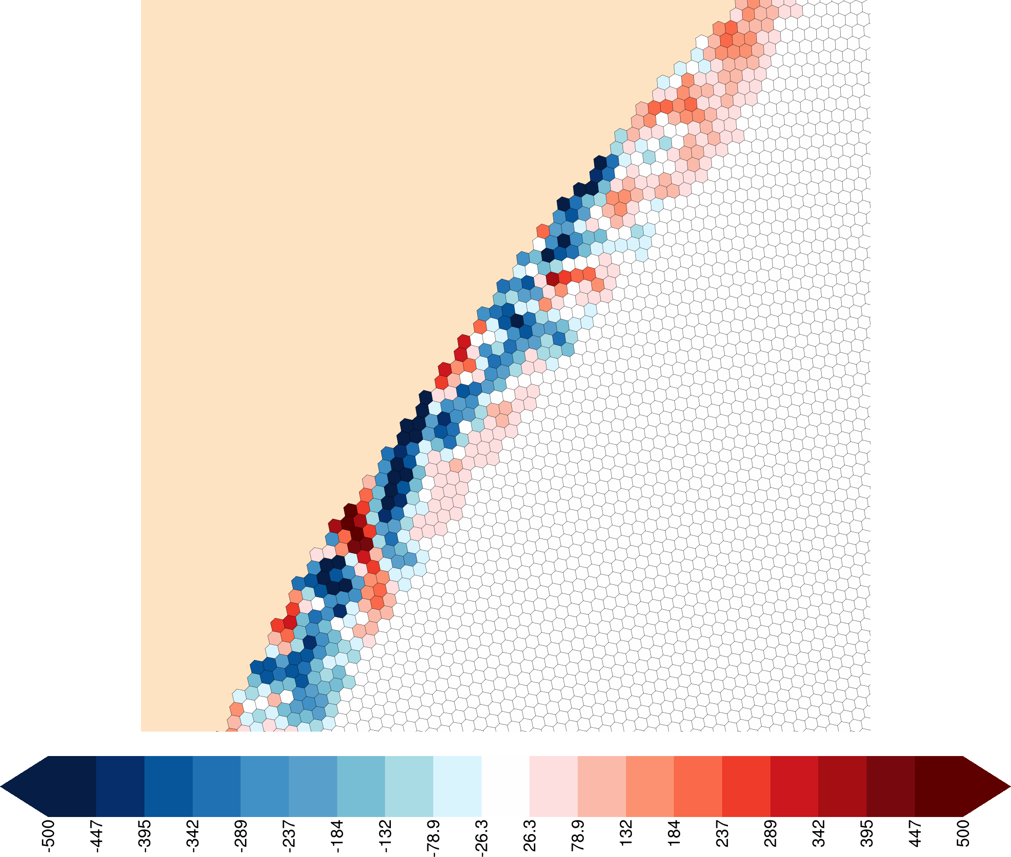
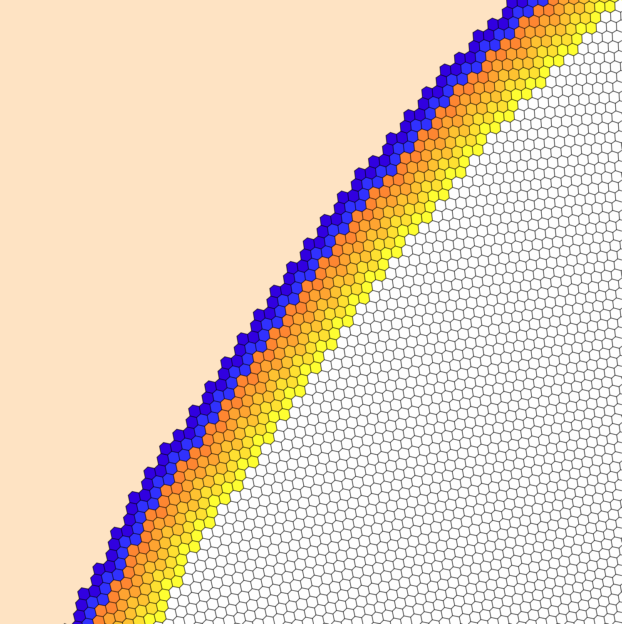
Regional ICs: blending boundary terrain
The config_blend_bdy_terrain option only affects terrain in the boundary cells (where bdyMaskCell > 0)
Blended terrain field
Difference between blended terrain and original terrain fields
bdyMaskCell (>0 for yellow-orange and blue-purple cells)

Slide 17
Generating regional LBCs
Lateral Boundary Conditions (LBCs) for limited-area simulations are created by the init_atmosphere core with “init case” 9:
&nhyd_model
config_init_case = 9
config_start_time = '2019-08-31_00:00:00'
config_stop_time = '2019-09-03_00:00:00'
/
&data_sources
config_met_prefix = 'GFS'
config_fg_interval = 10800
config_use_spechumd = false
/
&interpolation_control
config_extrap_airtemp = 'lapse-rate'
/
Left: The key namelist options to be set when generating lateral boundary conditions with the init_atmosphere core
See Section 8.2 in the User’s Guide

Slide 18
Generating regional LBCs
The “input” stream must be set up to read from a file with vertical grid information
Typically, this done by setting the filename_template to the name of the initial conditions file
<immutable_stream name="input"
type="input"
filename_template=”CONUS.init.nc"
input_interval="initial_only" />

Slide 19
Generating regional LBCs
The “output_interval” for the “lbc” stream must also be set in the streams.init_atmosphere file
This interval must match “config_fg_interval” from the namelist.init_atmosphere file
<immutable_stream name="lbc"
type="output"
filename_template="lbc.$Y-$M-$D_$h.$m.$s.nc"
filename_interval="output_interval"
packages="lbcs"
output_interval="3:00:00" />
Above: A typical “lbc” stream definition for the init_atmosphere core. Besides the output_interval, one may also change the filename_template.

Slide 20
What’s in an LBC file?
The individual LBC netCDF files contain full, uncoupled fields of:
Potential temperature (lbc_theta)
Dry density (lbc_rho)
Normal component of horizontal winds on edges (lbc_u)
Vertical velocity on vertical cell interfaces (lbc_w)
Scalars (lbc_qv, lbc_qc, lbc_qr, etc.)
Valid time of fields (xtime)

Slide 21
Applying LBCs during the simulation
When running the atmosphere core (i.e., the model itself), enable the enforcement of LBCs in the namelist.atmosphere file:
&limited_area
config_apply_lbcs = true
/
Above: The only namelist option needed to “activate” a regional simulation in MPAS v8.2
If config_apply_lbcs is not set to true for a regional simulation, the model will stop with the following error:
ERROR: Boundary cells found in the bdyMaskCell field, but config_apply_lbcs = false.
ERROR: Please ensure that config_apply_lbcs = true for limited-area simulations.
ERROR: Please correct issues with the model input fields and/or namelist.

Slide 22
Applying LBCs during the simulation
Additionally, set the “input_interval” for the “lbc_in” stream in the streams.atmosphere file
The interval must not be higher in frequency than the interval at which LBC files were produced!
<immutable_stream name="lbc_in"
type="input"
filename_template="lbc.$Y-$M-$D_$h.$m.$s.nc"
filename_interval="input_interval"
packages="limited_area"
input_interval="3:00:00" />
If the “input_interval” is smaller than the interval of LBC files, the model will stop with an error like:
ERROR: Could not read from 'lbc_in' stream after the current date to update lateral boundary tendencies
ERROR: Failed to process LBC data at next time after 2019-08-31_00:00:00

Slide 23
Example simulation: Hurricane Harvey
Above: Animation of the precipitable water field from a 6-day variable-resolution, global simulation alongside a 6-day regional simulation

Slide 24
Post-processing concerns
Along the lateral boundaries of meshes cells, edges, and vertices will be missing “neighbors”
If using the cellsOnCell, edgesOnVertex, cellsOnEdge, or edgesOnEdge fields, remember that a neighbor index of 0 indicates a non-existent neighbor
This may be important particularly when applying horizontal operators (e.g., smoothing) to model input or output fields

Slide 25
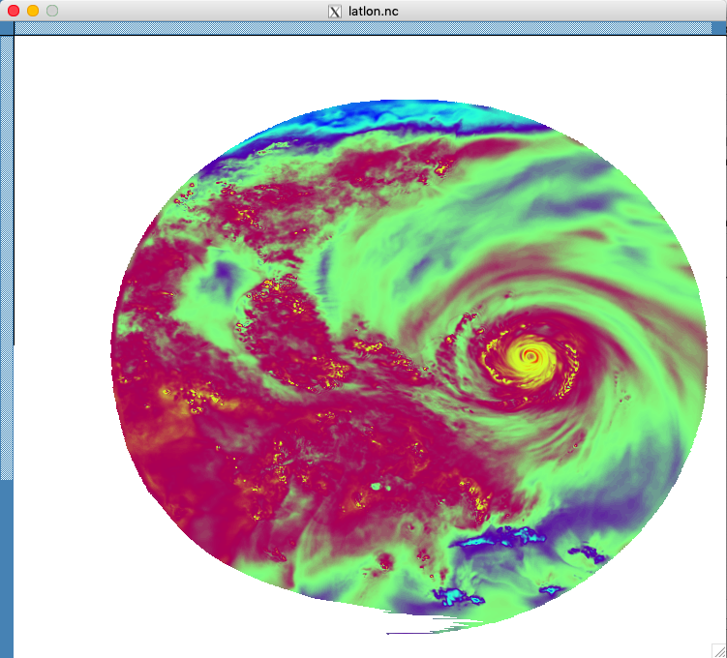
Post-processing concerns
As of today, the convert_mpas program doesn’t handle limited-area meshes very well…
“Smearing” or “streaking” is almost certainly an interpolation artifact and not a problem in your model fields
We expect to fix this soon!
These are interpolation artifacts produced by the convert_mpas program as of this tutorial…

Slide 26
Summary
Running limited-area simulations is only slightly more difficult than running a global simulation!
Create a subset of an existing mesh with the MPAS-Limited-Area tool
Generate initial conditions using “init case” 7 as usual, but set
Generate LBCs using “init case” 9
Run the model as usual, but set
and set the input interval for the “lbc_in” stream in the streams.atmosphere file
&vertical_grid
config_blend_bdy_terrain = true
/
&lbcs
config_apply_lbcs = true
/

