Slide 1
An Overview of the Structure of MPAS Meshes
Michael G. Duda
NCAR/MMM

Slide 2
Background
The use of centroidal Voronoi tessellations (CVTs) with a C-grid staggering of velocity components is a defining feature of MPAS-A
  When constrained to lie on the surface of a sphere, we often call them spherical centroidal Voronoi tessellations (SCVTs)

Slide 3
Background
The use of centroidal Voronoi tessellations (CVTs) with a C-grid staggering of velocity components is a defining feature of MPAS-A
  When constrained to lie on the surface of a sphere, we often call them spherical centroidal Voronoi tessellations (SCVTs)
Voronoi = each grid volume (cell) V_{i} is uniquely associated with a generating point x_{i} such that all points within V_{i} are closer to x_{i} than to any other x_{j}
Lines joining generating points of adjacent cells are
bisected by the shared cell face; and
intersect the shared cell face at a right angle.
Centroidal = the generating point for each Voronoi cell is also the mass centroid of that cell (w.r.t. some density function)

Slide 4
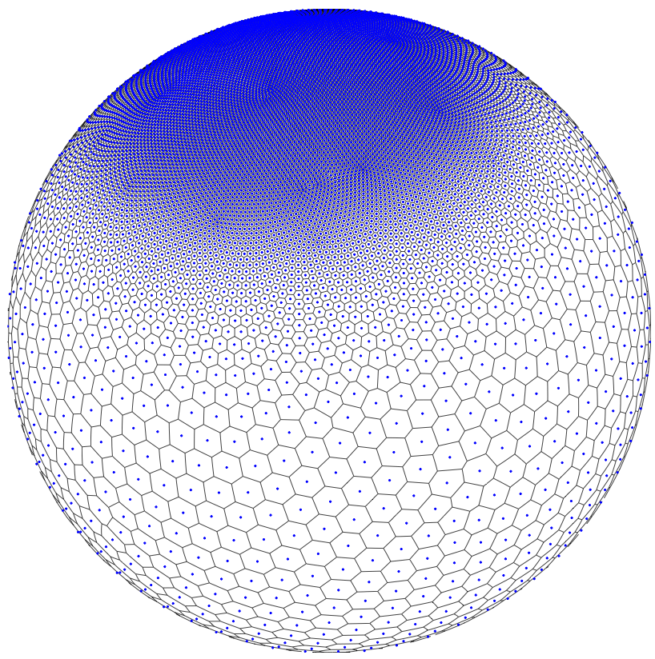
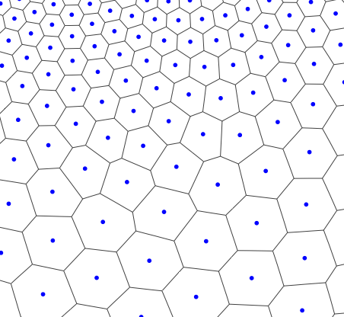
Background
The centroidal aspect of CVTs is used to produce meshes with smoothly-varying resolution
Given a set of generating points, the primal mesh (finite volume mesh) in MPAS is defined by the Voronoi tessellation induced by this set
Observe that we have a fully unstructured horizontal mesh, not just a deformation of the icosahedral mesh! Cells may have 5, 6, 7, or more sides.

Slide 5

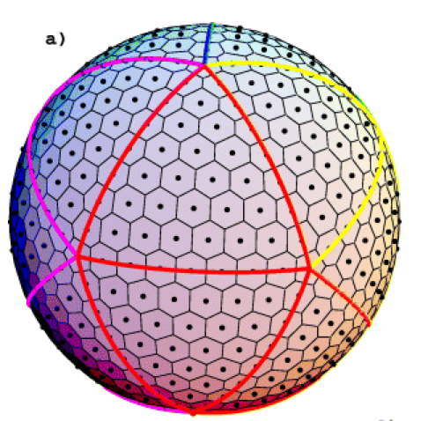
How does MPAS keep track of this unstructured mesh?
Quasi-uniform MPAS meshes look just like icosahedral meshes...
A quasi-uniform MPAS mesh
An icosahedral mesh
... but the MPAS solver considers every mesh as a completely general, unstructured mesh. There are no special cases!

Slide 6
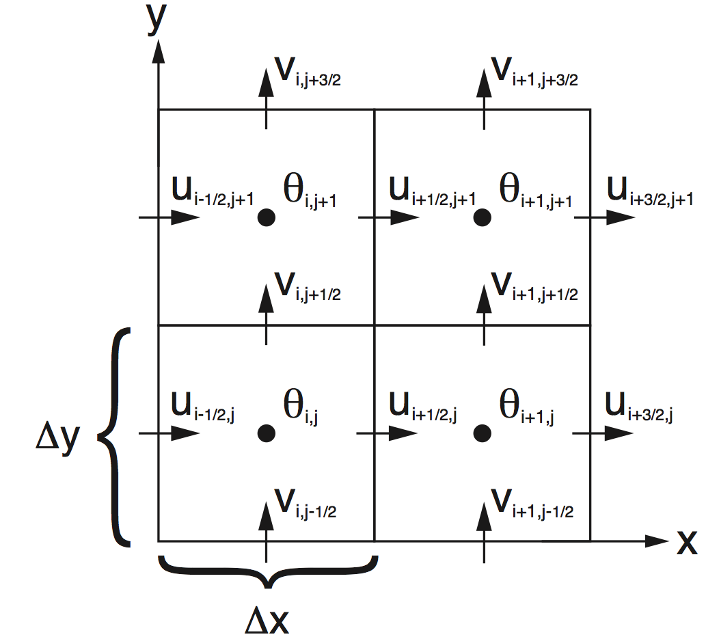
How does MPAS keep track of this unstructured mesh?
One can start to imagine ways to identify neighboring cells implicitly based on the index or location of each cell
In a rectangular mesh, our neighbors are at (i+1, j), (i-1, j), (i, j+1), (i, j-1)
Above: A region from the ARW C-staggered grid, stored in a 2-d array.

Slide 7
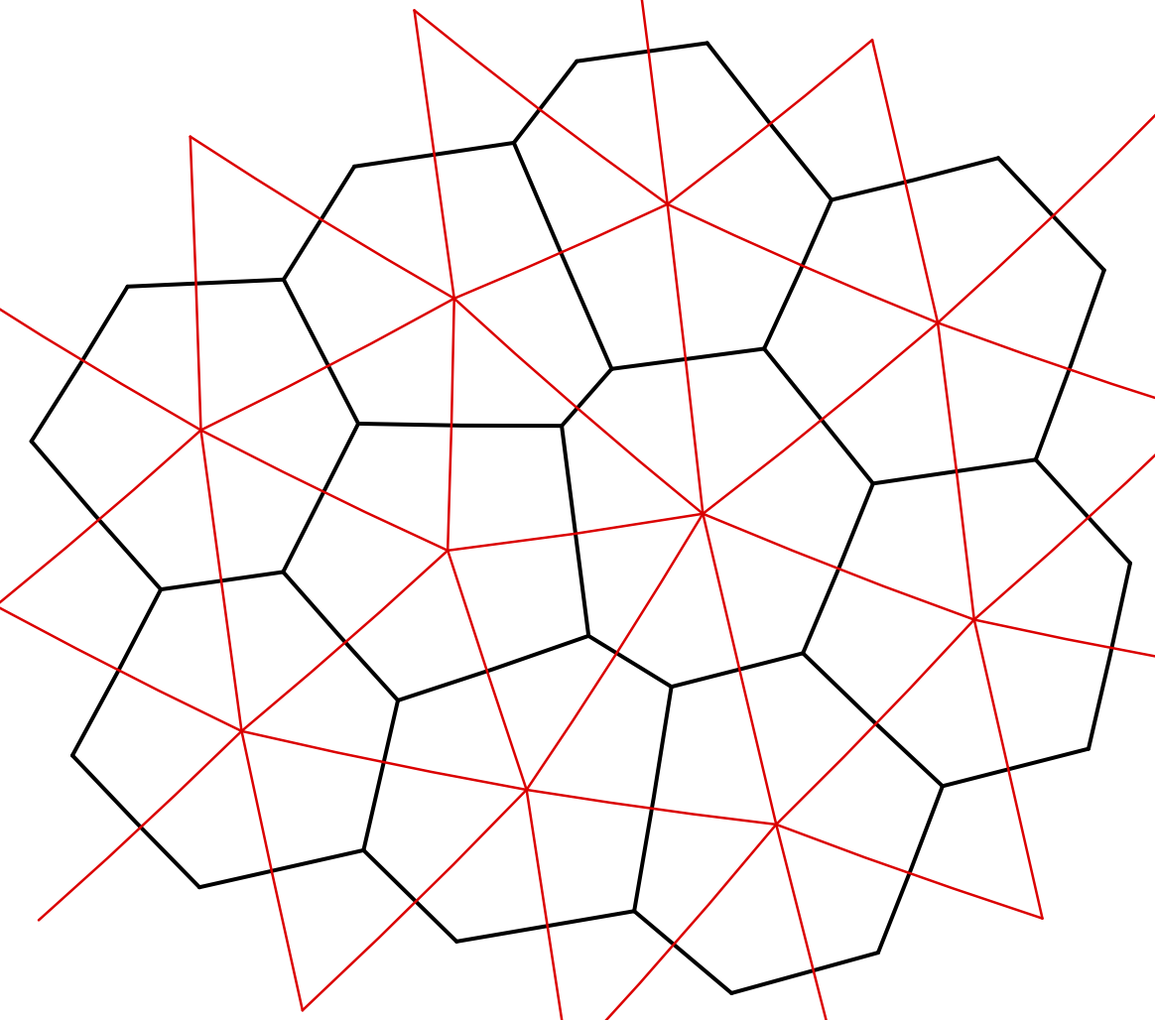
How does MPAS keep track of this unstructured mesh?
One can start to imagine ways to identify neighboring cells implicitly based on the index or location of each cell
In a rectangular mesh, our neighbors are at (i+1, j), (i-1, j), (i, j+1), (i, j-1)
Who is the “next” cell after this one in any direction?
Above: A region from the ARW C-staggered grid, stored in a 2-d array.
Above: A region from an MPAS mesh showing Voronoi regions (black) and Delaunay triangles (red).

Slide 8
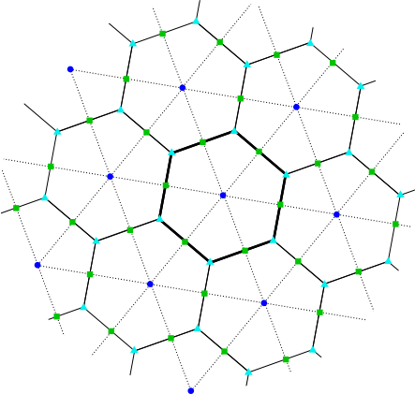
How does MPAS keep track of this unstructured mesh?
Schemes for implicitly finding the indices/identities (the “IDs”) of neighboring mesh cells are bound to fail...
... so we must find them explicitly through connectivity fields that are the foundation of the MPAS mesh representation.
Three types of mesh elements are tracked in the mesh representation:
Cell locations (blue circles) - the generating points of the Voronoi mesh
Vertex locations (cyan triangles) - the corners of primal mesh cells
Edge locations (green squares) - the points where the dual mesh edges intersect the primal mesh edges

Slide 9
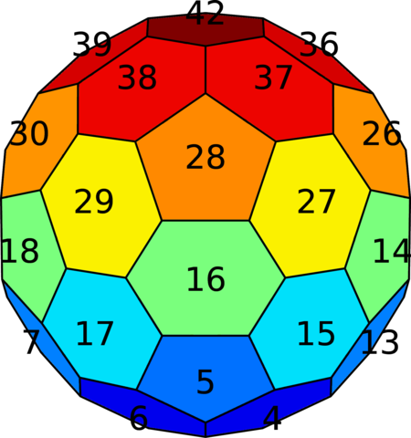
How does MPAS keep track of this unstructured mesh?
For the unstructured, horizontal dimension there is nothing to be gained from using 2-d arrays...
...hence, the horizontal dimension is collapsed into a single array dimension. We then have a simple list of elements!
Example: For some 2-d field (shown in color) defined on mesh cells, that field is stored in a 1-d array (bottom) that is indexed by cell number (labeled in black).

Slide 10
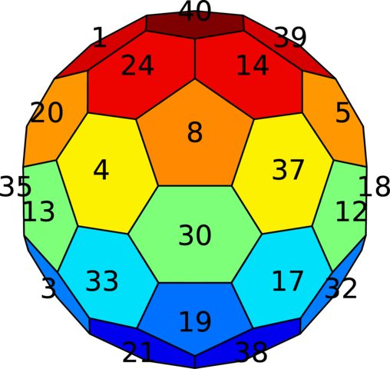
How does MPAS keep track of this unstructured mesh?
For the unstructured, horizontal dimension there is nothing to be gained from using 2-d arrays...
...hence, the horizontal dimension is collapsed into a single array dimension. We then have a simple list of elements!
From the perspective of the MPAS solver, any ordering of cells in the mesh is as good as any other¹, as long as the mesh representation is consistent with this ordering.
¹Though some orderings may give better performance, e.g., due to better cache reuse.

Slide 11
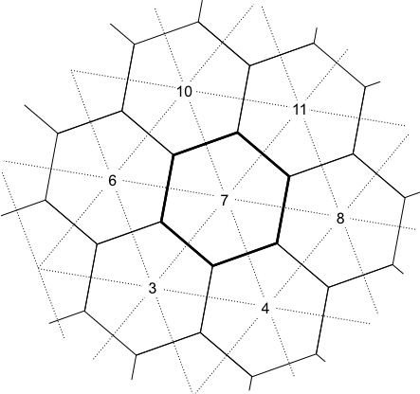
Explicit connectivity fields
nEdgesOnCell(nCells) – the number of neighbors for each cell
cellsOnCell(maxEdges, nCells) – the indices of neighboring cells for each cell
edgesOnCell(maxEdges, nCells) – the indices of bounding edges for each cell
verticesOnCell(maxEdges, nCells) – the indices of corner vertices for each cell
edgesOnVertex(vertexDegree,nVertices) – the indices of edges incident with each vertex
verticesOnEdge(2,nEdges) – the indices of endpoint vertices for each edge
cellsOnVertex(vertexDegree,nVertices) – the indices of cells meeting at each vertex
cellsOnEdge(2,nEdges) – the indices of cells separated by each edge
nEdgesOnCell(7)=6
cellsOnCell(1,7)=8
cellsOnCell(2,7)=11
cellsOnCell(3,7)=10
cellsOnCell(4,7)=6
cellsOnCell(5,7)=3
cellsOnCell(6,7)=4
At model start-up, all indices in these arrays are re-numbered to a local indexing scheme.

Slide 12
Horizontal wind vectors: how are these defined?
In a rectangular C-grid, which directions represent positive normal velocity?
On a rectangular grid, one might say that positive U flows from left to right, and positive V flows from bottom to top when looking down on the xy-plane.
On a CVT mesh, one could introduce a similar definition, but we have only U, not V, so such a definition becomes more complicated...

Slide 13
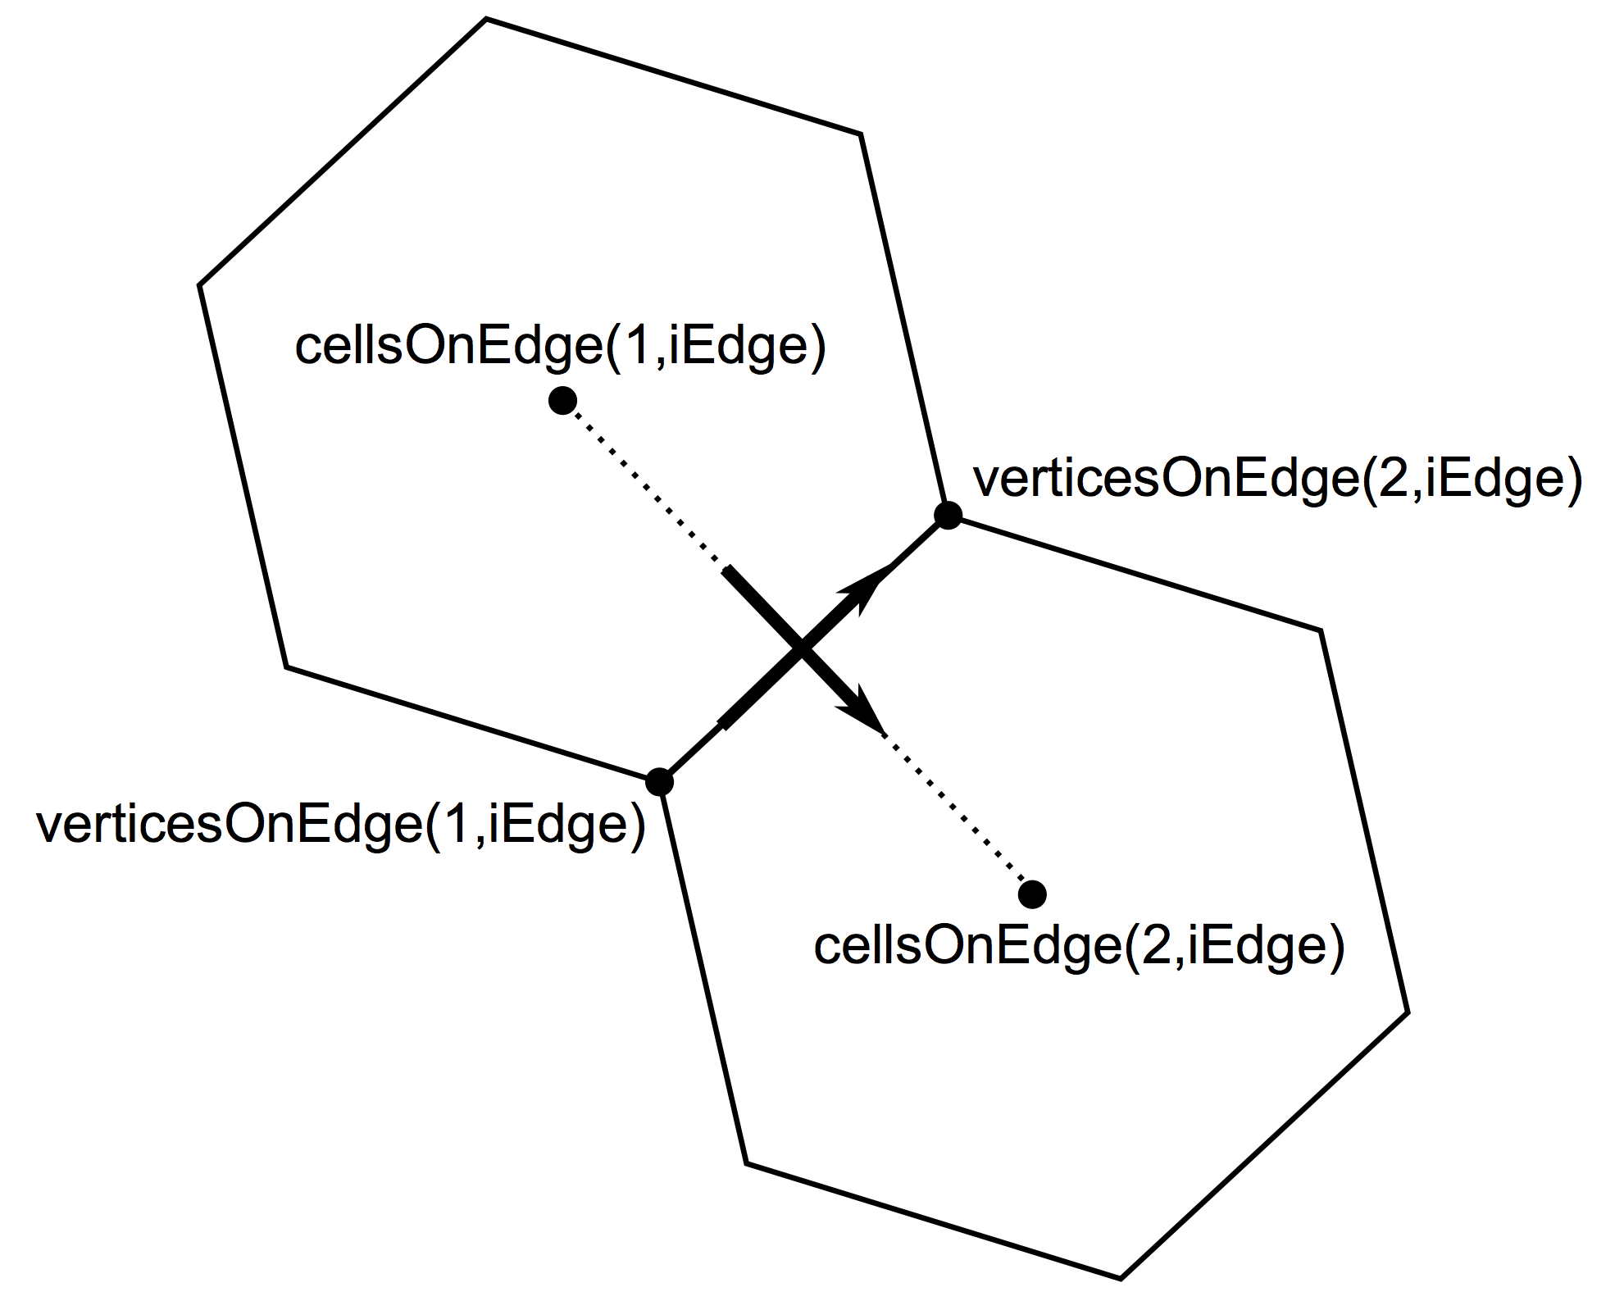
Horizontal wind vectors: how are these defined?
Positive u (normal) velocity is always defined as flow from
cellsOnEdge(1,iEdge) to cellsOnEdge(2,iEdge) for edge iEdge
Positive v (tangential) velocity is always defined as flow from verticesOnEdge(1,iEdge) to verticesOnEdge(2,iEdge) for edge iEdge
The cross product of the positive u and v vectors always points upward (out of the plane)

Slide 14
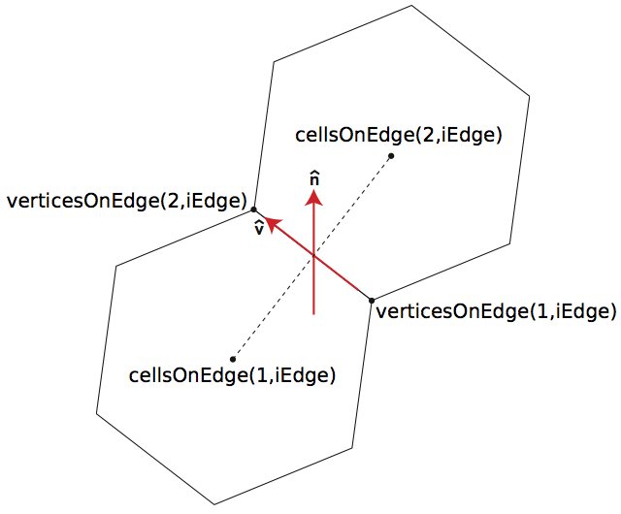
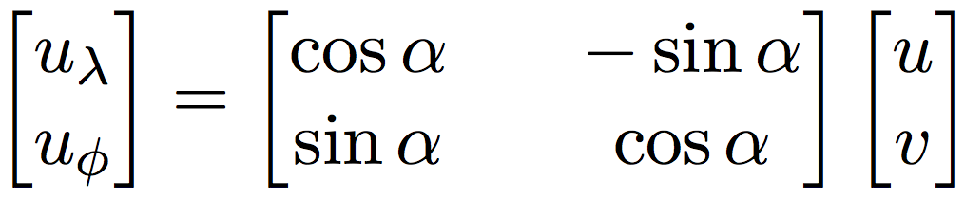
Horizontal wind vectors: how are these defined?
angleEdge(nEdges) – angle between east and positive u
Earth-relative horizontal winds, u_{zonal} and u_{meridional}, can be calculated using u and v:
where α is angleEdge.

Slide 15
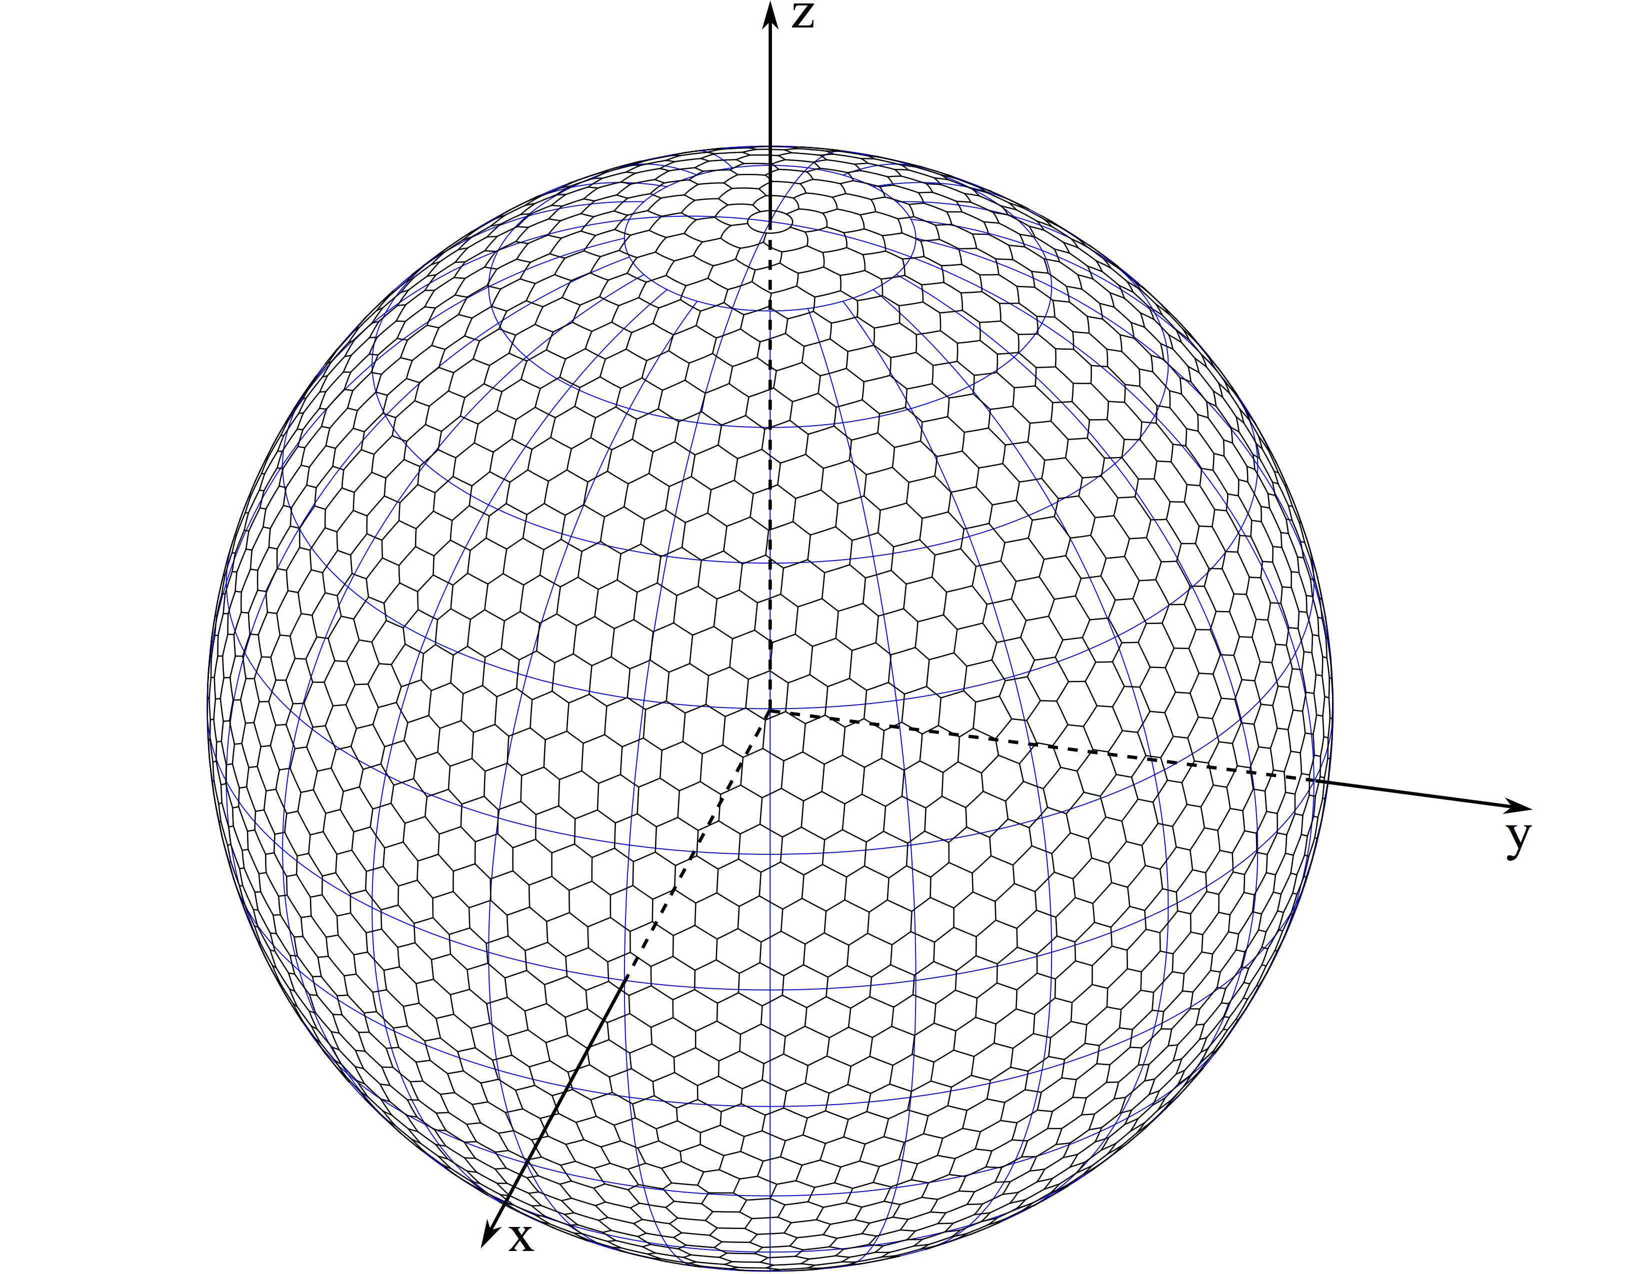
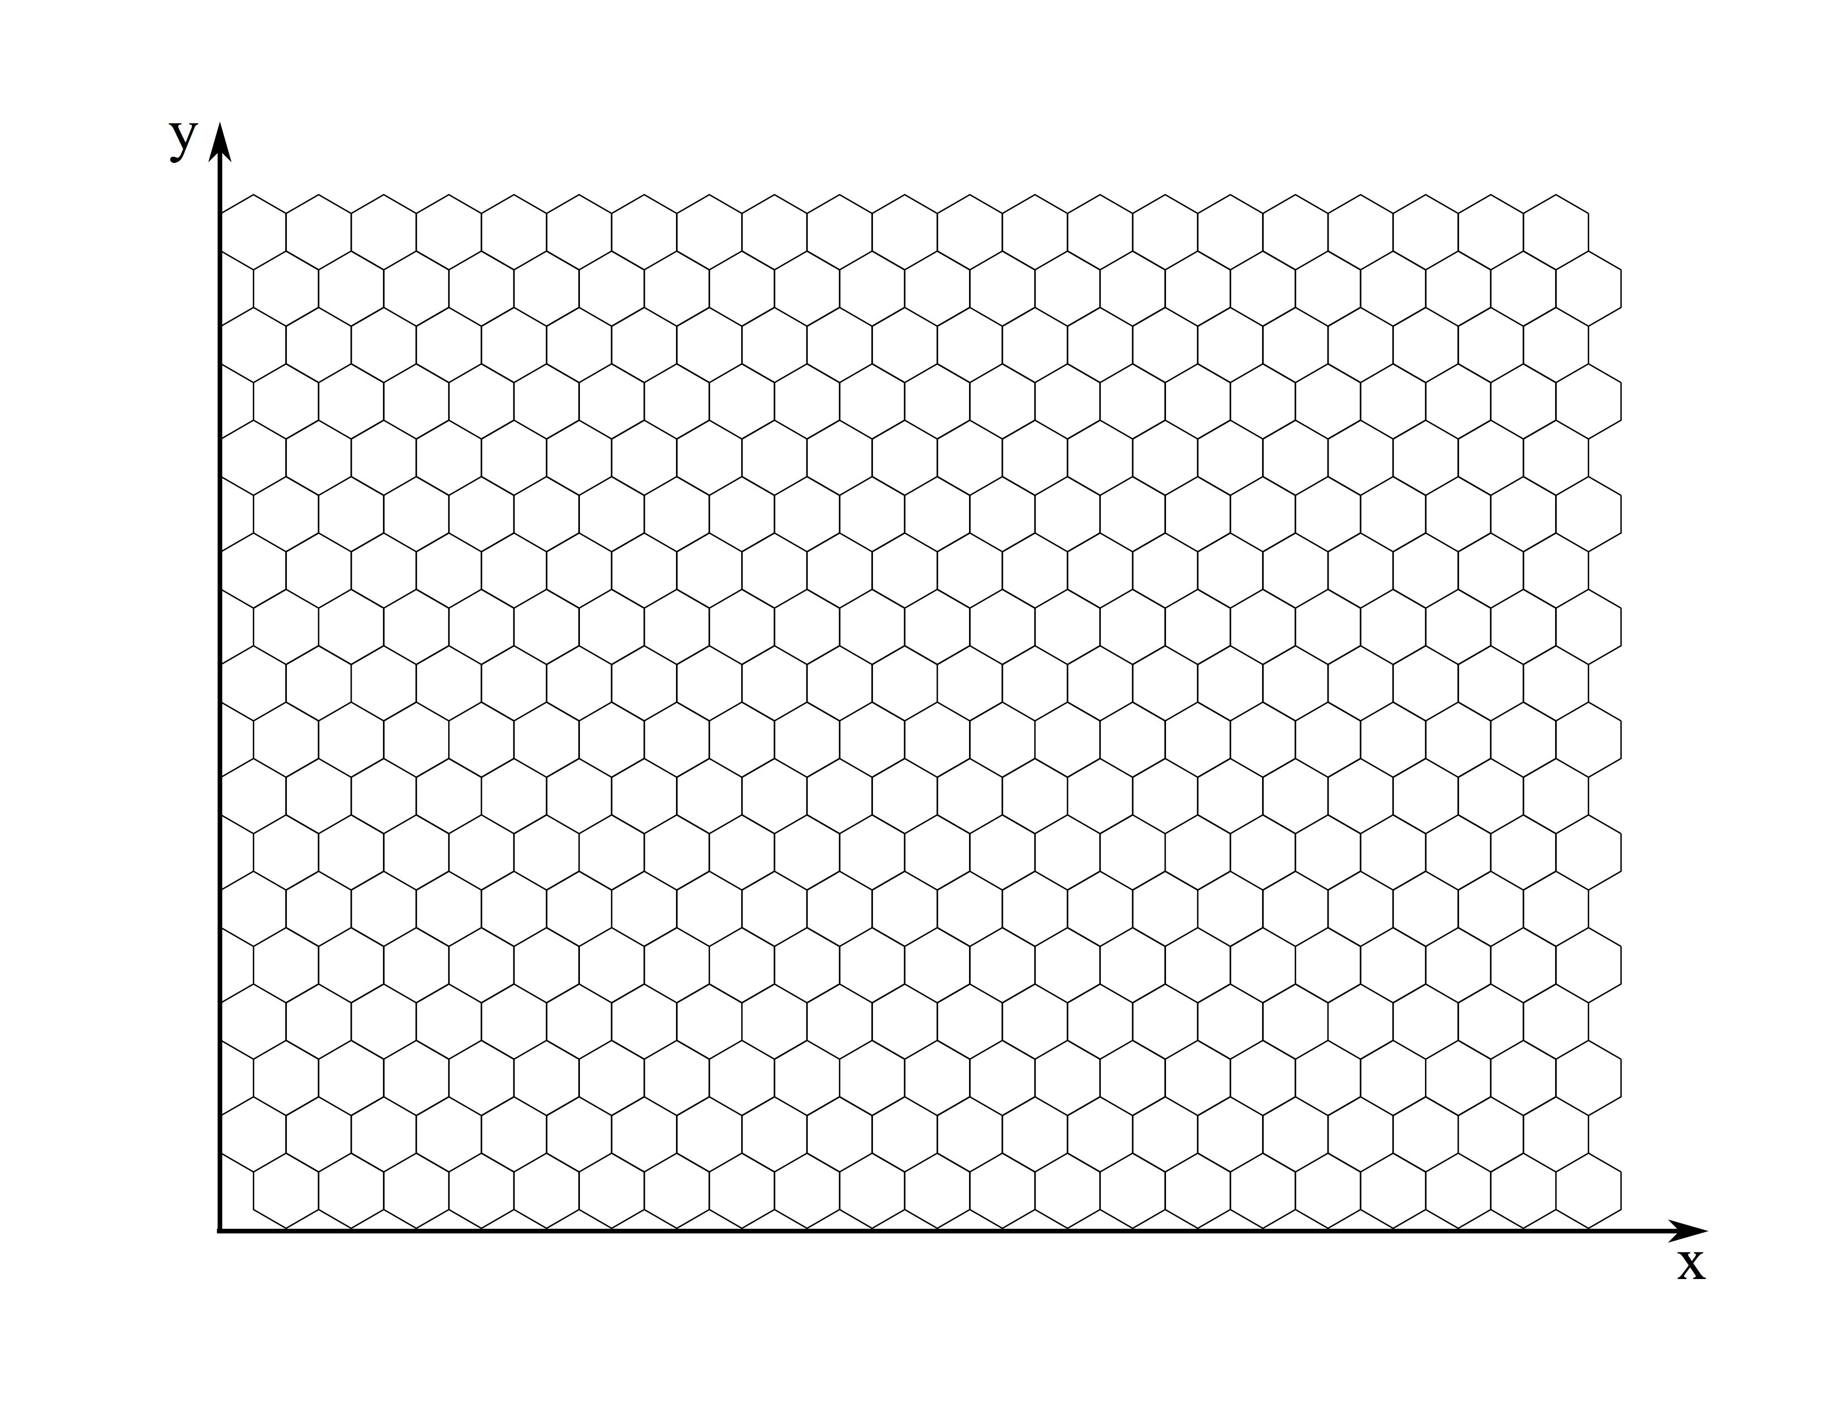
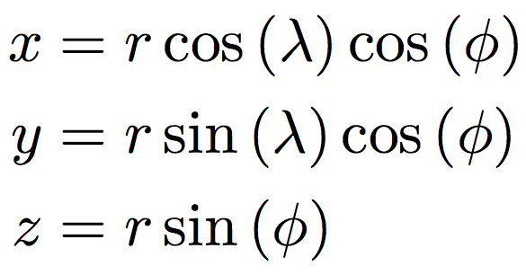
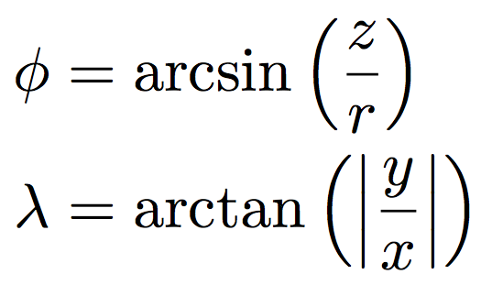
Which mesh geometries does MPAS support?
On the surface of the sphere: all distances and areas are computed in spherical geometry.
In the Cartesian plane: all distances and areas are computed in Euclidean geometry.

Slide 16
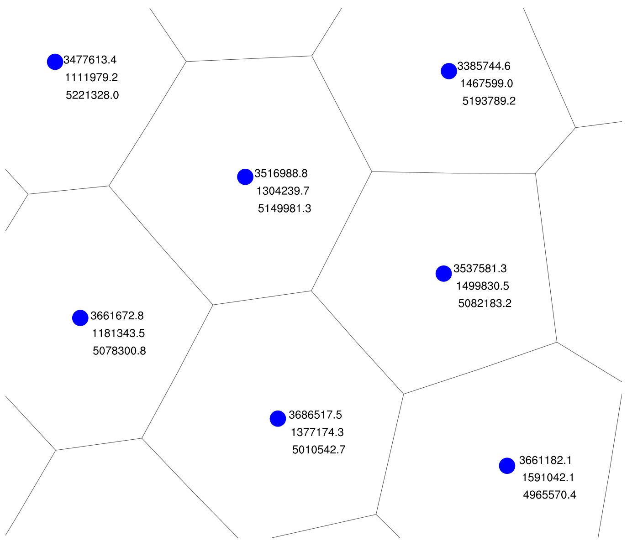
Notes about MPAS mesh geometry
Global Cartesian coordinates are computed for each element
For planar meshes, coordinates lie in the plane z=0
For spherical meshes, coordinates lie on the surface of the sphere
For cells: xCell, yCell, zCell
Latitudes and longitudes are computed from Cartesian coordinates as described earlier
positive x-axis through 0° longitude
positive y-axis through 90° longitude
positive z-asix through 90° latitude
Above: Cartesian coordinates for cell locations near
(52.9°N lat, 20.8°E lon) in a variable-resolution spherical mesh with radius 6371229 m.

Slide 17
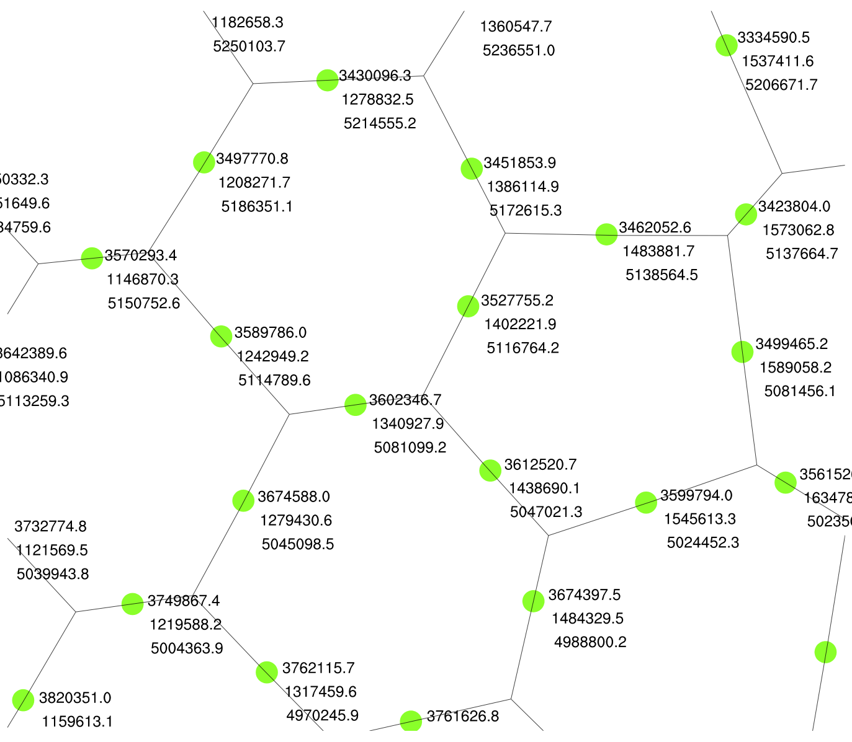
Notes about MPAS mesh geometry
Global Cartesian coordinates are computed for each element
For planar meshes, coordinates lie in the plane z=0
For spherical meshes, coordinates lie on the surface of the sphere
For cells: xEdge, yEdge, zEdge
Latitudes and longitudes are computed from Cartesian coordinates as described earlier
positive x-axis through 0° longitude
positive y-axis through 90° longitude
positive z-asix through 90° latitude
Above: Cartesian coordinates for cell locations near
(52.9°N lat, 20.8°E lon) in a variable-resolution spherical mesh with radius 6371229 m.

Slide 18
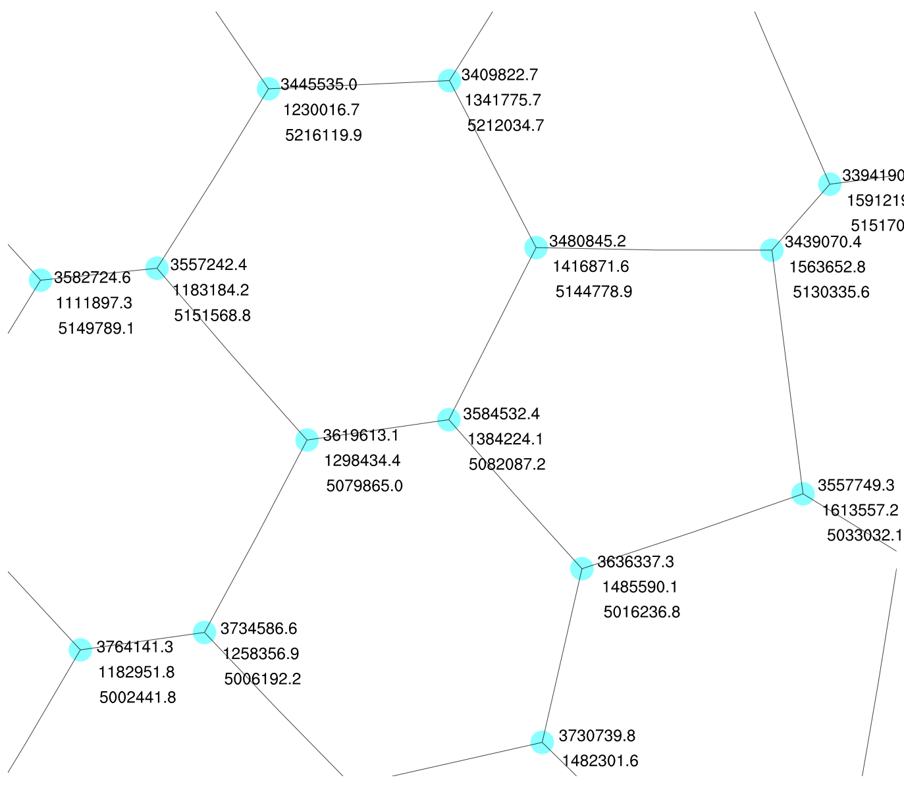
Notes about MPAS mesh geometry
Global Cartesian coordinates are computed for each element
For planar meshes, coordinates lie in the plane z=0
For spherical meshes, coordinates lie on the surface of the sphere
For cells: xVertex, yVertex, zVertex
Latitudes and longitudes are computed from Cartesian coordinates as described earlier
positive x-axis through 0° longitude
positive y-axis through 90° longitude
positive z-asix through 90° latitude
Above: Cartesian coordinates for cell locations near
(52.9°N lat, 20.8°E lon) in a variable-resolution spherical mesh with radius 6371229 m.

Slide 19
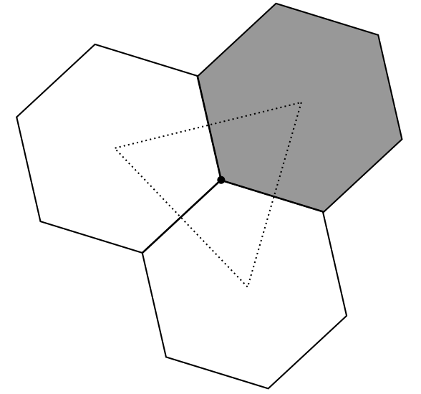
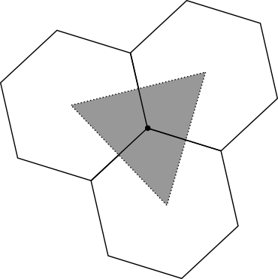
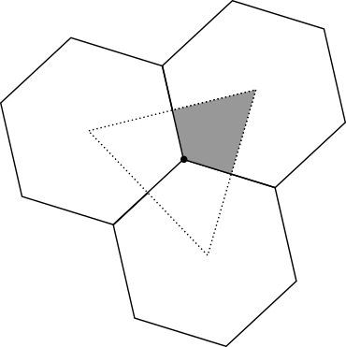
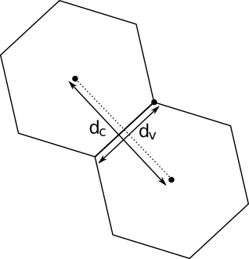
Mesh geometry fields in MPAS
areaCell(nCells) – area of each cell
areaTriangle(nVertices) – area of each dual-grid cell
kiteAreasOnVertex(vertexDegree,nVertices) – area of intersection between dual- and primal-mesh cells
dcEdge(nEdges) – distances between cell centers
dvEdge(nEdges) – length of each edge

Slide 20
Indexing of mesh fields, both connectivity and geometry
For *On* arrays (e.g., cellsOnCell), elements are listed in anti-clockwise order
  Whenever possible, starting points are consistent between indexing arrays (e.g., cellsOnVertex and kiteAreasOnVertex)
  E.g., the first edgeOnCell separates a given cell from the first cellOnCell
All indices are 1-based
  (MPAS is written in Fortran, after all...)
1
2
2
1
3
3
cellsOnVertex(:,V)
kiteAreasOnVertex(:,V)

Slide 21
A practical example of mesh fields in use
An example of using mesh fields: Averaging a vertex-based field, vorticity(nVertLevels,nVertices), to cells as vortcell(nVertLevels,nCells):
vortcell(:,:) = 0.0
do iVtx = 1, nVertices
do j = 1, vertexDegree
iCell = cellsOnVertex(j,iVtx)
vortcell(:,iCell) = vortcell(:,iCell) +
kiteAreasOnVertex(j,iVtx) * vorticity(:,iVtx)
end do
end do
do iCell = 1, nCells
vortcell(:,iCell) = vortcell(:,iCell) / areaCell(iCell)
end do

Slide 22
What do MPAS meshes look like in netCDF files?
When stored in netCDF files (“grid.nc”), MPAS meshes have at least the following dimensions:
dimensions:
nCells = 40962 ;
nEdges = 122880 ;
nVertices = 81920 ;
maxEdges = 7 ;
maxEdges2 = 14 ;
TWO = 2 ;
vertexDegree = 3 ;
The number of cells, edges, and vertices in the mesh.
For global, spherical meshes:
nVertices = 2 * (nCells - 2)
nEdges = 3 * (nCells - 2)
For doubly-periodic planar meshes:
nEdges = nCells + nVertices
For limited-area meshes:
nEdges + 1 = nCells + nVertices

Slide 23
What do MPAS meshes look like in netCDF files?
When stored in netCDF files (“grid.nc”), MPAS meshes have at least the following dimensions:
dimensions:
nCells = 40962 ;
nEdges = 122880 ;
nVertices = 81920 ;
maxEdges = 7 ;
maxEdges2 = 14 ;
TWO = 2 ;
vertexDegree = 3 ;
The maximum number of faces (edges) any cell can have; equivalent to the maximum number of cell neighbors or vertices that a cell can have.

Slide 24
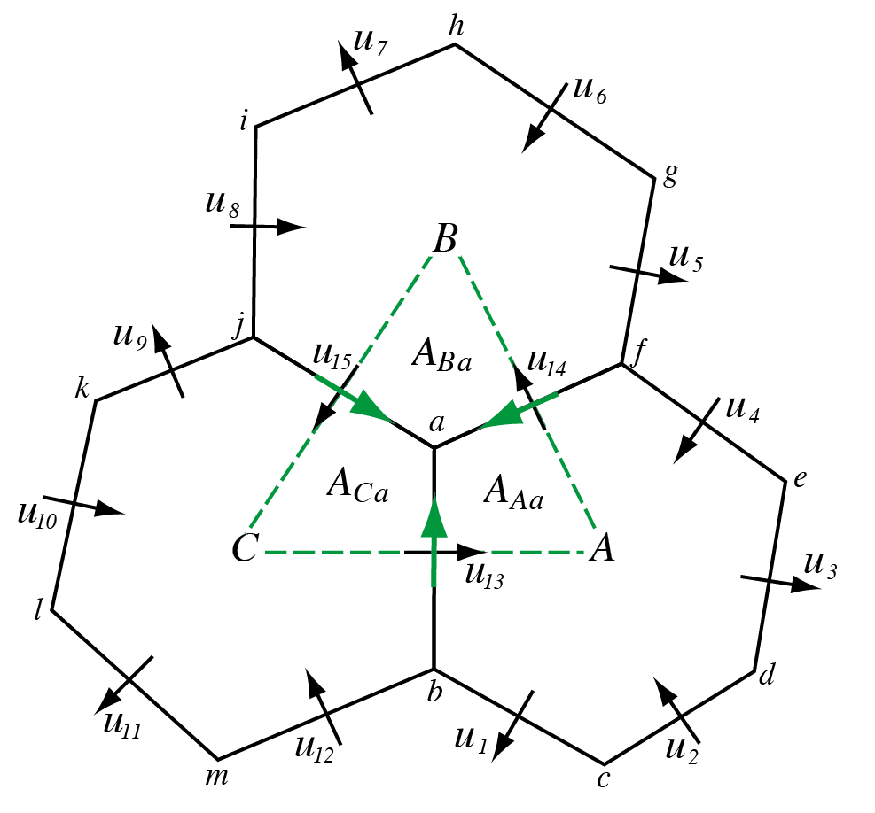
What do MPAS meshes look like in netCDF files?
When stored in netCDF files (“grid.nc”), MPAS meshes have at least the following dimensions:
dimensions:
nCells = 40962 ;
nEdges = 122880 ;
nVertices = 81920 ;
maxEdges = 7 ;
maxEdges2 = 14 ;
TWO = 2 ;
vertexDegree = 3 ;
The maximum number of edges that participate in the reconstruction of tangential velocities at cell faces (edges).

Slide 25
What do MPAS meshes look like in netCDF files?
When stored in netCDF files (“grid.nc”), MPAS meshes have at least the following dimensions:
dimensions:
nCells = 40962 ;
nEdges = 122880 ;
nVertices = 81920 ;
maxEdges = 7 ;
maxEdges2 = 14 ;
TWO = 2 ;
vertexDegree = 3 ;
Always 2 (every dimension must have a name in netCDF). Used for, e.g., the number of vertices forming the endpoints of edges and the number of cells separated by an edge.

Slide 26
What do MPAS meshes look like in netCDF files?
When stored in netCDF files (“grid.nc”), MPAS meshes have at least the following dimensions:
dimensions:
nCells = 40962 ;
nEdges = 122880 ;
nVertices = 81920 ;
maxEdges = 7 ;
maxEdges2 = 14 ;
TWO = 2 ;
vertexDegree = 3 ;
The number of cells/edges that meet at each vertex.
In principle, quadrilateral meshes could be represented by setting vertexDegree = 4

Slide 27
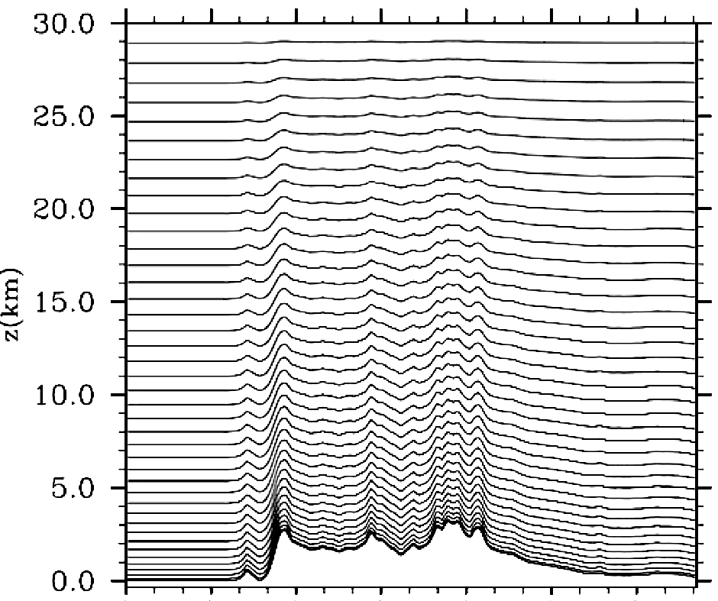
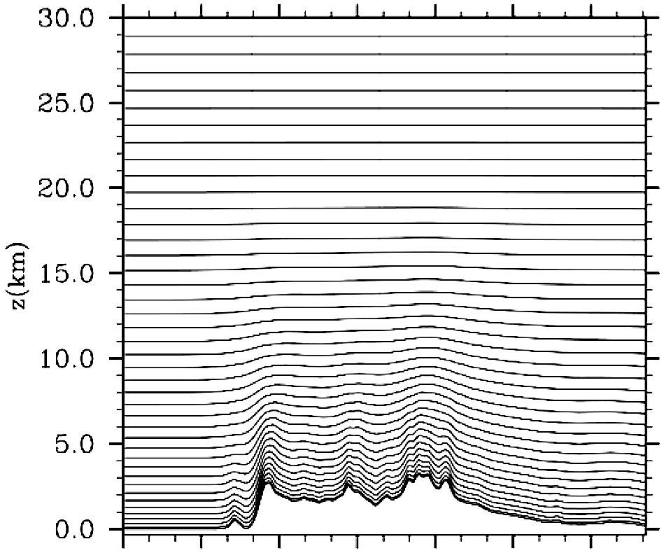
What about the vertical grid?
WRF
Pressure-based
terrain-following sigma
vertical coordinate
MPAS
Height-based hybrid smoothed terrain-following vertical coordinate
    Improved numerical accuracy

Slide 28
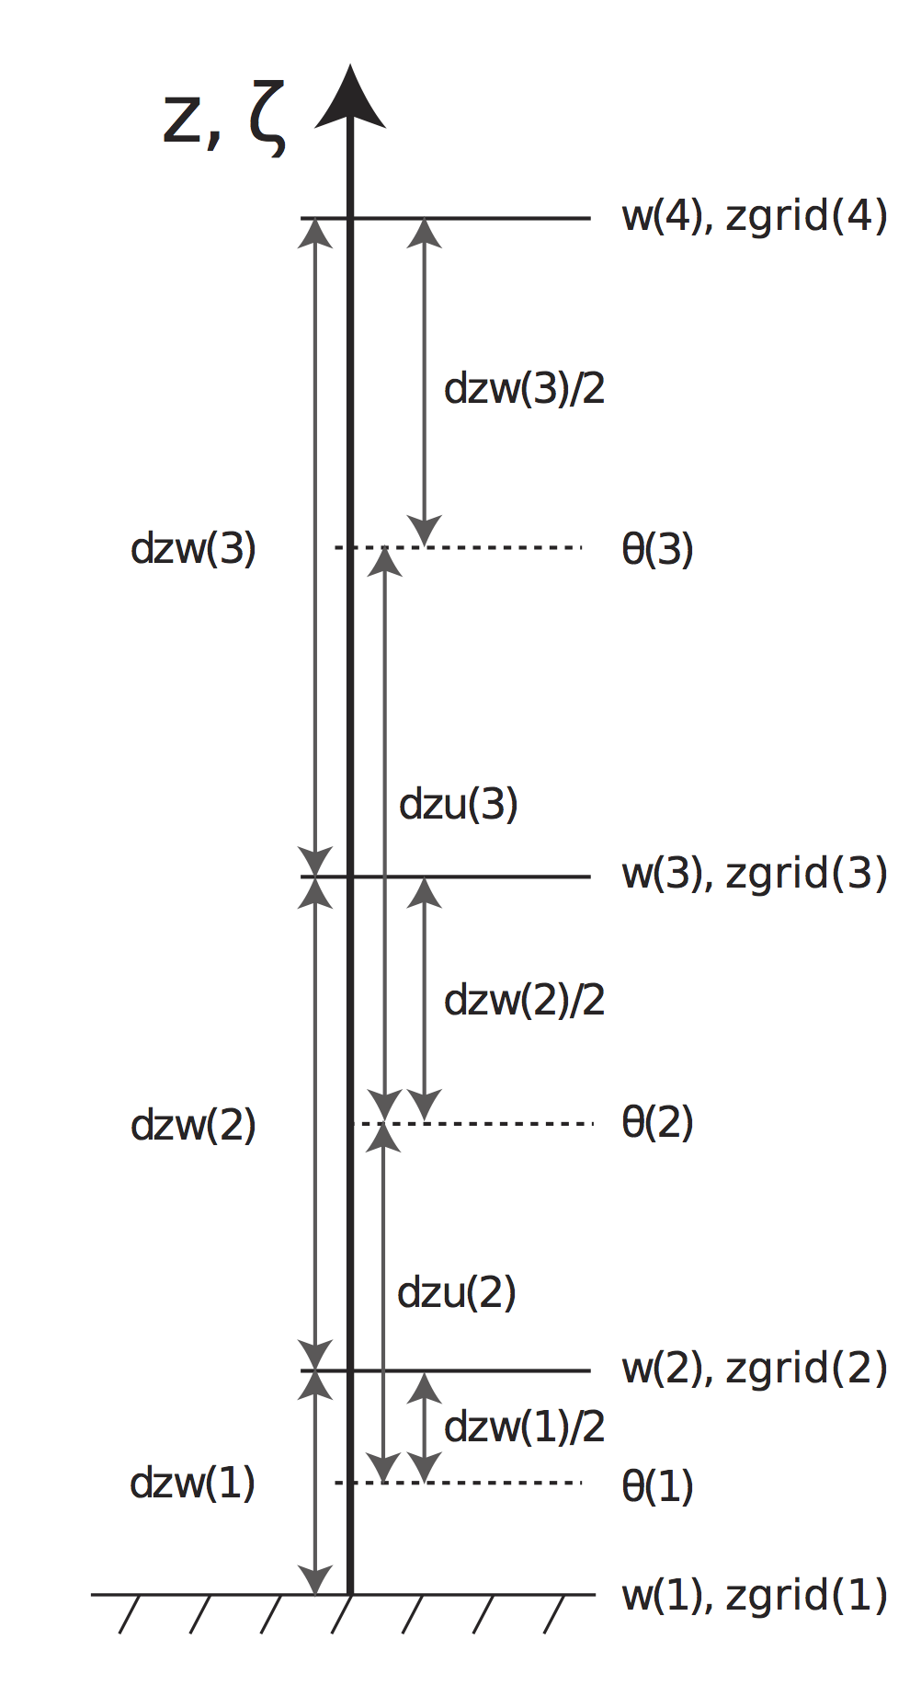
Vertical grid
The MPAS-Atmosphere vertical grid is also staggered:
vertical velocities on w levels
all other fields on Θ levels
zgrid gives geometric height at w levels
Θ levels lie at the midpoints of bracketing w levels
To vertically interpolate field F from Θ levels to w levels:
fzp(k) = 0.5 * dzw(k) / dzu(k)
fzm(k) = 0.5 * dzw(k-1) / dzu(k)
F_{w}(k) = fzm(k) * F_{Θ}(k) + fzp(k) * F_{Θ}(k-1)

Slide 29
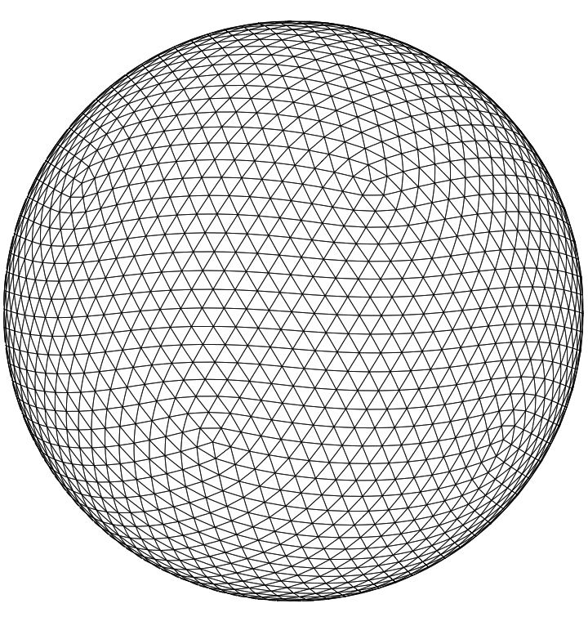
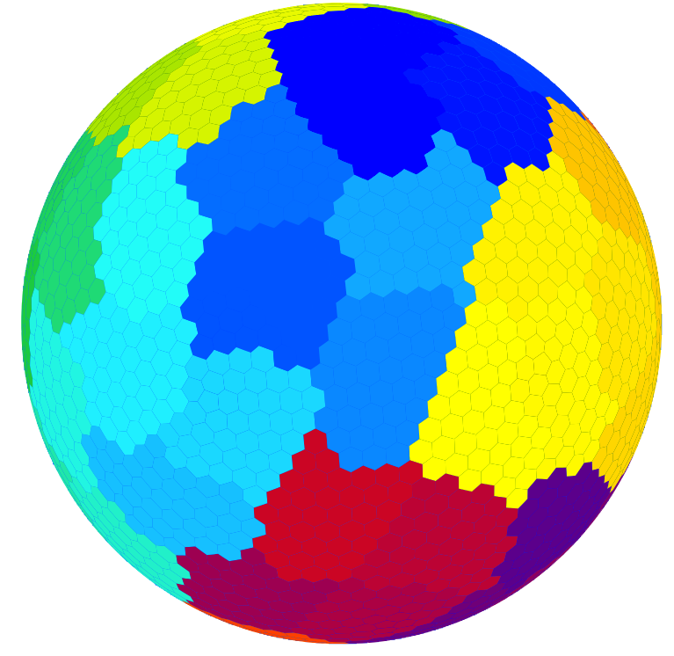
Meshes partitioning for parallelization
The dual mesh of a Voronoi tessellation is a Delaunay triangulation – essentially the connectivity graph of the cells
Parallel decomposition of an MPAS mesh then becomes a graph partitioning problem: equally distribute nodes among partitions (give each process equal work) while minimizing the edge cut (minimizing parallel communication)
Graph partitioning
We use the Metis package for parallel graph decomposition
  Currently done as a pre-processing step, but could be done “on-line”
  Fortunately, Metis runs quickly, and a partitioning into n pieces only needs to be done once for a given mesh

Slide 30
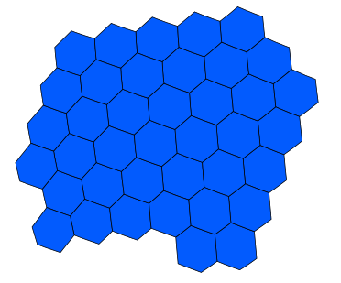
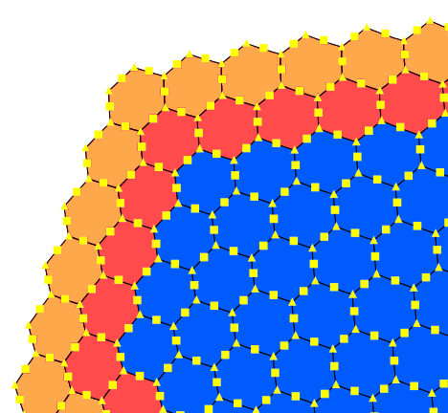
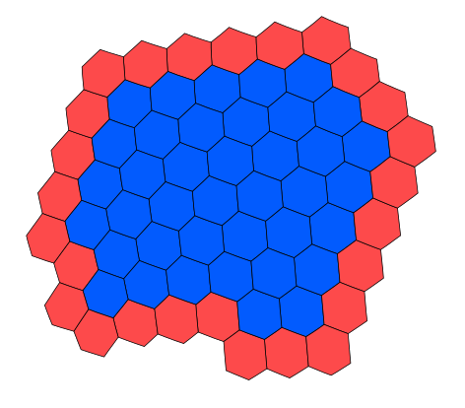
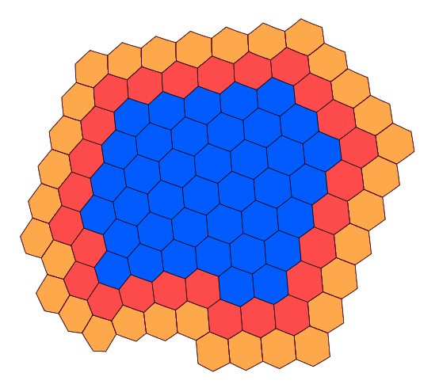
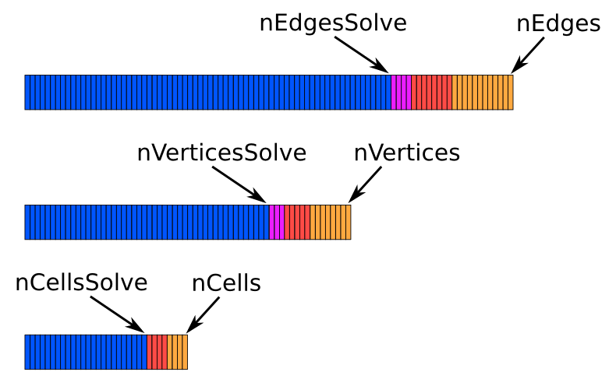
Meshes partitioning for parallelization
Given an assignment of cells to a process, any number of layers of halo (ghost) cells may be added
Block of cells owned by a process
With a complete list of cells stored in a block, adjacent edge and vertex locations can be found; we apply a simple rule to determine ownership of edges and vertices adjacent to real cells in different blocks
Block plus one layer of halo/ghost cells
Cells, edges, and vertices are stored in a 1-d array, with halo cells at the end of the array
Block plus two layers of halo/ghost cells

Slide 31
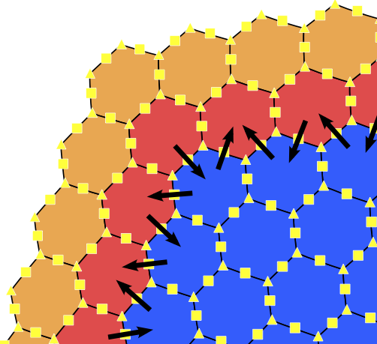
Meshes partitioning for parallelization
An edge E is an owned edge iff cellsOnEdge(1,E) is an owned cell
A vertex V is an owned vertex iff cellsOnVertex(1,V) is an owned cell
For n layers of ghost cells, we have n+1 layers of ghost edges and ghost vertices.

