Slide 1
Introduction to practical sessions

Slide 2
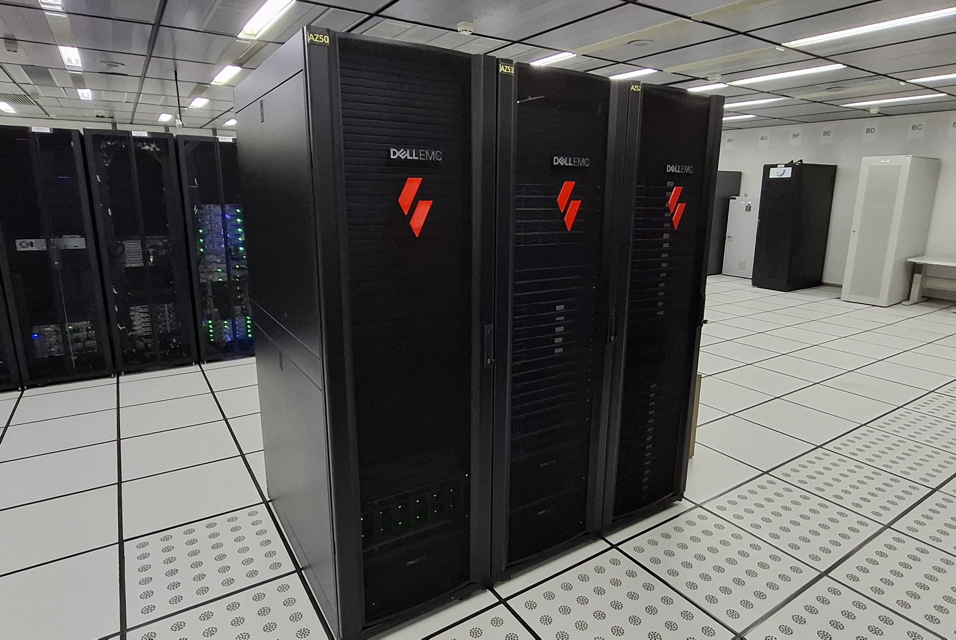
Egeon
The practical sessions of this tutorial will be run on Egeon
35 compute nodes
2x AMD 7H12 EPYC 64-core processors
512 GB RAM
/mnt/beegfs
BeeGFS filesystem, 466 TB
/home
NFS filesystem, 729 TB
Notes:
Currently (Nov. 2023) #73 in the world (CPU partition)

Slide 3
Egeon
The practical sessions of this tutorial will be run on Egeon
egeon-login.cptec.inpe.br
Your username will be: aluno#
Don't forget to enable X11 forwarding when connecting!
ssh -XC <username>@egeon-login.cptec.inpe.br
On macOS systems you might try –Y rather than -X
ssh -YC <username>@ egeon-login.cptec.inpe.br
Notes:
Currently (Nov. 2023) #73 in the world (CPU partition)

Slide 4
Job scripts
Job scripts are submitted to the queuing system with sbatch
#!/usr/bin/env sh
#SBATCH --output=job.out
#SBATCH --error=job.err
#SBATCH --time=00:30:00
#SBATCH --tasks-per-node=128
#SBATCH --nodes=1
#SBATCH --job-name=run_model
#SBATCH --partition=batch
# ... load modules ...
mpiexec ./atmosphere_model

Slide 5
Managing queued jobs
The squeue command is used on Egeon to check the status of queued jobs
squeue with no arguments shows all jobs on the system, which is less useful for us
squeue –u $USER shows only your jobs
The scancel command is used to cancel a job
scancel <job_id>
The <job_id> can be obtained from the squeue command

Slide 6
Practical exercises
We have a web page to guide you through some exercises:
https://www2.mmm.ucar.edu/projects/mpas/tutorial/INPE2024/

Slide 7
Practical exercises
We have a web page to guide you through some exercises:
https://www2.mmm.ucar.edu/projects/mpas/tutorial/INPE2024/
If you're logged in to Egeon, you can get this URL with:
cat ~professor/url

Slide 8
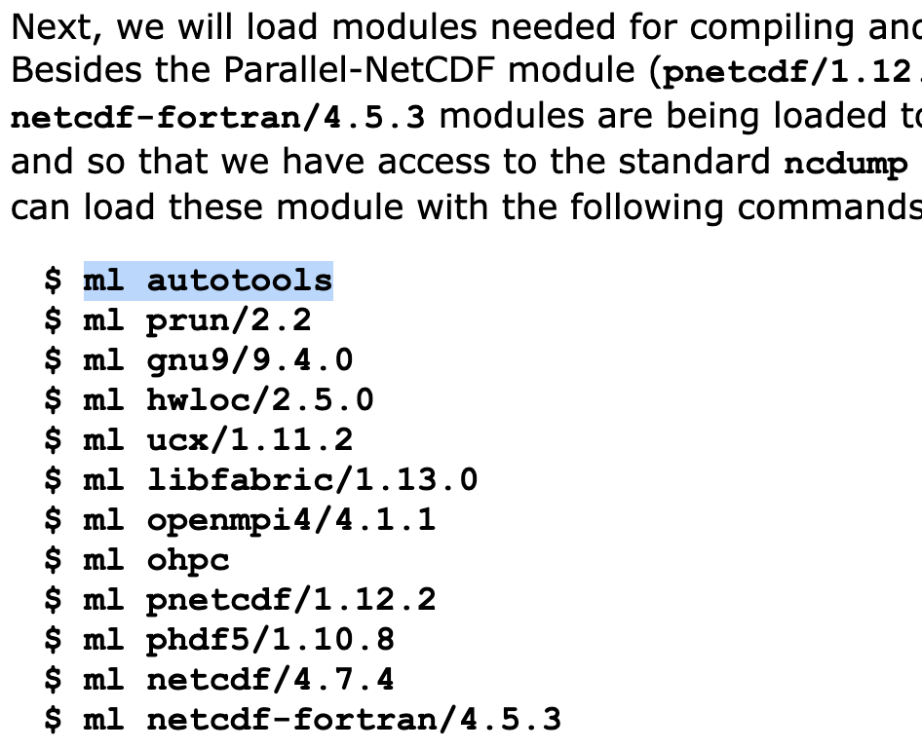
Practical exercises
Blocks of shell commands can be selected all at once

Slide 9
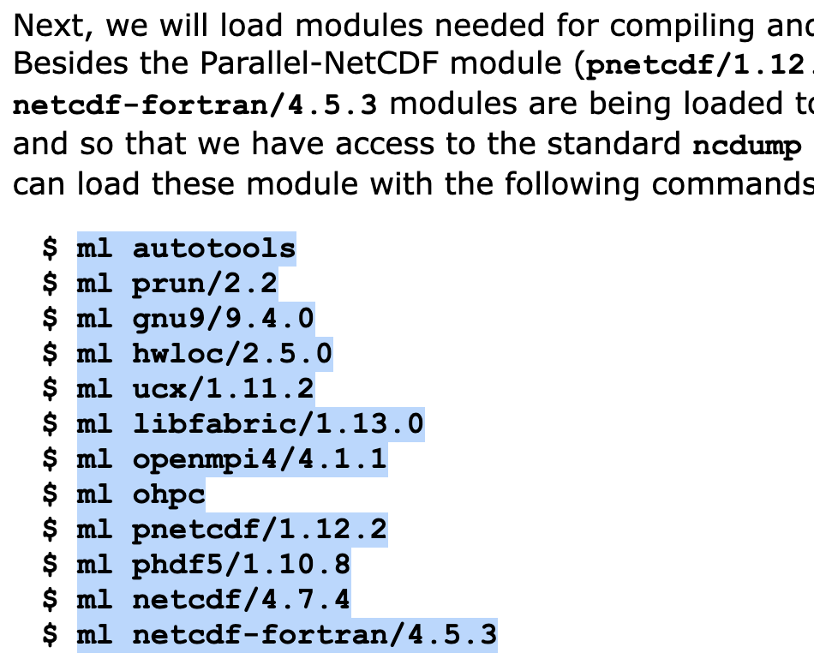
Practical exercises
Blocks of shell commands can be selected all at once

Slide 10
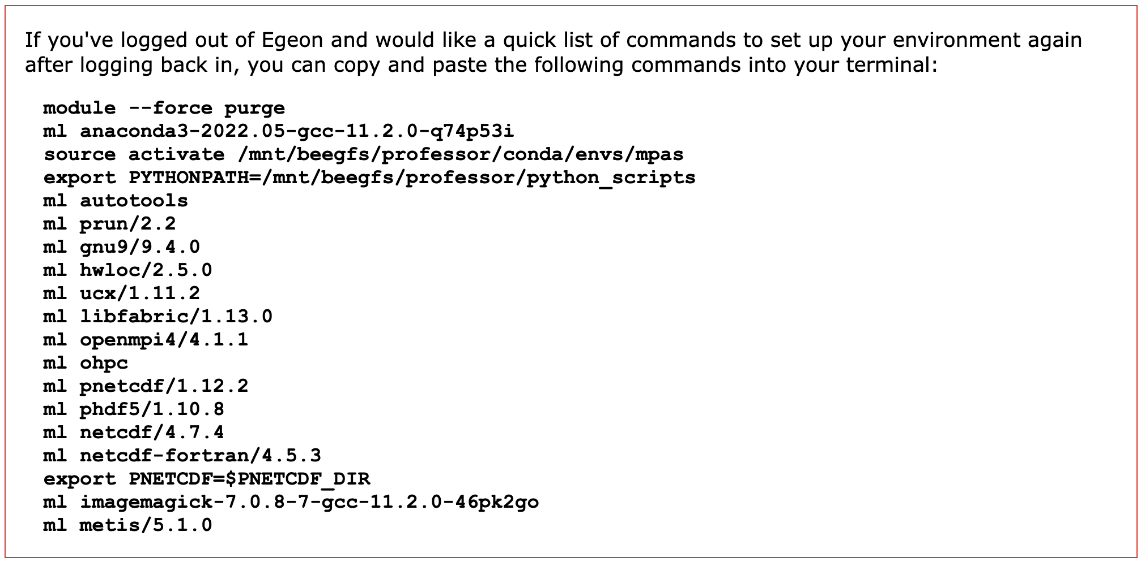
Environment setup
As noted in the practice guide, you should set up your environment every time you log in:

