Slide 1
Running MPAS Part 2: Variable-resolution global meshes, I/O streams, restart runs, and other options
Michael G. Duda
NCAR/MMM

Slide 2
Review
In the "Running MPAS Part 1" talk, we saw:
How to interpolate time-invariant terrestrial fields to make a “static” file for real-data simulations
How to interpolate meteorological and land-surface fields to produce real-data initial conditions
How to produce SST and sea-ice update files
How to run a simulation
How to set up idealized test cases

Slide 3
Review
In the "Running MPAS Part 1" talk, we saw:
How to interpolate time-invariant terrestrial fields to make a “static” file for real-data simulations
How to interpolate meteorological and land-surface fields to produce real-data initial conditions
How to produce SST and sea-ice update files
How to set up idealized test cases
What we will cover in this talk:
How to work with variable-resolution meshes
Details of the MPAS streams files
How to restart a simulation from a previously saved checkpoint
And a few other model options…

Slide 4
Outline
How to work with variable-resolution meshes
Details of the MPAS streams files
How to restart a simulation from a previously saved checkpoint
And a few other model options…

Slide 5
Variable-resolution meshes
You might expect that generating a variable-resolution mesh is a simple matter...
Left: Contours of horizontal grid distance for a variable-resolution, 15 km – 3 km MPAS mesh
... but some meshes have taken months to generate using our current software on a desktop system
So, we’d like to re-use meshes whenever possible!

Slide 6
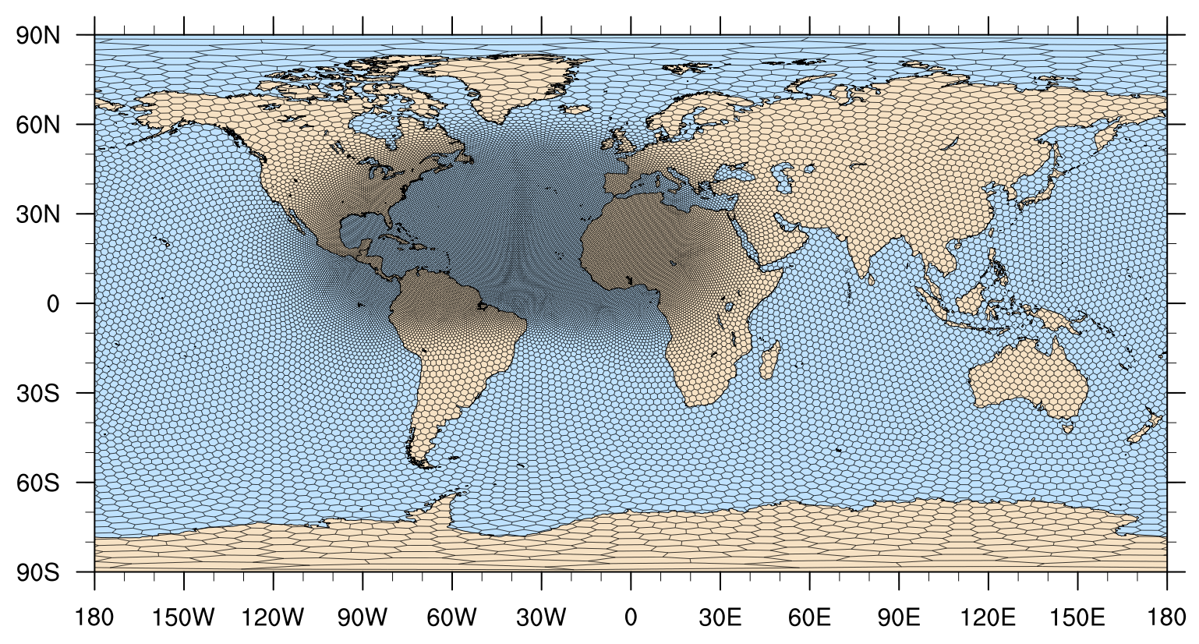
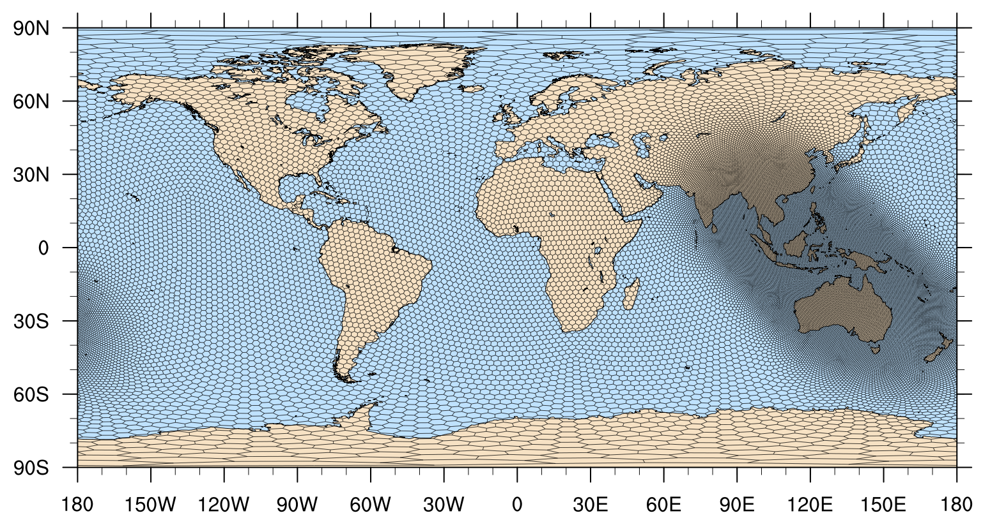
Variable-resolution meshes
The key idea for re-using variable-resolution meshes is to rotate the refined region
This may be accomplished easily (and quickly!) using the “grid_rotate” tool
Implements two solid-body rotations for spherical meshes:
Move center of refined region from one location to another
Rotate the relocated refinement about its center to change orientation
Above: A refinement region originally centered at 25N, 40W has been shifted to 7S, 125E and rotated by -45 degrees.

Slide 7
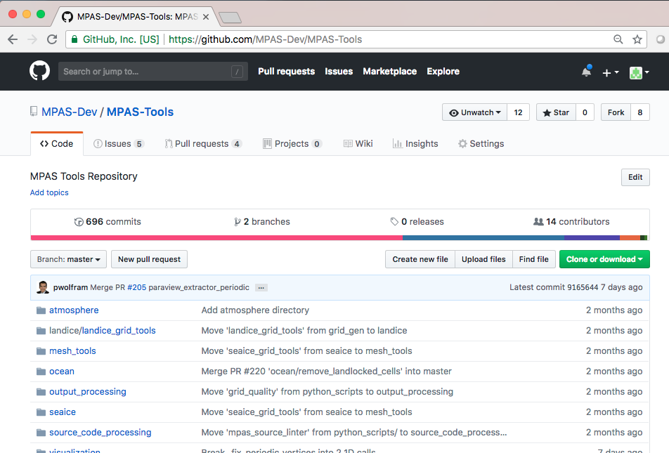
Variable-resolution meshes
The grid_rotate tool is available in a GitHub repository at
https://github.com/MPAS-Dev/MPAS-Tools.git
From a clone of the MPAS-Tools repo, change directories to mesh_tools/grid_rotate and run ‘make’

Slide 8
Variable-resolution meshes
The grid_rotate tool uses a Fortran namelist file to control rotation of the mesh:
&input
config_original_latitude_degrees = 0.0
config_original_longitude_degrees = 0.0
config_new_latitude_degrees = -19.5
config_new_longitude_degrees = -62.0
config_birdseye_rotation_counter_clockwise_degrees = 90
/
Typical usage might look like:
grid_rotate x5.30210.grid.nc SouthAmerica.grid.nc

Slide 9
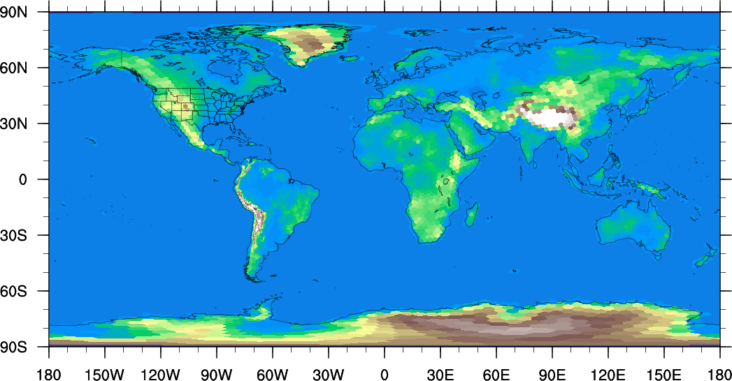
Variable-resolution meshes
After rotating a variable-resolution mesh, one can produce a “static” file for real-data simulations, or, e.g., baroclinic wave idealized ICs, as usual
Right: Terrain field for a variable-resolution, 240 km – 48 km MPAS mesh with refinement over South America
When running MPAS-A, be sure to set:
config_dt appropriately for the finest-resolution part of the mesh

Slide 10
Outline
How to work with variable-resolution meshes
Details of the MPAS streams files
How to restart a simulation from a previously saved checkpoint
And a few other model options…

Slide 11
MPAS I/O “Streams”
Recall that we used the streams.atmosphere file to set the names of the input and output files for the MPAS-Atmosphere model:
<immutable_stream name="input"
type="input"
filename_template="x1.10242.init.nc"
input_interval="initial_only" />
<immutable_stream name="restart"
type="input;output"
filename_template="restart.$Y-$M-$D_$h.$m.$s.nc"
input_interval="initial_only"
output_interval="1_00:00:00" />
<stream name="output"
type="output"
filename_template="history.$Y-$M-$D_$h.$m.$s.nc"
output_interval="6:00:00" >
<file name="stream_list.atmosphere.output"/>
</stream>

Slide 12
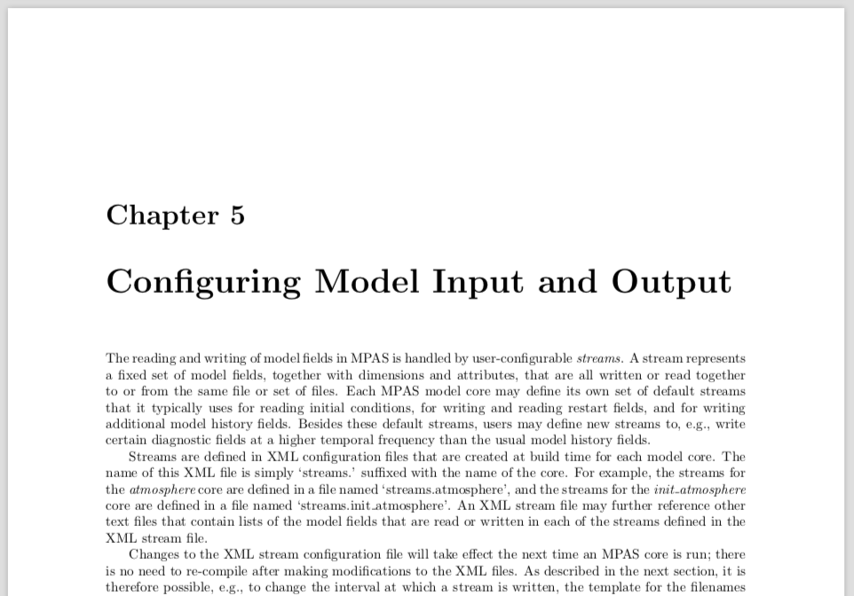
MPAS I/O “Streams”
An XML file seems overly complicated for setting the names of input and output files…
You may begin to suspect that the streams files are capable of a little more than this
Chapter 5 of the MPAS-A Users’ Guide describes the complete functionality provided by streams files

Slide 13
Anatomy of an XML streams file
An example streams configuration file:
<streams>
<immutable_stream name="input"
type="input"
filename_template="x1.4002.init.nc"
input_interval="initial_only" />
<immutable_stream name="restart"
type="input;output"
filename_template="restart.$Y-$M-$D_$h.nc"
input_interval="initial_only"
output_interval="1_00:00:00" />
<stream name="output"
type="output"
filename_template="history.$Y-$M-$D_$h.$m.$s.nc"
output_interval="6:00:00" >
<var name=”mslp"/>
<var name=”height_500hPa"/>
<var name=”rainc"/>
<var name=”rainnc"/>
</stream>
</streams>

Slide 14
Anatomy of an XML streams file
An example streams configuration file:
<streams>
<immutable_stream name="input"
type="input"
filename_template="x1.4002.init.nc"
input_interval="initial_only" />
<immutable_stream name="restart"
type="input;output"
filename_template="restart.$Y-$M-$D_$h.nc"
input_interval="initial_only"
output_interval="1_00:00:00" />
<stream name="output"
type="output"
filename_template="history.$Y-$M-$D_$h.$m.$s.nc"
output_interval="6:00:00" >
<var name=”mslp"/>
<var name=”height_500hPa"/>
<var name=”rainc"/>
<var name=”rainnc"/>
</stream>
</streams>
The variables read/written by immutable streams may not be changed at runtime
This is the set of variables written by this stream

Slide 15
Anatomy of an XML streams file
An example streams configuration file:
<streams>
<immutable_stream name="input"
type="input"
filename_template="x1.4002.init.nc"
input_interval="initial_only" />
<immutable_stream name="restart"
type="input;output"
filename_template="restart.$Y-$M-$D_$h.nc"
input_interval="initial_only"
output_interval="1_00:00:00" />
<stream name="output"
type="output"
filename_template="history.$Y-$M-$D_$h.$m.$s.nc"
output_interval="6:00:00" >
<var name=”mslp"/>
<var name=”height_500hPa"/>
<var name=”rainc"/>
<var name=”rainnc"/>
</stream>
</streams>
This stream is named “input”
This stream is named “restart”
This stream is named “output”

Slide 16
Anatomy of an XML streams file
An example streams configuration file:
<streams>
<immutable_stream name="input"
type="input"
filename_template="x1.4002.init.nc"
input_interval="initial_only" />
<immutable_stream name="restart"
type="input;output"
filename_template="restart.$Y-$M-$D_$h.nc"
input_interval="initial_only"
output_interval="1_00:00:00" />
<stream name="output"
type="output"
filename_template="history.$Y-$M-$D_$h.$m.$s.nc"
output_interval="6:00:00" >
<var name=”mslp"/>
<var name=”height_500hPa"/>
<var name=”rainc"/>
<var name=”rainnc"/>
</stream>
</streams>
This stream is only read by MPAS
This stream is both read and written
This stream is only written

Slide 17
Anatomy of an XML streams file
An example streams configuration file:
<streams>
<immutable_stream name="input"
type="input"
filename_template="x1.4002.init.nc"
input_interval="initial_only" />
<immutable_stream name="restart"
type="input;output"
filename_template="restart.$Y-$M-$D_$h.nc"
input_interval="initial_only"
output_interval="1_00:00:00" />
<stream name="output"
type="output"
filename_template="history.$Y-$M-$D_$h.$m.$s.nc"
output_interval="6:00:00" >
<var name=”mslp"/>
<var name=”height_500hPa"/>
<var name=”rainc"/>
<var name=”rainnc"/>
</stream>
</streams>
This stream reads from a file named “x1.4002.init.nc”
This stream reads and writes from files with names of this form
This stream writes to files with names of this form

Slide 18
Anatomy of an XML streams file
An example streams configuration file:
<streams>
<immutable_stream name="input"
type="input"
filename_template="x1.4002.init.nc"
input_interval="initial_only" />
<immutable_stream name="restart"
type="input;output"
filename_template="restart.$Y-$M-$D_$h.nc"
input_interval="initial_only"
output_interval="1_00:00:00" />
<stream name="output"
type="output"
filename_template="history.$Y-$M-$D_$h.$m.$s.nc"
output_interval="6:00:00" >
<var name=”mslp"/>
<var name=”height_500hPa"/>
<var name=”rainc"/>
<var name=”rainnc"/>
</stream>
</streams>
This stream is read only at the start of execution
This stream is read only at the start of execution
This stream is written every 1 day
This stream is written every 6 hours

Slide 19
Anatomy of an XML streams file
At runtime, it’s easy to define a new output stream!
<stream name="sfcwinds"
type="output"
filename_template="winds.$Y$M$D$h$m.nc"
filename_interval="24:00:00 "
output_interval="0:30:00" >
<var name="u10"/>
<var name="v10"/>
</stream>

Slide 20
Anatomy of an XML streams file
At runtime, it’s easy to define a new output stream!
Define a new stream with <stream> … </stream> tags and give the stream a unique name
<stream name=”sfcwinds"
type="output"
filename_template=”winds.$Y$M$D$h$m.nc”
filename_interval=”24:00:00”
output_interval=”0:30:00" >
<var name=”u10"/>
<var name=”v10"/>
</stream>

Slide 21
Anatomy of an XML streams file
At runtime, it’s easy to define a new output stream!
Set the type of the stream to “output”
<stream name=”sfcwinds"
type="output"
filename_template=”winds.$Y$M$D$h$m.nc”
filename_interval=”24:00:00”
output_interval=”0:30:00" >
<var name=”u10"/>
<var name=”v10"/>
</stream>

Slide 22
Anatomy of an XML streams file
At runtime, it’s easy to define a new output stream!
Provide a filename template to be use for the output files. Possible variables include:
$Y = year $h = hour
$M = month $m = minute
$D = day of month $s = second
$d = day of year
<stream name=”sfcwinds"
type="output"
filename_template=”winds.$Y$M$D$h$m.nc”
filename_interval=”24:00:00”
output_interval=”0:30:00" >
<var name=”u10"/>
<var name=”v10"/>
</stream>

Slide 23
Anatomy of an XML streams file
At runtime, it’s easy to define a new output stream!
Specify how often the stream will be written. Time formats can be ”ss”, “mm:ss”, “hh:mm:ss”, or “ddd_hh:mm:ss”. A value of “none” means the stream is effectively deactivated (it is never written).
<stream name=”sfcwinds"
type="output"
filename_template=”winds.$Y$M$D$h$m.nc”
filename_interval=”24:00:00”
output_interval=”0:30:00" >
<var name=”u10"/>
<var name=”v10"/>
</stream>

Slide 24
Anatomy of an XML streams file
At runtime, it’s easy to define a new output stream!
Optionally, specify how often one output file should be closed and a new one opened. The default is to place all output records into separate files (i.e., the filename interval is the same as the output interval).
<stream name=”sfcwinds"
type="output"
filename_template=”winds.$Y$M$D$h$m.nc”
filename_interval=”24:00:00”
output_interval=”0:30:00" >
<var name=”u10"/>
<var name=”v10"/>
</stream>

Slide 25
Anatomy of an XML streams file
At runtime, it’s easy to define a new output stream!
List one or more variables to be written to the stream as <var/> XML tags.
<stream name=”sfcwinds"
type="output"
filename_template=”winds.$Y$M$D$h$m.nc”
filename_interval=”24:00:00”
output_interval=”0:30:00" >
<var name=”u10"/>
<var name=”v10"/>
</stream>

Slide 26
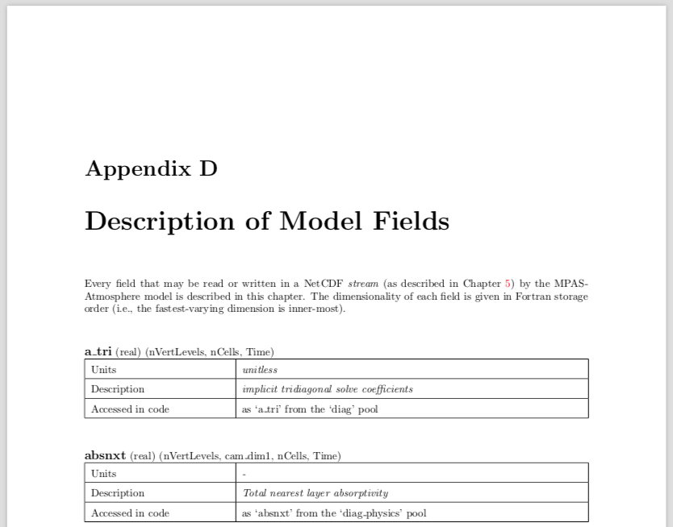
Anatomy of an XML streams file
Input and output streams may contain any field defined in the MPAS Registry.xml file
Appendix D of the MPAS-A Users’ Guide lists every field available for input/output

Slide 27
Outline
How to work with variable-resolution meshes
Details of the MPAS streams files
How to restart a simulation from a previously saved checkpoint
And a few other model options…

Slide 28
Restarting a simulation
Saving checkpoints (restart state) periodically during a simulation is as easy as setting an output interval for the “restart” stream:
<immutable_stream name="restart"
type="input;output"
filename_template="restart.$Y-$M-$D_$h.$m.$s.nc"
input_interval="initial_only"
output_interval="1_00:00:00" />
Note that the “restart” stream is both an “input” and an “output” stream:
Read if we are performing a restart simulation
Written periodically during a simulation

Slide 29
Restarting a simulation
Restarting a simulation from any existing restart file requires two namelist changes:
&nhyd_model
config_start_time = "2014-09-11_00:00:00"
/
The time from which we wish to restart the simulation
&restart
config_do_restart = true
/

Slide 30
Outline
How to work with variable-resolution meshes
Details of the MPAS streams files
How to restart a simulation from a previously saved checkpoint
And a few other model options…

Slide 31
Other options: detailed printout
More information on the locations of the min/max horizontal and vertical velocities in the simulation can be requested:
&printout
config_print_detailed_minmax_vel = true
/
Begin timestep 2014-09-10_00:16:00
...
global min w: -1.03829 k=14, -27.5557 lat, -68.5647 lon
global max w: 0.757052 k=19, -34.0048 lat, -52.0361 lon
global min u: -117.846 k=41, -69.4637 lat, 135.753 lon
global max u: 118.322 k=41, -69.6092 lat, 129.425 lon
global max wsp: 118.366 k=41, -69.6092 lat, 129.425 lon
Timing for integration step: 3.15425 s

Slide 32
Other options: physics suites
In MPAS v8.1, there are two suites of physics:
&physics
config_physics_suite = ‘mesoscale_reference’
/
&physics
config_physics_suite = ‘convection_permitting’
/
We’ll say more about physics options in the physics lecture
Note: before running the ‘convection_permitting’ suite for the first time, you’ll need to generate look-up tables for the Thompson microphysics with the build_tables utility.

Slide 33
Other options: soundings
It’s also possible to write out soundings from the model grid cells that contain specified (lat,lon) locations
1) Create a text file named sounding_locations.txt with a list of sounding locations and names ( latitude longitude name )
40.0 -105.25 Boulder
28.7 77.2 NewDelhi
-77.85 166.67 McMurdo
2) In the namelist.atmosphere file, select the interval at which soundings will be written from the model
&soundings
config_sounding_interval = ‘1:00:00’
/
3) Sounding text files will be written as <name>.YYYYMMDDhhmmss.snd

