Slide 1
Running MPAS Part 1:
Creating initial conditions and running a basic global simulation
Michael G. Duda
NCAR/MMM

Slide 2
Outline
Initial conditions for "real-data" simulations
Processing time-invariant, terrestrial fields ("static" fields)
Interpolating atmospheric and land-surface fields
Producing SST and sea-ice update files
Running a basic simulation
Initial conditions for "idealized" simulations
3-d baroclinic wave test case
3-d supercell test case
2-d mountain wave test case
There will be many digressions along the way…

Slide 3
Outline
Real-data Initial Conditions
Processing time-invariant fields (“static” file generation)
Interpolating atmospheric and land-surface fields
Producing SST and sea-ice update files
Running a basic simulation
Creating idealized initial conditions
3-d baroclinic wave test case
3-d supercell test case
2-d mountain wave test case

Slide 4
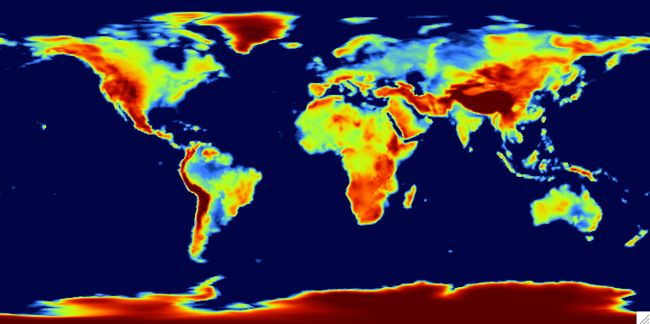
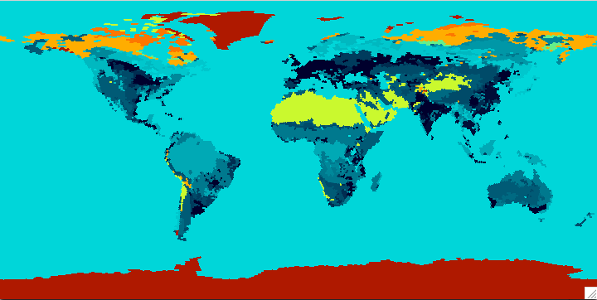
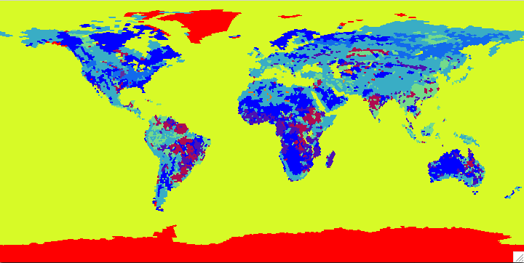
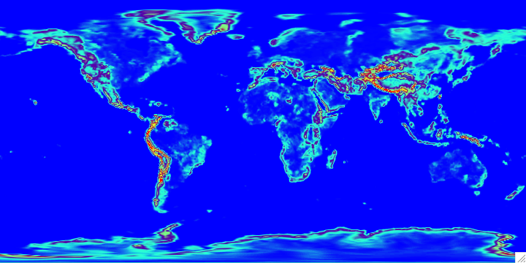
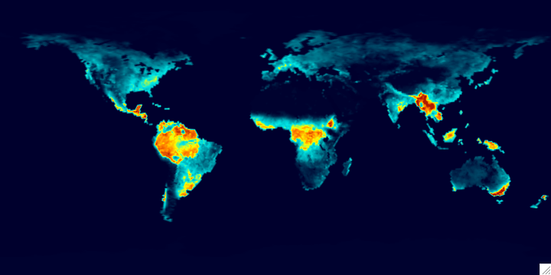
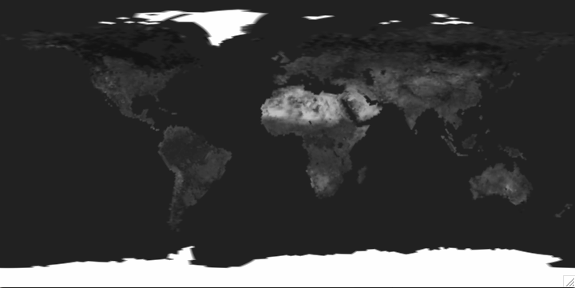
Real-data ICs: processing static fields
When we talk about time-invariant, “static” fields, what exactly do we mean?
Terrain elevation
Dominant land use category
Dominant soil category
Sub-grid-scale terrain variance
Climatological monthly vegetation fraction
Climatological monthly surface albedo
These fields can be interpolated once and re-used for any real-data simulation

Slide 5
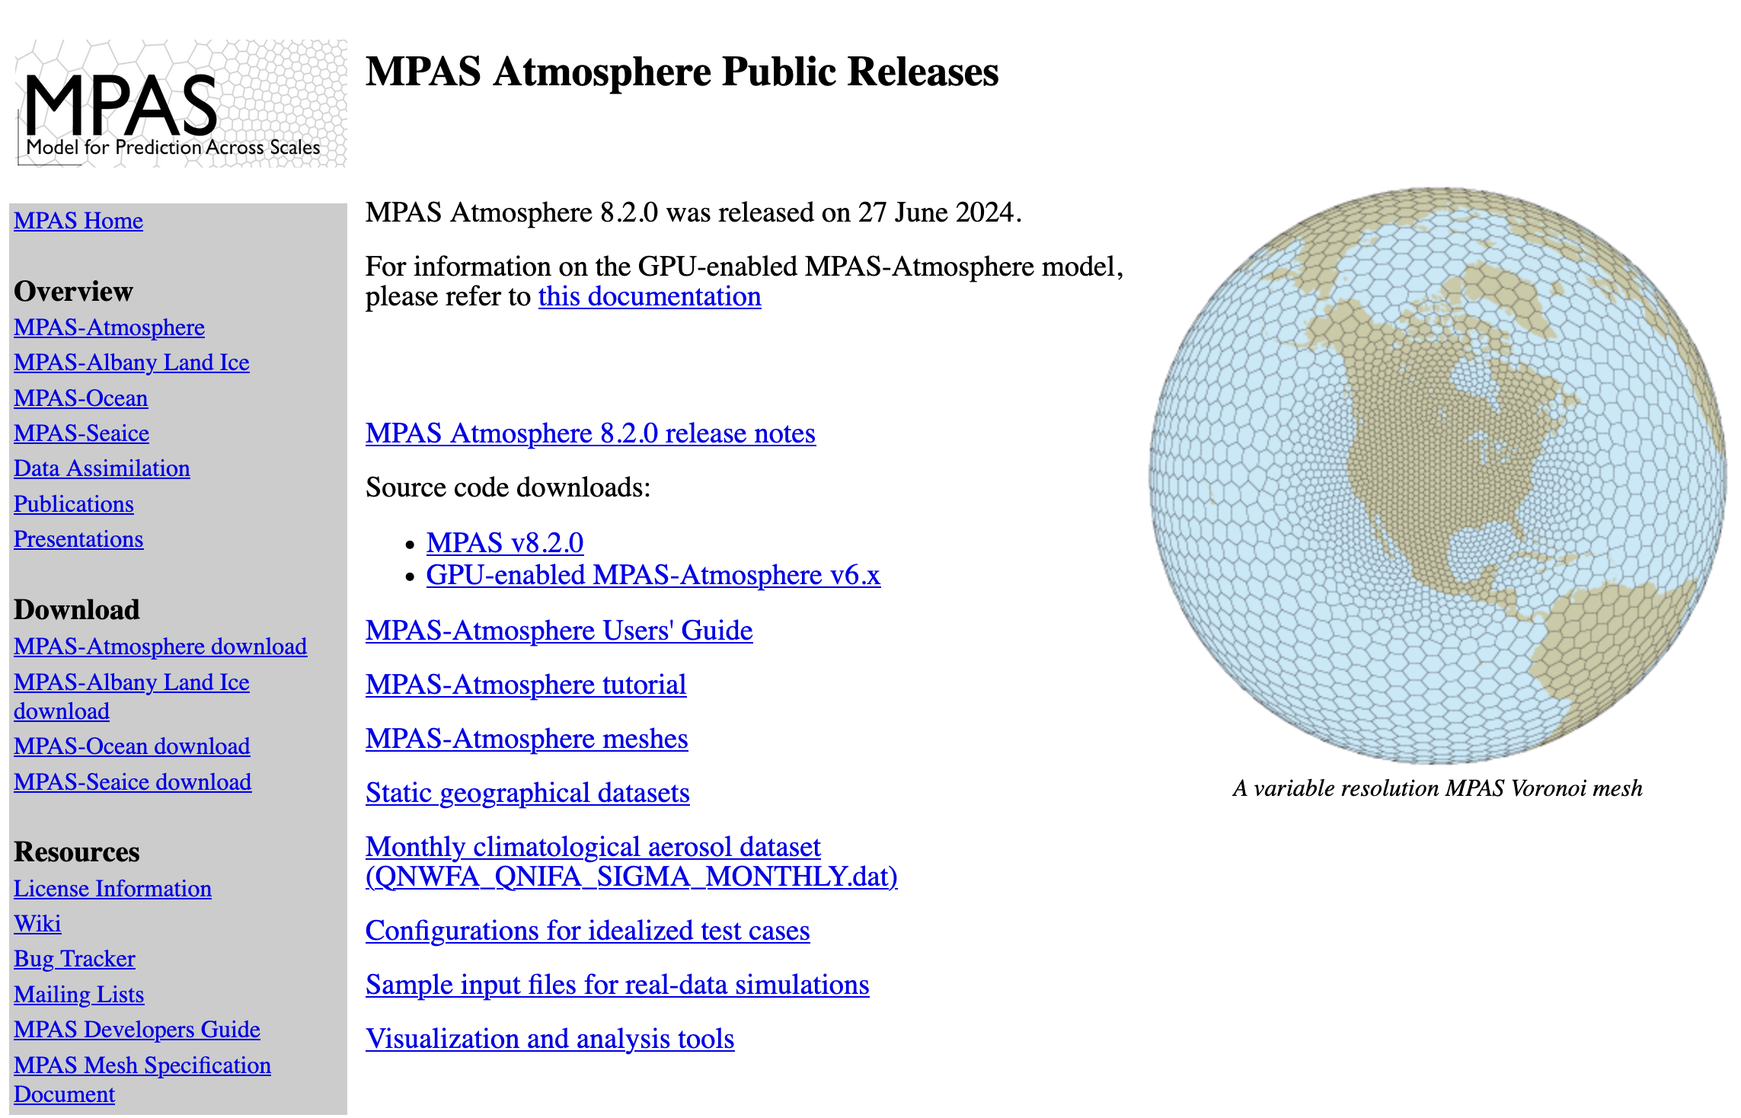
Real-data ICs: processing static fields
From where do we obtain the datasets for these “static” fields?
First…
Next…

Slide 6
Real-data ICs: processing static fields
Before creating initial conditions, we need a CVT mesh!
First…
Next…

Slide 7
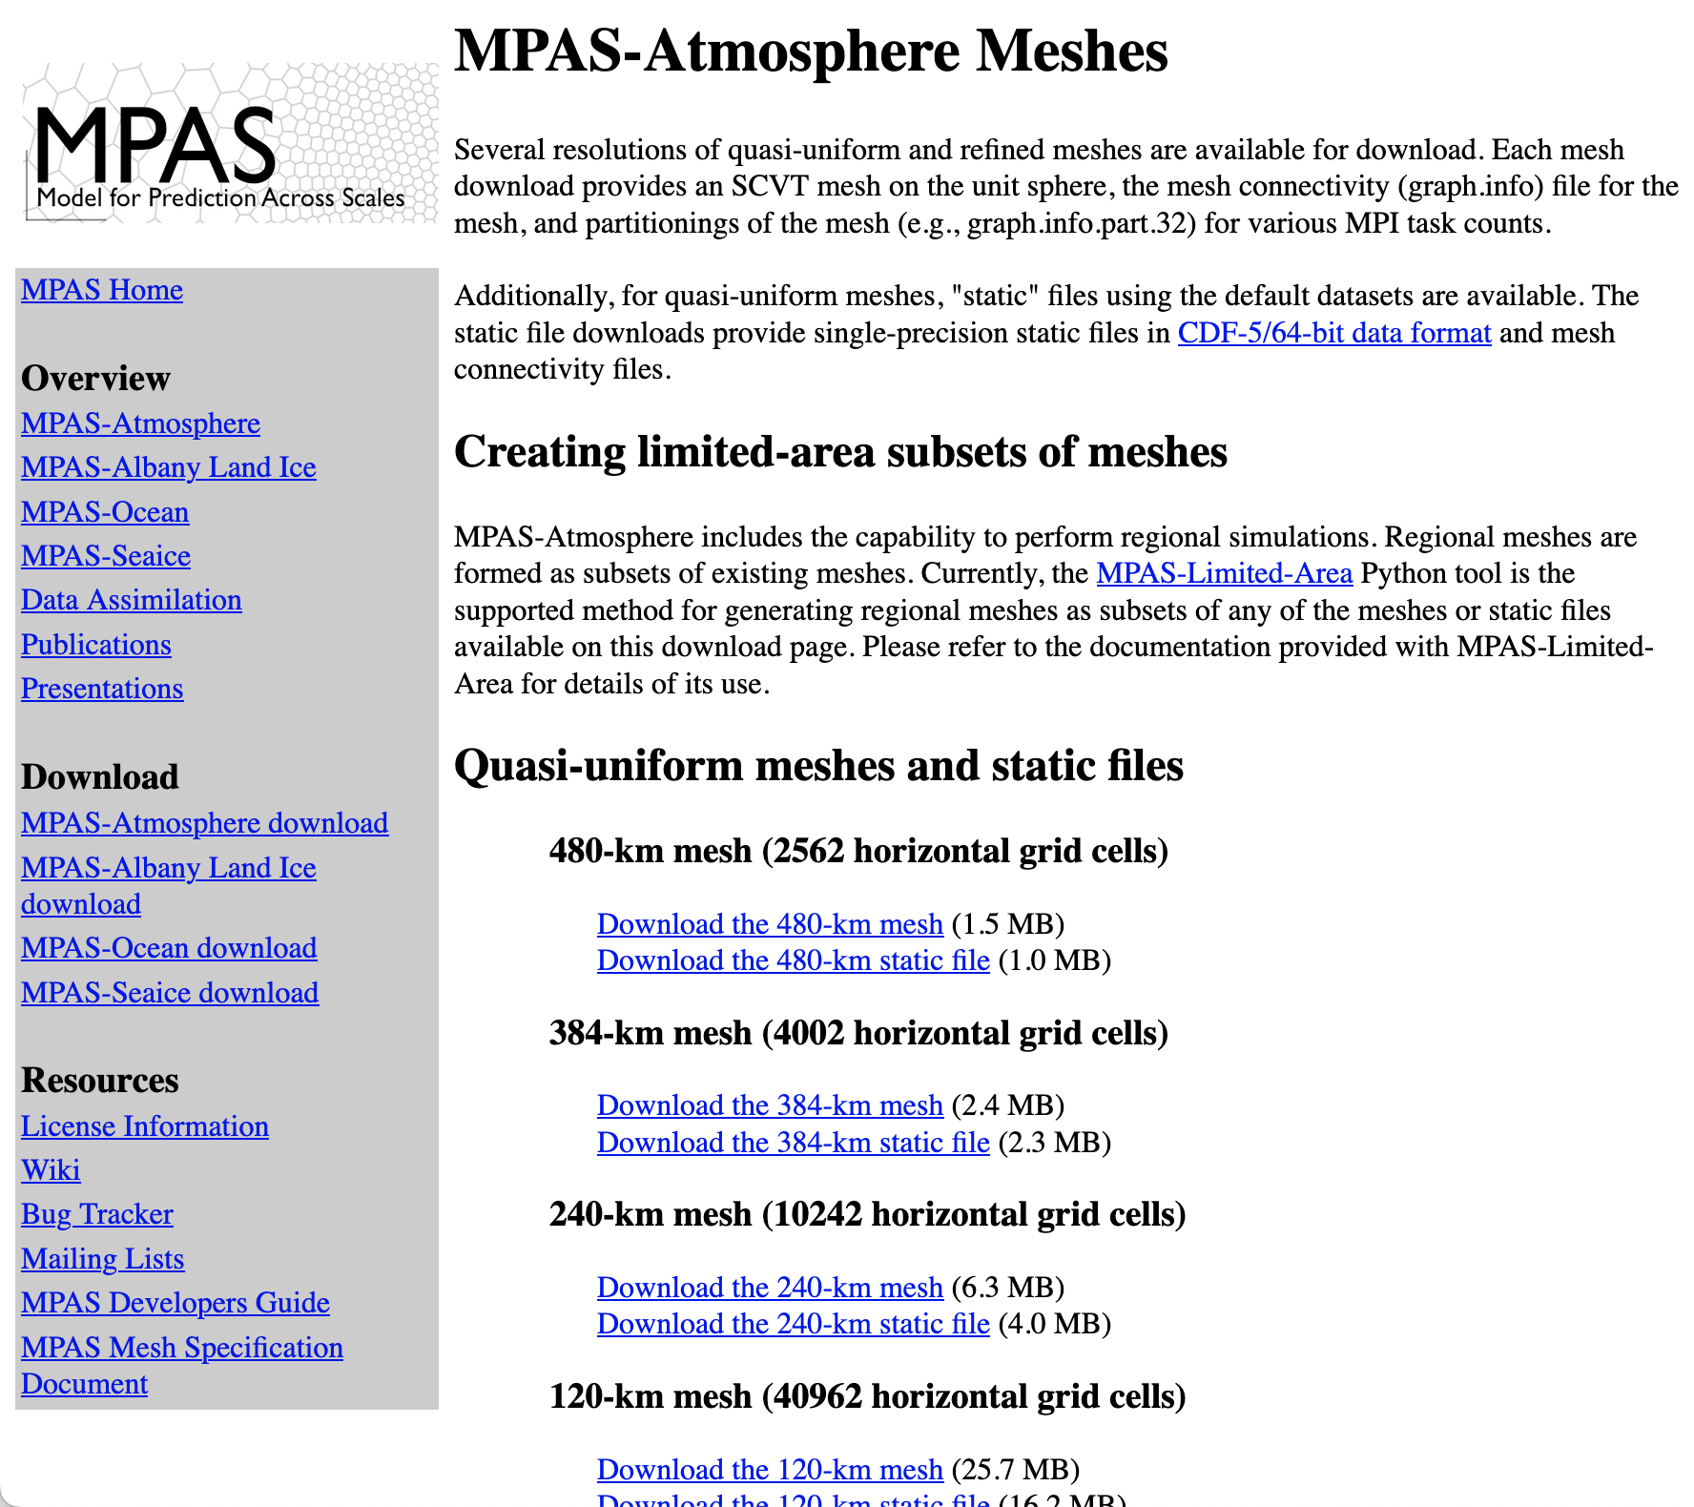
Real-data ICs: processing static fields
The mesh download page has meshes that have been well-tested

Slide 8
Real-data ICs: processing static fields
Filenames of the meshes that are found on the download page include:
x1.40962.grid.nc
x1.163842.grid.nc
x1.655362.grid.nc
x1.2621442.grid.nc
x1.5898242.grid.nc
x4.163842.grid.nc
x4.535554.grid.nc
x5.6488066.grid.nc
How does one interpret these cryptic names?

Slide 9
Real-data ICs: processing static fields
Filenames of the meshes that are found on the download page include:
x1.40962.grid.nc
x1.163842.grid.nc
x1.655362.grid.nc
x1.2621442.grid.nc
x1.5898242.grid.nc
x4.163842.grid.nc
x4.535554.grid.nc
x5.6488066.grid.nc
Refinement factor:
x1 = no refinement (quasi-uniform)
x4 = refinement by a factor of 4
x5 = refinement by a factor of 5

Slide 10
Real-data ICs: processing static fields
Some of the meshes that are found on the download page include:
x1.40962
x1.163842
x1.655362
x1.2621442
x1.5898242
x4.163842
x4.535554
x5.6488066
Total number of cells in the mesh

Slide 11
Real-data ICs: processing static fields
When downloading a mesh, you’ll get the mesh itself as well as various mesh (graph) partition files.
For example, the x1.40962 mesh (about 120-km resolution) is provided with the following files:
x1.40962.grid.nc – the mesh itself
x1.40962.graph.info – the mesh connectivity graph
x1.40962.graph.info.part.2 – pre-computed partitioning for 2 MPI tasks
x1.40962.graph.info.part.8 – pre-computed partitioning for 8 MPI tasks
x1.40962.graph.info.part.16 – pre-computed partitioning for 16 MPI tasks
...
We’ll say more about partition files when talking about running the model, and also when talking about MPAS meshes

Slide 12
Real-data ICs: processing static fields
Recall from the lecture about compiling MPAS that there are two executables we need to initialize and run an MPAS-Atmosphere simulation:
init_atmosphere_model
Handles all stages of processing real-data initial conditions
Handles processing of SST and sea-ice update files
Handles generation of various idealized initial conditions
Handles generation of lateral boundary conditions
atmosphere_model
The model itself, responsible for performing integration/simulation given any source of initial conditions

Slide 13

Real-data ICs: processing static fields
How does the ‘init_atmosphere’ core manage to combine all of this functionality into one program?
The key idea is that init_atmosphere_model may be run in stages using different options
2 = ideal baroclinic wave
4 = ideal squall line
5 = ideal supercell
6 = ideal mountain wave
7 = real-data initialization
8 = surface update file creation
9 = lateral boundary conditions
&nhyd_model
config_init_case = 7
...
/
&preproc_stages
config_static_interp = true
config_native_gwd_static = true
config_vertical_grid = false
config_met_interp = false
config_input_sst = false
config_frac_seaice = false
/
Only used for real-data cases to control, e.g., whether we interpolate static fields, compute fields for GWDO scheme, interpolate meteorological data, etc.

Slide 14
Real-data ICs: processing static fields
Generally, there are two files that must be edited every time the init_atmosphere_model program is run:
namelist.init_atmosphere
Fortran namelist file
Determines which “case” will be prepared (e.g., idealized cases, real-data case)
Determines sub-options for the selected initialization case
streams.init_atmosphere
XML file
Specifies which netCDF files will be read and written by the init_atmosphere_model program

Slide 15

Real-data ICs: processing static fields
Input and output files when producing a “static” file:
namelist.init_atmosphere
log.init_atmosphere.0000.out
streams.init_atmosphere
init_atmosphere_model
Static file
(e.g., x1.40962.static.nc)
Mesh file
(e.g., x1.40962.grid.nc)
Global terrestrial datasets

Slide 16
Real-data ICs: processing static fields
Key settings in the namelist.init_atmosphere file:
&nhyd_model
config_init_case = 7
/
&data_sources
config_geog_data_path = '/glade/work/wrfhelp/WPS_GEOG/'
config_landuse_data = 'MODIFIED_IGBP_MODIS_NOAH'
config_topo_data = 'GMTED2010'
config_vegfrac_data = 'MODIS'
config_albedo_data = 'MODIS'
config_maxsnowalbedo_data = 'MODIS'
/
&preproc_stages
config_static_interp = true
config_native_gwd_static = true
config_vertical_grid = false
config_met_interp = false
config_input_sst = false
config_frac_seaice = false
/

Slide 17
Real-data ICs: processing static fields
Key settings in the streams.init_atmosphere file:
<immutable_stream name="input"
type="input"
filename_template="x1.40962.grid.nc"
input_interval="initial_only" />
<immutable_stream name="output"
type="output"
filename_template="x1.40962.static.nc"
packages="initial_conds"
output_interval="initial_only" />

Slide 18
Real-data ICs: processing static fields
The result should be a “static” netCDF file with
terrain
land use category
soil category
climatological albedo
climatological vegetation fraction
sub-grid-scale orography statistics for the GWDO scheme
Also, the radius of the SCVT mesh should be 6371229.0 m!

Slide 19
Real-data ICs: processing static fields
Look for messages like the following in the log.init_atmosphere.0000.out file:
--- enter subroutine init_atm_static:
Using GMTED2010 terrain dataset
/shared/WPS_GEOG/topo_gmted2010_30s/00001-01200.00001-01200
/shared/WPS_GEOG/topo_gmted2010_30s/01201-02400.00001-01200
/shared/WPS_GEOG/topo_gmted2010_30s/02401-03600.00001-01200
Computing GWDO static fields on the native MPAS mesh
--- Using GMTED2010 terrain dataset for GWDO static fields
-----------------------------------------
Total log messages printed:
Output messages = 3067
Warning messages = 10
Error messages = 0
Critical error messages = 0
-----------------------------------------

Slide 20
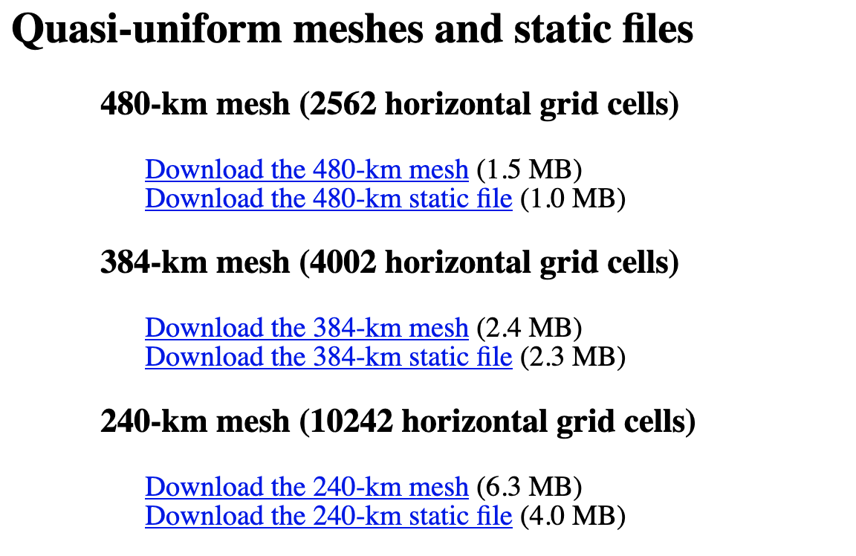
Quasi-uniform static files
At this point, you may ask:
If the "static" fields are independent of the starting time of a simulation,
couldn't the MPAS developers do the preceding steps once and make the resulting static files available for everyone?
The mesh download page has links to "static" files for all quasi-uniform meshes

Slide 21
Outline
Real-data Initial Conditions
Processing time-invariant fields (“static” file generation)
Interpolating atmospheric and land-surface fields
Producing SST and sea-ice update files
Running a basic simulation
Creating idealized initial conditions
3-d baroclinic wave test case
3-d supercell test case
2-d mountain wave test case

Slide 22
Digression: “intermediate” data files
Time-varying meteorological and land-surface fields in MPAS-Atmosphere are interpolated from intermediate files produced by the ungrib component of the WRF Pre-processing System.
We’ll assume in this tutorial that these files have already been prepared!
Additional details may be found in the links, below
WRF Model web page: http://www2.mmm.ucar.edu/wrf/users/
WRF Users’ guide: https://www2.mmm.ucar.edu/wrf/users/wrf_users_guide/build/html/index.html
WPS source code: https://github.com/wrf-model/WPS
Tutorial slides for running ungrib: http://www2.mmm.ucar.edu/wrf/users/tutorial/201801/wps_general.pdf
Notes:
UPDATE: should refer to latest WPS, which include '—nowrf' and '—build-grib2-libs'

Slide 23
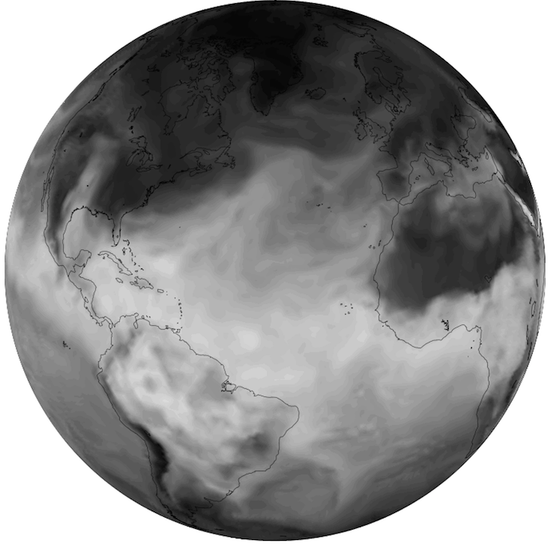
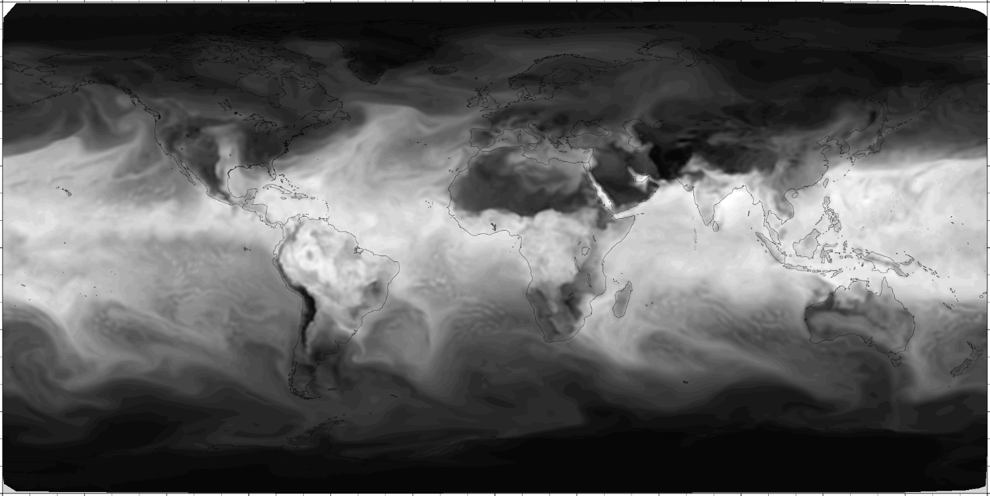
Real-data ICs: interpolating meteorological fields
Input and output files when producing an “init” file:
namelist.init_atmosphere
log.init_atmosphere.0000.out
streams.init_atmosphere
init_atmosphere_model
Static file
(e.g., x1.40962.static.nc)
Initial conditions file
(e.g., x1.40962.init.nc)
The smoothed terrain following vertical grid has also been generated…
WPS “intermediate” file
(e.g., GFS:2014-09-10_00)

Slide 24
Real-data ICs: interpolating meteorological fields
Key settings in the namelist.init_atmosphere file:
&nhyd_model
config_init_case = 7
config_start_time = '2014-09-10_00:00:00'
/
&dimensions
config_nvertlevels = 55
config_nsoillevels = 4
config_nfglevels = 38
config_nfgsoillevels = 4
/
&data_sources
config_met_prefix = 'GFS'
/

Slide 25
Real-data ICs: interpolating meteorological fields
Key settings in the namelist.init_atmosphere file (cont.):
&vertical_grid
config_ztop = 30000.0
config_nsmterrain = 1
config_smooth_surfaces = true
config_dzmin = 0.3
config_nsm = 30
config_tc_vertical_grid = true
config_blend_bdy_terrain = false
/
&preproc_stages
config_static_interp = false
config_native_gwd_static = false
config_vertical_grid = true
config_met_interp = true
config_input_sst = false
config_frac_seaice = true
/

Slide 26
Real-data ICs: interpolating meteorological fields
Key settings in the streams.init_atmosphere file:
<immutable_stream name="input"
type="input"
filename_template="x1.40962.static.nc"
input_interval="initial_only" />
<immutable_stream name="output"
type="output"
filename_template="x1.40962.init.nc"
packages="initial_conds"
output_interval="initial_only" />

Slide 27
Real-data ICs: interpolating meteorological fields
The result should be a “init” netCDF file with
everything from the “static” file
3-d vertical grid information
3-d potential temperature (theta)
3-d winds (u and w)
3-d water vapor mixing ratio (q_{v})
3-d soil moisture
3-d soil temperature

Slide 28
Real-data ICs: interpolating meteorological fields
Look for messages like the following in the log.init_atmosphere.0000.out file:
real-data GFS test case
Using option 'linear' for vertical extrapolation of temperature
max ter = 5393.19321458650
Setting up vertical levels as in 2014 TC experiments
--- config_tc_vertical_grid = T
--- als = 0.750000000000000E-01
--- alt = 1.70000000000000
--- zetal = 0.750000000000000
Interpolating TT at 27 1000.00000000000
Interpolating U at 27 1000.00000000000
Interpolating V at 27 1000.00000000000
Interpolating RH at 27 1000.00000000000
Interpolating GHT at 27 1000.00000000000
*************************************************
Found 38 levels in the first-guess data
*************************************************

Slide 29
Outline
Real-data Initial Conditions
Processing time-invariant fields (“static” file generation)
Interpolating atmospheric and land-surface fields
Producing SST and sea-ice update files
Running a basic simulation
Creating idealized initial conditions
3-d baroclinic wave test case
3-d supercell test case
2-d mountain wave test case

Slide 30
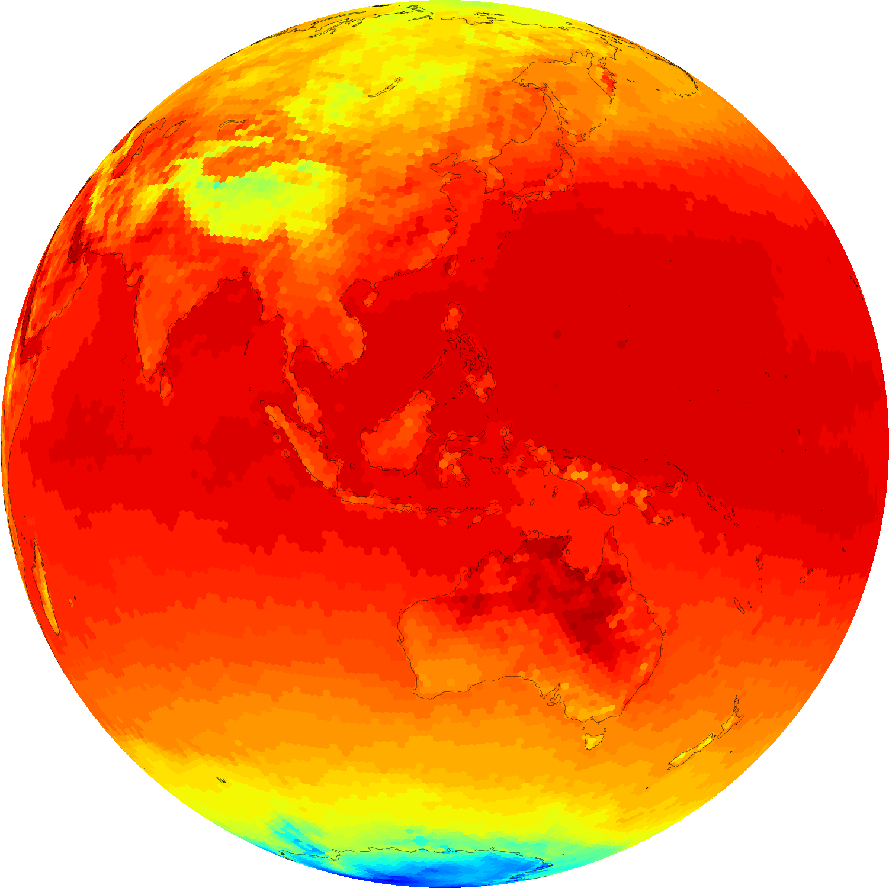
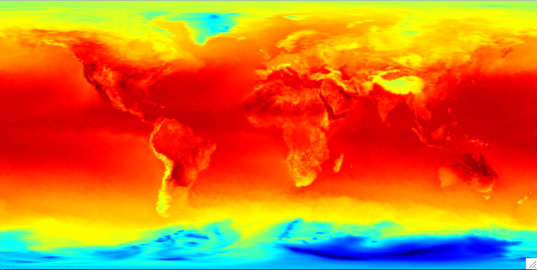
Producing SST and sea-ice update files
Input and output files when producing an SST update file:
namelist.init_atmosphere
log.init_atmosphere.0000.out
streams.init_atmosphere
init_atmosphere_model
Static file
(e.g., x1.40962.static.nc)
Time-varying SST data
(e.g., x1.40962.sfc_update.nc)
WPS “intermediate” files
(e.g., SST:2014-09-*)

Slide 31
Producing SST and sea-ice update files
Key settings in the namelist.init_atmosphere file:
&nhyd_model
config_init_case = 8
config_start_time = '2014-09-10_00:00:00'
config_stop_time = '2014-09-20_00:00:00'
/
&data_sources
config_sfc_prefix = 'SST'
config_fg_interval = 86400
/
&preproc_stages
config_static_interp = false
config_native_gwd_static = false
config_vertical_grid = false
config_met_interp = false
config_input_sst = true
config_frac_seaice = true
/

Slide 32
Producing SST and sea-ice update files
Key settings in the streams.init_atmosphere file:
<immutable_stream name="input"
type="input"
filename_template="x1.40962.static.nc"
input_interval="initial_only" />
<immutable_stream name="surface"
type="output"
filename_template="x1.40962.sfc_update.nc"
filename_interval="none"
packages="sfc_update"
output_interval="86400" />

Slide 33
Real-data ICs: processing static fields
Look for messages like the following in the log.init_atmosphere.0000.out file:
real-data surface (SST) update test case
Processing file SST:2014-09-10_00
Processing file SST:2014-09-11_00
Processing file SST:2014-09-12_00
Processing file SST:2014-09-13_00
Processing file SST:2014-09-14_00
Processing file SST:2014-09-15_00
Processing file SST:2014-09-16_00
Processing file SST:2014-09-17_00
Processing file SST:2014-09-18_00
Processing file SST:2014-09-19_00
Processing file SST:2014-09-20_00
-----------------------------------------
Total log messages printed:
Output messages = 144
Warning messages = 0
Error messages = 0
Critical error messages = 0
-----------------------------------------

Slide 34
Outline
Real-data Initial Conditions
Processing time-invariant fields (“static” file generation)
Interpolating atmospheric and land-surface fields
Producing SST and sea-ice update files
Running a basic simulation
Creating idealized initial conditions
3-d baroclinic wave test case
3-d supercell test case
2-d mountain wave test case

Slide 35
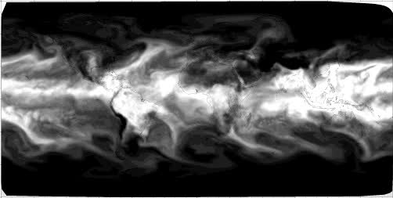
Running the MPAS-Atmosphere model
The same atmosphere_model executable can be used for either real-data or idealized simulations
Given initial conditions (e.g., x1.40962.init.nc), all that is needed to run the model is to:
Edit the namelist.atmosphere file to set model timestep, mixing and damping parameters, physics options, etc.
Edit the streams.atmosphere file to specify the name of the input initial conditions file and the frequency of model history files
Ensure that the proper mesh partition file (e.g., x1.40962.graph.info.part.64) is present
Run atmosphere_model
atmosphere_model

Slide 36
Running the MPAS-Atmosphere model
Before running the model itself (atmosphere_model), verify that the following namelist options have been properly set:
config_start_time – The starting time of the simulation, which should either match the time in the initial conditions files or a model restart file.
config_dt – The model timestep, in seconds; try starting with a timestep of between 5 and 6 times the minimum model grid spacing in kilometers; also ensure that model output interval is evenly divided by the timestep
Besides these crucial namelist options, ensure that the names of input and output files are correctly set in the streams.atmosphere file!
Notes:
UPDATE: should we mention config_len_disp in case anyone has old mesh files?

Slide 37

Digression: Mesh partition files
MPAS meshes must be partitioned using Metis in order for MPAS to allow simulations to run in parallel
However, the meshes available from the MPAS-Atmosphere download page are provided with several pre-computed partition files
In many cases, it may not be necessary for you to run Metis yourself; just use a pre-computed partitioning
For example, the x1.40962 mesh (about 120-km resolution) is provided with the following files:
x1.40962.grid.nc – the mesh itself
x1.40962.graph.info – the mesh connectivity graph
x1.40962.graph.info.part.2 – pre-computed partitioning for 2 MPI tasks
x1.40962.graph.info.part.8 – pre-computed partitioning for 8 MPI tasks
x1.40962.graph.info.part.16 – pre-computed partitioning for 16 MPI tasks
...

Slide 38
Running the MPAS-Atmosphere model
As the model runs, information about the progress of the model is written to the file log.atmosphere.0000.out
You can tail this file to check on model progress, e.g.,
$ tail -f log.atmosphere.0000.out
Begin timestep 2017-06-12_01:00:00
--- time to run the LW radiation scheme L_RADLW = T
--- time to run the SW radiation scheme L_RADSW = T
--- time to run the convection scheme L_CONV = T
--- time to apply limit to accumulated rainc and rainnc L_ACRAIN = F
--- time to apply limit to accumulated radiation diags. L_ACRADT = F
--- time to calculate additional physics_diagnostics = F
split dynamics-transport integration 3
global min, max w -0.4467210 1.098162
global min, max u -89.13145 88.83957
Timing for integration step: 0.3368 s
Above: Example output for a timestep in the log file from a typical model run.

Slide 39
One final, important note…
If there are any errors reported in the log.init_atmosphere.0000.out or log.atmosphere.0000.out files, look for log.*.err files, and have a closer look!
-----------------------------------------
Total log messages printed:
Output messages = 46
Warning messages = 0
Error messages = 0
Critical error messages = 1
-----------------------------------------
----------------------------------------------------------------------
Beginning MPAS-init_atmosphere Error Log File for task 0 of 1
Opened at 2018/07/27 16:35:58
----------------------------------------------------------------------
CRITICAL ERROR: Could not open input file 'x1.40926.init.nc' to read mesh fields
Logging complete. Closing file at 2018/07/27 16:35:58

Slide 40
Outline
Real-data Initial Conditions
Processing time-invariant fields (“static” file generation)
Interpolating atmospheric and land-surface fields
Producing SST and sea-ice update files
Running a basic simulation
Creating idealized initial conditions
3-d baroclinic wave test case
3-d supercell test case
2-d mountain wave test case

Slide 41
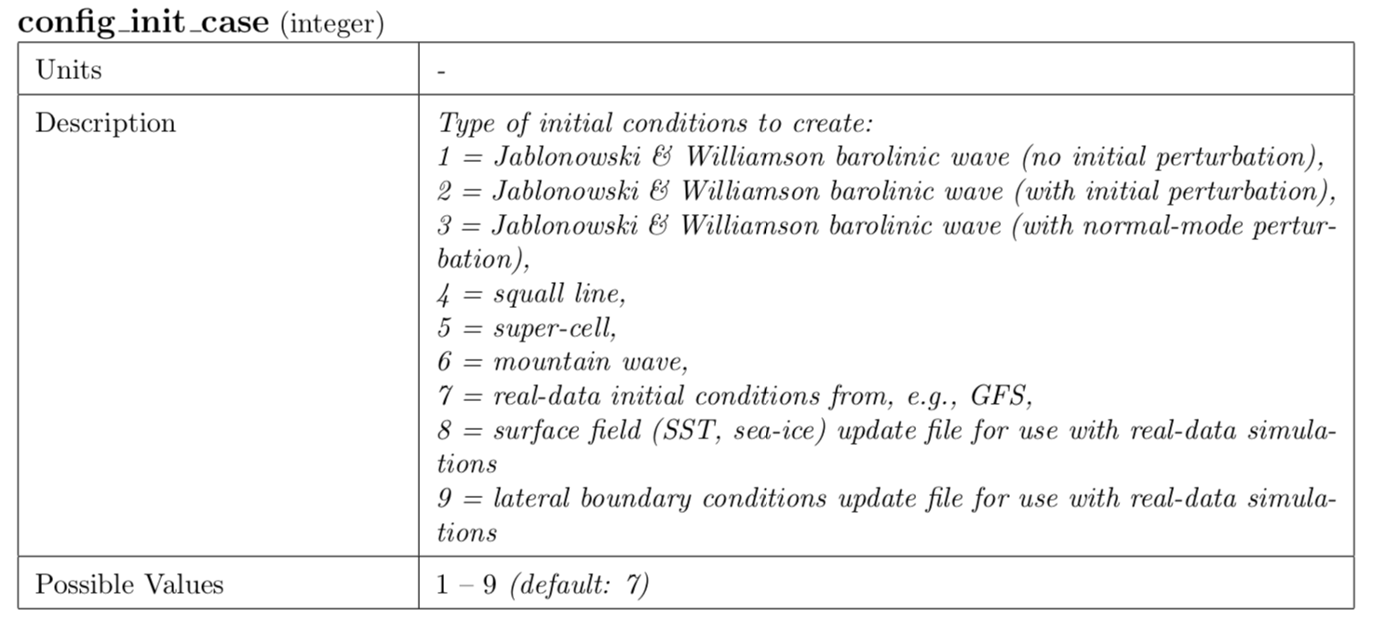
Selecting among idealized cases
Creating idealized initial conditions (ICs) with the init_atmosphere_model program is much easier than creating real-data ICs
No need for external datasets or multiple pre-processing steps: model fields are prescribed by formulae!
Simply choose the appropriate initialization case

Slide 42
Idealized case downloads
Some idealize cases (e.g., super-cell) require doubly-periodic meshes
Your best option is to simply download a prepared run directory for idealized cases
After unpacking the tar file, symbolically link your init_atmosphere_model and atmosphere_model executables into the resulting directory and follow the README file

Slide 43
Idealized case downloads
First…
Next…

Slide 44
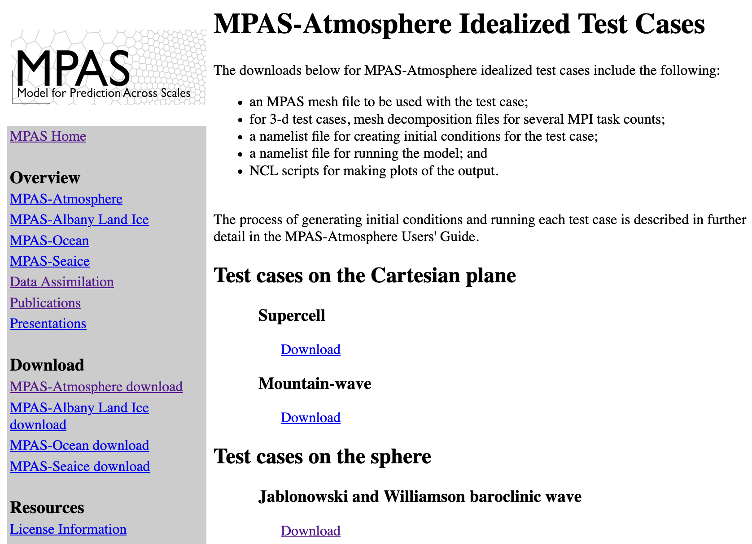
Idealized case downloads

Slide 45
Summary
Begin by downloading a mesh from the MPAS-A mesh download page
For real-data initial conditions:
  Interpolate time-invariant ("static") terrestrial fields
  Obtain an "intermediate" file with atmospheric and soil state
  Generate vertical grid and interpolate time-varying fields
For idealized initial conditions:
  Easiest to download .tar.gz file for the idealized case from MPAS webpage
Run the simulation
  At a minimum, set starting time and integration step in the namelist.atmosphere file
  Ensure you have a mesh partition file corresponding to # of MPI tasks
  Set input and output filenames in the streams.atmosphere file

