Slide 1
MPAS-Atmosphere Mesh Generation
Michael G. Duda
NCAR/MMM

Slide 2
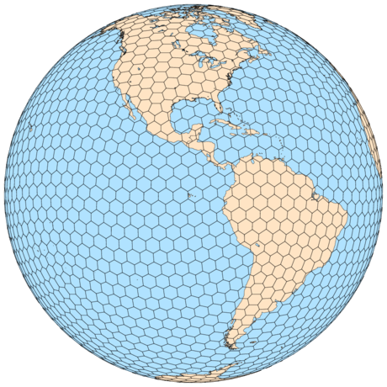
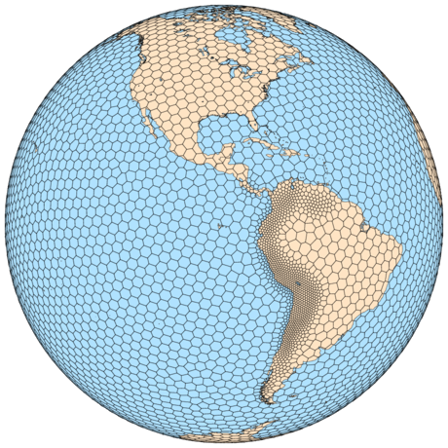
Motivation
How do we generate the meshes that are a central feature of MPAS?
The mesh on the left looks simple to generate...
but what
about the mesh
on the right?
Notes:
We’ll focus mostly on the generation of variable-resolution meshes, but towards the end we’ll say a few words about the generation of quasi-uniform meshes.

Slide 3
Centroidal Voronoi tessellations defined
Both meshes in the preceding slide are (spherical) centroidal Voronoi tessellations:
Voronoi = each grid volume (cell) V_{i} is uniquely associated with a generating point x_{i} such that all points within V_{i} are closer to x_{i} than to any other x_{j}
Lines joining generating points of adjacent cells are
bisected by the shared cell face; and
intersect the shared cell face at a right angle.
Centroidal = the generating point for each Voronoi cell is also the mass centroid of that cell (w.r.t. some density function)
Three Voronoi cells, V_{i} , along with their associated generating points, x_{i} . Each Voronoi cell corner is uniquely associated with a Delaunay triangle (dashed line).
Notes:
One of our goals is to explain how (but perhaps not why) the centroidal property allows us to produce variable-resolution meshes with complete control over the distribution of cells

Slide 4
Centroidal Voronoi tessellations as minimizers
Du et al.¹ show that the minimizer of a particular problem is necessarily a CVT
It is reasonable, then, to approach the generation of CVTs as an optimization problem
Many algorithms could be brought to bear, but we employ Lloyd’s Method
For constant density in the plane, hexagons provide the minimum energy configuration of Voronoi regions (Newman², also Gersho³).
Notes:
And this is promising, because optimization is a well-studied field.

Slide 5
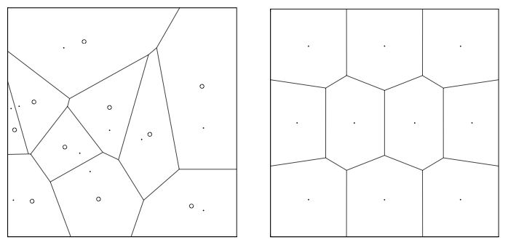
Introduction to Lloyd’s method
Originally developed by Stuart Lloyd at Bell Labs for optimal signal quantization
Given an initial set of generating points and a density function ρ(x), Lloyd’s method may be used to arrive at a CVT:
Begin with any set of initial points (“generating points”)
Construct a Voronoi diagram for the point set
Locate the mass centroid of each Voronoi cell
Move each generating point to the mass centroid of its Voronoi cell
Repeat 2-4 to convergence
An example CVT (right) produced using Lloyd iteration, beginning from random points in the domain. From Du et al.¹
Notes:
Lloyd’s method is attractive because it is a simple iteration that can be easily implemented

Slide 6

Density function: the key to refinement
For a density function ρ(x) > 0, it is conjectured (Ju et al.⁴) that, as the number of Voronoi cells increases, the diameters, h, of Voronoi cells are related by
where d’ is 2.
By defining an appropriate density function, therefore, we can distribute cells essentially however we choose!
Notes:
We have a method to arrive at a CVT given initial generating points and a mesh density function. But we need to identify a relationship between the mesh density function and the sizes of cells in the CVT.

Slide 7
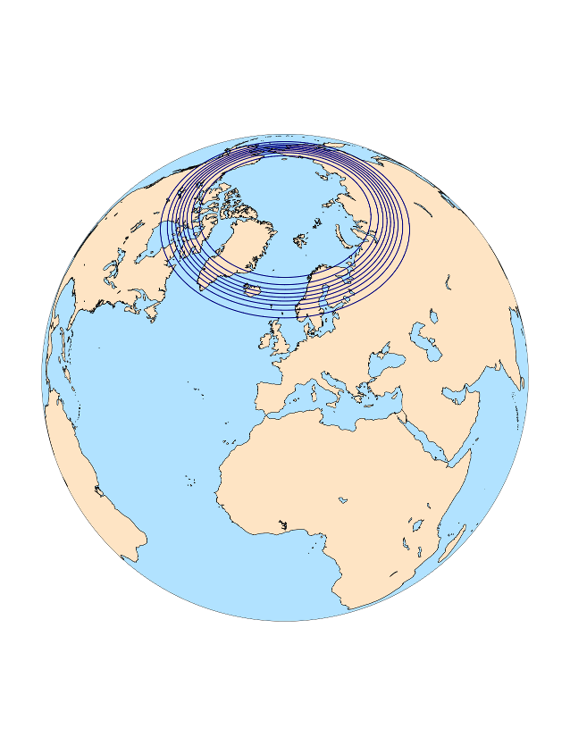
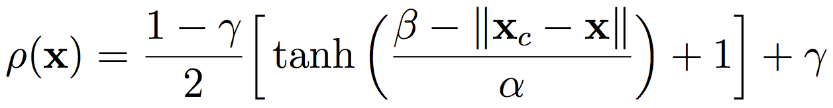
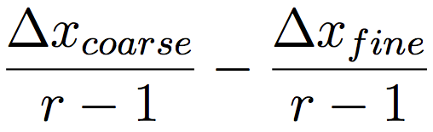
A few notes on density functions
Functions with continuous first derivatives seem to work well; most of our atmosphere meshes use a density function based on Ringler et al.⁵ :
How small can our “transition” zone be if we want the average cell diameter to vary by at most a factor of r (with r > 1) from any cell to its neighbors? At least
Here, x_{c} is the center of the refinement region, β is the half-width of the high-resolution region, α is the width of the “transition zone”, and γ is the minimum density. x_{c} and x are constrained to lie on the surface of the sphere.
Notes:
Density function takes as input a vector constrained to the surface of the sphere, and is based on a hyperbolic tangent function with three parameters.
The parameter beta can be freely chosen, as can gamma. But how quickly can we go from high to low resolution?

Slide 8
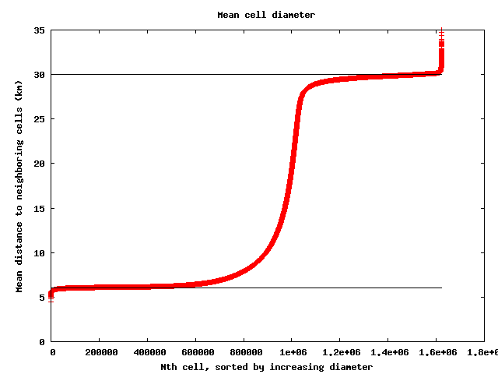
How many generating points are needed?
Density function controls the relative resolution in mesh, while the total number of generating points set the absolute mesh resolutions
We use a simple Monte-Carlo method to estimate the required number of generating points
ds_{min} = min. desired grid
distance in the mesh
N_{s} = number of samples
A_{s} = 4πR² / N_{s}
for 1 to N_{s}
  p = random point on sphere
  r = density(p)
  ds = ds_{min} / r^{0.25}
  nCells = nCells + A_{s} /
  hexagon_area(ds)
end for
Resulting mean cell diameters from a 30-6 km mesh with the number of generating points estimated using the Monte-Carlo method
Notes:
Would be cool to identify the cell with 35-km mean cell diameter and plot it inside the graph
We’ve found it to be easy (and accurate enough) to employ a Monte-Carlo method to estimate the total number of generating points.

Slide 9
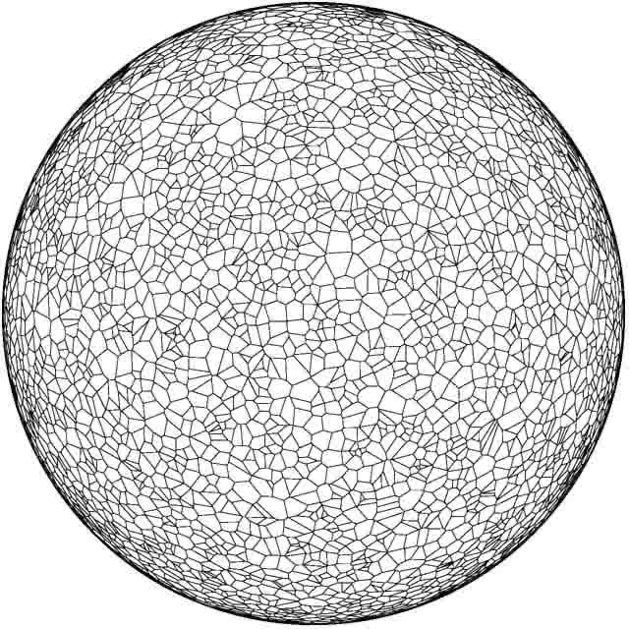
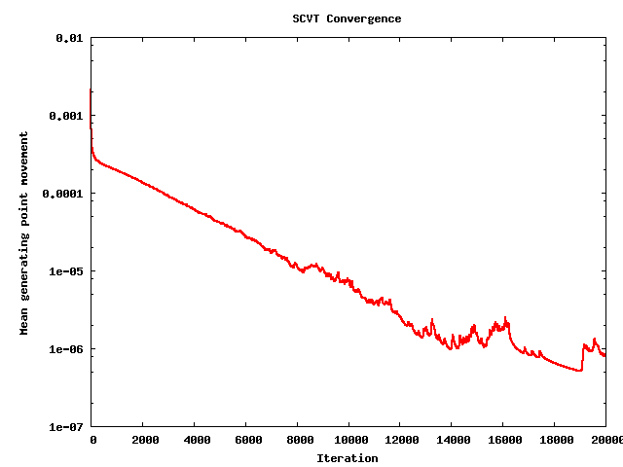
A first attempt at mesh generation
The obvious approach suggests simply defining the density function, generating the required number of generating points randomly, and iterating to convergence
The animation at left covers only the first 4000 iterations at a variable framerate

Slide 10
Problems with the obvious approach
With uniformly-distributed random initial generating points, there is apparently quite a lot of time spent in allowing points to migrate around the sphere
This suggests we try to get cells into nearly their final position as “cheaply” as possible
Rather than choosing uniformly-distributed points, one might instead choose points based on the density function
As a second attempt, draw initial points from a probability density function defined as ρ(x)^{0.5}

Slide 11
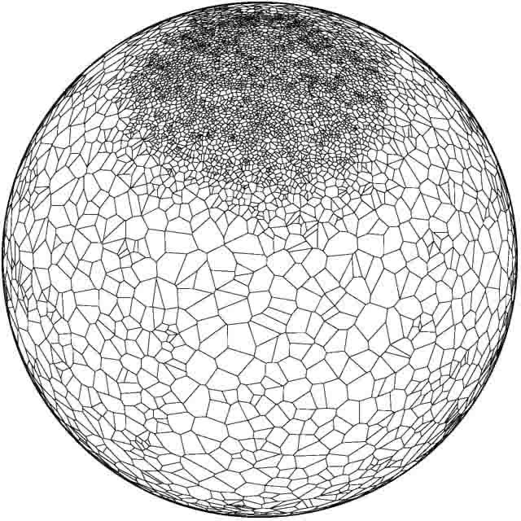
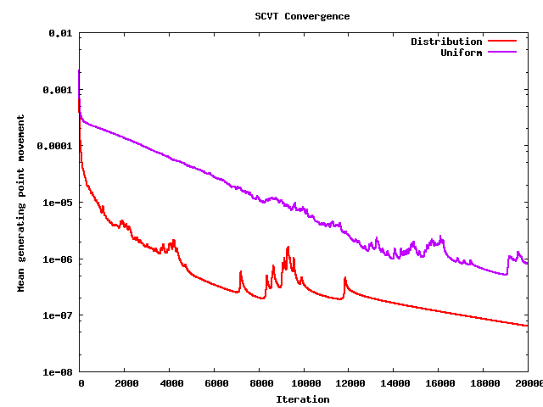
A second attempt...
Choosing initial generating points according to the p.d.f. given by ρ(x)^{0.5} does significantly reduce the generating point movement overall
The animation at left covers iterations 1-624 and 8000-10000 at a variable framerate

Slide 12
Incremental grid generation
The preceding approaches may be fine for coarse meshes, but convergence can still take quite some time for high-resolution meshes.
Todd Ringler (then at LANL) had suggested an approach that leads to meshes in significantly less time, and is what we now employ almost exclusively:
Begin with a random set X₀ = {x_{i}}, with |X₀| = O(100), of initial generating points suitable for a mesh that is 2^{n} times coarser in resolution than the target mesh
For k = 0 ... n
  Perform Lloyd iterations on X_{k} to convergence to produce a mesh M_{k}
  If k < n, let X_{k+1} be the set of points resulting from the bisection of M_{k}
The mesh M_{n} is the a CVT with the desired resolution

Slide 13
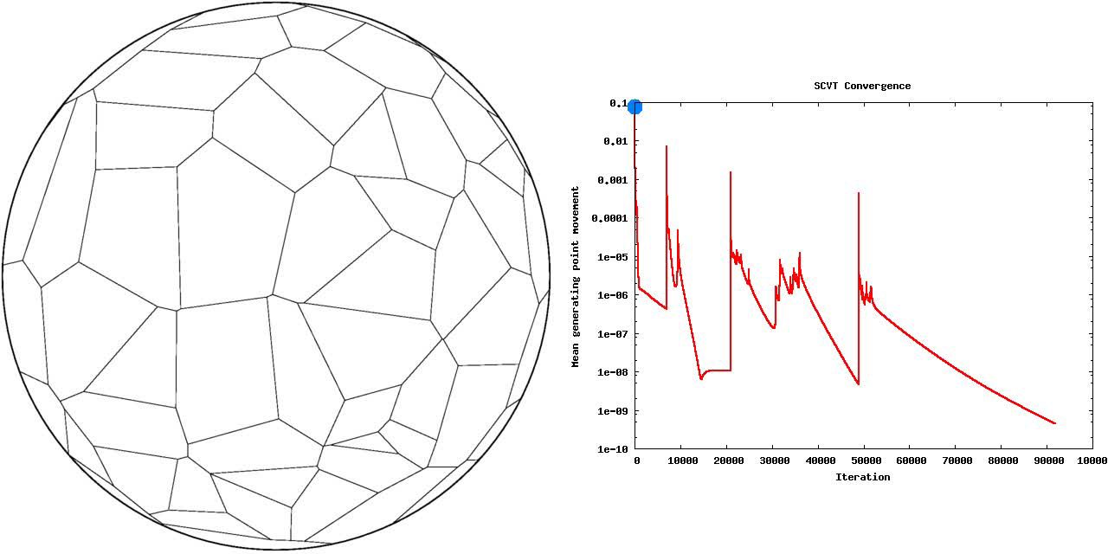
Incremental mesh generation
Experience indicates that the incremental approach to grid generation does lead to a higher-quality mesh in significantly less wall-clock time

Slide 14
Simple parallel implementation
The incremental generation approach appears to be robust enough, but generating a mesh is still very slow
Can take several months on a single multi-core desktop for high-resolution meshes
Lloyd iteration has two main computational phases, one of which is embarrassingly parallel
Currently computed in serial in the code we use for MPAS-Atmosphere meshes
while (not converged)
let {x_{i}} = {x_{i}’}
compute Voronoi regions, {V_{i}}, of {x_{i}}
compute mass centers, {x_{i}’}, of {V_{i}}
end
Trivially parallelized, since computation of mass center for a Voronoi region is independent of other regions

Slide 15
Simple parallel implementation
Unless we’re parallelizing a part of the Lloyd iteration that takes considerable time, we’ll not gain very much
How much time is spent in the two main phases of our implementation of Lloyd’s method?
Number of generating points | Centroid computation (seconds) | Voronoi tessellation (seconds) | Ratio of centroid time to Voronoi time
100 | 0.02688 | 0.000138 | 194.8
1000 | 0.24740 | 0.001441 | 171.7
10000 | 2.462 | 0.01958 | 125.7
101378 | 25.37 | 0.1478 | 171.7
405506 | 101.9 | 0.8024 | 127.0
1622018 | 406.9 | 3.753 | 108.4
6488066 | 1629 | 23.86 | 68.29
“Toy” meshes with random initial generating points
Refinement stages from a 15-3 km mesh

Slide 16
Simple parallel implementation
With the addition of a single OpenMP parallel loop, we’re able to gain a significant improvement in performance
Numbers above bars indicate percent of theoretical speedup
Using SMT reduces runtime by a further 15% compared with 12 OpenMP threads
97%
94%
91%
89%
From Amdahl’s Law, we achieve an overall speedup of 11.3 on a 2x6-core Xeon desktop!

Slide 17
Distributed-memory parallel algorithm
Parallelization of centroid computation with OpenMP is nearly trivial, but limits scaling to the number of cores in a shared-memory node
Even with 24 threads on the desktop in my office, generating a 15-3 km mesh with ~6.5 M cells still took months!
Jacobsen et al.⁶ describe a more scalable approach with both phases of Lloyd’s method parallelized with MPI
Parallelize Voronoi tessellation using stereographic projections
This approach seems better for larger meshes in particular

Slide 18
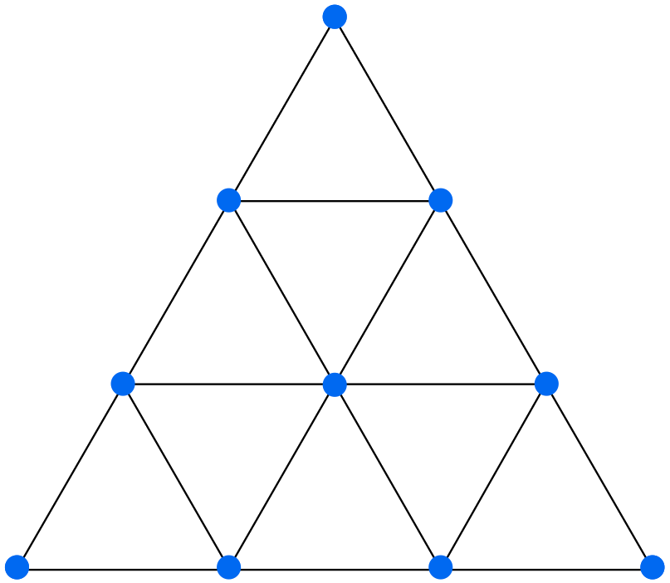
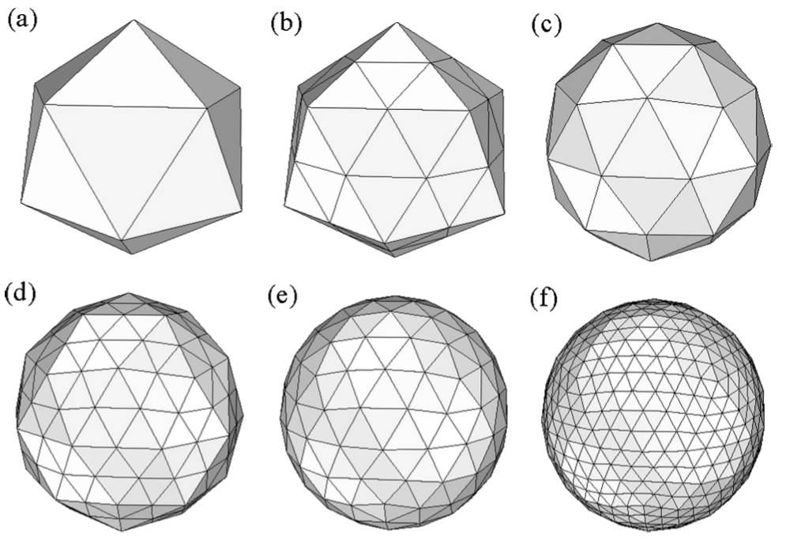
Quasi-uniform meshes
In contrast to variable-resolution meshes, quasi-uniform meshes are comparatively simple!
Grid distance in original icosahedron = 7530 km (for earth radius 6371 km)
Divide triangles by any integral factor, and let vertices of triangles be generating points after projection to the sphere
Bisecting an icosahedral mesh and projecting vertices to the sphere. Lipscomb and Ringler (2005)
For quasi-uniform MPAS meshes, we may divide by any positive integer factor.

Slide 19
Final remarks
Grid generation at present is a slow process that often requires human judgment in, e.g., knowing when a stage of mesh generation is converged “enough”, working around stable but undesirable mesh features, etc.
Before this is supportable to the community, we need to make mesh generation more user-friendly
  Integrated grid metrics are needed to tell us:
    When to stop iterating
    Whether we can expect good numerical properties from resulting mesh
Improvements to performance are still needed
  Can techniques like over-relaxation be applied to improve convergence rate?
  Implement code optimizations, exploit GPUs for embarrassingly parallel work, etc. to improve iteration rate

Slide 20
References
¹ Du, Q., V. Faber, and M. Gunzburger, 1999. “Centroidal Voronoi Tessellations: Applications and Algorithms”. SIAM Review, 41, 637 – 676.
² Newman, D. J., 1982. “The Hexagon Theorem”. IEEE Transactions on Information Theory, 28, 137 – 139.
³ Gersho, A., 1979. “Asymptotically Optimal Block Quantization”. IEEE Transactions on Information Theory, 25, 373 – 380.
⁴ “Voronoi Diagrams and their Application in Climate and Global Modeling”, Chapter in Numerical Techniques for Global Atmospheric Models. Springer-Verlag Berlin Heidelberg, 2011.
⁵ Ringler, T. D., D. Jacobsen, M. Gunzburger, L. Ju, M. Duda, and W. Skamarock, 2011. “Exploring a Multiresolution Modeling Approach within the Shallow-Water Equations”. Mon. Wea. Rev., 139, 3348 – 3368.
⁶ Jacobsen, D.W., M. Gunzburger, T. Ringler, J. Burkardt, and J. Peterson, 2013. “Parallel algorithms for planar and spherical Delaunay construction with an application to centroidal Voronoi tessellations”. Geosci. Model Dev., 6, 1353 – 1365.

