Slide 1
Computing New Diagnostic Fields in MPAS-Atmosphere Simulations
Michael G. Duda
NCAR/MMM

Slide 2
Motivation
As the number of people using MPAS-Atmosphere increased to even a very modest number, it was recognized that we needed some structured way of introducing the computation of new diagnostics
We wanted a framework that could handle:
Instantaneous diagnostics
Cumulative diagnostics
Extreme value diagnostics
Or anything that looked like the above from a computational standpoint!
Diagnostics should be able to change in response to modifications of the streams that write them, too.
Notes:
Average rain rate over an output interval

Slide 3
Introduction
Broadly, there are five stages in the computation of diagnostics like those types listed on the previous slide:
Setup – Pre-allocate arrays that will be needed by the diagnostic during the simulation, initialize values, etc.
Update – Accumulate values, update extrema, etc.
Compute – Divide by the accumulation period to get mean values, compute instantaneous fields, etc.
Reset – After writing the diagnostic, zero-out accumulation arrays, etc.
Cleanup – Deallocate any memory that was allocated by the diagnostic

Slide 4
Diagnostics framework
Other than Setup and Cleanup, how do these phases fit into the sequence of a model timestep?
time step loop
timestep
update
compute
stream
output
reset
Accumulate, update extreme values, etc.
Compute instantaneous field, mean value, RMS, etc.
Zero-out accumulation arrays, etc.
Critically, we need some way for a diagnostic to determine whether it will be written out in a given timestep!
Notes:
"Reset" also happens before the first timestep

Slide 5
Diagnostics utilities
Along with the diagnostics framework, a utility module has been written that will tell a diagnostic:
Whether its field will be written in a given timestep
Generally called from the Compute phase
How many output streams include its field
time step loop
timestep
update
compute
stream
output
reset
Accumulate, update extreme values, etc.
Compute instantaneous field, mean value, RMS, etc.
Zero-out accumulation arrays, etc.

Slide 6
Code organization
In terms of code structure, where do we add diagnostics?
The idea is that all diagnostics should be implemented as self-contained modules
All diagnostics modules should reside in the same place
MPAS-Model/
src/
core_atmosphere/
diagnostics/
dynamics/
inc/
physics/
Registry.xml
utils/
Add new diagnostics in this directory
The main Registry.xml file will include “sub-Registry” sections from the diagnostics directory
Notes:
Why self-contained?
1) If we want to remove it – it's slow, causes the model to crash, etc.
2) We want to implement the same diagnostic in another model

Slide 7
Code organization
In terms of code structure, where do we add diagnostics?
The idea is that all diagnostics should be implemented as self-contained modules
All diagnostics modules should reside in the same place
MPAS-Model/
src/
core_atmosphere/
diagnostics/
Makefile
Registry_diagnostics.xml
mpas_atm_diagnostics_manager.F
dynamics/
inc/
physics/
Registry.xml
utils/
These files serve as the interface between your new diagnostic and the rest of MPAS
Notes:
The key to modularity is having well-defined interfaces

Slide 8
How to add a new diagnostics?
Define new namelist options and fields in a new Registry_<your_diagnostic>.xml file. Add a #include statement for this new Registry section in the Registry_diagnostics.xml file.
Create a new module for the diagnostic.
Add calls to your diagnostic's setup, update, compute, reset, and cleanup routines in the main diagnostic driver.
Update the Makefile to compile your new diagnostic module.
The README file in the diagnostics/ subdirectory describes the step-by-step process to adding a new diagnostic

Slide 9
Example: Maximum SW downward flux
Working in the src/core_atmosphere/diagnostics/ directory:
1. Define the maximum SWDOWN field in a new Registry_swdown.xml file
<var_struct name="diag_physics" time_levs="1">
<var name="gsw_max" type="real"
dimensions="nCells Time"
units="W m^{-2}"
description="Maximum surface SW radiation flux"/>
</var_struct>
2. Include Registry_swdown.xml in Registry_diagnostics.xml
<!-- SW radiation diagnostics -->
#include "Registry_swdown.xml"

Slide 10
Example: Maximum SW downward flux
Working in the src/core_atmosphere/diagnostics/ directory:
3. Write the setup, update, and reset routines for the diagnostic:
subroutine swdown_setup(all_pools)
type (MPAS_pool_type), pointer :: all_pools
type (MPAS_pool_type), pointer :: diag_physics
call mpas_pool_get_subpool(all_pools, 'diag_physics', diag_physics)
call mpas_pool_get_array(diag_physics, 'gsw', gsw)
call mpas_pool_get_array(diag_physics, 'gsw_max', gsw_max)
gsw_max(:) = 0.0
end subroutine swdown_setup
Not shown in the code above is the declaration of gsw and gsw_max pointers as module variables…

Slide 11
Example: Maximum SW downward flux
Working in the src/core_atmosphere/diagnostics/ directory:
3. Write the setup, update, and reset routines for the diagnostic:
subroutine swdown_update()
gsw_max(:) = max(gsw_max(:), gsw(:))
end subroutine swdown_update

Slide 12
Example: Maximum SW downward flux
Working in the src/core_atmosphere/diagnostics/ directory:
3. Write the setup, update, and reset routines for the diagnostic:
subroutine swdown_reset()
use mpas_atm_diagnostics_utils, only : mpas_field_will_be_written
if (mpas_field_will_be_written('gsw_max')) then
gsw_max(:) = 0.0
end if
end subroutine swdown_reset

Slide 13
Example: Maximum SW downward flux
After adding a couple of lines to the Makefile, we’re ready to compile MPAS-Atmosphere and try out our new diagnostic
We’ll test it by:
Outputting the gsw_max field every 60 minutes
Outputting the gsw_max field every 1440 minutes
Our test simulation will start at 2010-10-23 at 00 UTC, and we’ll look at the output that we get at 2010-10-24 at 00 UTC…

Slide 14
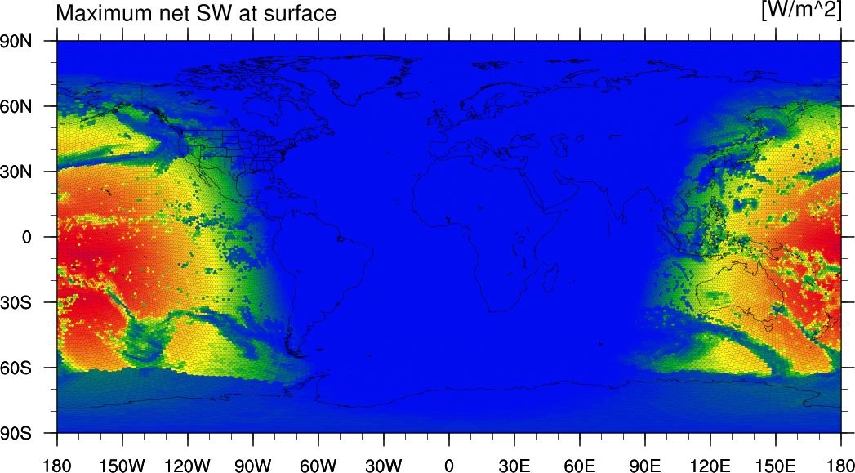
Example: 60-minute output interval

Slide 15
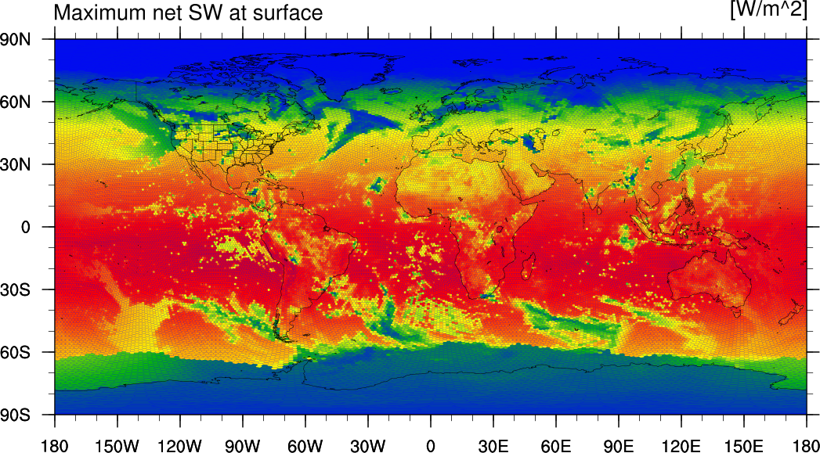
Example: 1440-minute output interval

Slide 16
Summary
MPAS-Atmosphere provides a framework that enables many types of diagnostic fields to be implemented in a modular way
The file
MPAS-Model/src/core_atmosphere/diagnostics/README summarizes the steps to implementing a new diagnostic.

