Slide 1
Downloading and compiling MPAS-Atmosphere
Michael G. Duda
NCAR/MMM

Slide 2
Basic system requirements
Before getting in to the details of how to download and compile the code, let's first answer the question:
On which systems can MPAS-Atmosphere be run?
There are essentially two considerations:
Hardware
Software

Slide 3
Hardware requirements
Generally speaking, no requirement regarding number of CPUs or type of CPU
But you must have relatively modern Fortran and C/C++ compilers that target your CPU architecture
However, the amount of memory (RAM) dictates the maximum domain size
Roughly 0.175 MB/memory per grid column (assuming 55 vertical levels and 'mesoscale_reference' physics suite)
As long as you're patient enough, and as long as your simulation fits in memory, a single processor is all you need!
On the upper end of CPU count, model generally scales well to around 100 grid columns per MPI task

Slide 4
Software requirements
Generally, a UNIX-like OS is needed
Linux, *BSD, macOS, AIX, etc.
Untested: Windows Subsystem for Linux (WSL)?
If using MPAS v8.0+, the Simple MPAS I/O Layer (SMIOL) requires just the PNetCDF library
If using MPAS v7.3 and earlier, or if using the PIO library.
A POSIX shell and the usual programs:
GNU Make, git, grep, awk, sed, cat, ranlib/libtool, etc.
Libraries
MPI (OpenMPI, MPICH, etc.)
Parallel-NetCDF
zlib
HDF5
NetCDF4 (C + Fortran)
PIO

Slide 5
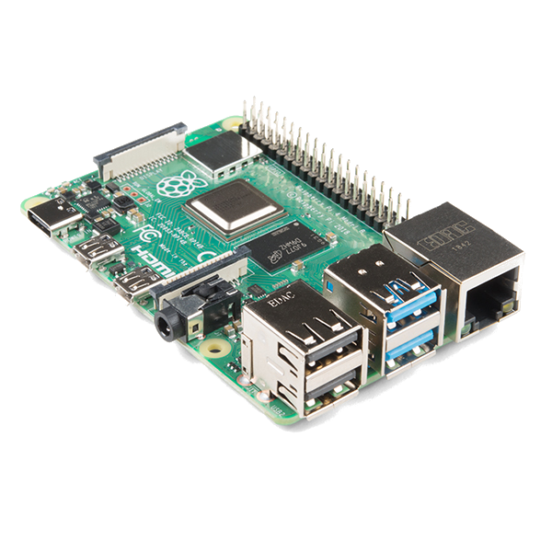
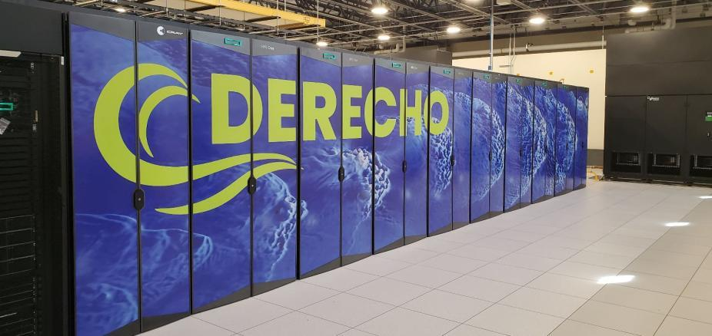
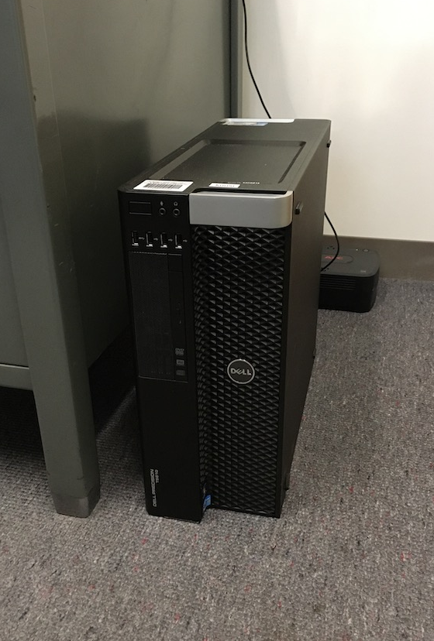
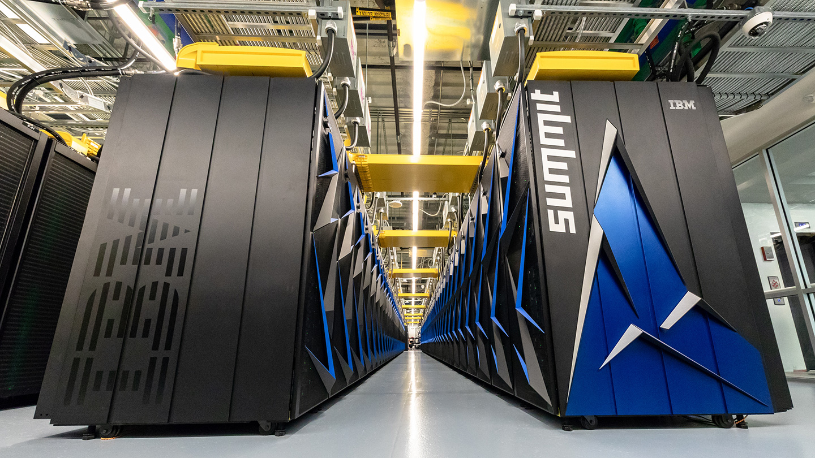
Example systems that run MPAS-A
$35M
$35
$5000
$200M
(?)

Slide 6
Obtaining MPAS-Atmosphere source code
Working under the assumption that we have a system that meets the basic requirements, we can then ask:
How do I get a copy of the source code?
There are essentially two options:
The “traditional”, but not necessarily encouraged, method
Download a .tar.gz or .zip file
The preferred method
Make a clone of the MPAS-Model repository

Slide 7
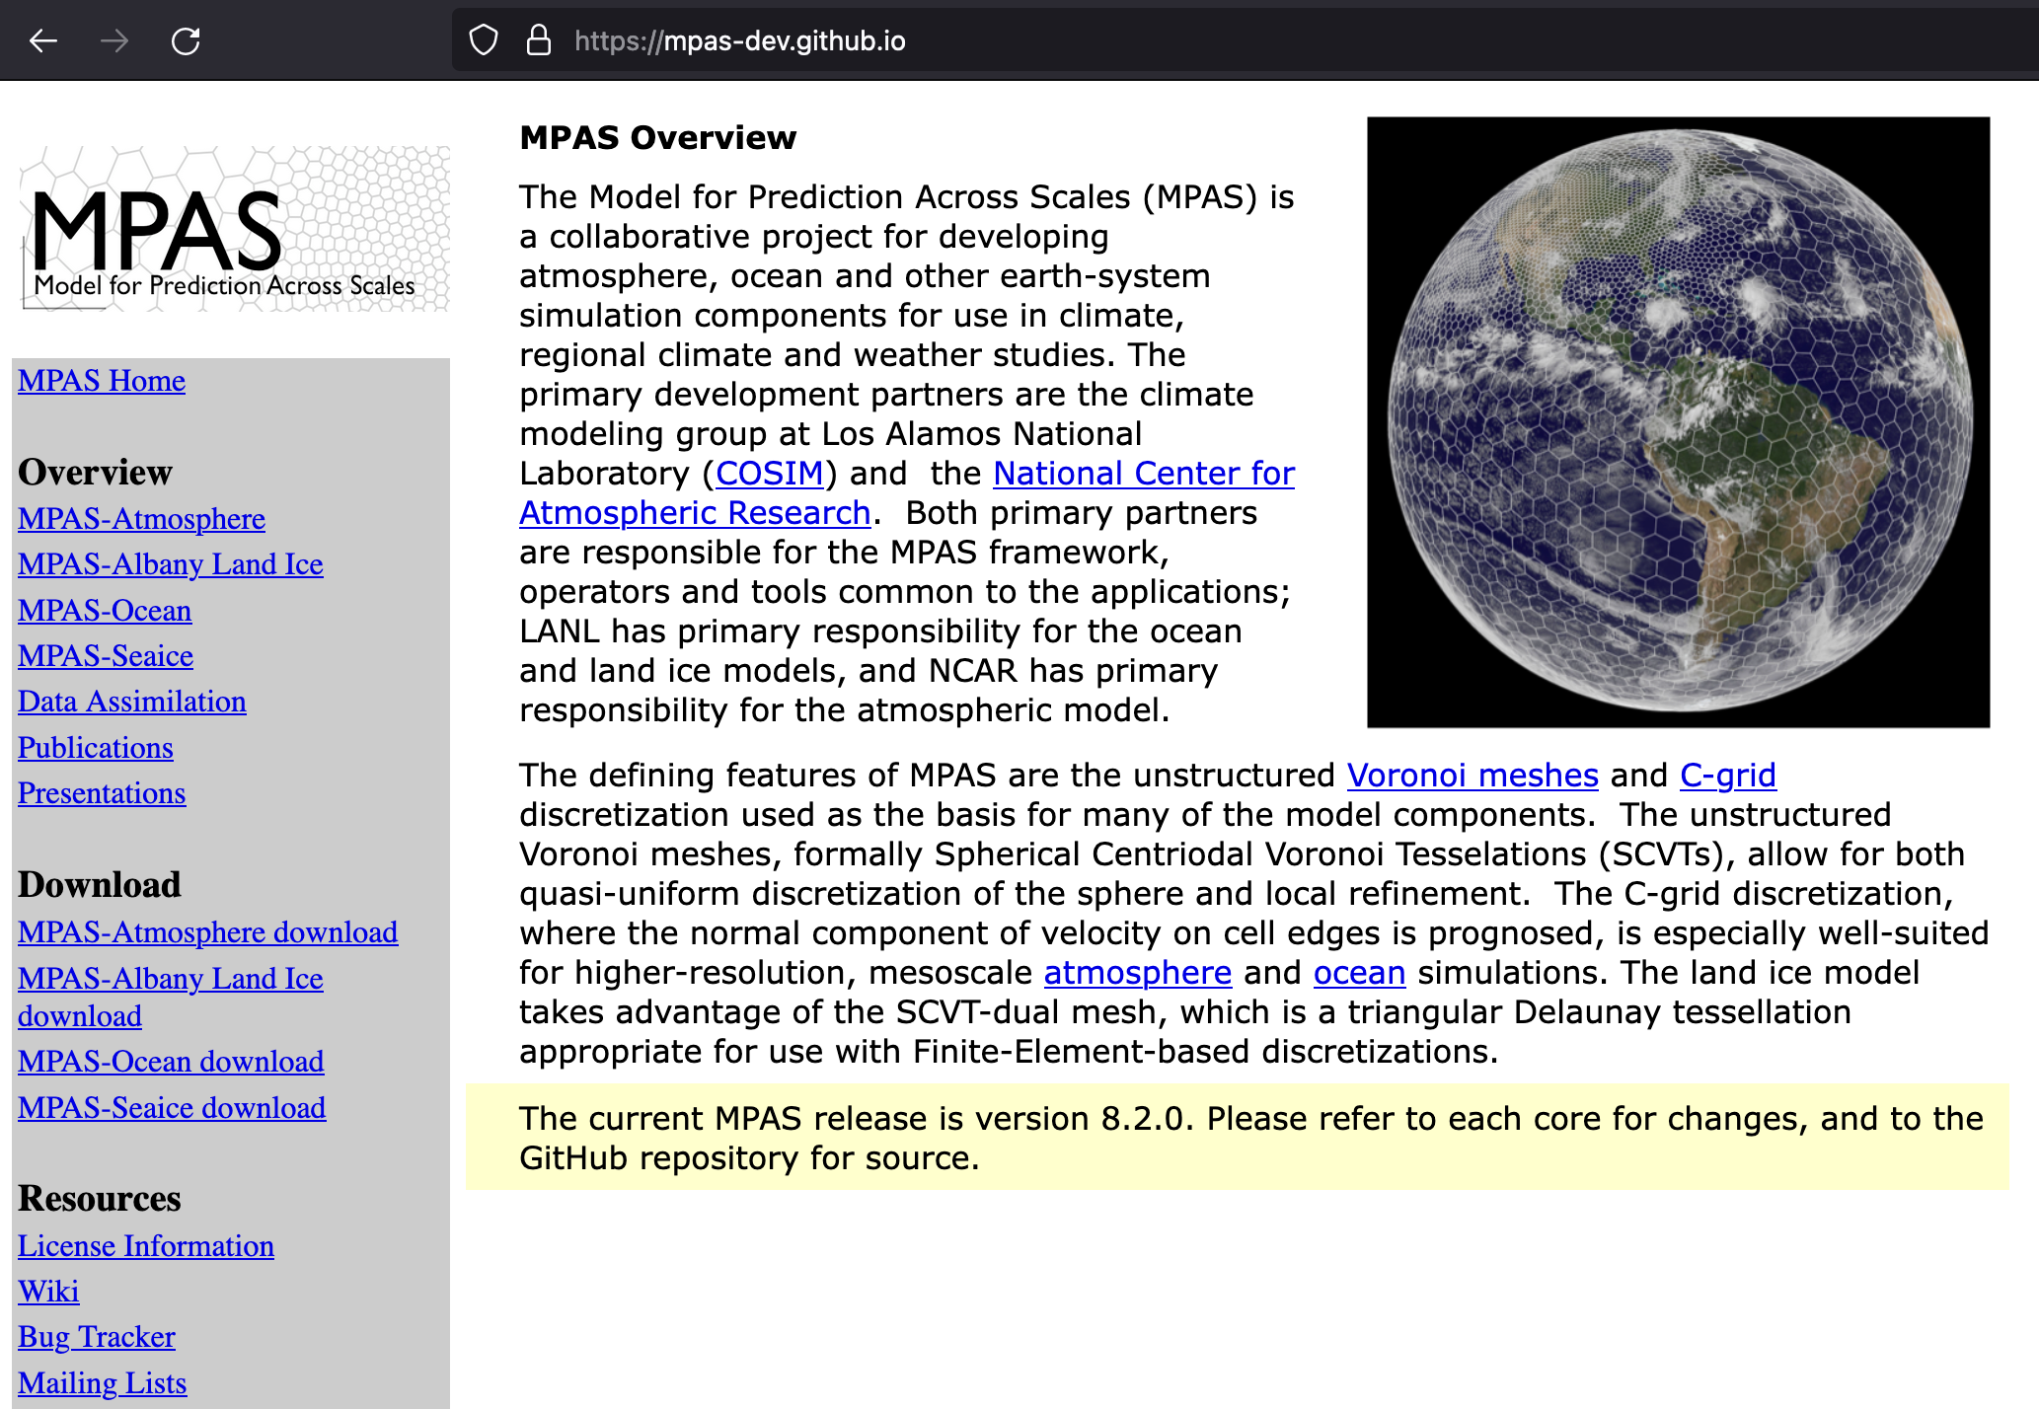
The ”less preferred” method of obtaining code
One can navigate to a download link from the MPAS homepage at https://mpas-dev.github.io/

Slide 8
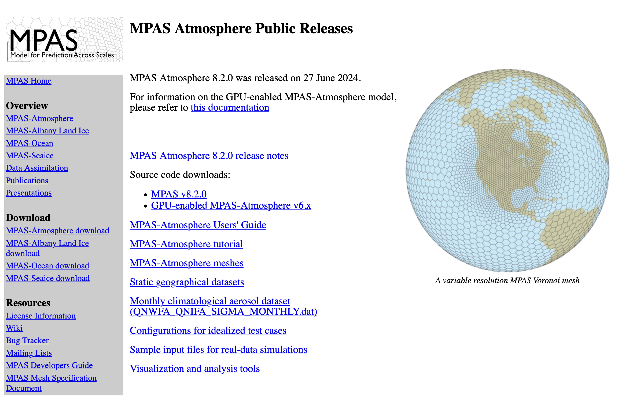
The ”less preferred” method of obtaining code
One can navigate to a download link from the MPAS homepage at https://mpas-dev.github.io/

Slide 9
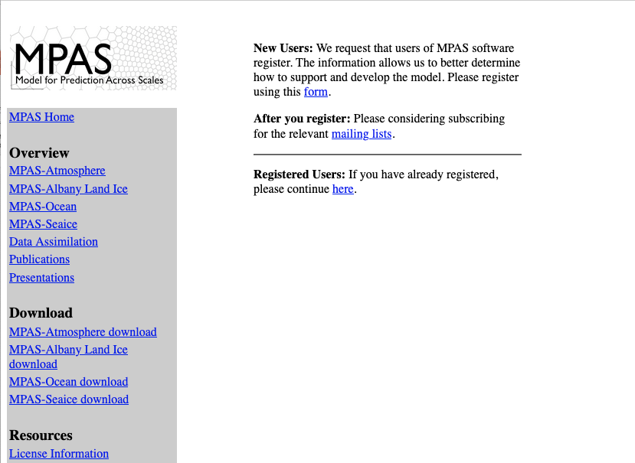
The ”less preferred” method of obtaining code
One can navigate to a download link from the MPAS homepage at https://mpas-dev.github.io/

Slide 10
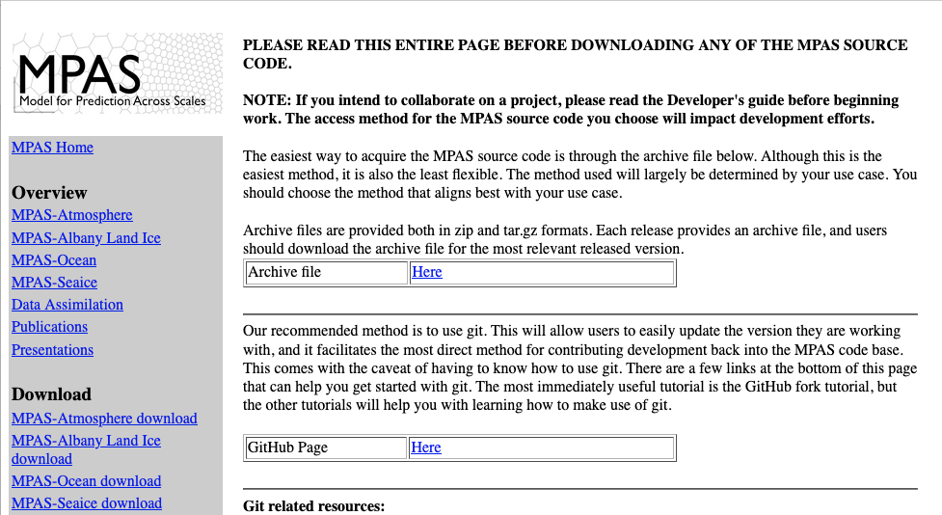
The ”less preferred” method of obtaining code
One can navigate to a download link from the MPAS homepage at https://mpas-dev.github.io/

Slide 11
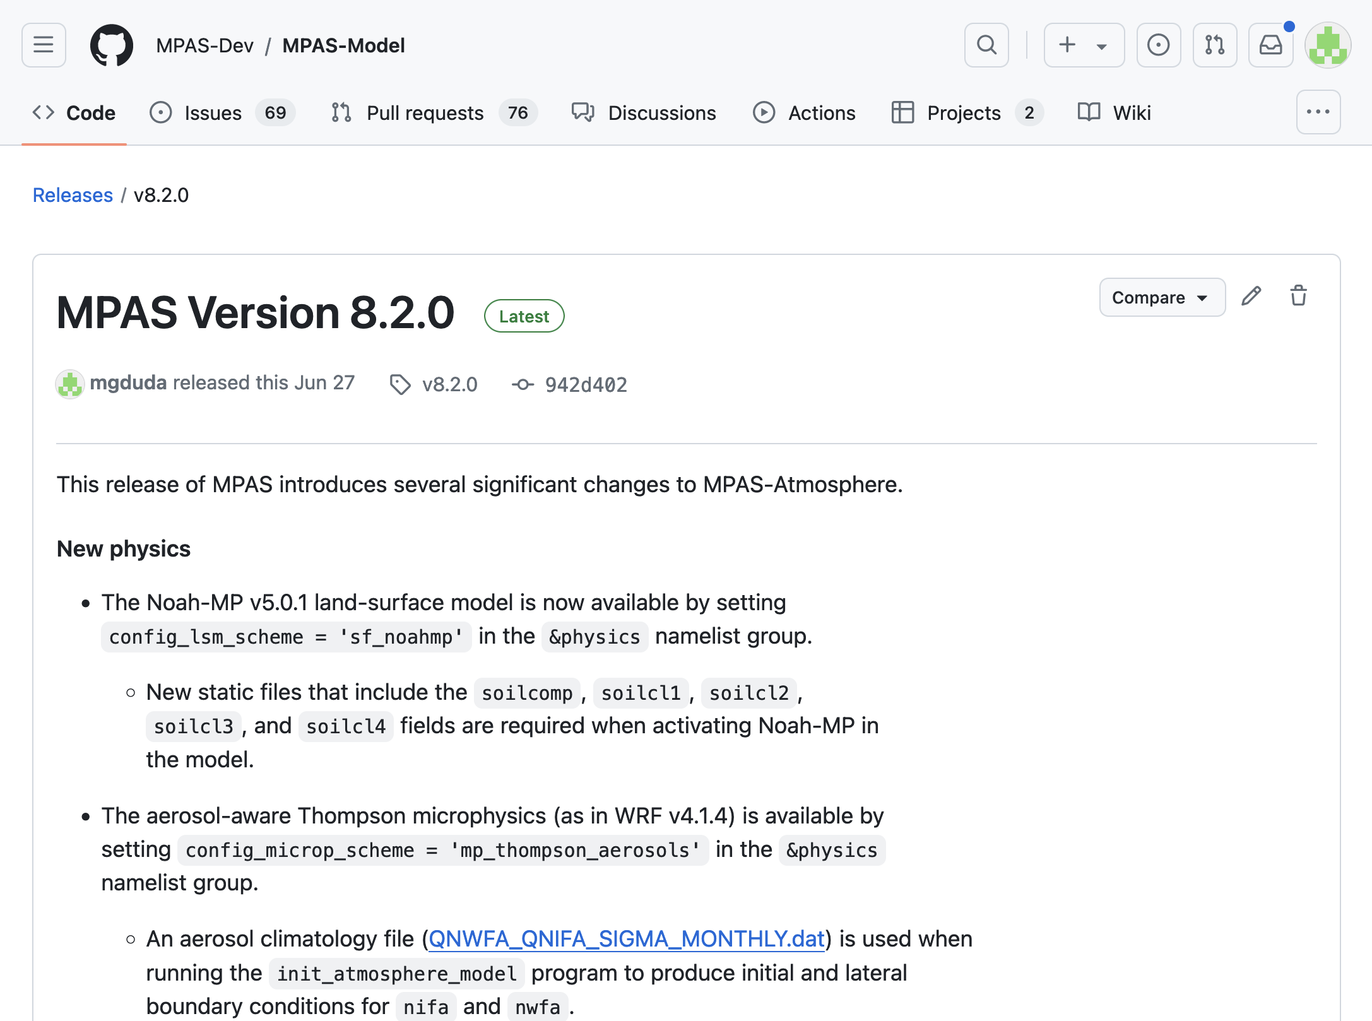
The ”less preferred” method of obtaining code
One can navigate to a download link from the MPAS homepage at https://mpas-dev.github.io/

Slide 12
The ”less preferred” method of obtaining code
Downloading a .tar.gz file of a particular release of the MPAS code certainly works, but it has several disadvantages:
You’ll only obtain a specific release of the code
There’s no direct way to see the history of changes to parts of the code
It’s more difficult to see what local modifications have been made to the code
There’s no easy route to updating to a newer release while preserving your local code modifications

Slide 13
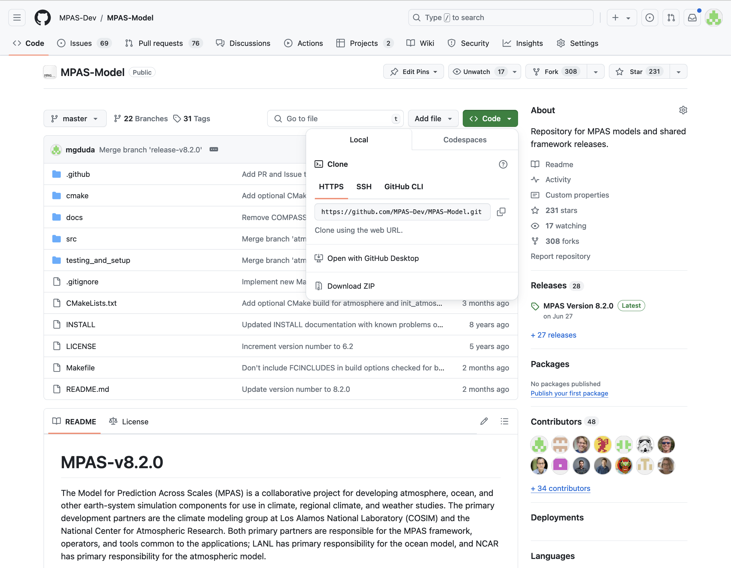
The preferred method of obtaining code
A much better option is to clone the MPAS-Model repository
The repository URL can be found from the MPAS GitHub page at https://github.com/MPAS-Dev/MPAS-Model

Slide 14
The preferred method of obtaining code
From the command-line, the following should be sufficient:
git clone https://github.com/MPAS-Dev/MPAS-Model.git
Cloning the repository should take about 10 seconds or less…
(I timed this at home, and it took 5.16 s)
$ git clone https://github.com/MPAS-Dev/MPAS-Model.git
Cloning into 'MPAS-Model'...
remote: Enumerating objects: 71, done.
remote: Counting objects: 100% (71/71), done.
remote: Compressing objects: 100% (47/47), done.
remote: Total 46608 (delta 38), reused 42 (delta 23), pack-reused 46537
Receiving objects: 100% (46608/46608), 19.65 MiB | 2.57 MiB/s, done.
Resolving deltas: 100% (35848/35848), done.

Slide 15
After obtaining the code for the first time
You may also like to register as an MPAS user and join the MPAS-Atmosphere Users mailing list

Slide 16
Preliminary requirements
In order to compile MPAS and its required libraries, relatively modern Fortran, C, and C++ compilers are necessary
The Fortran compiler should be recent enough to support the ISO_C_BINDING module from the Fortran 2003 standard, procedure pointer components of derived types, and a few bits of the Fortran 2008 standard
Most versions of common compilers from the last couple of years should be fine
Building MPAS requires at least the following libraries:
Any implementation of MPI-2, e.g., MPICH, MVAPICH, OpenMPI
Ensure that mpif90 and mpicc commands are in your path
Parallel-NetCDF (http://trac.mcs.anl.gov/projects/parallel-netcdf/)
Set PNETCDF environment variable to base installation directory

Slide 17
Preliminary requirements: the easiest route
Installing the full set of I/O libraries required by MPAS can be tedious.
To make this easier, we've prepared a shell script that may be helpful:
https://www2.mmm.ucar.edu/projects/mpas/scripts/mpas_lib_install.sh
Notes:
Before running or following the above script, you will need to have downloaded the library sources from https://www2.mmm.ucar.edu/projects/mpas/scripts
If you already have an MPI library, skip the MPICH installation
After editing paths and compiler names at the top, you may be able to run the script, but in general the script may be best used as a guide

Slide 18
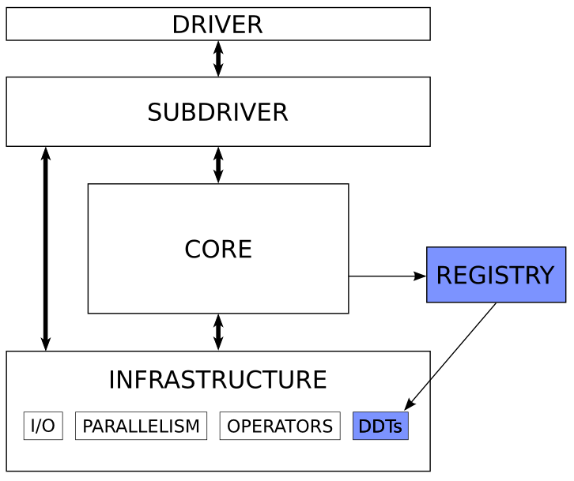
Model Organization
Checking out the MPAS code provides all MPAS models, not just MPAS-Atmosphere
All models share a common set of infrastructure modules
Each MPAS model is implemented as a “core” that lives in its own directory
User must select which “core” to compile
Each “core” is associated with a source code subdirectory under src/ and has a Registry file (similar to WRF)
MPAS-Model/
src/
core_atmosphere/
core_init_atmosphere/
core_landice/
core_ocean/
driver/
external/
framework/
operators/

Slide 19
Model Organization
Running MPAS-Atmosphere involves two “cores”:
The init_atmosphere core is responsible for
Interpolating static fields to the mesh
Generating a vertical grid
Horizontally and vertically interpolating meteorological data to the 3-d grid
The atmosphere core is the model itself; integrates forward in time from initial state

Slide 20
Compiling MPAS
There is no “configuration” step for MPAS, unlike, e.g., for the WRF model
All build flags are either set in the top-level Makefile or on the command-line
General MPAS build command:
$ make target CORE=core <options>
target can be either
clean
or
gnu
intel
nvhpc
llvm
... plus a few others...
For MPAS-Atmosphere, core may be
atmosphere
init_atmosphere
<options> can be any of
DEBUG=true
AUTOCLEAN=true
PRECISION=double
OPENMP=true

Slide 21
Compiling MPAS
Typical build of both the init_atmosphere and atmosphere cores involves:
make gnu CORE=init_atmosphere (build init_atmosphere_model)
make clean CORE=atmosphere (clean any infrastructure files used by both init_atmosphere and atmosphere)
make gnu CORE=atmosphere (build atmosphere_model)
Beginning with MPAS v8.2.0, an intermediate “clean” step is no longer needed!
By default, MPAS cores are built with single-precision floating-point variables
MPAS-Atmosphere can be built in double precision
Add PRECISION=double to build commands for double-precisoin executables
Execution time is slower compared with single-precision
Output files approximately twice as large

Slide 22
Compiling MPAS v8.2.0+
Typical build of both the init_atmosphere and atmosphere cores involves:
make gnu CORE=init_atmosphere (build init_atmosphere_model)
make gnu CORE=atmosphere (build atmosphere_model)
By default, MPAS cores are built with single-precision floating-point variables
MPAS-Atmosphere can be built in double precision
Add PRECISION=double to build commands for double-precisoin executables
Execution time is slower compared with single-precision
Output files approximately twice as large

Slide 23
Summary
Ensure that you have a system running a UNIX-like operating system with the usual commands: make, awk, sed, grep, git, etc.
Available memory dictates maximum number of grid cells
Ensure that you have modern Fortran, C, and C++ compilers
Install supporting libraries (MPI, Parallel-NetCDF; or if you need PIO: HDF5, NetCDF4, Parallel-NetCDF, PIO)
Can use mpas_lib_install.sh script as a guide
Obtain the MPAS-Model source code with git clone
Compile the init_atmosphere and atmosphere cores

