Slide 1

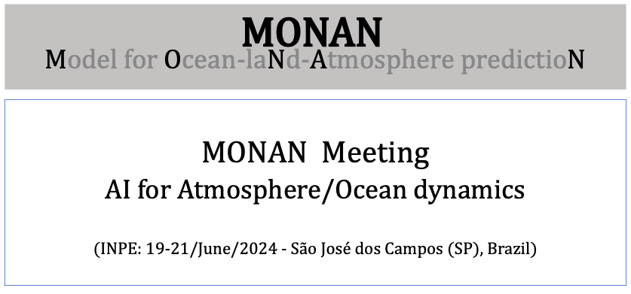
Notes:
‹#›

Slide 2
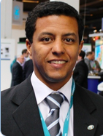
Talk 4: Earth-2 Project
Dr. Pedro Mario Cruz e Silva
  Nvidia: Solutions Architect Manager
  Tecgraf / PUC-Rio: Manager - Computational Geophysics Group (2014-2016)
  PhD: Informatic (PUC-RJ, 2004)
  M.Sc.: Mathematics (UFPE, 1997)
  Mathematics: Federal Univ. of Pernambuco (UFPE, 1995)
MONAN Meeting: AI for atmosphere/ocean dynamics
19-21/June/2024 - INPE - São José dos Campos - Brazil
Notes:
‹#›

